Slide 1
Can international law solve transboundary conflicts? – The Role & Relevance of the 1997 UN Watercourses Convention
30th May 2011
Dr Alistair Rieu-Clarke

Slide 2
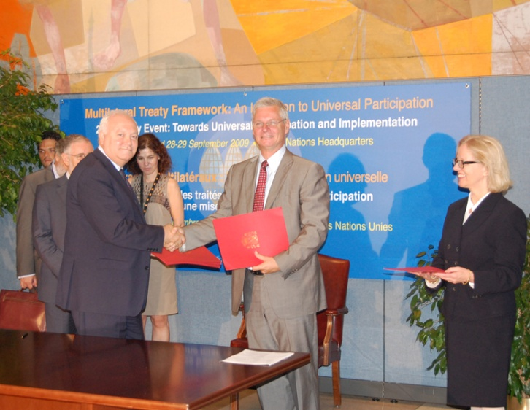
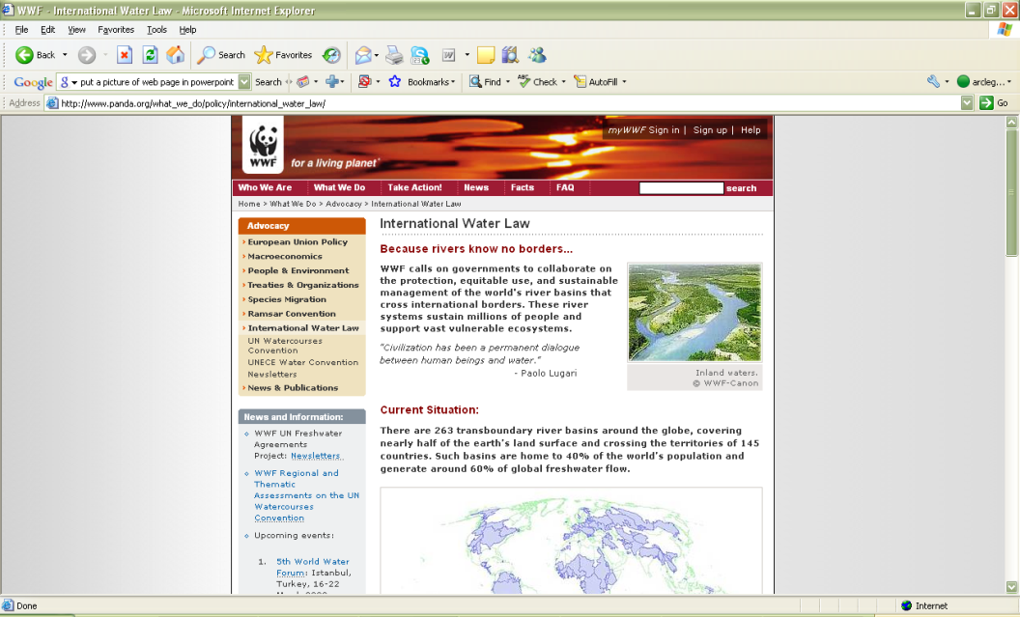
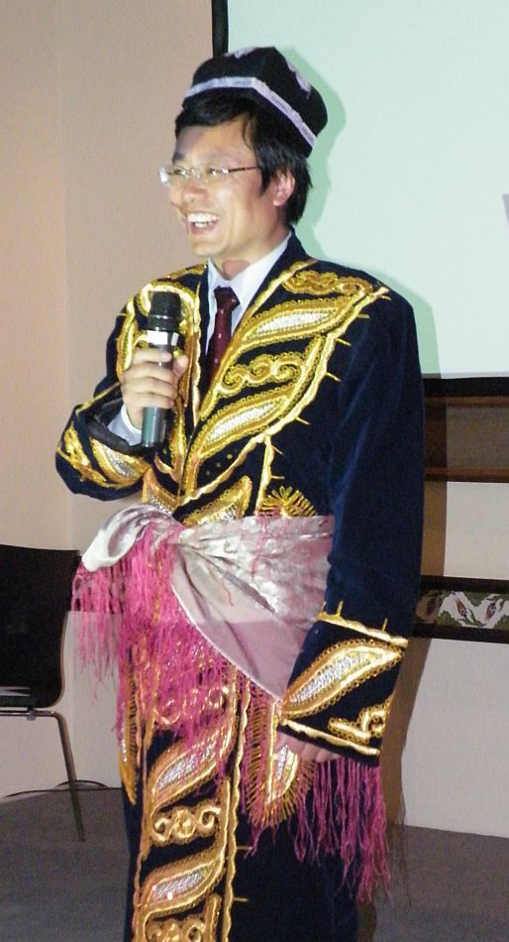
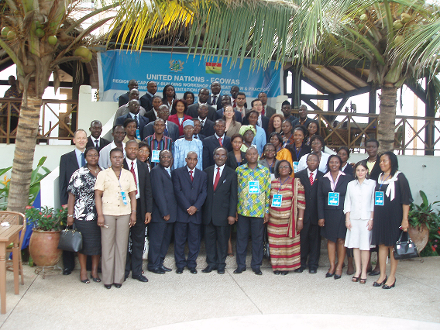
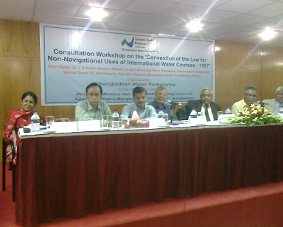
The Global Initiative

Slide 3
Transboundary Water Challenges
International Architecture for Transboundary Water Governance
The UN Watercourses Convention: evolution and content
Reasons for, and benefits of, entry into force/widespread support
Prospects for entry into force
Beyond entry into force to implementation

Slide 4
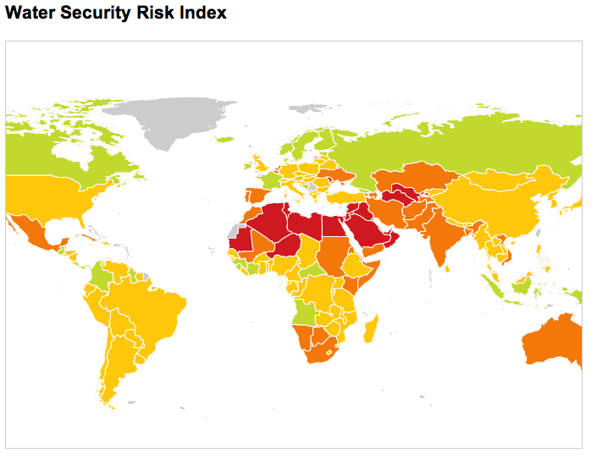
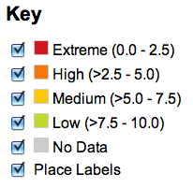
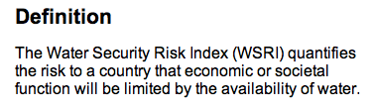

Transboundary Water Challenges
Notes:
2007 Intergovernmental Panel on Climate Change (IPCC) reports made it very clear that climate change will have impacts on water and that some of the major challenges to adaptation are related to water resources development and management.
Many countries will experience increased water scarcity.
One sixth of the world population, currently living in snowmelt-fed river basins, will experience increased water shortages due to the reduction of snow cover and subsequent run-off.
At the same time extreme events will increase, i.e. floods will become more frequent and violent, and droughts longer.
1.1 billion people currently lack access to clean water and that some 2.6 billion people, almost half the total population of developing countries, do not have access to adequate sanitation.

Slide 5
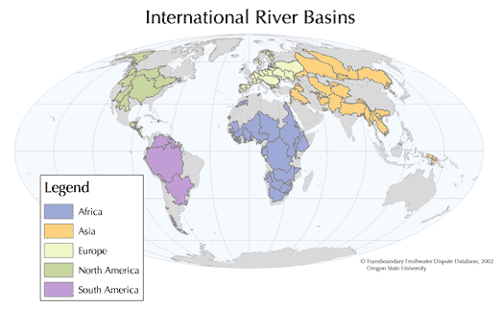
“All transboundary water bodies create hydrological, social and economic interdependencies between societies. They are vital for economic development, reducing poverty and contributing to the attainment of the Millennium Development Goals” UN-Water
Notes:
263 international river basins, and around 300 transboundary aquifers
Almost ½ the world’s land surface
60% of global freshwater flow
40% world population live in international river basins
145 countries contribute territory to international river basins (90% of the world’s population)
2 billion people rely on groundwater

Slide 6
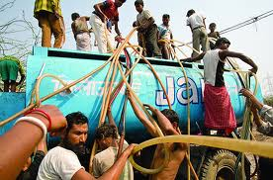
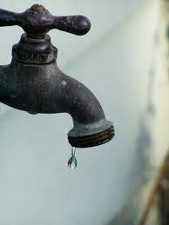

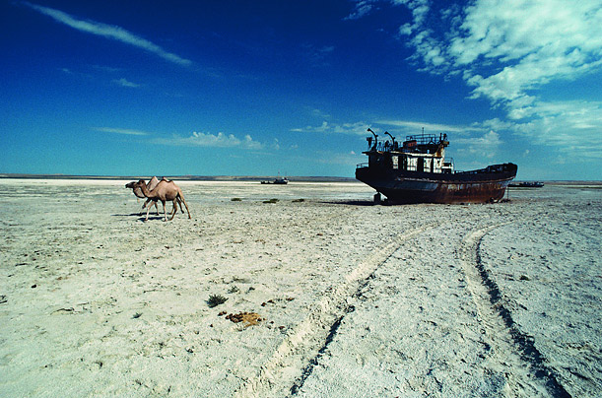
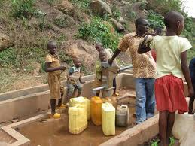
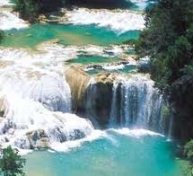
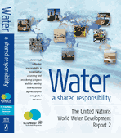
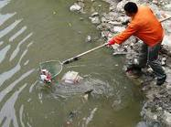
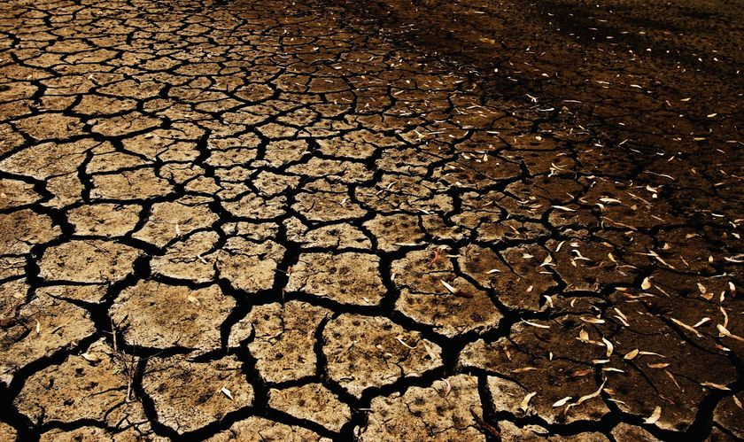
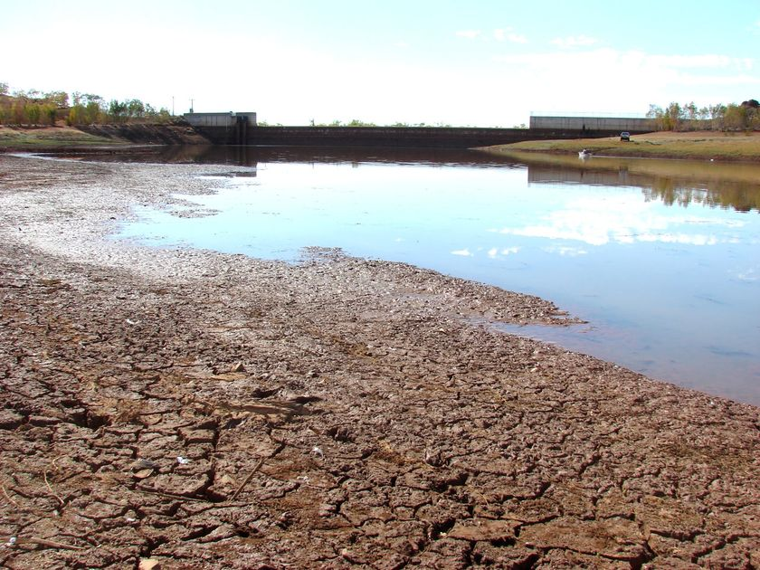
“There is a water crisis, and there is an increasing understanding that it is a crisis of governance rather than one of physical scarcity of water” (UNEP, 2008)
“I urge Governments to recognize the urban water crisis for what it is — a crisis of governance, weak policies and poor management, rather than one of scarcity.” UN Secretary General Ban Ki-moon, 2011
"This crisis is one of water governance, essentially caused by the ways in which we mismanage water,” UNWWDR, 2006

Slide 7
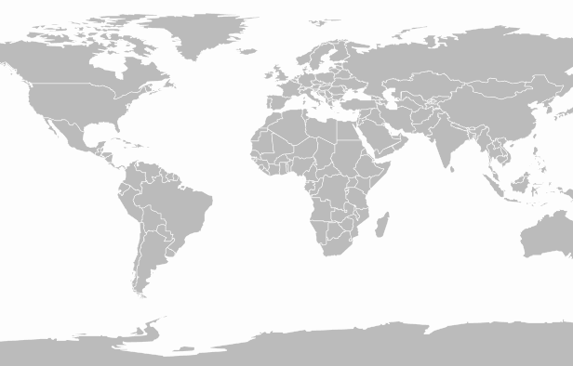
International Architecture for Transboundary Governance: A fragmented system
Architecture
Global
UN Watercourses Convention (not yet in force)
MEAs (Biodiversity, Climate Change, Ramsar, Desertification)
Regional
SADC Protocol
Customary international law (basic principles)
UN ECE Watercourses Convention
EC Water Framework Directive
Basin & Sub-basin
400+ treaties signed since 1820
158 basin lack cooperative management framework
Majority of treaties bilateral
National and sub-national
“Existing agreements are sometimes not sufficiently effective to promote integrated water resources management due to problems at the national and local levels such as inadequate water management structures and weak capacity in countries to implement the agreements as well as shortcomings in the agreements themselves (for example, inadequate integration of aspects such as the environment, the lack of enforcement mechanisms, limited – sectoral – scope and non-inclusion of important riparian States)” – (UN-Water, Transboundary Waters: Sharing Benefits, Sharing Responsibilities, Thematic Paper, 2008)
Notes:
400 treaties related to transboundary watercourses across the world
Zawahri and Mitchell observe that 42 per cent of watercourse treaties are bilateral, and amongst these treaties 67 per cent were signed on multilateral basins.

Slide 8
The UN Watercourses Convention – Evolution

Slide 9

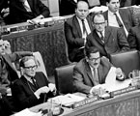

  UN GA Resolution 2669 (XXV), 8th December 1970
    Population growth, increasing and multiplying needs and demands for water, limited supply, need to preserve and protect of great importance to all nations
    Importance of legal problems relating to the use of international watercourses
    Fragmentation of international law (bilateral treaties and regional regulations)
    Need for International Law Commission to take the study of the law of the non-navigational uses of international watercourses
Notes:
UN GA Resolution 2669 (XXV), 8th December 1970
Considering that water, owing to the growth of population and the increasing and multiplying needs and demands of mankind, is of growing concern to humanity, that the available fresh water resources of the world are limited and that the preservation and protection of those resources are of great importance to all nations
Conscious of the importance of legal problems relating to the use of international watercourses…
Recalling that despite the greater number of bilateral treaties and other regional regulations… the use of international rivers and lakes is still based in part on general principles and rules of customary law.
Recommends that the International Law Commission should, as first step, take up the study of the law of the non-navigational uses of international watercourses with a view to its progressive development and codification.

Slide 10
Preparatory Documents
Replies of Governments
Replies of Governments to the Commission’s questionnaire (A/CN.4/294 and Add.1, 1 April 1976, reproduced in Yearbook of the International Law Commission, 1976, vol. II, Part One, pp.147-183)
Replies of Governments to the Commission's questionnaire (A/CN.4/314, 23 June 1978, reproduced in Yearbook of the International Law Commission, 1978, vol. II, Part One, pp. 253-261)
Replies of Governments to the Commission’s questionnaire (A/CN.4/324, 13 July 1979, reproduced in Yearbook of the International Law Commission, 1979, vol. II, Part One, pp. 178-181)
Replies of Governments to the Commission's questionnaire (A/CN.4/329 and Add.l, 10 March and 3 July 1980, reproduced in Yearbook of the International Law Commission, 1980, vol. II, Part One, pp. 153-158)
Replies of Governments to the Commission's questionnaire (A/CN.4/352 and Add.l, 18 February and 28 June 1982, reproduced in Yearbook of the International Law Commission, 1982, vol. II, Part One, pp. 191-197)
Replies of Governments to the Commission's questionnaire (A/CN.4/447 and Add.1-3, 3 March, 15 April, 18 May and 14 June 1993, reproduced in Yearbook of the International Law Commission, 1993, vol. II, Part One, pp. 146-178)
ILC Special Rapporteur Reports
First report on the law of the non-navigational uses of international watercourses by Mr. Richard D. Kearney, Special Rapporteur (A/CN.4/295, 7 May 1976, reproduced in Yearbook of the International Law Commission, 1976, vol. II, Part One, pp. 184-191))
First Report on the law of the non-navigational uses of international watercourses, by Mr. Stephen Schwebel, Special Rapporteur (A/CN.4/320 and Corr.1, 21 May 1979, reproduced in Yearbook of the International Law Commission, 1979, vol. II, Part One, pp. 143-177))
Second report on the law of the non-navigational uses of international watercourses, by Mr. Stephen M. Schwebel, Special Rapporteur (A/CN.4/332 and Add.1, 24 April and 22 May 1980, reproduced in Yearbook of the International Law Commission, 1980, vol. II, Part One, pp. 159-198))
Third report on the law of the non-navigational uses of international watercourses, by Mr. Stephen M. Schwebel, Special Rapporteur (A/CN.4/348 and Corr.1, 11 December 1981, reproduced in Yearbook of the International Law Commission, 1982, vol. II, Part One, pp. 65-191))
First report on the law of the non-navigational uses of international watercourses, by Mr. J. Evensen, Special Rapporteur (A/CN.4/367 and Corr.1, 19 April 1983, reproduced in Yearbook of the International Law Commission, 1983, vol. II, Part One, 157-194))
Second report on the law of the non-navigational uses of international watercourses, by Mr. Jens Evensen, Special Rapporteur (A/CN.4/381 and Corr.1 and Corr.2 (French only), 24 April 1984, reproduced in Yearbook of the International Law Commission, 1984, vol. II, Part One, pp. 103-127))
Preliminary report on the law of the non-navigational uses of international watercourses, by Mr. Stephen McCaffrey, Special Rapporteur (A/CN.4/393, 5 July 1985, reproduced in Yearbook of the International Law Commission, 1985, vol. II, Part One, pp. 87-96))
Second report on the law of the non-navigational uses of international watercourses, by Mr. Stephen C. McCaffrey, Special Rapporteur (A/CN.4/399 and Add.1 and 2, 19 March, 12 and 21 May 1986, reproduced in Yearbook of the International Law Commission, 1986, vol. II, Part One, pp. 88-144))
Third report on the law of the non-navigational uses of international watercourses, by Mr. Stephen C. McCaffrey, Special Rapporteur (A/CN.4/406 and Corr.1 and Add.1 and 2, 30 March; 6 and 8 April 1987 reproduced in Yearbook of the International Law Commission, 1987, vol. II, Part One, pp. 16-46)
Fourth report on the law of the non-navigational uses of international watercourses, by Mr. Stephen C. McCaffrey, Special Rapporteur (A/CN.4/412 and Add.1 and 2, 3 March, 3 and 9 May 1988, reproduced in Yearbook of the International Law Commission, 1988, vol. II, Part One, pp. 206-250)
Fifth report on the law of the non-navigational uses of international watercourses by Mr. Stephen C. McCaffrey, Special Rapporteur (A/CN.4/421 and Add.1 and 2, 5 April, 4 and 19 May 1989, reproduced in Yearbook of the International Law Commission, 1989, vol. II, Part One, pp. 92-130))
Sixth report on the law of the non-navigational uses of international watercourses, by Mr. Stephen C. McCaffrey, Special Rapporteur (A/CN.4/427 and Corr.1 and Add.1, 23 February and 7 June 1990, reproduced in Yearbook of the International Law Commission, 1990, vol. II, Part One, pp. 42-82))
Seventh report on the law of the non-navigational uses of international watercourses, by Mr. Stephen C. McCaffrey, Special Rapporteur (A/CN.4/436 and Corr.1-3, 15 March 1991, reproduced in Yearbook of the International Law Commission, 1991, vol. II, Part One, pp. 46-69))
First report on the law of the non-navigational uses of international watercourses, by Mr. Robert Rosenstock, Special Rapporteur (A/CN.4/451, 20 April 1993 reproduced in Yearbook of the International Law Commission, 1993, vol. II, Part One, pp. 179-185))
Second report on the law of the non-navigational uses of international watercourses, by Mr. Robert Rosenstock, Special Rapporteur (A/CN.4/462 and Corr.1, 21 April 1994, reproduced in Yearbook of the International Law Commission, 1994, vol. II, Part One, pp. 114-128)
Outcomes
Draft articles on the law of the nhttp://untreaty.un.org/ilc/documentation/english/a_cn4_462.pdfon-navigational uses of international watercourses. Titles and texts adopted by the Drafting Committee: Parts I, II and VI of the draft articles; articles 2, 10 and 26-33 (A/CN.4/L.458 and Corr.1 and Add.1, 6 June 1991)
International Law Commission, Draft articles and commentaries thereto adopted by the Drafting Committee on second reading: articles 1-33, reproduced in Yearbook of the International Law Commission 1994, vol. II, Part Two, para. 222 (A/CN.4/L.493 and Add.1 and Add.1/Corr.1 and Add. 2, 12 July 1994)
General Assembly resolution 51/229 of 21 May 1997 (Convention on the Law of the Non-Navigational Uses of International Watercourses)

Slide 11
Process
Year | Event
1970 | UN GA Resolution 2669 (XXV)
1976 – 1994 | 15 ILC Special Rapportuer Reports
1991 | ILC Draft Articles submitted to UN GA
1993 | Replies from Government to Draft Articles
1994 | Revised ILC Draft Articles submitted to UN GA
1996-1997 | UN GA Sixth (legal) Committee to negotiate text of the Convention
1997 | UN Watercourses Convention adopted by 38 sponsors, 103 votes in favour, 26 abstentions and 3 against
2011 | 24 Parties

Slide 12
The Need for a Global Framework Instrument
‘…the framework agreement approach, adopted by the Commission in drafting the articles provides a good basis for further negotiations. It leaves the specific rules to be applied to individual watercourses to be set in agreements between the States concerned, as has been the current practice.’
(Replies of Governments to the Commission's questionnaire, 1993)
3 key areas where a framework agreement might be of benefit, namely where,
no governing regime for transboundary waters exists
not all basin states were party to an existing agreement and
an agreement only partially covered matters addressed by the rules

Slide 13
The UN Watercourses Convention – Content

Slide 14
Key Provisions – Scope
  “Uses of international watercourses and of their waters for purposes other than navigation and to measures of protection, preservation and management related to the uses of those watercourses and their waters” (Art. 1(1))
  “Watercourse” – “a system of surface waters and groundwaters constituting by virtue of their physical relationship a unitary whole and normally flowing into a common terminus” (Art 2(b))
Notes:
“Uses of international watercourses and of their waters for purposes other than navigation and to measures of protection, preservation and management related to the uses of those watercourses and their waters” (Art. 1(1)
“Watercourse” – “a system of surface waters and groundwaters constituting by virtue of their physical relationship a unitary whole and normally flowing into a common terminus” (Art 2(b))
“In the absence of an agreement to the contrary, nothing in the present Convention shall affect the rights and obligations of a watercourse State arising from agreements in force for it on the state on which it became a party to the present Convention” (Art. 3(1))

Slide 15
Key Provisions – Substantive Norms
Equitable and reasonable utilization
No significant harm
Protection and preservation of ecosystems
Notes:
“Watercourse States shall in their respective territories utilize an international watercourse in an equitable and reasonable manner” (Art. 5(1))
“Watercourse States shall, in utilzing an international watercourse in their territories, take all appropriate measures to prevent the causing of significant harm to other watercourse states” (Art. 7(1))
“Where significant harm nevertheless is caused to another watercourse State, the States whose use causes such harm shall, in the absence of agreement to such use, take all appropriate measures, having due regard for the provisions of articles 5 and 6, in consultation with the affected State, to eliminate or mitigate such harm and, where appropriate, to discuss the question of compensation” (Art. 7(2)
“Watercourse States shall, individually and, where appropriate, jointly, protect and preserve the ecosystems of international watercourses” (Art. 20)

Slide 16
Key provisions – Procedural
It is reasonable … that procedural requirements should be regarded as essential to the equitable sharing of water resources. …. In the absence of hard and precise rules of allocation, there is a relatively greater need for specifying requirements for advance notice, consultation, and decision procedures.
Schachter, Sharing the World’s Resources (Columbia Uni Press New York 1977)

Slide 17
Notification process under 1997 UN Watercourses Convention
No notification option
State B request to apply Art. 12
State A justifies no notification to State B
Consulta-tion
Planned Measure by State A
Proceed
Declaration of urgency to State B
Proceed
Timely notification to State B
Consulta-tion
Notes:
Article 12 Notification concerning planned measures with possible adverse effects
Article 13 Period to reply to notification
Article 14 Obligations of the notifying State during the period for reply
Article 15 Reply to notification
Article 16 Absence of reply to notification
Article 17 Consultations and negotiations concerning planned measures
Article 18 Procedures in absence of notification
Article 19 Urgent implementation of planned measures

Slide 18
Key Provisions – Procedural
Strong emphasis on process and cooperation
Equitable participation
Duty to cooperate
Regular exchange of data and information
“Where appropriate, jointly…”
  Protect and preserve the ecosystems of international watercourses
  Respond to needs or opportunities for regulation of the flow of waters of an international watercourse
  Prevent or mitigate conditions … that may be harmful to other watercourse States, whether resulting from natural causes or human conduct, such as flood or ice conditions, water-borne diseases, siltation, erosion, salt-water intrusion, drought or desertification
  Take all practicable measures necessitated by the circumstances to prevent, mitigate and eliminate harmful effects of an emergency
Notes:
Article 5(2) - Watercourse States shall participate in the use, development and protection of an international watercourse in an equitable and reasonable manner. Such participation includes both the right to utilize the watercourse and the duty to cooperate in the protection and development thereof, as provided in the present Convention.
Article 8
1.Watercourse States shall cooperate on the basis of sovereign equality, territorial integrity, mutual benefit and good faith in order to attain optimal utilization and adequate protection of an international watercourse.
2.In determining the manner of such cooperation, watercourse States may consider the establishment of joint mechanisms or commissions, as deemed necessary by them, to facilitate cooperation on relevant measures and procedures in the light of experience gained through cooperation in existing joint mechanisms and commissions in various regions
Article 9(1)
1.Pursuant to article 8, watercourse States shall on a regular basis exchange readily available data and information on the condition of the watercourse, in particular that of a hydrological, meteorological, hydrogeological and ecological nature and related to the water quality as well as related forecasts.
Article 20
Watercourse States shall, individually and, where appropriate, jointly, protect and preserve the ecosystems of international watercourses.
Article 21(2)
2.Watercourse States shall, individually and, where appropriate, jointly, prevent, reduce and control the pollution of an international watercourse that may cause significant harm to other watercourse States or to their environment, including harm to human health or safety, to the use of the waters for any beneficial purpose or to the living resources of the watercourse. Watercourse States shall take steps to harmonize their policies in this connection.
3.Watercourse States shall, at the request of any of them, consult with a view to arriving at mutually agreeable measures and methods to prevent, reduce and control pollution of an international watercourse, such as:
Setting joint water quality objectives and criteria;
Establishing techniques and practices to address pollution from point and non-point sources;
Establishing lists of substances the introduction of which into the waters of an international watercourse is to be prohibited, limited, investigated or monitored.
Article 23 Protection and preservation of the marine environment
Watercourse States shall, individually and, where appropriate, in cooperation with other States, take all measures with respect to an international watercourse that are necessary to protect and preserve the marine environment, including estuaries, taking into account generally accepted international rules and standards.
Article 25 Regulation
1.Watercourse States shall cooperate, where appropriate, to respond to needs or opportunities for regulation of the flow of the waters of an international watercourse.
2.Unless otherwise agreed, watercourse States shall participate on an equitable basis in the construction and maintenance or defrayal of the costs of such regulation works as they may have agreed to undertake.
Article 27 Prevention and mitigation of harmful conditions
Watercourse States shall, individually and, where appropriate, jointly, take all appropriate measures to prevent or mitigate conditions related to an international watercourse that may be harmful to other watercourse States, whether resulting from natural causes or human conduct, such as flood or ice conditions, water-borne diseases, siltation, erosion, salt-water intrusion, drought or desertification.
Article 28 Emergency Situations
2.A watercourse State shall, without delay and by the most expeditious means available, notify other potentially affected States and competent international organizations of any emergency originating within its territory.
3.A watercourse State within whose territory an emergency originates shall, in cooperation with potentially affected States and, where appropriate, competent international organizations, immediately take all practicable measures necessitated by the circumstances to prevent, mitigate and eliminate harmful effects of the emergency.

Slide 19
Key Provisions – Joint Institutions
Article 24(1) Management
“Watercourse States shall, at the request of any of them, enter into consultations concerning the management of an international watercourse, which may include the establishment of a joint management mechanism”

Slide 20
Key Provisions – Dispute Settlement
  Must settle disputes by peaceful means
  May jointly seek good offices, mediation or conciliation
  Use joint watercourse institutions where established
  Submit dispute to arbitration or ICJ
  Compulsory third party fact finding
Notes:
“In the event of a dispute between two or more parties concerning the interpretation or application of the present Convention, the parties concerned shall, in the absence of an applicable agreement between them, seek a settlement of the dispute by peaceful means” (Art. 33(1))
If the parties cannot reach agreement by negotiation requested by one of them, they may jointly seek the good offices of, or request mediation or conciliation by, a third party, or make use, as appropriate, of any joint watercourse institutions that may have been established by them or agree to submit the dispute to arbitration or to the International Court of Justice (Art. 33(2)
… if after six months from the time of the request for negotiations referred to in paragraph 2, the parties concerned have not been able to settle their dispute through negotiation or any other means referred to in paragraph 2, the dispute shall be submitted, at the request of any of the parties to the dispute… unless the parties otherwise agree (Art. 33(3)

Slide 21
Reasons for non-entry into force
Treaty congestion
Lack of awareness
Lack of champions
Misunderstandings
Notes:
Treaty Congestion
One possible reason behind the low number of Contracting States could be ‘treaty congestion’. The UN Watercourses Convention was adopted at a time when international law relating to the environment and development was undergoing significant change. The 1990s witnessed the negotiation and conclusion of global agreements relating to climate change,76 bio- diversity77 and desertification,78 as well as non-binding instruments, such as the Rio Declaration on Environment and Development, the Forest Principles and the Agenda 21.79 This proliferation of international agreements and ‘soft-law’ instruments has led to the phenomenon described as ‘treaty congestion’. Already in 1993, Edith Brown Weiss noted that:
. . . treaty congestion leads to overload at the national level in implementing the international agreements. A country needs sufficient political, administrative, and economic capacity to be able to implement agreements effectively. Today a large number of international environmental institutions, including most pointedly the numerous secretariats servicing inter- national environmental agreements, have some claim on the administrative capacity of national States.80
The UN Watercourses Convention was adopted in the latter half of the 1990s, at the tail end of many other agreements relating to the environment and development. Treaty congestion could, therefore, be a possible reason why States have not been more proactive in joining the Convention.
2. Lack of awareness
Another reason why the UN Watercourses Convention has not been widely ratified may relate to lack of aware- ness and capacity. Such a finding was evident from a recent survey of West African States. That survey found that few ministries responsible for water-related issues in that region were aware of the content, relevance and sometimes even existence of the Convention.88 Given the current water crisis, and the recognized need for good governance, it is disappointing that more States are not aware of the potential value of the Convention. Fortunately, nonetheless West African States have now recognized the need to look more closely at the UN Watercourses Convention and promote its widespread ratification across the region. At the same time, however, these countries have called for greater support from the international community to aid their governments, both technically and financially, through the ratification process.89
3. Lack of champions
Finally, for many years, the Convention lacked any champions, both among governments and international organizations. While some key individual governments, UN bodies, such as UNEP, or regional organizations, such as the European Community, have been behind the swift (or, at least, more effective) ratification process of other multilateral agreements, no such support had been afforded to the UN Watercourses Convention until recently. It is only during the last few years that the international community has come together around the goal of accelerating the Convention’s ratification process. For instance, in 2006, the World Wide Fund for Nature (WWF) – an environmental non-governmental organization – launched an international initiative to raise awareness of the Convention, promote its entry into force and future implementation, and assist States through the ratification process. Other stakeholders have progressively joined the initiative, which has produced some tangible results over the years. The initiative has mobilized several key stakeholders to support the process, including among the current Contracting States (e.g. the Netherlands, Sweden), some relevant UN agencies (such as the UN Development Programme) and intergovernmental organizations (such as the Economic Community of West African States). Furthermore, the initiative comprises technical and financial assistance to States in several regions, including Latin America, Africa and Asia. This component has enabled countries such as Ghana, Benin, Niger and Papua New Guinea to engage in an informed and multi-stakeholder consultation and decision-making process and, more recently, to trigger the necessary procedures for acceding to the Convention.90
Finnemore and Skikink note that, ‘Norms do not appear out of thin air; they are actively built by agents having strong notions about appropriate or desirable behaviour in their community. … “
4. Misunderstandings
4.1 Equitable and Reasonable Utilization and No Significant Harm
The first and most important area of contention amongst the riparian states is the relationship between the principle of equitable and reasonable utilization (Articles 5 and 6 of the Convention) and the obligation not to cause harm (Article 7 of the Convention) and which of them prevails over the other. As a general rule, lower riparians tend to favor the no harm rule, as it protects existing uses against impacts resulting from activities undertaken by upper riparians. Conversely, upper riparians tend to favor the equitable and reasonable utilization principle because it provides more scope for states to utilize their share of the watercourse for activities that may impact on downstream states.
4.2 Notification of Planned Measures
Related to the view that the Convention is biased in favor of downstream riparians is the perception by upper riparians that the notification process under the Convention favors downstream riparians and provides them with a veto power over projects and programs of upstream riparians. Unfortunately, it is widely believed that notification is an exclusive right of lower riparians because only upstream riparians can cause harm to downstream riparians by affecting the quantity and quality of water flows to such downstream riparians. This belief is actually incorrect and is one of the basic misunderstandings about international water law in general, and the Convention in particular. It is a common mistaken belief among a large segment of lawyers and non-lawyers that harm can only “travel” downstream, and it is not recognized that upstream states can also be harmed by activities by downstream states. In other words, this mistaken notion is based on the assumption that only upstream riparians can harm downstream riparians. It is obvious, and clearer, that the downstream riparians can be harmed by the physical impacts of water quality and quantity changes caused by use by upstream riparians. It is much less obvious, and generally not recognized, that the upstream riparians can be harmed by the potential foreclosure of their future use of water caused by the prior use and the claiming of rights by downstream riparians. For example, a poor upstream country could be precluded from developing the water resources of an international waterway tomorrow if a richer downstream riparian, without consultation or notification, develops it today. This is an important, albeit not widely understood, principle of international water law which establishes a clear linkage between the principle of equitable and reasonable utilization, and the obligation not to cause harm. It should be noted, nonetheless, that there is a gradual but growing realization by some countries of the linkage between the two principles, which is a first step in understanding the concept of “potential foreclosure of future uses.” For example, Ethiopia, the upper most riparian of the Blue Nile Basin, protested to Egypt and Sudan when the two countries concluded the 1959 Nile Agreement that divided the Nile waters exclusively between them. Ethiopia has since been protesting most of the projects undertaken by Egypt and Sudan on the Nile because it has realized that those projects potentially foreclose its future uses of the Nile waters and deprives it of its equitable and reasonable share of the Nile waters. Moreover, an understanding of this concept has been reflected in some recent treaties. The Senegal River Water Charter which was concluded by Senegal, Mauritania and Mali in May 2002, and which Guinea signed in 2006, enumerates in Article 4 a number of principles for allocation of the waters of the Senegal River. Such principles include “the obligation of each riparian state to inform other riparian states before engaging in any activity or project likely to have an impact on water availability, and/or the possibility to implement future projects.”
See Salman M.A. Salman, Downstream riparians can also harm upstream riparians: the concept of foreclosure of future uses, 35 Water International, 350-364 (2010).
See John Waterbury, The Nile Basin – National Determinants and Collective Action, Yale University Press, 2002, at 84-85.
4.3 Existing agreements
A third issue that has contributed to the reluctance of some states to become parties to the Convention is the manner in which the Convention has dealt with existing agreements. As indicated earlier, the Convention does not affect the rights or obligations of watercourse states arising from agreements that are in force. Nonetheless, it asks the parties to consider, where necessary, harmonizing such agreements with the basic principles of the Convention. It also allows watercourse states to enter into agreements which apply and adjust the provisions of the Convention to the characteristics and uses of a particular international watercourse. Furthermore, the Convention states that when some, but not all, watercourse states to a particular international watercourse are parties to an agreement, nothing in such an agreement would affect the rights or obligations under the Convention of watercourse states that are not parties to such an agreement.
Riparian states that already have agreements in place believe that the Convention has not fully recognized those agreements because it suggests that the parties may consider harmonizing such agreements with the principles of the Convention. Conversely, riparian states that have been left out of existing agreements believe that the Convention should have subjected those agreements to the provisions of the Convention, and should have required consistency between the two. However, a close reading of the provisions of the Convention reveals that the Convention recognizes both, the validity of existing agreements, as well as the right of the riparian states which are not parties to such agreements in the shared watercourse. The Convention could not have simply annulled those existing agreements, because such a provision would have been rejected by most members of the General Assembly, and would have resulted in chaos in a number of basins. Any number of riparian states has the right under international law to enter into an agreement regarding the shared watercourse, but that right is also subject to the rights of other riparians in the uses of the shared watercourse. The Convention has basically reflected this legal and common sense principle. It should be recalled that the Convention is a framework convention that lays down basic principles that are to be complemented by agreements between the parties, taking into account the characteristics of the specific watercourse.
4.4 Dispute settlement mechanisms
A fourth area of contention is the belief by some riparian states that the dispute settlement provisions of the Convention are too weak because they do not provide for any binding mechanism. In contrast, other riparian states view the fact finding procedures of the Convention as a compulsory method, and argue that such a fact finding method interferes with their sovereign right of choosing the dispute settlement procedures. As discussed earlier, the Convention suggests for the parties a number of methods for settlement of disputes, including negotiations, jointly seeking the good offices of, or mediation and conciliation by a third party, or use of joint watercourse institutions, or submission of the dispute to arbitration or to the International Court of Justice. The only obligatory method set forth in the Convention is impartial fact finding where the parties are required to consider the report of the fact finding commission in good faith.
Thus, the Convention provides a basic mechanism for ascertaining the facts of the dispute, and leaves it for the parties to agree on the method for resolving it from a wide menu of choice. This is quite reasonable given that the Convention is a framework one. Yet again, neither side seems to be satisfied with this sensible and reasonable compromise.
4.5 Loss of sovereignty
Another reason for the reluctance of some states to become parties to the Convention is the apprehension about loss of sovereignty over shared waters. Actually, during the General Assembly discussion of the draft Convention, a few states criticized the Convention for its failure to refer to the sovereignty of the watercourse states over the parts of the international watercourses located in their territory. This notion indicates a total failure to comprehend the basic rules of contemporary international water law that have long rejected the principle of absolute territorial sovereignty. It is now generally agreed that the “management of international watercourses should be determined less by the traditional notion of ‘restricted sovereignty’ than by a positive spirit of cooperation and effective interdependence.”
See United Nations, supra note X.
Green Cross International, National Sovereignty and International Watercourses (Geneva, Switzerlands.2000), at 18).

Slide 22
Strengths
Clarifies customary international law
Weaknesses
Framework instrument – general principles lack specificity
No strong institutional mechanism to support implementation
Informs adoption of new/ revised agreements
Supplements gaps and failings
Supports existing environmental conventions
Currently lacks (formal) widespread support
1997 UN Watercourses Convention
Strengthens the legitimacy of customary international law
Basis for further development of treaty law
Notes:
Strengths
Strengthens the legitimacy of customary international law
1.1 Legitimacy, international law and obligation
Entry into force and widespread support can strengthen the legitimacy of the Convention as a reflection of customary international law. In his study of legitimacy, Franck observes that, ‘the surprising thing about international law is that nations ever obey its strictures or carry out its mandates’ (Franck, 1988). Franck argues that in a community organised around rules, ‘compliance is secured – to whatever degree it is – at least in part by a perception of the rule as legitimate by those to whom it is addressed’ (Franck, 1988) ‘Legitimacy’ is defined by Franck to mean, the quality of a rule which derives from a perception on the part of those to whom it is addressed that it has come into being in accordance with right process. Brunee & Toope expand this line of reasoning to maintain that, ‘legitimacy is built through broad participation in the construction and maintenance of legal regimes’. The latter authors go on to argue that, ‘for legal rules to emerge it is not enough, however, for there to exist underlying shared understandings with their attendant social legitimacy. To create ‘legal legitimacy’, the criteria of legality must also be substantially … met… However, even that is not sufficient to instantiate the rule of law, or even particular legal rules. Shared understandings and rules that meet the criteria of legality must be continuously reinforced through a robust practice of legality. In other worlds, law is created and maintained through interaction. It is interaction that makes their relationship ‘horizontal’ and ‘reciprocal’, and is the core of ‘legal’ legitimacy.
1.2 Treaty law and custom
There is a close relationship between treaty and custom. As the International Court of Justice observed in the North Sea Continental Shelf Cases, a rule originally embodied in a treaty can pass into the corpus of customary international law. In the 198 Continental Shelf Case (Libya v. Malta) it declared that, ‘multilateral conventions may have an important role to play in recording and defining rules deriving from custom, or indeed in developing them.’ On relationship between entry into force and non-entry into force, Leapard notes that, ‘the act of signing a treaty may be some evidence of opinio juris – indicating an intention by a government to submit the treaty for ratification according to its own internal legal processes…. Because, however, signature by itself, unlike ratification, does not express consent to be legally bound, it is less important evidence of opinio juris than ratification. Ratification provides stronger evidence of a belief that treaty norms should be authoritative for non-parties as well as parties. As Leapard notes, ‘in ratifying a treaty a state incurs a political and legal ‘cost’ that demonstrates the sincerity of its beliefs’. In the case of multilateral treaties, the greater the number of ratifications, the greater the evidence base that states genuinely believe that the norms in the treaties should be universally implemented. The opposite is true, a low number of ratifications could be interpreted as showing that there is weak support for certain norms as customary international law. As the ICJ noted in the 1969 North Sea Continental Shelf Cases, ‘a very widespread and representative’ participation in a multilateral treaty regime, ‘might suffice of itself’ to create ‘a general rule of international law … even without the passage of any considerable period of time, … provided it included [the participation] of States whose interests were specifically affected.’
Finnerore and Skikkink observe that although it is not possible to predict exactly how many states must accept a norm to “tip” the process, because states are not equal when it comes to normative weight, empirical studies suggest that norm tipping rarely occurs before one-third of the total states in the system adopt the norm. … “Up to the tipping point, little normative change occures without significnat domestic movements supporting such change. After the rippoing point hs been reached, however, a different dynamic begins. More countries begin to adopt new norms more rapidly even without domestic pressure for such change.
1.3 Law and power
Political science theory would also support such a proposition. For example Cascão and Zeitoun identify four types of ‘power’ that is likely to influence transboundary water relations: (i) geographic power – riparian power; (ii) material power – economic, military or technological strength, as well as international political and financial support; (iii) bargaining power – the ability to control the rules of the game and set agendas; and (iv) ideational power – the capacity to impose and legitimize particular ideas and narratives. The latters writes maintain that, ‘soft power’, such as ideational and bargaining power, are much more prevalent within the transboundary water context than ‘hard power’, ie., material power. Along similar lines, Daoudy maintains that bargaining powers is a tool where non-hegemonic states can individually or collectively, ‘level the playing field’. Daudy maintains that states can, ‘mobilise structural factors, such as the codification of new ‘rules’ on watercourses.’ Zeitoun and Jägerskog argue that ‘basin bullies can be susceptible to the power of persuasion, and may be less likely to force an arrangement if they are held accountable to an objective standard, or risk being ‘named and shamed’.
Clarification of customary international law
The Convention provides a basis by which to clarify and resolve potential ambiguities within watercourse agreements and has, thus, a key role to play even in basins where such agreements already exist. In terms of clarifying international law, an example can be found in the obligation to notify neighbouring States within the basin that may be affected by planned measures. While the obligation to notify is widely accepted as representing customary international law, the precise content of that rule remains unclear.98 For instance, what is the level of potential harm that would trigger this rule? What form should notification take? When should such notification take place? How should States treat a reply to notification, or absence thereof? Widespread and representative support for the Convention by water- course States would help to clarify existing international law regarding the duty to notify and, where appropriate, progressively create new customary inter- national law.
The opposite would also be true. The lack of support for the Convention amongst watercourse States, emerging from non-entry into force, could growingly be interpreted as a sign of widespread dissatisfaction with the content of the agreement. This process could eventually put into question the status of the law and further contribute to inter-State disagreements and unilateral actions by more powerful riparian States.100
3. Basis for further develop of treaty law
Upon entering into force, the Convention would provide a global basis by which to further strengthen and develop treaty law at the global level in the field. In this sense, during the Convention’s drafting process within the ILC, the Nordic countries referred to the role that the Convention could play in coordinating the ‘work carried out by many international organs’.103
In fact, the Convention has already performed this function in the case of the recently completed ILC draft Articles on the Law of Transboundary Aquifers.104 These draft Articles draw heavily from the Convention, applying and adjusting its provisions to the special case of transboundary groundwater. Because, however, the Convention is still not in force, it is possible that the draft Articles are eventually adopted as a separate, independent treaty, rather than a protocol to the Convention. This outcome would run counter to the goal of promoting integrated water resources management. Hence, once in force, the Convention will be politically better suited to serve as a mother treaty for future protocols adopted with the intent of progressively developing treaty law in the field.
4. Supplements gaps and weaknesses
5. Supports existing environmental conventions
It is worth mentioning, however, that entry into force of the UN Watercourses Convention could support the implementation of other multilateral environmental agreements (MEAs) that touch on water-related issues. Such treaties include the Ramsar Convention,81 the World Heritage Convention,82 the Convention on Biological Diversity (CBD),83 the UN Framework Convention on Climate Change (UNFCCC)84 and the UN Convention to Combat Desertification (UNCCD).85 In this sense, a study by the Foundation for International Environmental Law and Development (FIELD) on MEAs and water resources management concluded that ‘there is a need for a coherent, transparent and participatory global framework to strengthen policy co-ordination and the implementation of water-related decisions . . . at the UN level’.86 Widespread support for the UN Watercourses Convention could therefore be a catalyst for facilitating such a coordination role.8
Informs adoption of new/ revised agreements
Recent studies indicate that only 40% of the world’s international watercourses are subject to management frameworks codified in watercourse agreements. Even where those treaties exist, 80% are bilateral, although more States are often part of the basin in question.102 Hence, there is a significant regulatory gap in the governance of the world’s transboundary basins that the UN Watercourses Convention could help address.
However, the Convention needs to be in force and widely ratified to have binding effects among parties and to serve as a compelling source of international customary law binding even on non-parties.
Furthermore, entry into force could enhance the Convention’s potential to act as a basis by which States can negotiate more specific instruments at the regional, basin and sub-basin levels. Such a benefit would be particularly advantageous where all States within a region or basin were a party to the Convention. In such cases, the Convention would serve as a universally agreed legal framework from which to start negotiations.
In addition, the Convention offers a mechanism by which to promote consistency among existing agreements in those situations where a riparian State shares more than one basin with different countries. For example, in obliging States to utilize their international watercourses in an equitable and reasonable manner, the Convention ensures that the interests of all co-riparians, as well as all the environmental and social needs at stake, are duly accounted for in the allocation and benefit-sharing processes.
7. Raise global profile of transbounday water issues
While some States have relied upon the Convention to conclude watercourse agreements, such reliance has so far been limited, and many watercourses still lack an adequate legal framework to ensure their equitable and reasonable utilization. The entry into force of the Convention would not only show that States are strongly committed to addressing the water crisis as a global issue, but would strengthen the role of inter- national law in enhancing cooperation between water- course States. In this context, the entry into force of the Convention, followed by appropriate levels of support to its widespread implementation, could serve as an added political impetus in establishing and, where necessary, strengthening regional, basin and sub-basin agreements.
Such a role for a global framework treaty was a major reason for countries like Finland, Germany and the Netherlands to support the Convention.91 Those countries have already concluded agreements with their neighbours, consistent with the provisions of the UN Watercourses Convention.92 Therefore, in those cases, there would be no direct added value in becoming a Contracting State. The relevance of the Convention for those countries relates more to foreign relations than to domestic benefits. By joining it, they reaffirm their recognition of the Convention’s value to the rest of the world, where sound watercourse agreements are largely lacking.
Such reasoning also came up during the drafting process of the Convention. In commenting on the 1994 ILC draft Articles, Germany recognized that the work of the ILC and the General Assembly met ‘a global need for regulation in this matter . . .’.93 Similarly, the UK noted that, while not a major international watercourse State, it welcomed that work as ‘a valuable contribution to the international protection of the environment’.94
It is, thus, surprising that other developed States, particularly those with a strong international development agenda in the water sector, have not followed suit and become a Contracting State to the Convention. For many countries, water is an integral part of international aid policies.95 Such policies have seen a shift from technical solutions to a management focus, with emphasis on equity and sustainability. Most countries pay particular attention to the need for integrated water resources management and for strengthening cooperation over international watercourses, as a basis for sustainable development at the regional level.96
Weaknesses
Currently lacks (formal) widespread support
As noted above a major weakness of the convention is that it lacks widespread support through the necessary formal ratifications
2. No strong institutional mechanism to support implementation
In McCaffrey’s Sixth Special Rapporteur Report on the law of the non-navigational uses of international watercourses in 1990, it was proposed that a Conference of the Parties to the Convention take place, ‘no later than two years after entry into force of the present article’, and periodically after that (ILC, 1990). The Conference of the Parties was designed to review the implementation of the Convention, and possibly, make recommendations on improving the effectiveness of the provisions, or even amending the present set of articles. McCaffrey maintains that, “Several recent conventions relating to the environment or transboundary harm contain provisions for regular meetings of a "conference of the parties".114 In general, these agreements provide for institutionalized and regular collective action by the contracting parties. This technique permits the parties to review, on a regular basis, the effectiveness of the convention in question and to monitor its implementation. Other multilateral agreements have made effective use of similar devices as an element of their dispute-settlement mechanisms.” Unfortunately, the final text of the 1997 UN Watercourses Convention did not contain any provision for a meeting of the parties or a supporting structure for its implementation, focusing its articles solely at a basin level.
Young maintains that the effectiveness international environmental regimes is contingent on a range of endogenous and exogenous factors. Endogenous factors posited by Young include, (i) the locus of the regime on a hard law –soft law continuum; (ii) the nature of the relevant decision rules; (iii) provisions for monitoring, reporting, and verification; (iv) funding mechanisms; and (v) procedures for amending a regime’s assemblage of rights, rules, and decision-making procedures. Young comments that,
“Some regimes start from a well-defined, albeit sometimes modest, initial state and advance steadily in a manner that dos not feature major challenges or severe setbacks and in a manner that increases the capacity of the regimes in question to address the problems they are created to solve. One path that exemplifies this pattern starts with a framework convention followed in fairly short order by one or more substantive protocols that are then amended and extended to accommodate new information about the nature of the problem or to build the capacity of the regime to influence the behaviour of those who are subject to its assemblage of rights, rules and decision-making procedures.
A widely endorsed global instrument could provide States, and others involved in the work related to international watercourses, with a common platform by which to exchange experiences and ideas on how best to develop and implement the law governing international watercourses. However, some form of institutional framework at the global level would be necessary to facilitate this function At the regional level, the UNECE Water Convention has played a comparable, very useful role, and serves to exemplify what the UN Watercourses Convention could offer to the international community globally. The UNECE Water Convention has been in force for over 10 years and has been particularly successful in strength- ening the legal arrangements for the management of ‘new’ international watercourses, following the breakup of the Soviet Union. This is the case, for example, with agreements governing the Kazakh-Russian and Russian-Ukrainian transboundary waters. The UNECE Water Convention also paved the way for the adoption of the EU Water Framework Directive, which builds on the experience and knowledge acquired through the implementation of that treaty.105
While the latter Convention benefits from an institutional structure, which includes a Secretariat and the Meeting of the Parties, there is no reason why parties to the UN Watercourses Convention could not conduct such activities through informal networks, or even, in the future, consider amending that Convention in order to establish a more formal global institutional structure consistent with other MEAs.
3. Framework instrument – general principles lack specificity
Watercourses convention will not be able to replace basin agreements.

Slide 23
Prospects for entry into force
24 parties / 35 needed entry into force

Slide 25
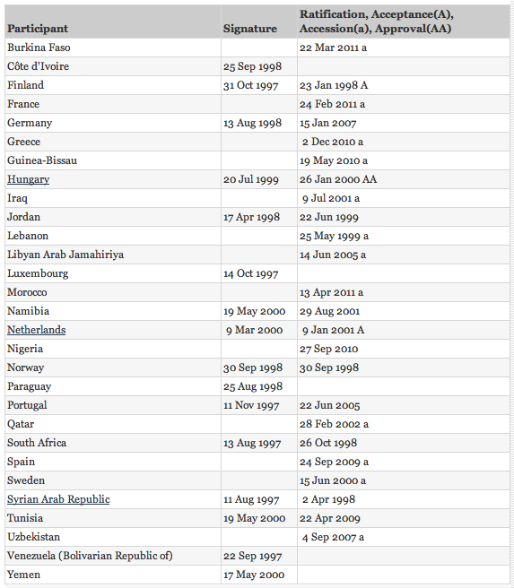

Slide 26
More information…
wwf.panda.org/what_we_do/how_we_work/policy/conventions/water_conventions/un_watercourses_convention/
www.dundee.ac.uk/water/projects/unwcglobalinitiative/

Slide 27
THANK YOU!

