Slide 1


Slide 2
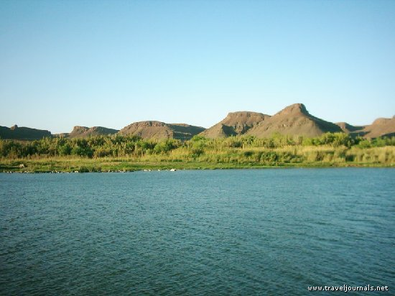


The Legal Challenges of Integrated Water Resources Management
Michael Kidd
IUCN Academy of Environmental Law Colloquium
Mpekweni
July 2011

Slide 3
Traditional approach to ‘natural resources’ mgt
Silo approach – separate resources, separate legislation, separate control authorities …
  Water – (national) Dept Water Affairs
  Land – town planning = local government
  Agriculture = Dept of Agriculture
  EIA – what’s that? (later, provincial Dept of Environment and [add appropriate companion function])

Slide 4
Traditional approach to water mgt
Surface water v ground water
Public water v private water
Use of water for agricultural purposes v use of water for industrial purposes v use of water for urban purposes

Slide 5
New water management trends
Integrated catchment management
River basin development planning and management
Integrated water management
Watershed management
Integrated water resources management

Slide 6
Contents
What is IWRM?
What legal requirements are needed for IWRM?
Does South Africa’s water law meet these requirements?

Slide 7
What is IWRM?
IWRM is a process which promotes the co-ordinated development and management of water, land and related resources, in order to maximize the resultant economic and social welfare in an equitable manner without compromising the sustainability of vital ecosystems.
Global Water Project (2000)

Slide 8
Elements of the definition
‘Water resource’ – surface and ground
Co-ordination
Maximisation of economic and social welfare
Equity
Sustainability of ecosystems

Slide 9
Dublin Principles
I Fresh water is a finite and vulnerable resource, essential to sustain life, development and the environment.
II Water development and management should be based on a participatory approach, involving users, planners and policymakers at all levels.
III Women play a central part in the provision, management and safeguarding of water.
IV Water has an economic value in all its competing uses and should be recognized as an economic good.

Slide 10
Elements of IWRM
‘Water resource’ – surface and ground
Co-ordination
Maximisation of economic and social welfare
Equity
Sustainability of ecosystems
Public participation
Emphasis of the role of women
Economic value of water

Slide 11
Elements of IWRM (SA context)
‘Water resource’ – surface and ground
Co-ordination
Maximisation of economic and social welfare
Equity
Sustainability of ecosystems
Public participation
Emphasis of the role of disadvantaged communities, especially women
Economic value of water

Slide 12
Elements of IWRM
Substantive
  Maximisation of economic and social welfare
  Equity
    Role of disadvantaged (esp. women)
  Sustainability of ecosystems
Procedural
  Co-ordination
  Public participation
  Economic value of water

Slide 13
Legal requirements
Guiding philosophy at national level;
Overarching national policy for IWRM which bridges the line functions of different Government departments;
Appropriate institutional and agency structures which are supported by legislation;
Suitable mechanisms to resolve conflicts between National, Provincial and Local authorities and agencies; and
Empowerment mechanisms for all participants.

Slide 14
Guiding philosophy (macro)
Constitution of the RSA 1996
  S 9 right to equality
    9(1) To promote the achievement of equality, legislative and other measures designed to protect or advance persons, or categories of persons, disadvantaged by unfair discrimination may be taken.
  S 10 right to dignity
  S 24 ‘environmental right’
  S 27(1)(b): Everyone has the right to have access to sufficient food and water
  S 27(2) progressive realisation: reasonable legislative and other measures, within state’s available resources
  S 32 – right of access to information (PAIA 2 of 2000)
  S 33 – right to administrative justice (PAJA 3 of 2000)

Slide 15
Guiding philosophy (less macro)
National Water Act 36 of 1998 section 2
The purpose of this Act is to ensure that the nation's water resources are protected, used, developed, conserved, managed and controlled in ways which take into account amongst other factors -
(a) meeting the basic human needs of present and future generations;
(b) promoting equitable access to water;
(c) redressing the results of past racial and gender discrimination;
(d) promoting the efficient, sustainable and beneficial use of water in the public interest;
(e) facilitating social and economic development;
(f) providing for growing demand for water use;
(g) protecting aquatic and associated ecosystems and their biological diversity;
(h) reducing and preventing pollution and degradation of water resources;
(i) meeting international obligations;
(j) promoting dam safety;
(k) managing floods and droughts,
and for achieving this purpose, to establish suitable institutions and to ensure that they have appropriate community, racial and gender representation.

Slide 16
Guiding philosophy (less macro than the Constitution but more macro than the NWA)
National Environmental Management Act s 2:
The principles set out in this section apply throughout the Republic to the actions of all organs of state that may significantly affect the environment
  Sustainable development (people-centred, three pillars)
  Sustainable development requires the consideration of all relevant factors including the following (next page)-

Slide 17
NEMA Principles
That the disturbance of ecosystems and loss of biological diversity are avoided, or, where they cannot be altogether avoided, are minimised and remedied.
Environmental management must be integrated, acknowledging that all elements of the environment are linked and interrelated, and it must take into account the effects of decisions on all aspects of the environment and all people in the environment by pursuing the selection of the best practicable environmental option.
Equitable access to environmental resources, benefits and services to meet basic human needs and ensure human well-being must be pursued and special measures may be taken to ensure access thereto by categories of persons disadvantaged by unfair discrimination. Etc etc

Slide 18
Overarching national policy …
National Water Resource Strategy 2004(ito s5 of NWA)
  3 fundamental objectives:
    To achieve equitable access to water, that is, equity of access to water services, to the use of water resources, and to the benefits from the use of water resources
    To achieve sustainable use of water by making progressive adjustments to water use with the objective of striking a balance between water availability and legitimate water requirements, and by implementing measures to protect water resources
    To achieve efficient and effective water use for optimum social and economic benefit

Slide 19
Overarching national policy
NWA Section 7: The Minister, the Director-General, an organ of state and a water management institution must give effect to the national water resource strategy when exercising any power or performing any duty in terms of this Act.
And what if the organ of state is not acting in terms of ‘this Act’?

Slide 20
… bridging govt. line functions
NWA s 3: As the public trustee of the nation's water resources the National Government, acting through the Minister, must ensure that water is protected, used, developed, conserved, managed and controlled in a sustainable and equitable manner, for the benefit of all persons and in accordance with its constitutional mandate.
(2) Without limiting subsection (1), the Minister is ultimately responsible to ensure that water is allocated equitably and used beneficially in the public interest, while promoting environmental values.
(3) The National Government, acting through the Minister, has the power to regulate the use, flow and control of all water in the Republic.

Slide 21
… bridging govt. line functions
NEMA principles:
The environment is held in public trust for the people, the beneficial use of environmental resources must serve the public interest and the environment must be protected as the people's common heritage.
There must be intergovernmental co-ordination and harmonisation of policies, legislation and actions relating to the environment.
Actual or potential conflicts of interest between organs of state should be resolved through conflict resolution procedures.

Slide 22
Institutional structures
Department of Water Affairs (part of Dept of Environmental Affairs)
Catchment Management Agencies (Ch 7)
  Only 4 out of 19 so far
  No (gazetted) catchment management strategies yet.
Water Services Authorities (Water Services Act 108 of 1997)
  Essentially local government

Slide 23
Conflict resolution mechanisms
Reminder: Suitable mechanisms to resolve conflicts between National, Provincial and Local authorities and agencies
Suitable mechanisms to identify and resolve conflicts between National, Provincial and Local authorities and agencies
Green Drop Report 2009 – approx. 702 out of 852 municipal treatment works NOT in compliance with legal emission standards

Slide 24
Conflict resolution
Principles of co-operative government – non-confrontation (no litigation before other methods of dispute resolution exhausted – Chapter 3 of the Constitution).

Slide 25
Empowerment mechanisms
Public participation (procedural fairness)
  S 41(4) NWA:
  A responsible authority may, at any stage of the [water use licence] application process, require the applicant -
  (a) to give suitable notice in newspapers and other media -
    (i) describing the licence applied for;
    (ii) stating that written objections may be lodged against the application before a specified date, which must be not less than 60 days after the last publication of the notice; …
  (b) to take such other steps as it may direct to bring the application to the attention of relevant organs of state, interested persons and the general public; and
  (c) to satisfy the responsible authority that the interests of any other person having an interest in the land will not be adversely affected.

Slide 26
Empowerment mechanisms
Appeal:
  NWA s 148(1): There is an appeal to the Water Tribunal – (f) against a decision of a responsible authority on an application for a licence under section 41, or on any other application to which section 41 applies, by the applicant or by any other person who has timeously lodged a written objection against the application.
  Water Tribunal decisions: interested and affected party who has not been invited to make representations ito s 41(4) has no locus standi to appeal. (Shear and Anderson cases).

Slide 27
Empowerment mechanisms
Standing: NEMA s 32
(1) Any person or group of persons may seek appropriate relief in respect of any breach or threatened breach of any provision of this Act, including a principle contained in Chapter 1, or of any provision of a specific environmental management Act, or of any other statutory provision concerned with the protection of the environment or the use of natural resources-
(a) in that person's or group of person's own interest;
(b) in the interest of, or on behalf of, a person who is, for practical reasons, unable to institute such proceedings;
(c) in the interest of or on behalf of a group or class of persons whose interests are affected;
(d) in the public interest; and
(e) in the interest of protecting the environment.

Slide 28
Conclusion
Dad, are we there yet?

Slide 29
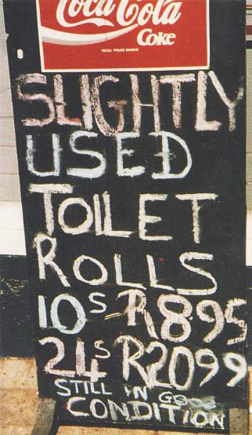
End

