Slide 1
Governance Criteria for the Effective Management of Transboundary Resources
Is Water Different from Biodiversity?
Michelle Lim University of New England
9th IUCN AEL Colloquium 7 July 2011

Slide 3
Transboundary Criteria
Freshwater
Terrestrial Biodiversity
Comparison

Slide 5

Transboundary Freshwater
=
Terrestrial
Biodiversity

Slide 6
Effective Management of Transboundary Freshwater

Slide 7
1. Operates at Each Level
2. Has Political Buy-In
3. Costs and Benefits Distributed Equitably
4. Practices IWRM, Incorporates Available Science
5. Clear Objectives & Common Goals
6. Good Governance Practiced

Slide 8
7. Adaptive Management Practiced. Clear Success Indicators, Ongoing M & E
Legal Instruments
Designated Institutions at Each Level
Operates in Consideration of
Capacity
11.Complexity Recognized &
Appropriate Resources Secured
12. Dispute Resolution Mechanisms Exist

Slide 10
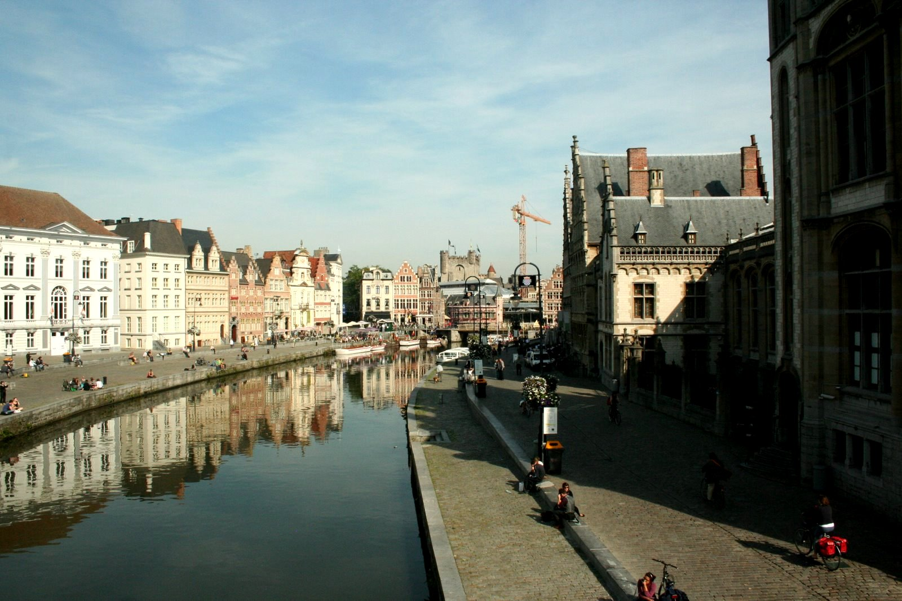


16 September
2010
Ghent, Belgium

Slide 11

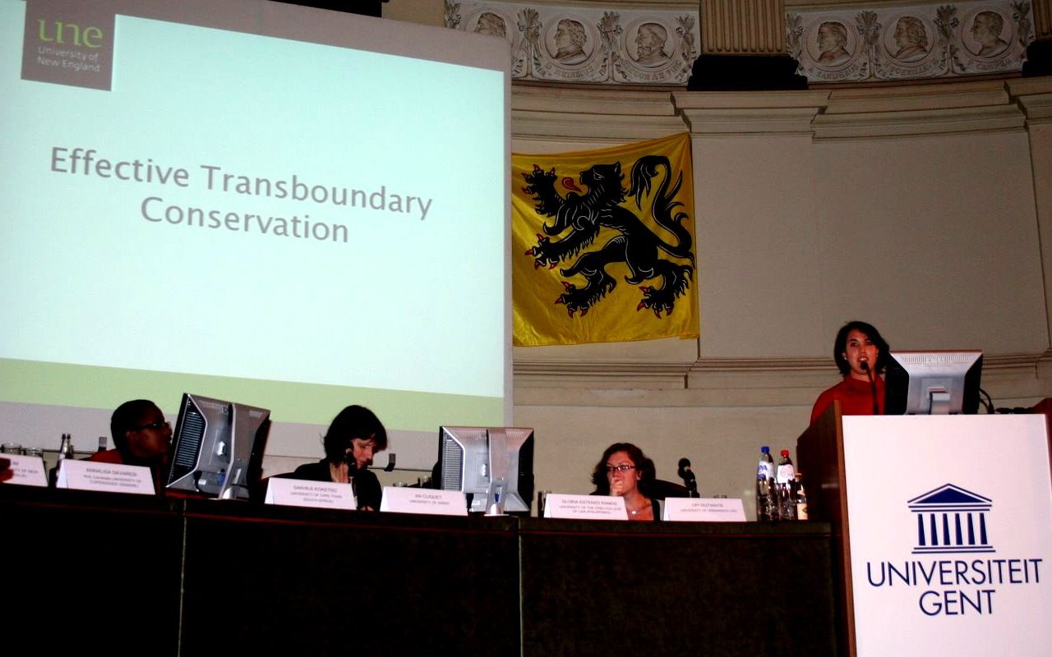

Slide 12
Effective Transboundary Conservation of Terrestrial Biodiversity

Slide 13
Threshold Issue:
Consider Net Benefits of
‘Going Transboundary’

Slide 14
1. Operates at Each Level
2. Has Political Buy-In
3. Costs and Benefits Distributed Equitably
4. Integrated Ecosystem Approach which Incorporates Available Science
5. Objective of Conservation Explicit
6. Good Governance Practiced

Slide 15
7. Adaptive Management Practiced. Clear Success Indicators, Ongoing M & E
8. Legal Instruments
9. Designated Institutions at Each Level
10. Operates in Consideration of
Capacity
11.Complexity Recognized and
Appropriate Resources Secured

Slide 17
Effective Management of Transboundary Freshwater

Slide 18
Threshold Issue:
Consider Net Benefits of
‘Going Transboundary’

Slide 19
1. Operates at Each Level
2. Has Political Buy-In
3. Costs and Benefits Distributed Equitably
4. Practices IWRM;Incorporates Available Science
5. Clear Objectives & Common Goals
6. Good Governance Practiced
4. An Integrated Ecosystem Approach Applied;Incorporates Available Science
5. Objective of Conservation Explicit

Slide 20
7. Adaptive Management is Practiced. Clear Success Indicators for Ongoing M & E
Legal Instruments and Rules
Designated Institutions at Each Level
Operates in Consideration of
Capacity
11.Complexity Recognized and
Appropriate Resources Secured
12. Dispute Resolution Mechanisms Exist

Slide 22
Transboundary Freshwater
?
=
Terrestrial
Biodiversity

Slide 24
Thank You!!!
Ke a leboha!!!
Buela!!!
Dankie!!!

