Slide 1
NIGERIA’S NEW ENVIRONMENTAL LAWS:
WHAT IMPLICATIONS FOR GROUNDWATER
PROTECTION AND SUSTAINABILITY ?
BY
Adebola Ogunba
Doctoral Candidate
Faculty of Law, University of Ottawa
Canada

Slide 2
Outline
History & Advent of environmental legislation & challenges of resource management in Nigeria
Groundwater’s Importance
The NESREA’s focus & the extent of its protection of groundwater
Threats to groundwater, Nigeria’s pollution trend, & issues for address
Strategic thoughts: A right to water vs. population growth, sustainability

Slide 3
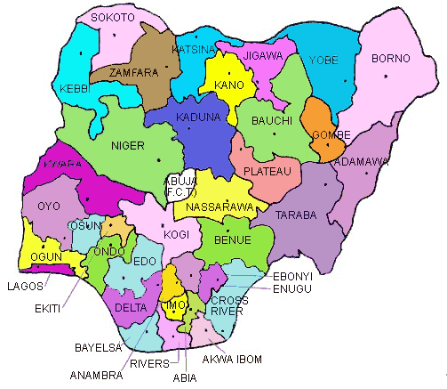
NIGERIA: 36 STATES & FCT

Slide 4
History of Environmental Legislation
“Oil Boom”: Crude oil discovered in 1956
1970s marked by oil exploration and national wealth
Environmental Legislations at this time were thus focused on oil, the economically important natural resource:
Petroleum Act 1969
Oil Pipelines Act 1956
Oil in Navigable Waters Act 1968

Slide 5
History of Environ. Legislation contd.
Pre-existent scant environmental
protection in Criminal Code prohibited
fouling of springs, and use of white
phosphorus in making matches.
It also had brief unconnected
regulations about “sanitation” “national
parks” “domestic personal hygiene” and
“wild animals”

Slide 6
Challenges of Managing Environmental Resources
Citizens’ Apathy
Citizens’ preoccupation with subsistence due to the absence of welfare programs despite the country’s oil wealth
An unbridled population growth grounded in religious/cultural beliefs

Slide 7
Overview/Advent of Environmental Protection Laws in Nigeria
1987: KOKO industrial waste dumping Incidence
1988: F.E.P.A. Decree enacted
1988: Harmful Wastes (Special Criminal Prov. Etc) Decree enacted
1989: A National Policy on the Environment formulated
1999: FME took over F.E.P.A.’s duties
2007: NESREA repealed F.E.P.A.

Slide 8
A Reactive Approach to Resource Management ?
Reactive Similarities with U.S. before EPA was established in 1970:
Protracted history of resource pollution
Land: indiscriminate dumping of municipal, industrial/chemical wastes;
Water: discharges of sewage and industrial waste into rivers and lakes
Air: poisonous emissions from automobile exhausts

Slide 9
Focus of Environmental Laws prior to NESREA
F.E.P.A. focused more on harmful Waste/Industrial Waste
Many FEPA regulations addressed this
The Harmful Wastes Decree criminalized the deposit of harmful wastes on Nigeria’s air, land & sea
“Harmful” was defined as ‘poisonous’, ‘noxious’, or ‘toxic’ waste

Slide 10
Groundwater Protection in Nigeria
Groundwater was scantily addressed in Environmental Laws prior to NESREA
11 river basin authorities intended to manage/develop surface & groundwater resources
But no integrated management with surface water as contemplated by RBDA Act
FEPA made cursory reference to “underground water”
“in built neglect of groundwater resource development” (Offodile, 2000)

Slide 11
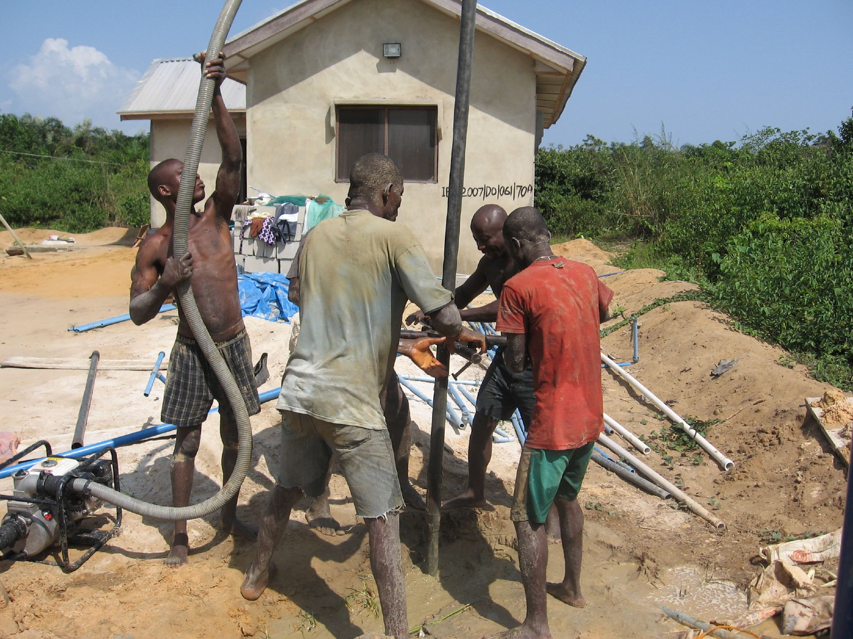
Groundwater’s Importance “Liquid Gold”
A valuable, hidden, resource (“buried treasure” – M. Trainer, 2010)
Good quality
Ubiquitous
Relatively inexpensive to exploit
Non-regulation makes access easy: 90% dependence in Nigeria
Unreliable public water supply enhances resort to it

Slide 12
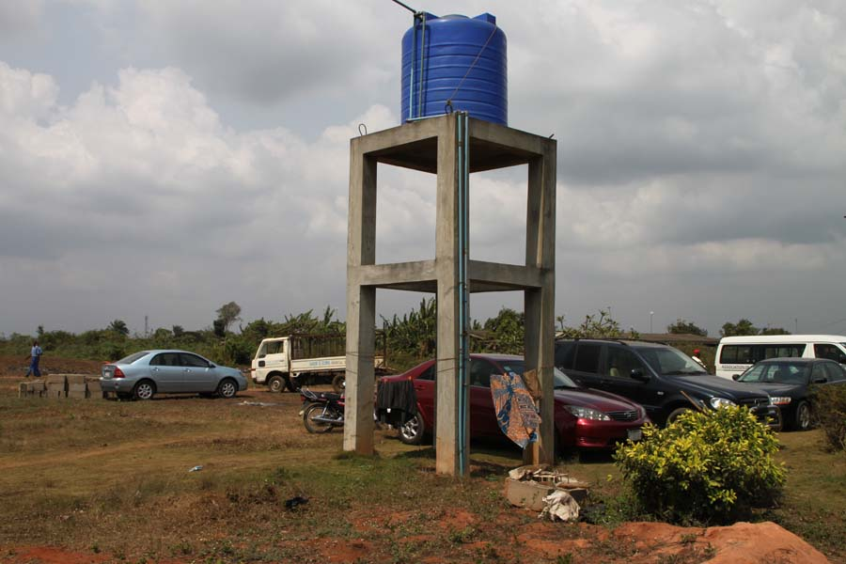
Drilled borehole & Overhead tank.
Exclusive dependence in many communities, e.g. Canaan land
But, alarming pollution compounded by hugely increased dependence now compel attention

Slide 13
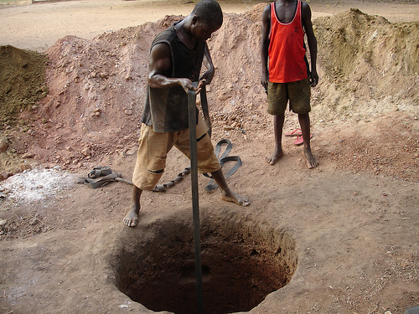
Water Wells unsophisticated version

Slide 14
The Making of NESREA
National Environmental Standards and Regulations Enforcement Agency (Establishment) Act 2007 (NESREA Act)
Repealed F.E.P.A. in 2007
To protect/develop environment, bio-diversity conservation, & “sustainable development of Nigeria’s natural resources”

Slide 15
NESREA’S enabling text
The Agency was given responsibility for
“the protection and development of the environment, biodiversity conservation and sustainable development of Nigeria’s natural resources in general and environmental technology, including coordination and liaison with relevantstakeholders within and outside Nigeria on matters of enforcement of environmental standards, regulations, rules, laws, policies and guidelines”

Slide 16
NESREA contd
Is a definite effort to protect natural resources, & a firm change from pre-1980s total neglect
11 regulations made to date, of which 9, though primarily for waste, have some bearing on groundwater.
There is a considerable focus on potential sources of water pollution rather than FEPA’s reactive hazardous waste preoccupation

Slide 17
NESREA (other regulations) collective notable provisions
“Polluter pays” principle & responsibility for clean up, remediation & compensation to affected persons is incorporated.
Effluent limitations for waste water
Prescriptions for treatment of effluents, and minimization of wastes generally

Slide 18
Is Groundwater Adequately Addressed?
National Environmental (Sanitation & Wastes Control) Regulations 2009 is most pertinent in its attention to waste management to achieve sustainable sanitation & minimize pollution
Prescribes that septic tanks/soak away pits must comply with detailed location specifications (due to non-collective treatment)
Requires proper waste disposal & treatment
Effluent limitation standards for waste water
Prescriptions for treatment of effluents, and minimization of wastes generally

Slide 19
Centralized sewage disposal mechanism (5 Stages)
A collective sewage treatment method,
barring unforeseen pipe breakages or
other disaster, poses no threat to
Groundwater. Has 5 stages:
Collection,
Biological nutrient removal,
Clarification
Filtration
Ultra violet disinfection (or other treatment method)
. But Nigeria uses a dispersed, untreated ejection system

Slide 20
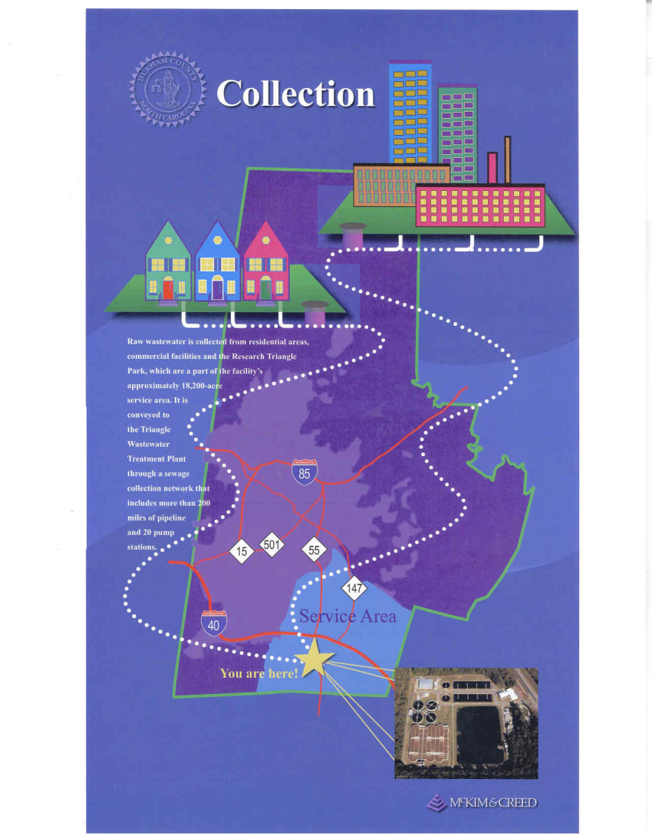
Centralized sewage treatment

Slide 21
Threats to Groundwater
BUT the NESREA provisions are
inadequate to safeguard
Groundwater because a collection
of direct, subtle, and institutional
threats plague the resource.

Slide 22
Specific Groundwater Threats in Nigeria
Haphazard unregulated exploitation and over-abstraction with depletion potential
Wrong well construction without understanding of ground/surface water interaction patterns
Saline intrusion (in coastal areas)
Pollution: this is the most urgent threat and is the progressive migration of potentially harmful microbial organisms e.g. from open dumps. and chemical compounds including nitrates from diverse sources
Nitrates are a potential cause of cancer, hypertension, and methemoglobinemia, a blood disorder characterized by abnormal build-up of hemoglobin in the body of a child

Slide 23
National Groundwater Nitrate Pollution trend (source: Adelana, 2006)
1938 -1960: 4.5% wells with over 50mg/L nitrate content (WHO limit)
1961-1968: 9-6% wells with nitrate content exceeding drinking water standard
2003: increasing trend in nitrate content and water quality depreciation (x 10 WHO limits)

Slide 24
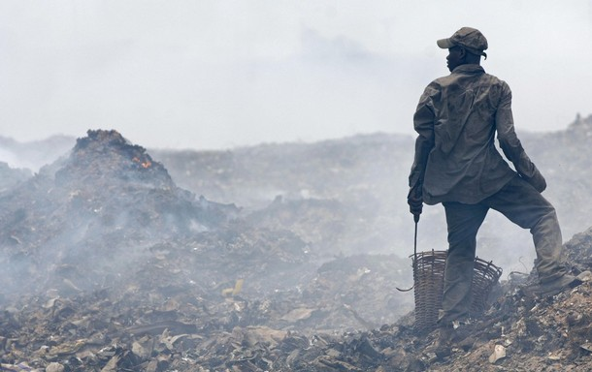
Olusosun, a waste dump in Lagos
A major waste dump with proven potential to leach into underground water

Slide 25
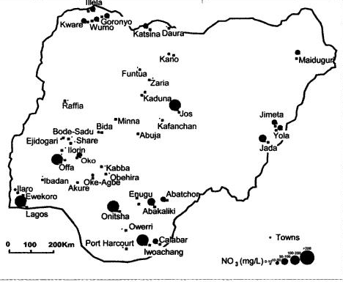
Nigeria’s Groundwater nitrate pollution status (source: Adelana, 2006)
Insert map

Slide 26
Some Specific Issues for Address
Identify diverse sources & mechanisms of pollution & limit human activities aggravating these (adopting polluter pays principle)
Monitor groundwater extractions & determine exploitation limits to avoid groundwater mining & land subsidence
Regulate location, use, (dis-use) of wells (not merely as revenue drive)
Prior yeild potentials, etc (dealt with in article)

Slide 27
Danger of non-address
Full blown water crisis if steady pollution left unaddressed (crisis experienced in 2000 in Walkerton, Canada from severe bacterial contamination of untreated/ unmonitored well that resulted in
2300 illnesses, 65 hospitalizations, 27 diseases, & 7 deaths)
At best a reactive and fragmented system of protection would be achieved

Slide 28
Some thoughts: A Human Right to Water?
Water has now ascended to the sacred realm of a “human right” (UN, 2010)
BUT there appears to be a paradox: Human right to water juxtaposed with unbridled population growth that stresses resources. Is humanity not undermining itself?
Nigeria + 4 others = 50% world population (China, India, U.S. & Brazil)
Population growth at least partly responsible for environmental woes

Slide 29
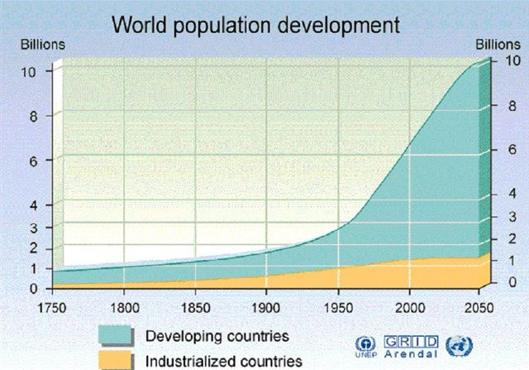
World Population Trend (2010: 6.6b)

Slide 30
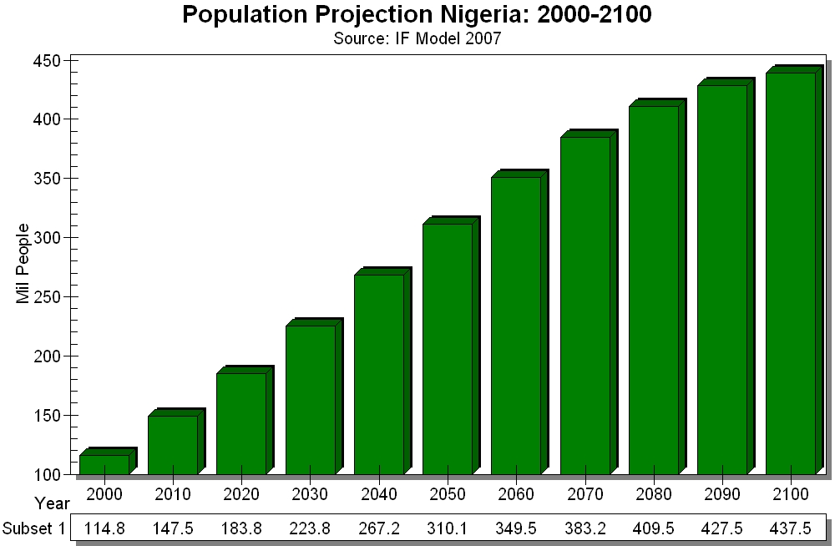
Nigeria’s Present & Projected Population

Slide 31
Strategic Sustainability thinking required
Volumetric: either restrict and monitor access, or adopt a “managed depletion” or total sustainability “zero depletion” or other suitable strategy
Quality: decide best measures to safeguard quality:
either a multiple barrier protection (source, treatment, distribution, monitoring, response), or concerted efforts at source protection, or consider
addressing other sustainability indices e.g. population explosion

Slide 32
A Way Forward
Put in place firm and comprehensive protection
Not a wholesale transplant from other jurisdiction as this may not be workable for Nigeria
Must be right for Nigeria’s social, economic, and cultural peculiarities
Discard reactive management tendency

Slide 33


