Slide 1
UNDERSTANDING PROGRESSIVE REALISATION AND IWRM WITHIN THE SOUTH AFRICAN CONTEXT
By
Derick du Toit, Ramin Pejan, Sharon Pollard, and Hubert Thompson
The Association for Water and Rural Development

Slide 2

Sponsored by
South African Water Research Commission
WRC

Slide 3
Key objectives of this study for the Water Research Commission (WRC)
The importance of water reforms in ensuring a sustainable resource, redressing past inequities and optimal use of resource
Definition of lag
Criteria that can govern policy implementation lag assessments
Recommendations

Slide 4
Reform or transform?
We take reform characteristics to be congruent with: restructure, rearrange, carry forward differently, reformulate and change direction, where transformation occurs when there is systemic change, new policy and principles, removal and replacement, redesign, adopt new procedures and practices, and reorientation.

Slide 5
SA Water Transformation
South Africa is unique in that it has undergone deep systemic changes, not only for environmental and sustainability reasons, but also to “engage in reallocation of resources in order to rectify an extremely skewed distribution resulting from a historical legacy of colonialism, apartheid and discrimination.”

Slide 6
Changes in water management
Integrated Water Resource Management (IWRM)
NEW water management paradigm introducing:
tradable formal or administrative entitlements, known variously as permits, licences, concessions or grants.
shift from water rights regimes, such as the riparian principle, to ones where authority to issue or use water is vested in the State.
Management at catchment level, new institution
Sustainability and equity feature as principles

Slide 7
LAGS
when there is a significant transformation always a “lag” from policy formulation to implementation (Pollard & du Toit 2008).
Implementation Lag: Economic defn etc

Slide 8
Dilemma
The best designed and intentioned policies are meaningless, if
  1) the time it takes to implement them is “too long” or
  2) their implementation is of an “unacceptable quality or standard”.
  The key, therefore, is to understand when a lag is unreasonable with respect to these two categories.

Slide 9
Why use progressive realisation as a guide for evaluating IWRM Lags?
S. 24 Constitution. Environment.-Everyone has the right-
(a) to an environment that is not harmful to their health or well-being; and
(b) to have the environment protected, for the benefit of present and future generations, through reasonable legislative and other measures that-(i) prevent pollution and ecological degradation; (ii) promote conservation; and(iii) secure ecologically sustainable development and use of natural resources while promoting justifiable economic and social development

Slide 10
Clarification of PR in South Africa
measures must be comprehensive and co-ordinated, clearly allocating responsibilities and tasks;
capable of promoting realisation of the right;
be reasonable in conception and realisation;
be balanced and flexible, providing for needs of different degrees of urgency, and refraining from excluding significant elements of society;
and include a component that responds to the most urgent needs and the management of crises (Glazewksi 2004).
KEY is to apply this test to IWRM’s major management actions

Slide 11
Challenges for applying PR to IWRM
PR test is still vague and general
Jurisprudence around IWRM and R. to Env. within this context is still undeveloped
Highly technical issues will cause courts to back-off applying PR
Working through resource availability arguments
Getting water managers and scientist to understand links between their language and that of the law

Slide 12
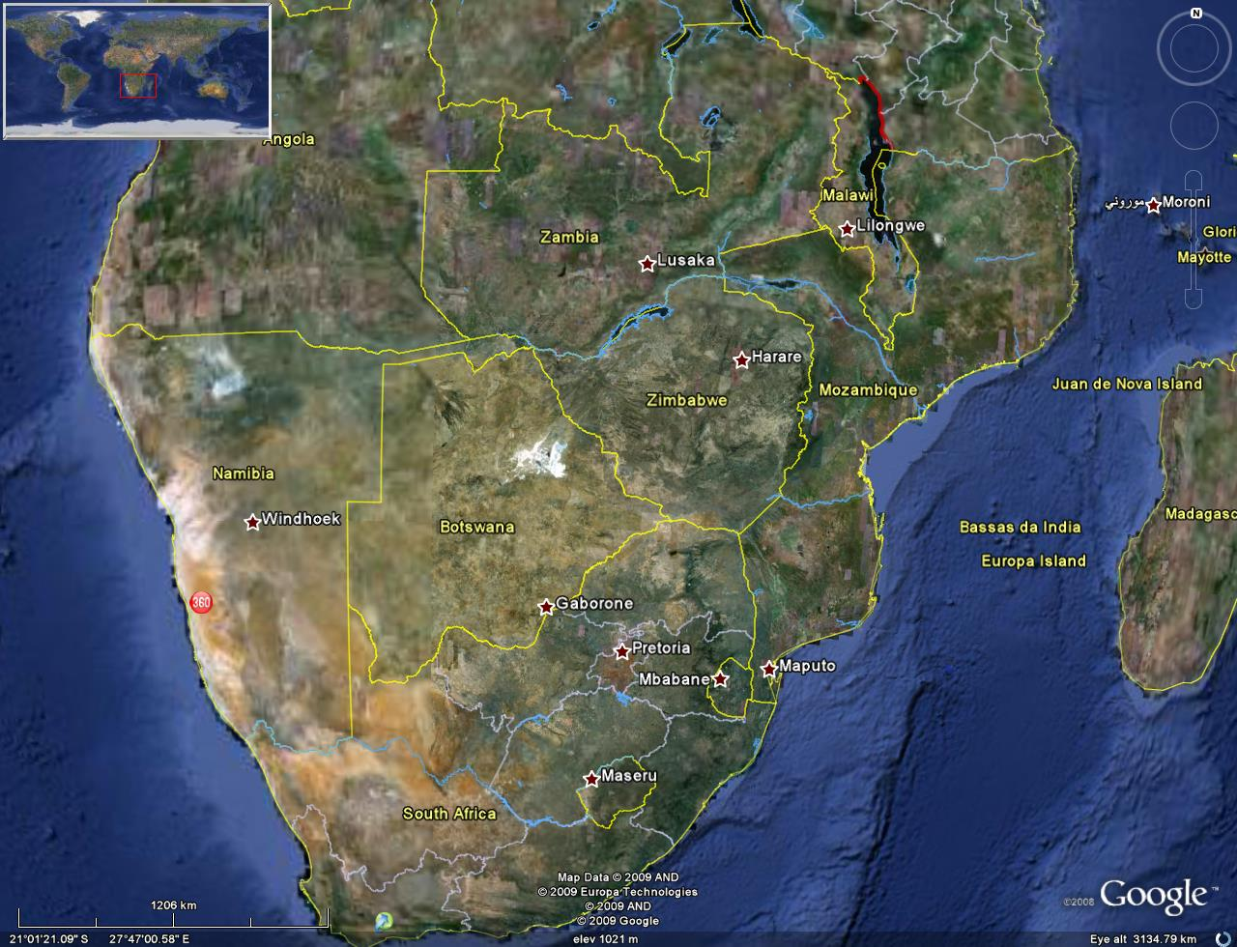
Seven catchments of the lowveld
Mozambique
Swaziland
South Africa

Slide 13
Management actions in SA around sustainability and equity
Management actions under the NWA | Management actions under the WSA
institution creation and development, such as CMA, WUA classification of water resources authorization and licensing validation and verification water allocation reform Reserve (determination and implementation) conservation and demand management pollution control compliance monitoring enforcement transboundary obligations | infrastructure development wastewater treatment water treatment setting tariffs compliance monitoring enforcement

Slide 14
What is the situation on the ground?
AWARD- Shared River Initiative
    Environmental Water Requirements (The Reserve)
    Use and availability (Validation and Verification)
    Registration & Licensing of use
    Compliance and Enforcement Unlawful Use
    Institutional development
    Integration between water services and water management
Schreiner et al. – “Reality Check” (2009 DBSA)
  A number of areas where lack of implementation

Slide 15
A need to develop framework for evaluating PR in IWRM
A critical need to better understand how:
the government can evaluate its performance against the obligation of progressive realisation; and
courts and civil society can also evaluate the reasonableness of lags in implementing access to socio-economic rights and environmental rights, including those that are relevant to water resource management

Slide 16
Framework
National transformation vision
Strategic objectives
Situation description, analysis, reconciliation and WMA vision
Water resources management actions
Faciltatory actions:
Public participation
Finances
Info management
Institutions and
Co-operative relationships
Water resources protection
Water use regulation
Objectives
Objectives
Objectives
Objectives
Objectives
Requirements?
Requirements?
Requirements?
Requirements?
Requirements?
Indicators
Indicators
Indicators
Indicators
Indicators
Evaluation of progressive realisation using above framework

Slide 17
Representation of assessment of lags
Simplified representation
Year 2009
Situation description, analysis, reconciliation and WMA vision
Water resources management actions
Current Score
Faciltatory actions:
Public participation
Finances
Info management
Institutions and
Co-operative relationships
Maximum score (5) = 100% realisation

Slide 18
Year 2010

Slide 19
Year 2011
Situation description, analysis, reconciliation and WMA vision
Water resources management actions
Faciltatory actions:
Public participation
Finances
Info management
Institutions and
Co-operative relationships
100% realisation (yeah right!)

Slide 20
Important to build on existing mechanisms in South Africa: NWRS and CMS.
NWRS:
  set out the strategies, objectives, plans, guidelines and procedures relating to the protection, use, development, conservation, management and control of water resources
  5 years
  Phased and progressive manner
CMS:
  Medium to long term strategy
  Established in a phased and progressive manner
  Reviewed at intervals not more than 5 years
  Not be in conflict with NWRS
  Based on SAM
  protection, use, development, conservation, management and control of water resources

