Slide 1

(Ground) water and property: a site of contestation
Janice Gray
Senior Lecturer

Slide 2
3
Questions to consider
1. Should we regulate groundwater when we still have serious knowledge gaps?
2. Is the propertisation of groundwater access (which arguably underpins tradable entitlements) helpful in dealing with the management of groundwater and contest over it?
3. Is the present regulatory mix appropriate or does it over-emphasise property and the market?

Slide 3

Australia

Slide 4
Statistics on Australian g/water
Groundwater makes up approximately 17% of Australia’s currently accessible water resources .
Groundwater accounts for over 30% or Australia’s total water consumption.
Figures from Connected Waters Initiative UNSW --taken from ‘National Water Commission’s Groundwater position statement’

Slide 5
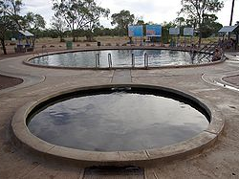
.
Thermal Pool . Water from Great Artesian Basin. Lightening Ridge.

Slide 6
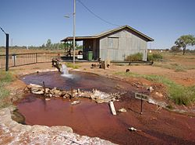
Hot water bore hole in Great Artesian Basin
At Thargomindah.

Slide 7

It’s not real water. It’s only bore water

Slide 8
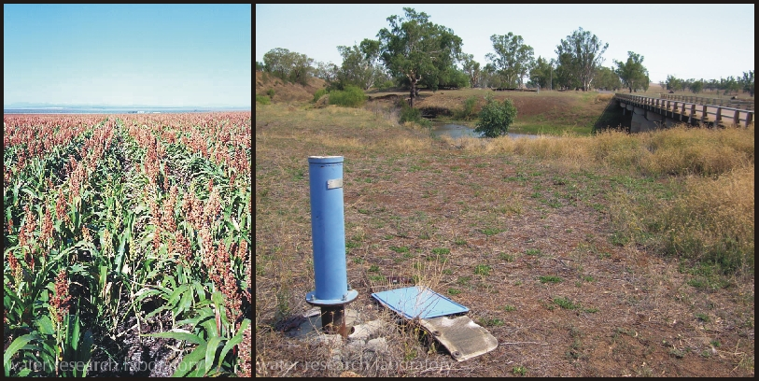
Groundwater in Namoi catchment , Australia UNSW image. Available http://www.wrl.unsw.edu.au/site/projects/groundwater-monitoring-and-evaluation-and-grower-survey-namoi-catchment/at

Slide 9
G/water historically difficult to regulate
Enigmatic
Mystique
Moves in ways unknown
Dries up without warning
Out of sight/out of mind

Slide 10
Advances and Changes in Groundwater knowledge
technological and scientific breakthroughs
-to locate groundwater sources
to help quantify it
to develop methodologies for understanding its behaviour
to develop g/water inventories

Slide 11
New g/water knowledge contd
Patterns of flow
  Pollution and discharge
  Salinity levels
  Pressure
  Recharge rates
  And
  Very importantly the inter-relationship of groundwater to surface water

Slide 12
But
Much about groundwater remains unknown.

Slide 13


Competing tensions, conflicts and contests
http://images.google.com.au/imgres?imgurl=http://deskofbrian.com/wp-content/uploads/tug-of-war.jpg&imgrefurl=http://deskofbrian.com/2011/01/free-or-fair-by-walter-e-williams/teenagers-hands-playing-tug-of-war-with-used-rope/&usg=__9Usmf353qKFK0IHebAU7e6DJBBo=&h=336&w=506&sz=58&hl=en&start=0&sig2=vV53P_OXcGFgAmok4ZCROA&zoom=1&tbnid=NygQwAeODWcsAM:&tbnh=152&tbnw=209&ei=io8ITqThIYmUvAPZ0pC6Dg&prev=/search%3Fq%3Dtug%2Bof%2Bwar%2Brope%26hl%3Den%26biw%3D1653%26bih%3D938%26gbv%3D2%26tbm%3Disch&itbs=1&iact=hc&vpx=988&vpy=656&dur=686&hovh=152&hovw=209&tx=119&ty=239&page=1&ndsp=37&ved=1t:429,r:34,s:0&biw=1653&bih=938

Slide 14
Who are the contests over g/water between?
Any and everyone – examples:
Individual user v individual user
Individual user v an environmental protection agency
Individual user v Minister- eg over consent
Community Action Group v mining co or developer
Mining company/Irrigator v Minister

Slide 15
Returning to 3 issues for consideration
(1) Should we regulate g/water if we don’t know everything about it?
(2) Is propertisation a helpful tool of g/water regulation? Does it help resolve contest?
(3) What alternatives approaches are available? Is the regulatory mix right?

Slide 16
1. Wait and See approach
Wait and don’t regulate- not really a viable approach despite the fears of hydrologists, botanists and other scientists.

Slide 17
How has groundwater been regulated?…..
Common Law- basically the rule of capture
Statutory overlay- era of public administration and ‘permissions’ to access
Tradable groundwater access entitlements which are likely to be classified as property.

Slide 18
Unbundling under ‘new’ legislation
WAL -aquifer access licence- NSW
Share component known as ‘paper water’ eg.05% of a variable consumptive pool
+ water allocation -‘real water’ - .05% of X gigalitres- paper water and real water both tradable.
Extraction component (specifies times/ rates/ circumstances, and locations for water extraction- plus works approval & use approval

Slide 19
Propertisation
Settles disputes
Creates disputes

Slide 20
Competing tensions that need to be addressed in groundwater governance
Competition between water exploitation/use and water preservation- often seen in terms of environmental v agricultural, commercial, industrial, domestic.
Competition between State and Individual rights to groundwater
Competition between different groups of water users

Slide 21
Problems with property rights and the market approach
Sleeper/dozer licences- increased consumption
Rather than sell WALs – just don’t plant
Environmental buy-backs problematic
Splintered communities/ stranded assets
Harder for government to intervene directly.
Salinity levels have not decreased.

Slide 22
ICM case as a site of contestation
Were old style bore licences property for the purposes an acquisition of property by the Commonwealth?
If so, their acquisition had not been compensated on just terms.
Court decided the matter on the basis of ‘no acquistion’ rather than on property issue.

Slide 23
3. Alternatives -Regulatory mix
New forms of regulation occur in an environment where the edges of the state and civil society have become blurred.
Self regulation, co-regulation, public private partnerships, pragmatic approaches which incorporate flexibility and a range of regulatory agencies including government, private sector and not for profit organisations – includes the market PLUS traditional forms of direct regulation often based on command and control.

Slide 24
It’s a work in progress
But maybe it is time to re-evaluate the mix.
Offer an invitation to consider a return to greater State intervention and command and control models.
A way forward may, in part be a way backwards.
Time to re-consider, re-evaluate and re-calibrate.

Slide 25
Conclusion
As surface water is depleted conflicts over groundwater are likely to continue.
Why? Because there is no simple regulatory solution to manage conflict and contestation and because water is a limited resource.

Slide 26


