Slide 1
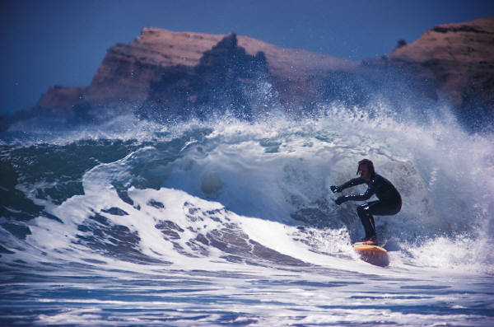
IUCN Academy of Environmental Law 2011 Colloquium
Water and the Law: Towards Sustainability
Mpekweni Beach Resort, Eastern Cape
South Africa, 3 – 7 July 2011
Rethinking Law in a Complex System: Energy, Water, and Climate Change
Prof. David Hodas
Widener University School of Law
Wilmington, Delaware, U.S.A.

Slide 2
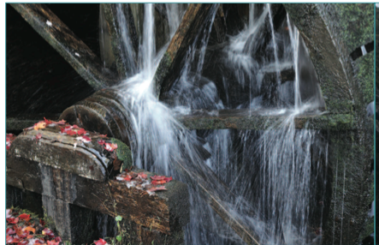
The Intimate Marriage of Water and Energy
Harnessing the oxen increased power available to a human being by a factor of 10. The water wheel increased the power available to a person another 6X; the steam engine increased it another 10X.
Virtually all electricity is produced in a steam engine
Notes:
To illustrate this point, a coal-fired power plant with a once-through cooling system will consume ten times more water than coal (by weight) or many times more for a closed-loop system. This makes it cheaper to transport the coal to the water than the other way around (Gleick 1994, 267- 299).Water has always been a potential constraint for thermal electricity generation, given the large volumes of water required for cooling. Water is also becoming increasingly important in production of fuels, especially with the increased use of biofuels from irrigation-dependent agriculture.Water, like energy, is a commodity but with very different characteristics. Water is almost always local where energy tends to be more global.

Slide 3
Is Water Heavier than Coal?
A coal-fired power plant (once-through cooling) will consume 10X more water than coal (by weight) or many times more for a closed-loop system.
So, it is cheaper to transport coal to water than the other way around.
Water is limitation on thermal electricity generation, given the large volumes of water required for cooling.
Water is almost always local where energy tends to be more global.
Erik Mielke, et al, Water Consumption of Energy Resource Extraction, Processing, and Conversion (Harvard Kennedy School Belfer Center 2010)

Slide 4
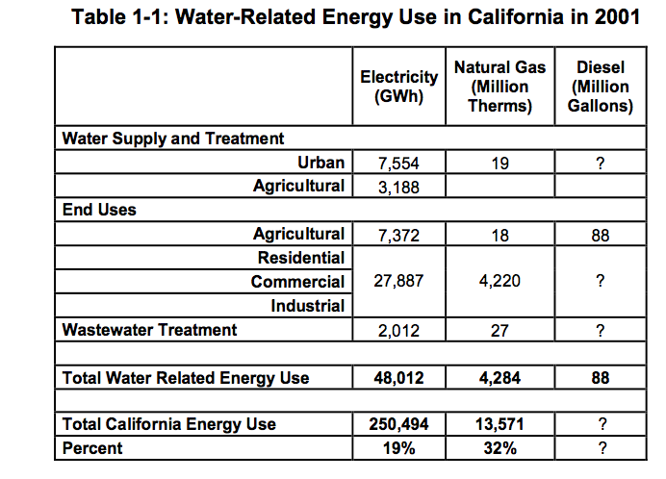
The Energy Use for Water
Moving water to where it is needed is energy intensive.
  In California, water-related energy use consumes 19 percent of the state’s electricity, 30 percent of its natural gas, and 88 billion gallons of diesel fuel every year.
Notes:
Divided equally by 24 hrs times 365 days equals 1.34 Gw

Slide 5
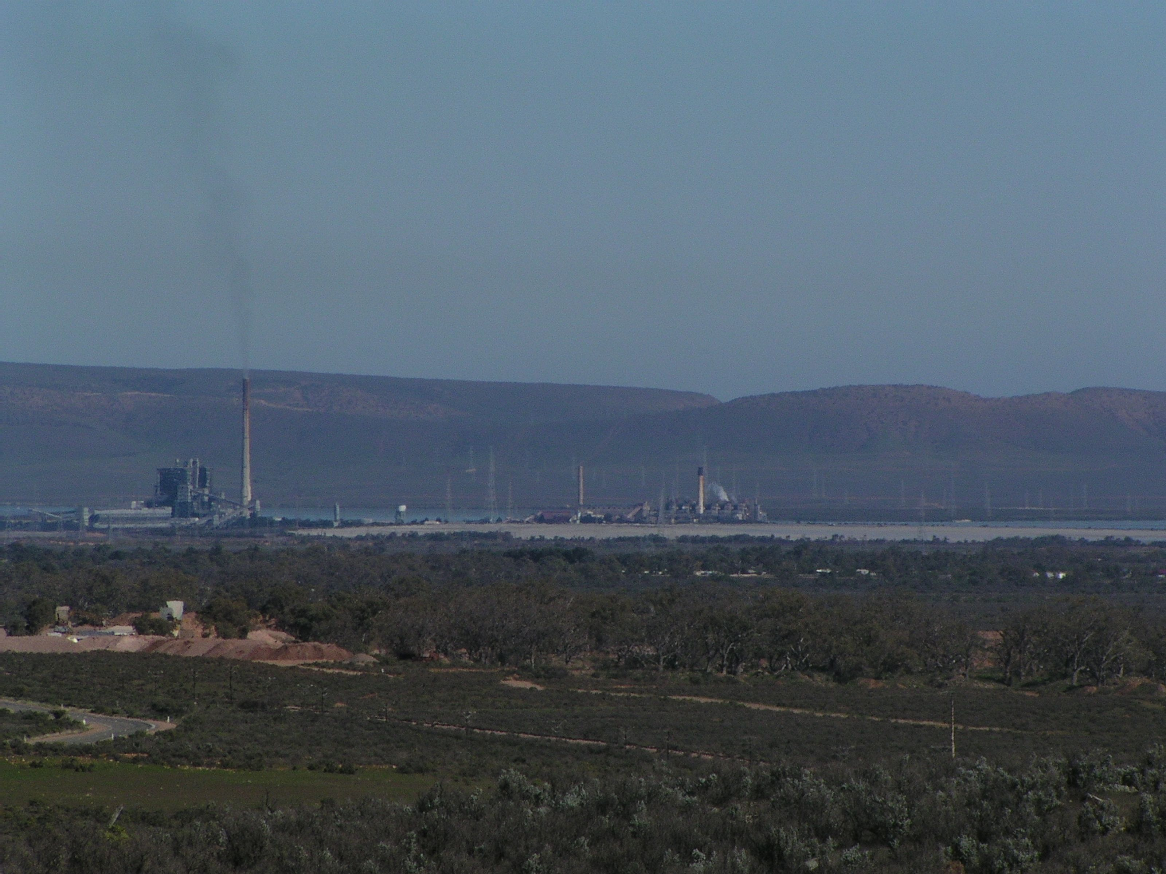
Water Used to Produce Electricity
Generating electricity and producing fuels requires substantial quantities of water.
When energy is inexpensive and water is plentiful there is little need to reconcile energy law with water law, and the two fields largely operate independently.
Where the two fields of law do intersect, as in the realm of hydroelectric power, the results have been problematic

Slide 6
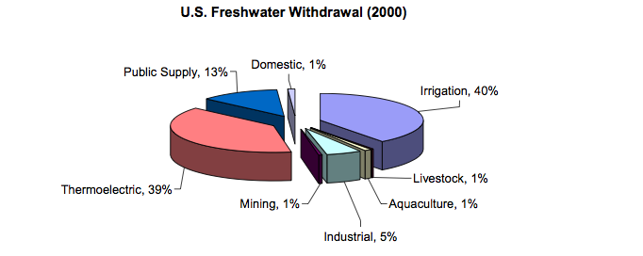
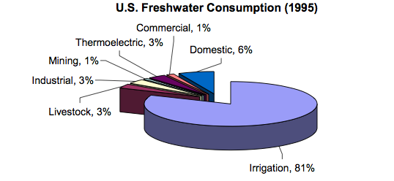
USGS 2004

Slide 7
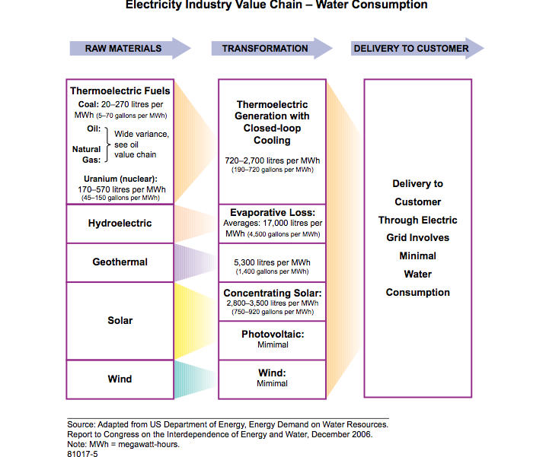

Slide 8
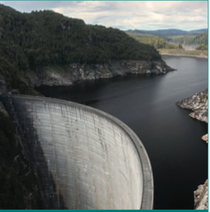
Hydroelectric dam reservoir – Evaporation consumes large quantities of water – about 30 times more than the free-flowing river did. Hydroelectric dams evaporate 18 gallons freshwater per kWh electricity Torecellini, et al, Consumptive Water Use fro U.S. Power Production (National Renewble Energy Laboratory Dec 2003)
Notes:
Hoover Dam evaporates 80 inches per year from its 164,000 acre surface area

Slide 9
Water Use in the Energy Supply Chain
Water uses:
  Resource extraction (e.g., oil, gas, coal, biomass)
  Energy Conversion (refining and processing)
  Transportation
  Electric power generation (thermal)
Energy accounts for 27% of all water consumed in the U.S. outside the agricultural sector (Electric Power research Institute 2008)
The average thermoelectric plant in the U.S. consumes 0.47 gallons/kwh

Slide 10
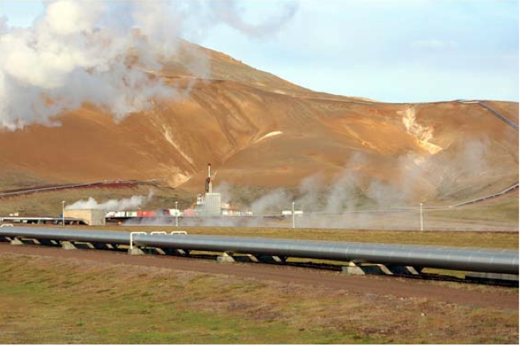
  Power plant cooling: 3-4% of U.S. water consumption
  Biofuels: most water intensive fuel by 1 -2 orders of magnitude – corn-based ethanol consumes >1,000 gallons per million Btu
  Nuclear power has highest water consumption of all steam generation technologies

Slide 11
Renewable Energy Can Consume Water
Geothermal Energy
Solar Thermal – use depends on coolling technology
Power Towers can consume 90 – 750 gallons/MWhr
Parabolic Troughs can consume 78 – 800 gal/MWhr
Fresnel technology – 1000 gal/MWhr
Dish/Sterling Engine mirror washing – 20 gal/MWhr

Slide 12
Water for Generating Electricity from Steam
The largest demand for water in thermoelectric plants is cooling water for condensing steam.
Thermoelectric generation relies on a fuel source (fossil, nuclear, solar or biomass) to heat water to steam that is used to drive a turbine-generator.
Steam exhausted from the turbine must be cooled (condensed) and recycled to a steam generator or boiler.
2 types of cooling water systems: once-through (open loop) and recirculating (closed loop).
Notes:
boiler. The steam condensation typically occurs in a shell-and-tube heat exchanger known as a condenser. The steam is condensed on the shell side by the flow of cooling water through tube bundles located within the condenser. Cooling water mass flow rates of greater than 25 times the steam mass flow rate are necessary depending on the allowable temperature rise of the cooling water – typically 15-25oF. The design and operating parameters of the cooling system are critically important to overall power generation efficiency. At higher condenser cooling water inlet temperatures, the steam condensate temperature is higher and subsequently turbine backpressure is higher. The turbine backpressure is inversely related to power generation efficiency: the higher the turbine backpressure, the lower the power generation efficiency.

Slide 13
Water and Electricity – The Dilemma
Water shortages, potentially the greatest challenge in the 21st century, will be an especially difficult issue for thermoelectric generators due to the large amount of cooling water required for power generation.
Population increases in water-stressed areas intensify water supply challenge.
2025 U.S. freshwater withdrawals by thermoelectric power generation will be 113 – 138 billion gallons per day (BGD) -- the amount will depend upon the source of cooling water, and type of cooling technology employed for new and retired capacity.

Slide 14
Once-Through Cooling Water
once-through systems:
  cooling water is withdrawn from a body of water (e.g., lake, river, or ocean)
  the warm cooling water is discharged back to the same water body after passing through the condenser.
Plants with once-through cooling water systems have relatively high water withdrawal, but low water consumption.

Slide 15
Recirculated Cooling Water
3 primary technologies used in recirculating cooling systems
  wet cooling towers
  cooling ponds
  dry cooling towers.

Slide 16
Recirculated Cooling Water: Wet Cooling Towers and Ponds
Warm cooling water is pumped to a cooling tower or pond where the heat is dissipated directly to ambient air by evaporation of the water and heating the air.
The cooled water is then recycled back to the condenser.
Because of evaporative losses, a portion of the cooling water needs to be discharged from the system (blowdown) to prevent the buildup of minerals and sediment
make-up water withdrawn from the local water body to replace water lost through evaporation and blowdown.
So, wet recirculating systems have relatively low water withdrawal, but high water consumption.

Slide 17
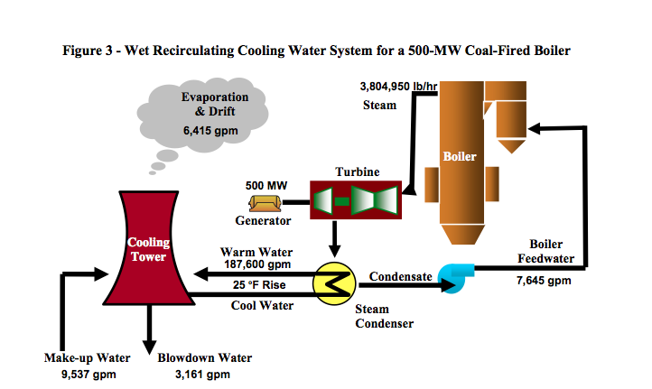
U.S. D.O.E., National Energy Technology Laboratory, Estimating Freshwater Needs to Meet Future Thermoelectric Generation Requirements (2006; rev. 2008)

Slide 18
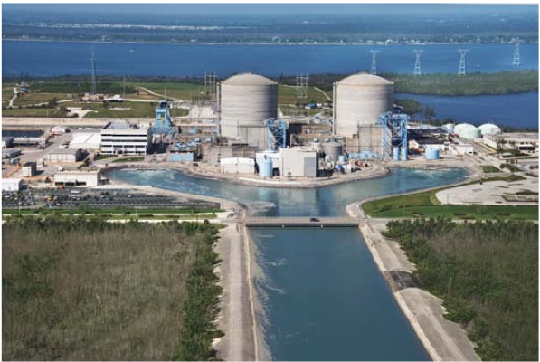
Cooling Pond at a nuclear power plant

Slide 19
Dry Recirculating Cooling
use either direct or indirect air-cooled steam condensers.
direct air-cooled steam condenser: exhaust steam flows through tubes that are cooled directly by conductive heat transfer using a high flow rate of air that is blown by fans.
indirect air- cooled steam condenser: conventional water-cooled surface condenser is used to condense the steam, but an air-cooled closed heat exchanger conducts the heat from the water to the ambient air.

Slide 20
Cost of Water for Power Generation
Water treatment: $0.10 – 4.00/kgal
Delivery costs: negligible – $1.20/kgal
Water Acquisition: up to $0.50/kgal
Estimated annual water costs for typical 350 MW coal-fired plant: > $8,000,000
Without cooling water plant MUST shut down
Notes:
Cost source: John R Wolfe, et al , An Electric Power Industry Perspective on Water Use Efficiency, 143 J. Contemporary Water Research & Education 30-34 (2009)

Slide 21
The Energy-Water Challenge
Competition for water within a system of incoherent, separate legal regimes
public drinking – Energy – Agriculture – Fishing -Industry -Ecological and environmental needs – cultural interests – etc.
What law will be used to resolve these disputes? Who will decide? Using what criteria?
How will the competing interests be weighed, measured, valued? What value do ecosystem services have?
What decision-making process? What level of review? Public participation?
Can law address this problem of regulating a complex system?

Slide 22
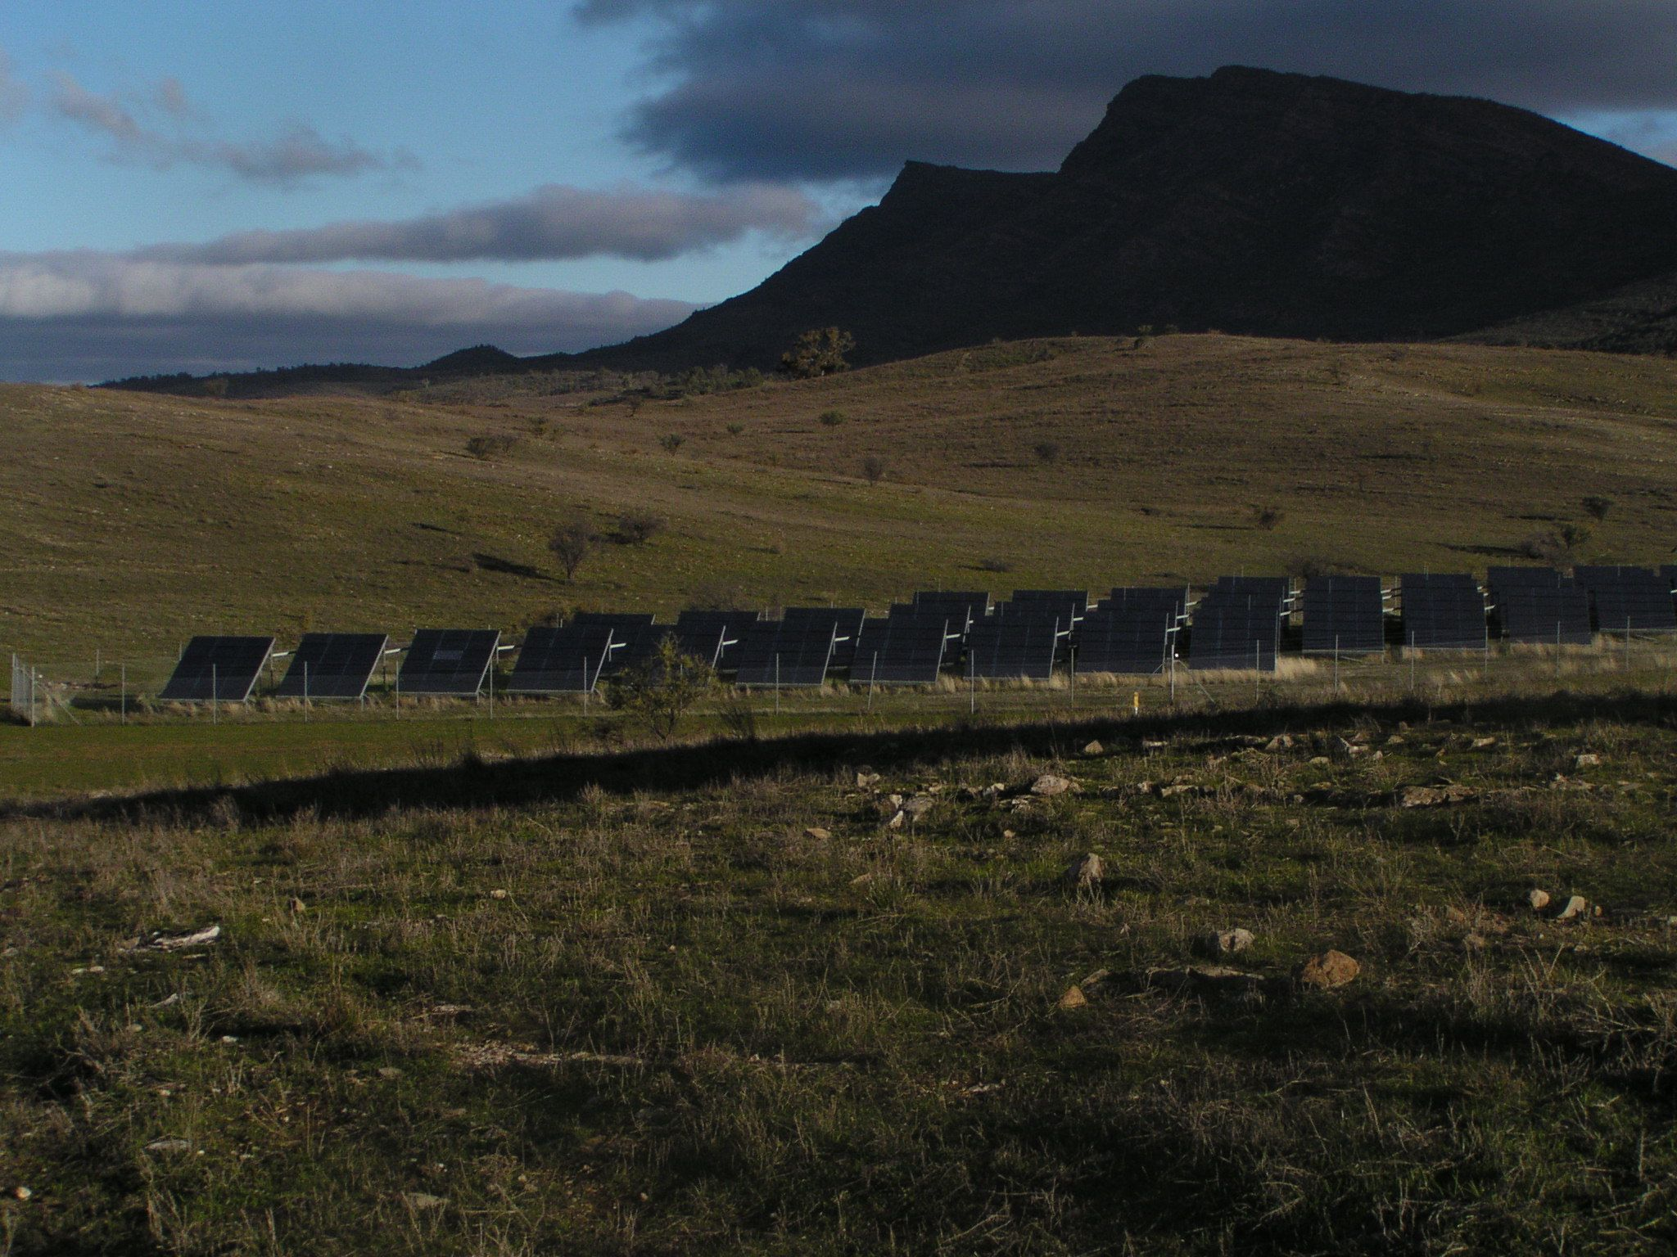
Solar Voltaics and Wind Do Not Consume Water

