Slide 1
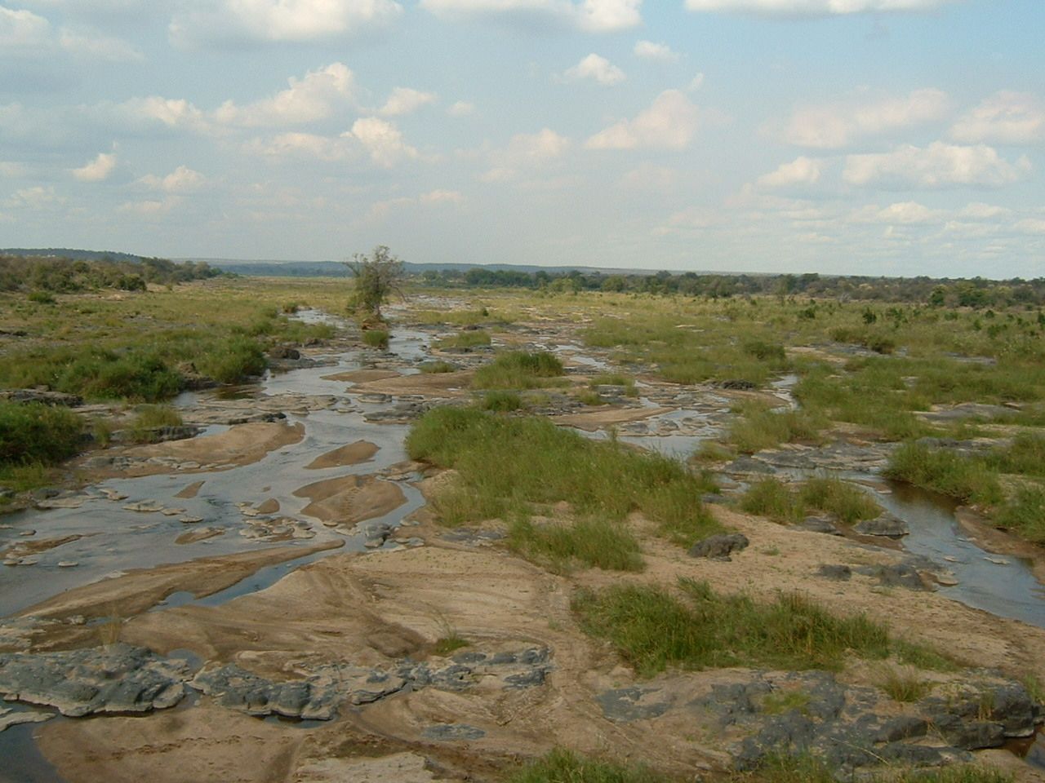
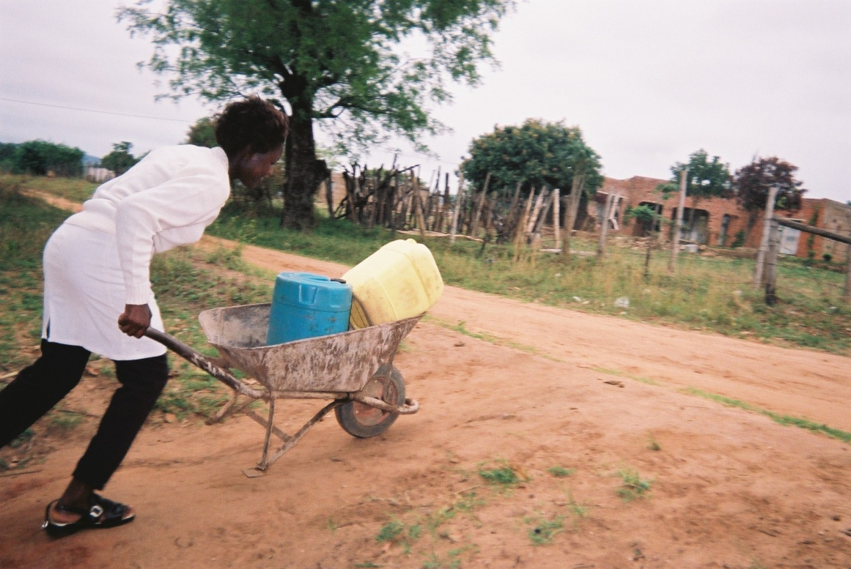
The language of sustainability: a missing piece of the IWRM puzzle?
derick@award.org.za
The Association for Water and Rural Development
Derick du Toit,
Sharon Pollard &
Ramin Pejan
South Africa

Slide 2

Sponsored by
South African Water Research Commission
WRC

Slide 3
Legal
Laws, regulations, rights, obligations, violations, reasonability,
litigation, political, lawyers, judges, regulators, informal/formal
Ecology
Nature, complex systems, conservation, management, academic, key drivers, resource, thresholds, resilience, biodiversity, scientism, understanding, uncertainty, scientist
Economics
Goods and services, trading, incentives/disincentives, supply and demand, free market, profit/loss, employment, growth, businesses, private individuals
Different discourses of IWRM

Slide 4
South Africa
The National Water Act of 1998 was set to change ‘business as usual’ by introducing a ‘new discourse’ for water resources management
SUSTAINABILITY
= fundamental objective

Slide 5
Emergence of scarcity
The first transition:
  from abundance to scarcity - latter part of the 19th Century
The second transition:
  from scarcity to deficit
                Movik 2010
South Africa is faced with absolute deficit by 2015..

Slide 6
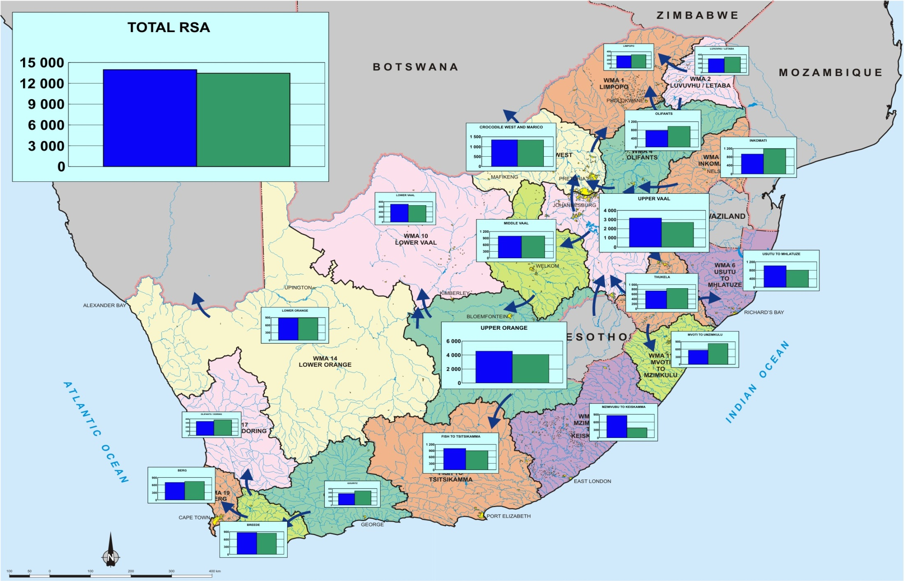
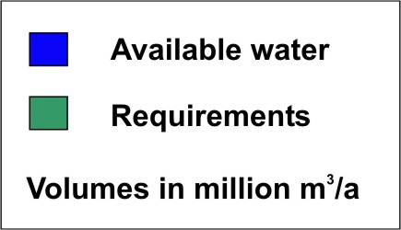
Is there enough where we need it?
Water reconciliation scenarios, year 2000

Slide 7
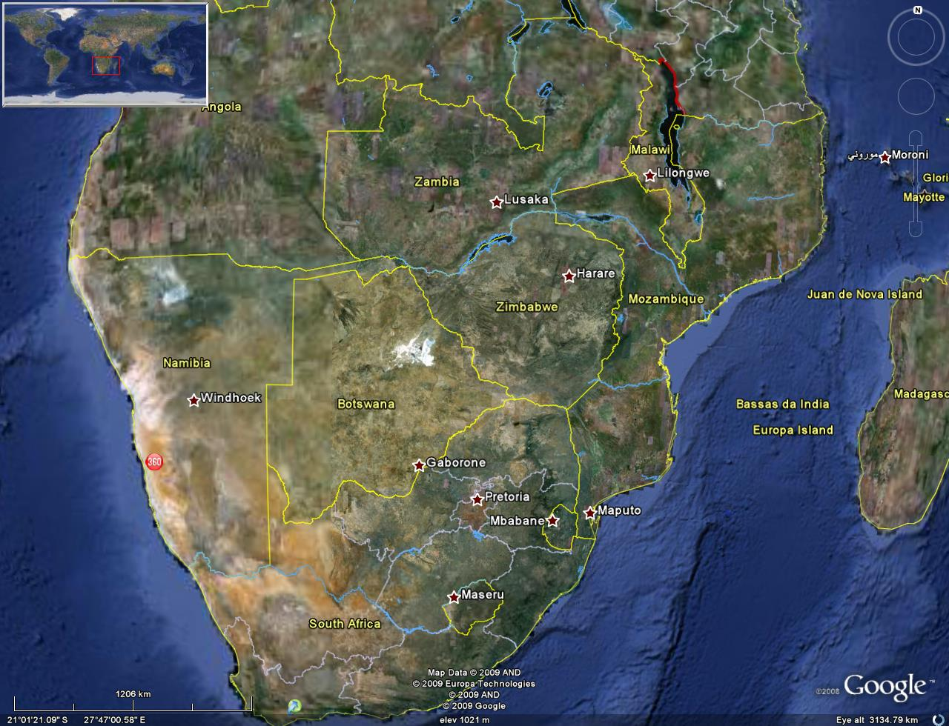
Seven catchments of the lowveld
Mozambique
Swaziland
South Africa

Slide 8
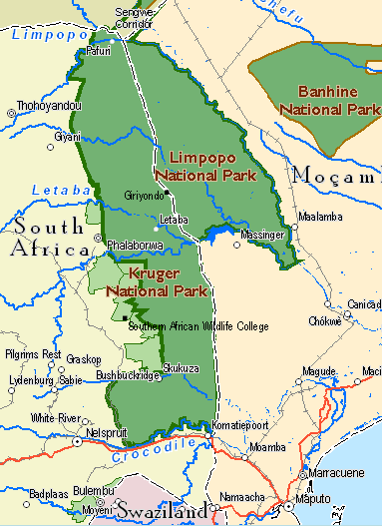
Perennial systems
Luvuvhu
Letaba
Olifants
Sand
Sabie
Crocodile
Komati

Slide 9
Emphemeral systems
Luvuvhu
Letaba
Olifants
Sand
Sabie
Crocodile
Komati

Slide 10
Sustainable configurations for water management

Slide 12
Need to address:
Standards
Outcomes
Rights
Obligations
Liabilities
(Douglas Fisher)

Slide 13
Intergenerational rights
Sustainability,
Intergenerational equity
Precautionary P, PPP,
Participation,
Economic
Foundational Information for the CMS
6.1 Catchment description
Sustainability,
6.2 Situation Assessment
6.3 Reconciliation
Sustainability, Intergenerational equity, Precautionary P, Human Rights, Participation
Developing a Vision
Economic principles
WRM Strategies
6.5 Water Resource Protection
6.6 Regulating Water Use
Sustainability,
PrecautionaryP,
6.7 Public Engagement
6.8 Monitoring & Info
Human rights
Participation
Human rights
Participation
Precautionary P,
6.9 Funding IWRM
Facilitating Strategies
6.10 Co-operative relationships
Integration Strategy

Slide 14
Sustainability principle
Foundational Information for the CMS
6.1 Catchment description
6.2 Situation Assessment
6.3 Reconciliation
Intergenerational equity,
Developing a Vision
WRM Strategies
Precautionary P,
6.5 Water Resource Protection
6.6 Regulating Water Use
Human rights principles
6.7 Public Engagement
6.8 Monitoring & Info
6.9 Funding IWRM
Participation
Facilitating Strategies
6.10 Co-operative relationships
Integration Strategy

Slide 15
THE ECOLOGICAL RESERVE: a Summary

Slide 16
Challenges for water management
Application of principles in practice
Allocation of duties
Co-ordination of duties
Monitoring and compliance
Enforcement and reporting
Adaptive management
Flexible standards
Reasonableness
Future-focussed

Slide 17
Legal implications?
Application of principles vs application of sections of the law?
Integrated sustainability discourse – new?
Conflict with other discourses
Obligation and liability
Intergenerational equity

Slide 18
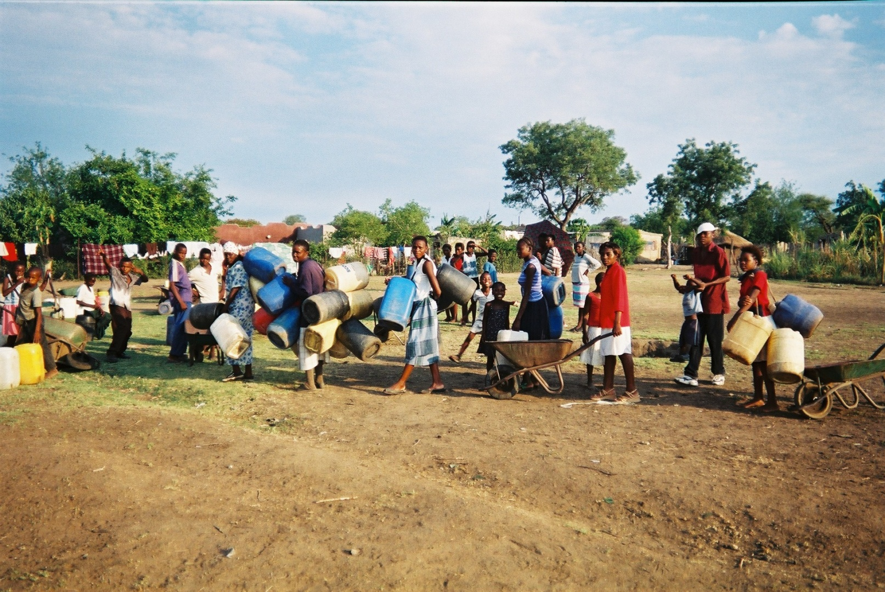
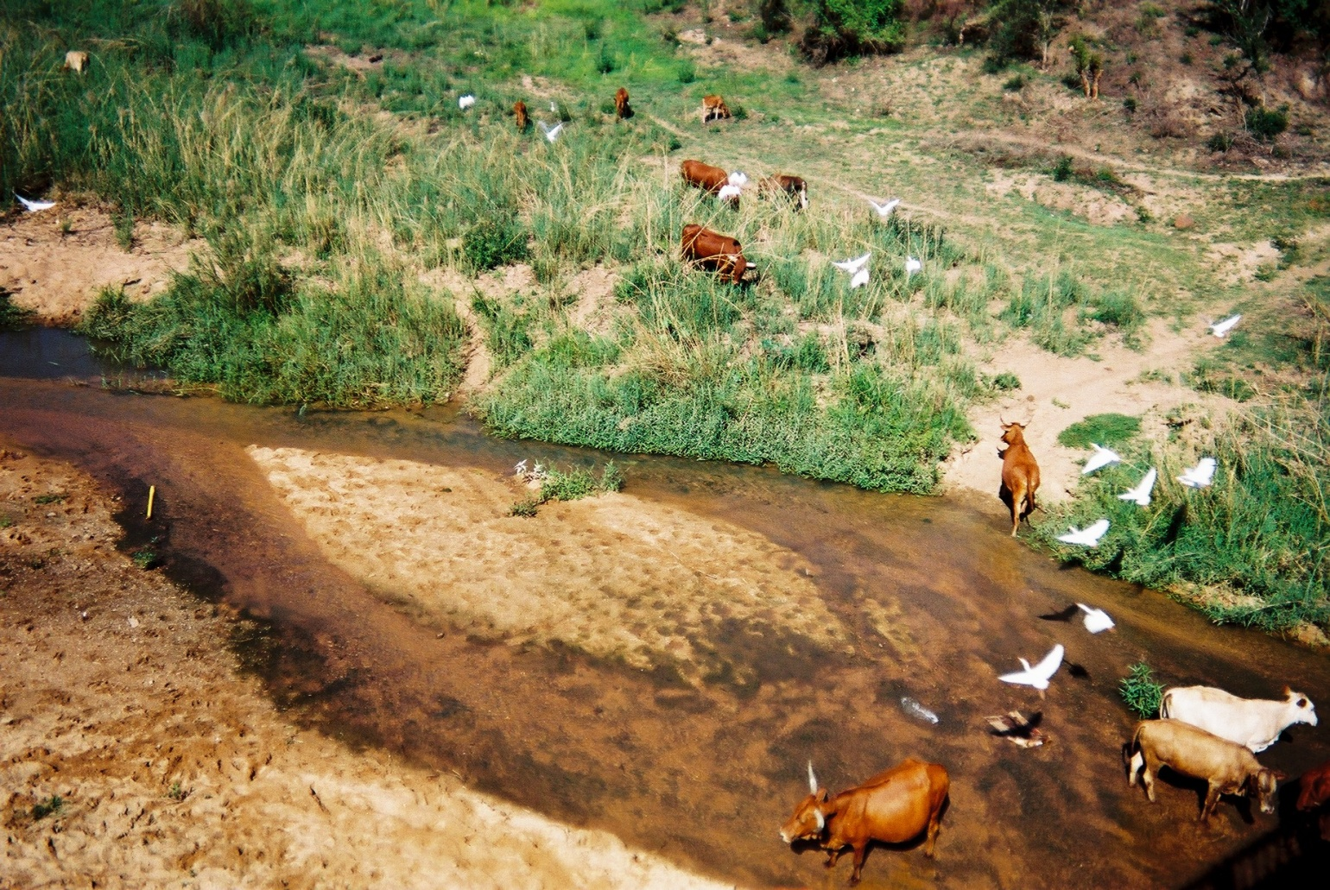
We all want to use the river….
Thank you

