Slide 1

IWRM in SA: Where are the law suits?
The Association for Water and Rural Development
Ramin Pejan (ramin@award.org.za)
Dr. Sharon Pollard (sharon@award.org.za)

Slide 2

Sponsored by
South African Water Research Commission
WRC

Slide 3
South Africa
24. Environment.-Everyone has the right-
(a) to an environment that is not harmful to their health or well-being; and
(b) to have the environment protected, for the benefit of present and future generations, through reasonable legislative and other measures that-(i) prevent pollution and ecological degradation; (ii) promote conservation; and(iii) secure ecologically sustainable development and use of natural resources while promoting justifiable economic and social development

Slide 4
Changes in water management -1998
Integrated Water Resource Management (IWRM)
NEW water management paradigm introducing:
Public Trust Doctrine
tradable formal or administrative entitlements, known variously as permits, licences, concessions or grants.
shift from water rights regimes, such as the riparian principle, to ones where authority to issue or use water is vested in the State.
Management at catchment level, new institutions
Sustainability and equity feature as principles

Slide 5
FRAMEWORK for…
WRM sub-strategies
Vision
Resource protection
Water use regulation
Cluster of
sub strategies
Cluster of
sub strategies
Authorisations
Allocation Plans
Licensing
WCDM
Monitoring, Compliance, enforcement
Classification
Reserve determination
Reserve Operationalisation
RQOs
Other protection measures

Slide 6
Resource Directed Measures
Set class of resource
Set Reserve
Set resource quality objectives
Vision
Monitor against Reserve requirements
Review
Determine Allocable Resource
Monitor Resource
Compulsory licensing?
Draw up allocation plan
Audit Compliance
Issue Water Use License
Evaluate water use license
Water Use License Application
Source Directed Controls

Slide 7
Focus on the Reserve
Q. What is the Reserve?
Q. What is non-compliance with respect to the Reserve? Are we seeing it in SA?
Q. What issues may give rise to litigation?
Q. Case Law? Constitution?
Q. Why has it not been litigated yet?
Case Study- Sabie Sand Game Reserve

Slide 8
Sustainability in freshwater systems:
“Environmental flows”
Environmental flow: the quantity and quality of water required to sustain aquatic ecosystems and the ecological components, processes and functions on which people depend.
Terminology
  Environmental Flows
  Environmental Water Allocations
  Ecological Flows
  Instream Flows
  The Reserve – South Africa
  Caudal Ecológico

Slide 9
The Reserve…..
The Reserve refers to both the quantity and quality of the water
the essential needs: water for drinking, food preparation and personal hygiene.
Basic Human Needs Reserve
Ecological Reserve
water required to protect the aquatic ecosystems of the water resource.

Slide 10
Important points
Once a Reserve and Class has been determined for the resource, then the allocation of water cannot impinge on these.
Moreover, the EWR is a hypothesis (based on best available information and expert opinion) as to flow requirements (magnitude, duration and timing) and quality to sustain the ecology in a certain state (Recommended Ecological Class, REC) and to meet user requirements/goods and services (management class)
Several Components- magnitude, frequency, duration, quality

Slide 11
Rights and entitlements
ENTITLEMENTS: All other uses authorised according to sustainability, equity and efficiency
Conditional
CMA
responsibility
International obligations, IBT’s, strategic needs, future use
National
responsibility
Basic Human Needs
The Reserve - the only right to water
Ecological Needs

Slide 12
3 Categories of Non-Compliance
Pre Determination
    is it reflected in policy, law, strategies
    is their adequate institutional alignment to ensure compliance?
Reserve Determination (is the process reasonable?)
    Too high?
    Too low?
    Is the underlying data reliable? Do we have sufficient data?
    Interacts with management and ecological class
Reserve Operationalisation/Delivery
    Ensuring that it is reflected in law and policy
    Implementation (e.g. operating rules, licensing, compulsory licensing?)
    Projecting ER for a pre-defined management period
    Monitoring (enough guaging stations, entire river or select sites)
    Enforcement (what if a violation? Who do you pursue)
    Stressed catchment=compulsory licensing

Slide 13
Some difficult questions/challenges
Is any flow less than the specified Reserve non-compliance?
Do all sites need to be compliant or just one?
Will a lawsuit solve the underlying problems with non-compliance?
Who do you sue? Water users, government (what level?)
Battle of experts
Technical issues- courts prepared? Lawyers? (Kidd 2006)
Constitutional issues? Progressive realisation? How does this fit into the picture?
Who brings the case? Who defends the resource?
Precedent?

Slide 14
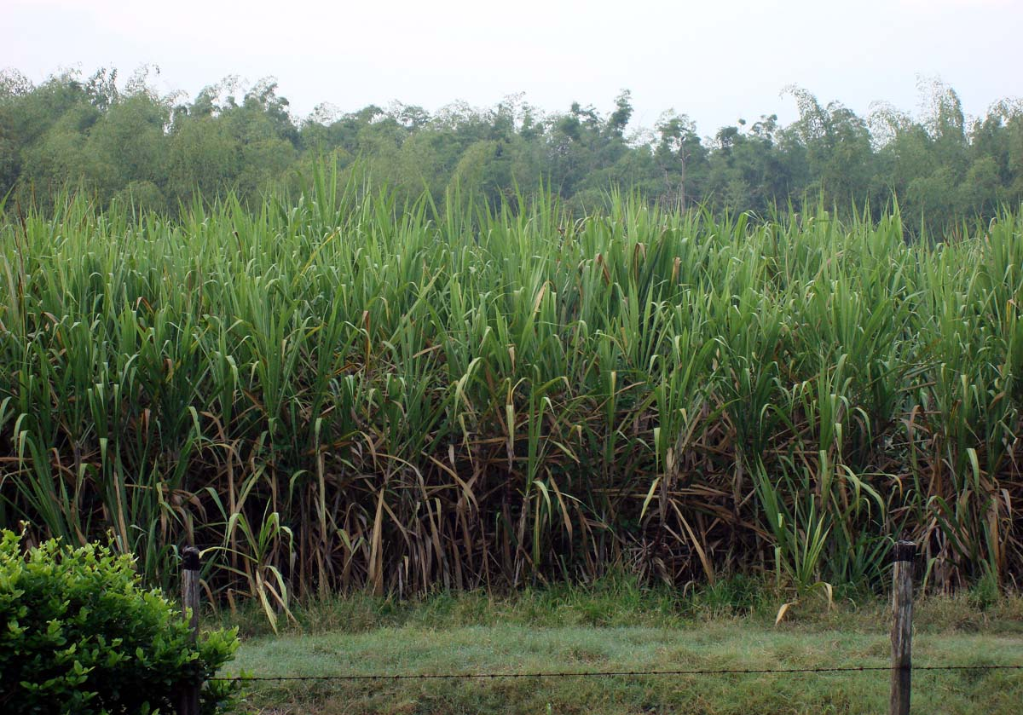
Who may want to bring litigation?
Existing Water Users?
  Commercial Conservation
  National Parks
  Commercial Farmers
  Industry
  Communities
  NGOs
New Water Users?
  Emerging Farmers?
  Municipalities expanding
  mines?

Slide 15
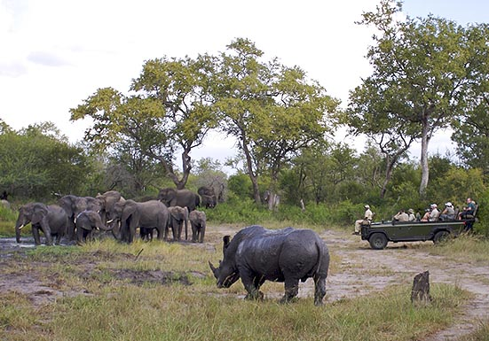
Case Study- Sabie Sands Game Reserve
What was the Injury?
Reserve the main issue
Why did not bring a law suit?
  Politics
  Will it achieve desired outcome?
  Costly and complex
  Will it fix the underlying problems?
  Will it create even bigger problems for SS?

Slide 16
What Next?
Water Tribunal?
SAHRC?
Better understanding of progressive realisation and its links to IWRM
NGOs (need to focus more on resource issues, and not just water equity)
Build capacity starting in law school to understand sustainability issue and natural resources better
Need plaintiffs?

