Slide 1
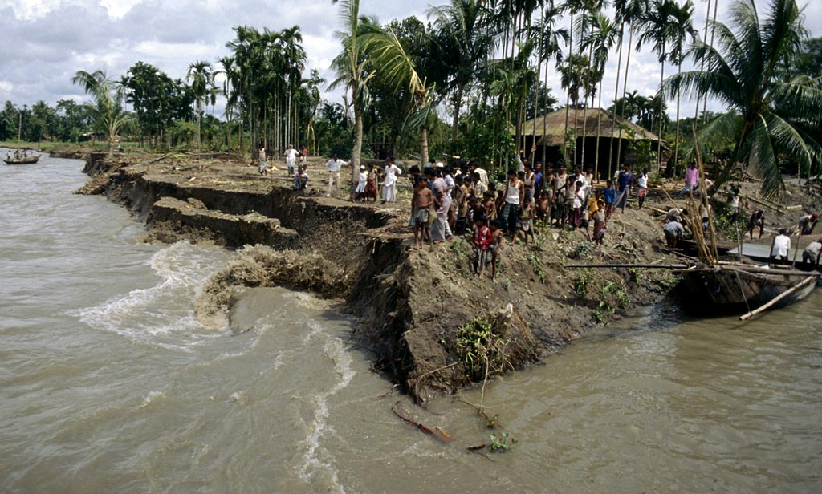
Climate Change and Human Displacement
IUCN Environmental Law Colloquium
Dr Rowena Maguire r.maguire@qut.edu.au

Slide 2
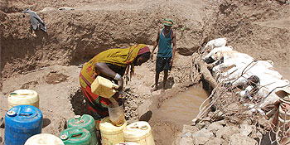
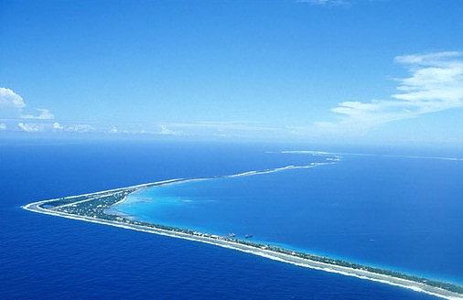
Water and Displacement
Small Island States: (Maldives, Tuvala, Kiribatu)
Water Scarcity (drought): Africa, China
Flooding: Pakistan, Brazil, Brisbane
Tsunami: Asia Region
Development Displacement (Dams): Asia Region

Slide 3
Vulnerability:
Communities and Ecosystems
Vulnerability
Resilience
The sensitivity of people, places and ecosystems to stress or perturbation, including their capacity to anticipate and cope with the stress.
Examples:
  Ecosystems: degraded areas, small isolated areas, geographical location.
  Communities: indigenous groups, informal settlements, rural groups.
Ecological Resilience
Amount of disturbance a system can absorb and still remain within the same state.
Community Resilience
Accumulation of financial, physical, human and natural capital that provide sources for reorganization following disturbances, and the social networks and institutions that provide entitlements to assets and well as coping resources and social capital.

Slide 4
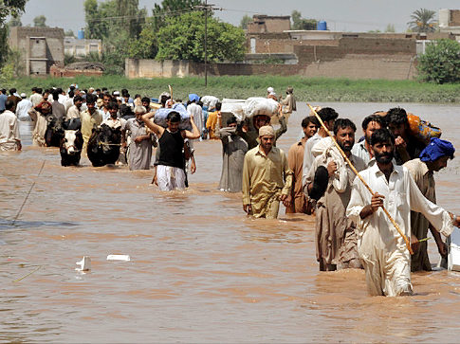
Defining:
Displacement
Temporary
Permanent local displacement
Permanent internal displacement
Permanent regional displacement
Permanent inter-continental displacement
Temporary regional or international displacement
NB: There is no agreed term to describe people: person displaced by climate change/environment, environmental migrant, climate/environmental refugee, climigration

Slide 5
Existing Displacement Governance
Displacement
Temporary
Hyogo Framework
Internal Displacement
Guiding Principles
International
Cancun Adaptation
Regional Agreements

Slide 6
Temporary Displacement
Hyogo Framework for Action 2005-2015: Building the Resilience of Nations and Communities to Disasters
Make DRR a national and local priority.
Identify and monitor DR disaster.
Education to build culture of safety and resilience
Reduce the underlying risk factors
Strengthen disaster preparedness of effective response at all levels.

Slide 7
Internal Displacement
Guiding Principles on Internal Displacement (2001)
Principle 15: Internally displaced persons have
  The right to seek safety in another part of the country;
  The right to leave their country;
  The right to seek asylum in another country; and
  The right to be protected against forcible return to or resettlement in any place where their life, safety, liberty and or health would be at risk.
Principle 6 (2) (c): large scale development projects
Principle 9: Obligations on States protect against displacement with groups with attachment to land.

Slide 8
Regional Agreements
Example of displacement: Pacific Island Nations
Immigration Provisions
New Zealand
-Threatened Pacific Islanders can move to NZ (Tonga, Kiribati, Tuvalu)
-Seasonal employer policy
-Refugee family support
-Samoan Category
USA
-Citizens of Marshall Island, Federated States of Micronesia and Republic of Palu can establish residence as non-immigrant in US.
-Seasonal worker scheme.
Australia
-Nursing Initiative: Kiribati overpopulation and climate change.
-Seasonal worker program

Slide 9
International Recognition
Refugee Convention
Human Rights Instruments
Guarantee protection for people within state borders: does not create obligation to protect human rights of people outside of State.
Climate Change Framework
Displacement not specifically addressed in UNFCCC or KP.
Cancan Adaptation Framework 2010
Refugee defined under Article 1A (2): owing to well-founded fear of being persecuted for reasons of race, religion, nationality, membership of a particular social group or political opinion, is outside the country of their nationality and is unable or, owing to such fear unwilling to avail himself of the protection.
Rights impact by climate change: right to life, food, water, health and housing.
UNFCCC: Article 4
KP: 10 (1) (b) and 12.

Slide 10
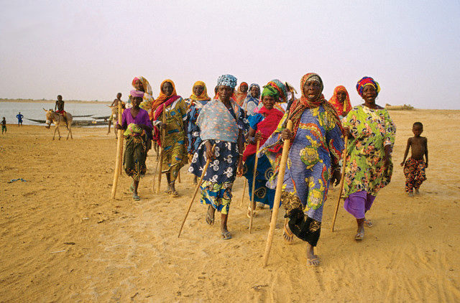
UNHCR and IMO
The United Nations Refugee Agency
Re-settlement Handbook (2004)
International Organisation for Migration
Reports, Studies, Policy Recommendations.
  Theme: Migration, Climate Change and the Environment.

Slide 11
Case Studies: Re-settlement
Alaska
Voluntary internal migration: Newtok Traditional Council
Carteret Islands (PNG)
Voluntary Internal Migration and Re-settlement.: Tulele Peisa
Narau
Regional permanent displacement to Australia.
Issues in understanding the significance of maintenance of cultural identify undoing of the proposals.
Governance issues: 25 different agencies involved
6000 inhabitants of Carteret and 3 other atolls resettled on larger island of Bougainville.

Slide 12
International Level
Cancun Adaptation Framework
  Article 14 (f): parties should take measures to enhance understanding, coordinating and cooperation with regard to climate change induced displacement, migration and planned relocation where appropriate at national, regional and international levels.
Proposal for a Loss and Damage Mechanism under the UNFCC (AOSIS)
  Risk management and risk reduction
  Risk sharing and risk transfer mechanisms (insurance)
  Rehabilitation measures: relocation and or compensation.

Slide 13
Cross-cutting Legal Issues
Improving DRR activities in vulnerable locations.
Funding: insurance and compensation options.
Relocation: tenure, sustainable development, cultural identity, respect of human rights, jurisdiction issues (tribal, federalism, regional, international).
Impact of climate change upon human rights.
Conflict: potential for migration to cause conflict (resource scarcity and competition)

Slide 14
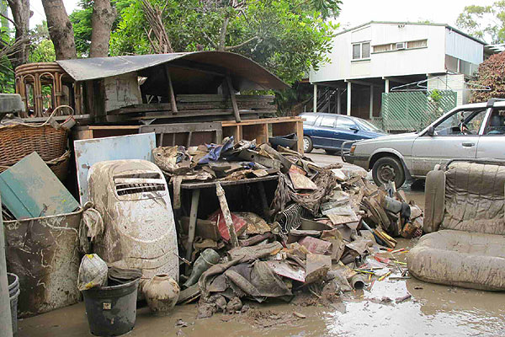
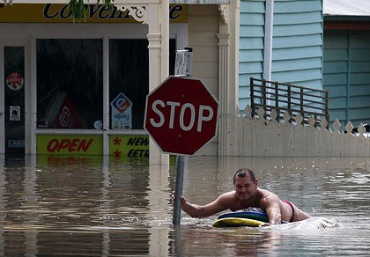
Brisbane Floods
Vulnerability
Resilience
Ecosystem: Medium
Community: Low
Ecosystem: Medium
Community: High

Slide 15
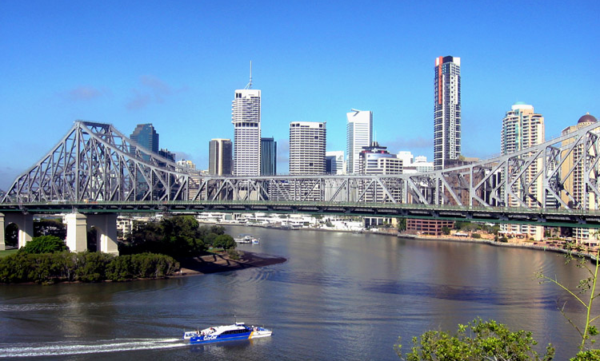
Thank you for your attention.

