Slide 1
A Code of Climate Change Ethics
Acceptance of Responsibility and United Action
Christina Macleod
Masters of Environmental Legal Studies
Prince Edward Island, Canada
September 27, 2008

Slide 2

Why a Code of Climate Change Ethics?

Slide 3
What Are Climate Change Ethics?
Common but Differentiated Responsibility
Intragenerational equity
Intergenerational equity
Ecological Integrity
Equity
Precautionary Principle

Slide 4

Future Generations

Slide 5
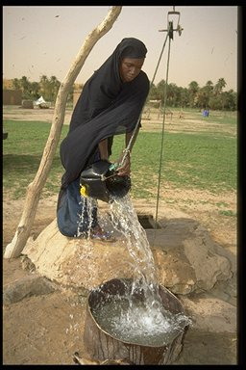
Developing Countries

Slide 6
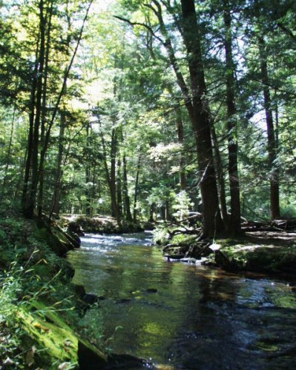
Ecological Integrity

Slide 7
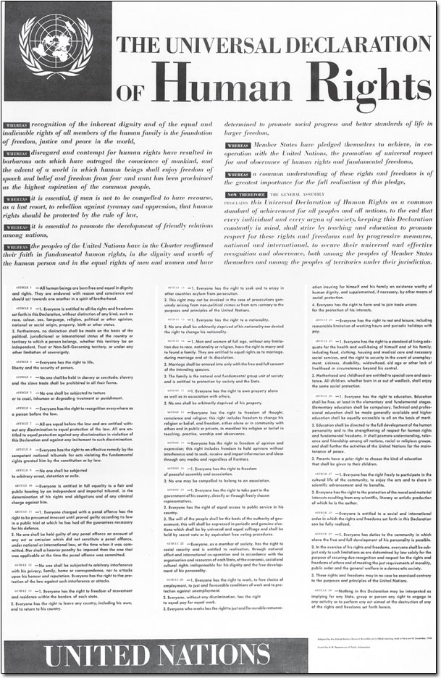
International Soft Law Documents
Universal Declaration of Human Rights
UN Conference on Environment and Development Agenda 21
The Earth Charter

Slide 8
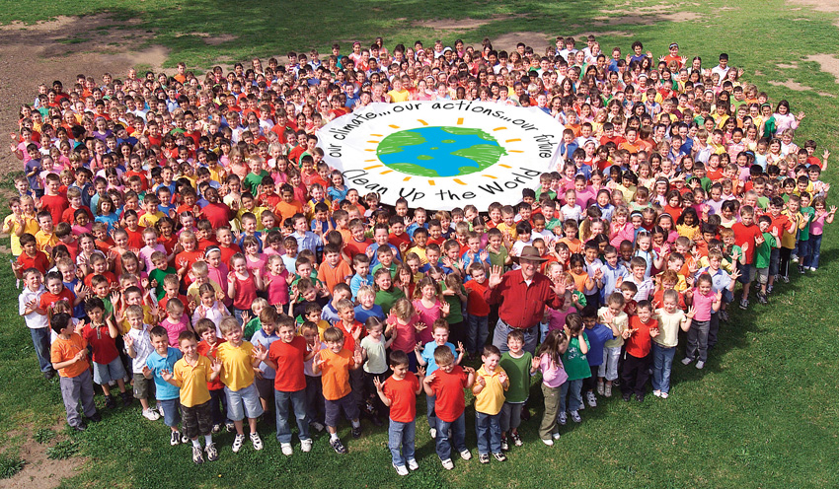
Benefits of a Code of Climate Change Ethics
Individual connection and responsibility
Augment existing and future international climate law
Moral Commitment
Flexibility
Education tool

Slide 9

Development of Global, United Action
Individual involvement in International Law
Collective action and a common goal

Slide 10
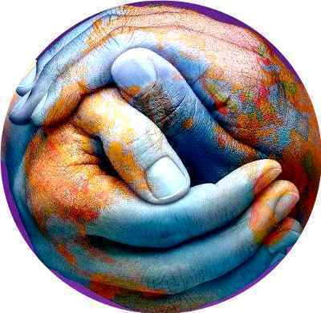
Development of the Code
Global Discussion
Involvement of all levels, generations and cultures
Availability in language and dialect
United unveiling

Slide 11
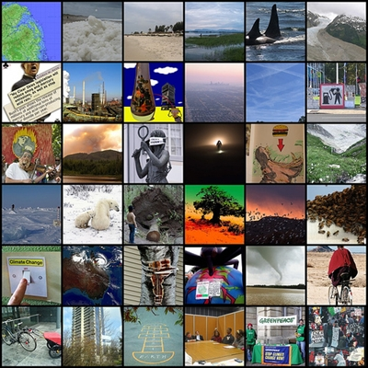
Conclusion
International tool inclusive of climate change ethics
A tool for individuals and countries
A joint direction towards sustainable development and action on climate change

