Slide 1
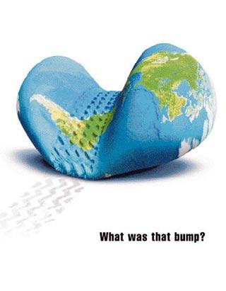
Corporate Liability for Environmental Damage:
A Human Rights Approach
Dr. Svitlana Kravchenko
University of Oregon
7th Colloquium of the IUCN Academy of Environmental Law

Slide 2
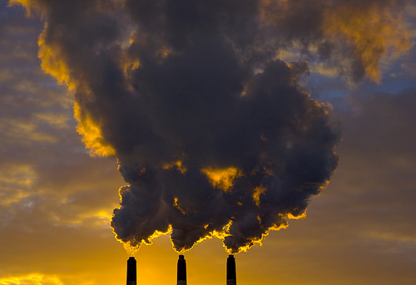
International Standards of
Voluntary Corporate Responsibility
U.N. Draft Code of Conduct of TNC (1992)
OECD Guidelines for Multinational Enterprises (1976, 2000)
ILO Tripartite Declaration of Principles concerning ME and Social Policy
U.N. Global Compact
Soft law: Enforcement?

Slide 3
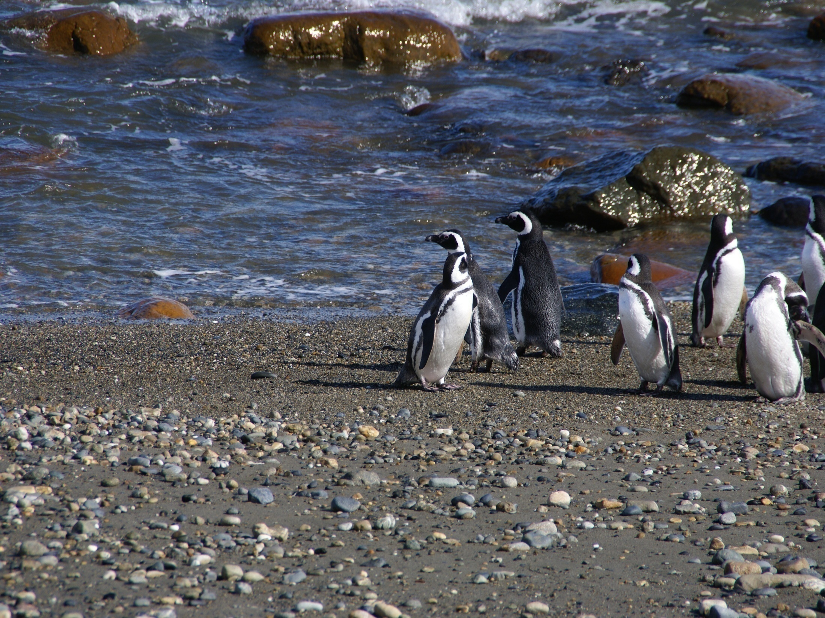
Applying Alien Torts Statute
Any civil action
By alien
For tort claim only
Violation of law of nations

Slide 4

Violation of law of nations
Thomas Jefferson : the law of nations is “an integral part of the laws of the land.”
American courts in early 1800s regularly decided cases under the law of nations.
Then in 1980s courts allowed cases against individuals for human rights abuses.
In 2004, such human rights cases were allowed against corporations.
But federal courts exercise extreme caution when adjudicating environmental rights claims under international law

Slide 5
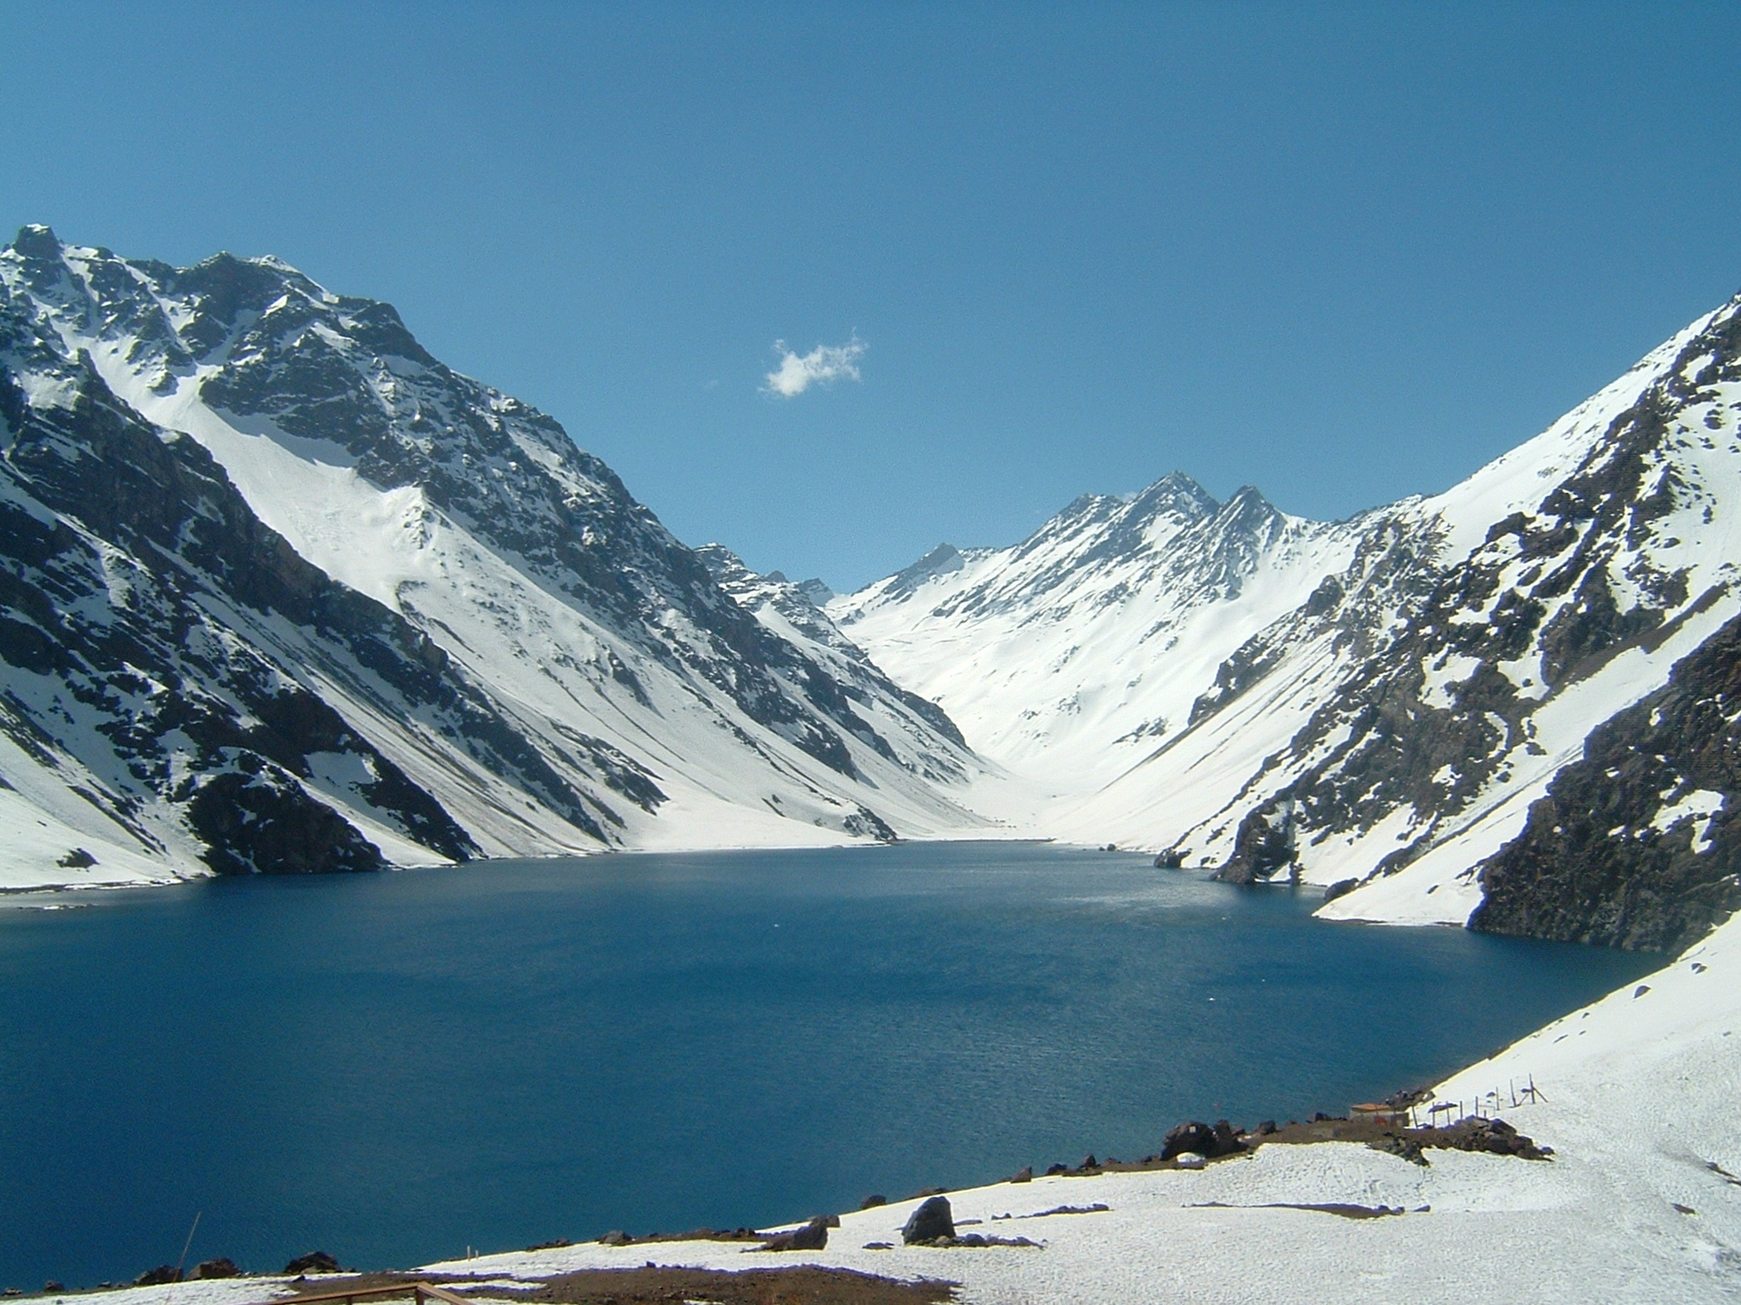
Applying ATS to corporations for human rights abuses
In Sosa v. Alvares (2004) the Supreme Court “explicitly contemplates the existence of corporate liability under customary international law.”

Slide 6
Doe v. Unocal
HR abuses in Myanmar: forced labor, murder, rape, and torture; complicity
During construction of a gas pipeline
Plaintiffs based their claims on ATS
Dismissal by district court
Reversed in part by 9th Cir., so case could proceed
Settlement (terms confidential)

Slide 7
Wiwa v. Shell
Human rights claims against Royal Dutch/Shell and its Nigerian subsidiary
Charged complicity in the torture, killing, and other abuses of Ogoni leader Ken Saro-Wiwa and other Ogoni activists
After Unocal case, this one settled in June 2009 for $15.5 million
Settlement was public, not secret

Slide 8
Not all cases will succeed
Presbyterian Church of Sudan v. Talisman Energy (Oct. 2009) a U.S. Court of Appeals held:
Mere investment in a country where human rights are abused is not enough to make a corporation liable under the ATS.
The plaintiffs must prove the company had specific intent to help the government violate human rights.

Slide 9
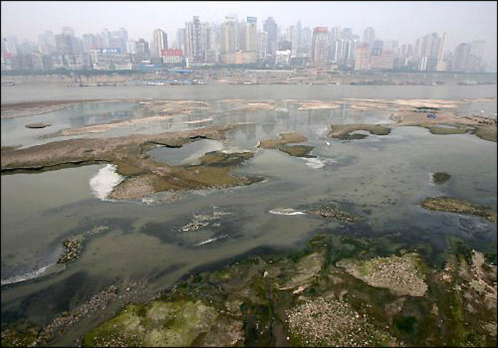
Environmental rights claims
Pollution in China

Slide 10
Beanal v. Freeport-McMoran:
Copper, gold, & silver mine in Indonesia, but HQ in USA
Alleged environmental abuses, human rights violations, and cultural genocide
Alleged violation of international law
Failure to show that these treaties enjoy universal acceptance in the international community

Slide 11
Flores v. Southern Peru Copper
Pollution and alleged violation of the right to life and the right to health
Pollution caused lung disease
US district court for Southern District of NY held that plaintiffs failed to establish the existence of a customary international law “right to life” or “right to health”

Slide 12
Sarei v. Rio Tinto
Rio Tinto built open-pit copper mine, PNG
Severe river and bay pollution
Alleged human rights and environmental abuses
9th Cir.: Potential violation of UNCLOS, customary international law against marine pollution (166 Parties)
9th Cir. en banc: plaintiffs did not exhaust local remedies, so case is returned

Slide 13
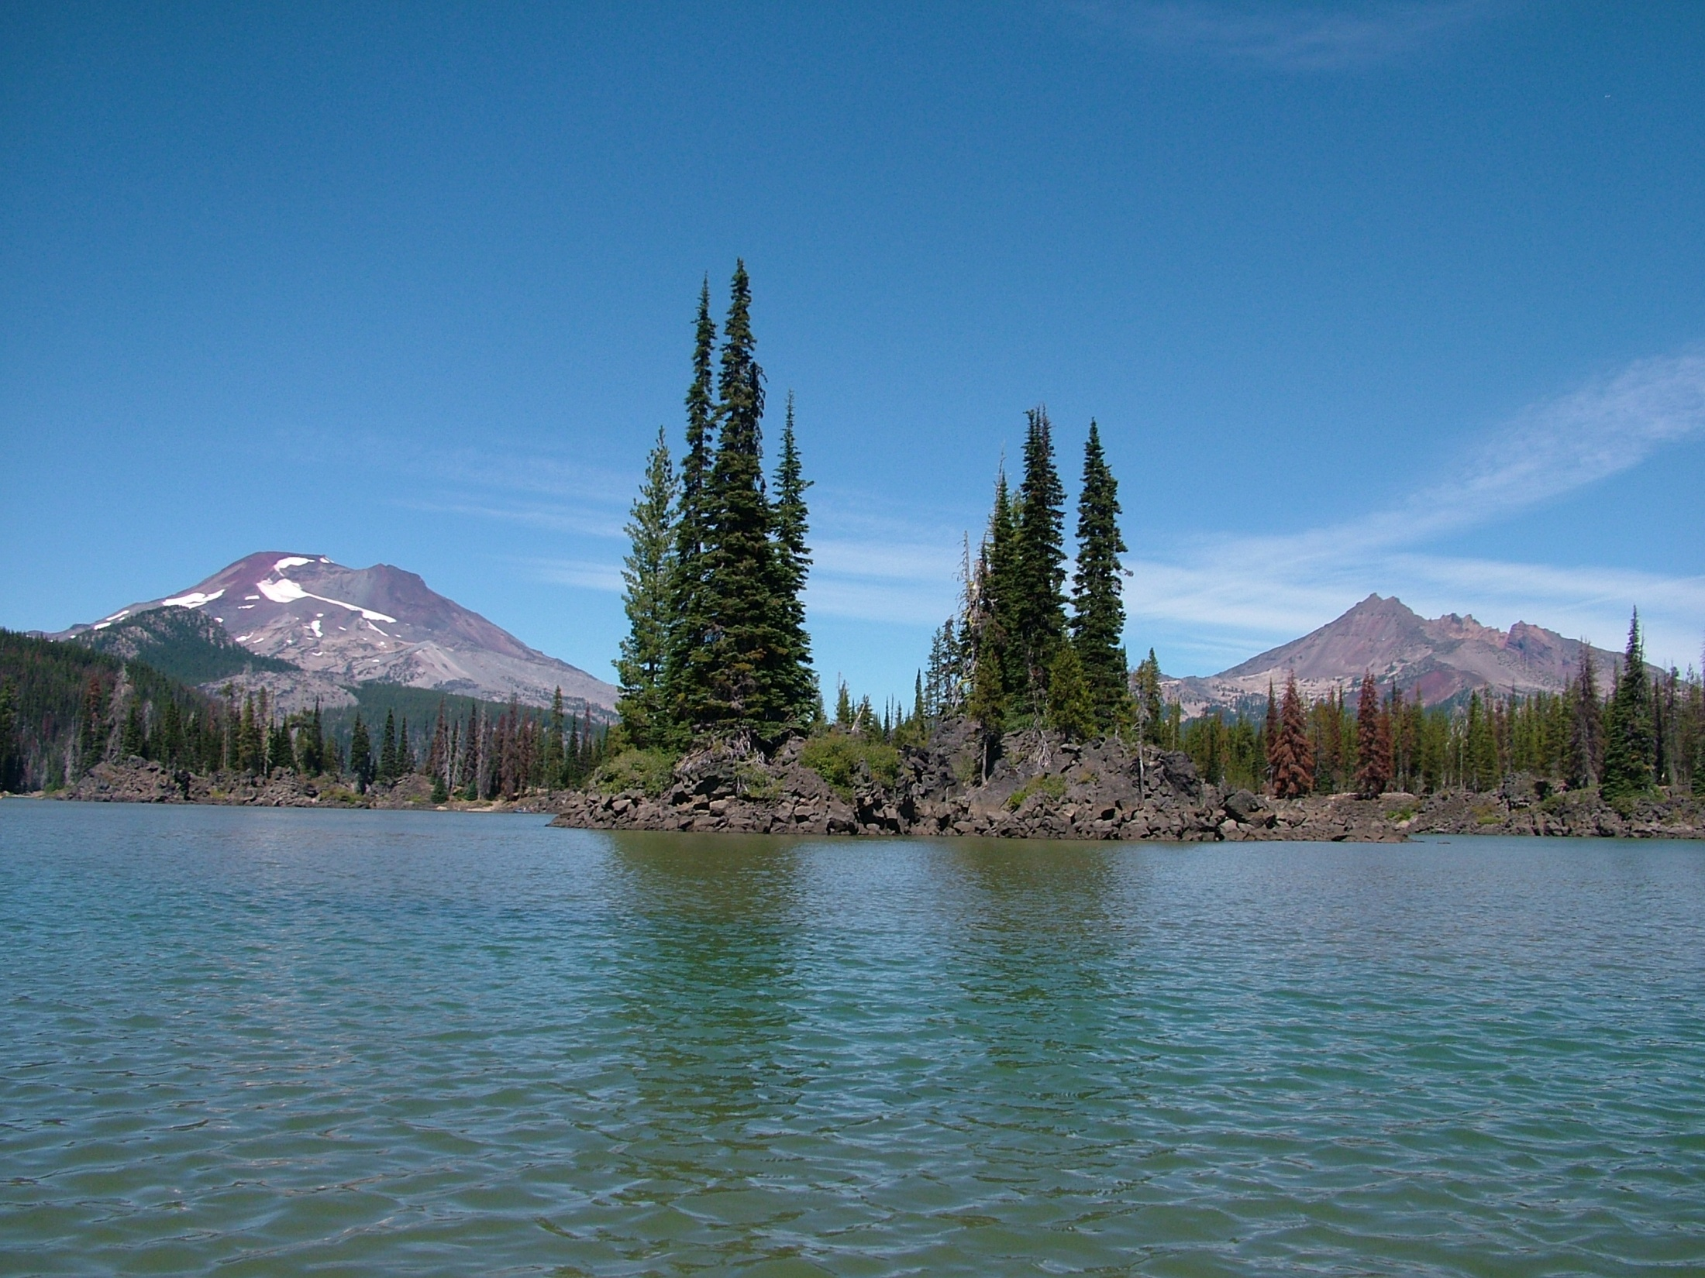
State Torts for Harm Abroad:
Forum non conveniens

Slide 14
Aguinda v. Texaco
Class action (1993) (NY)
18 mln gallons of oil contamination without treatment (banned in the US)
Company ignored Ecuador’s law
Remediation contract (1994-95)
Government and Petroecuador released Texaco from all claims
Dismissed in U.S. on FNC ground (2002)

Slide 15
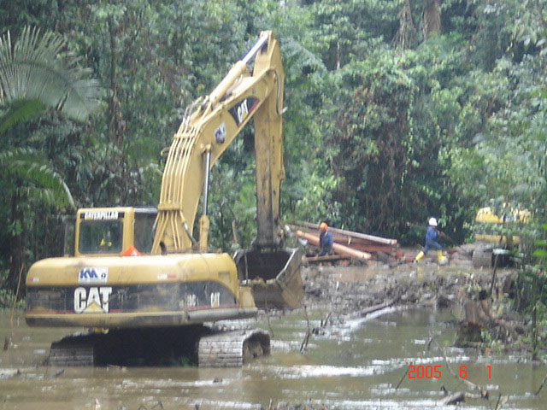
Oil, Ecology, and Culture

Slide 16
Aguinda v. Texaco (2004-2009)
In a local court of Ecuador
Pablo Fajardo on behalf of community
With support of Kohn, Swift, and Graf of Philadelphia
Court-appointed expert – $ 27 billion in remediation costs
Court decision pending

Slide 17
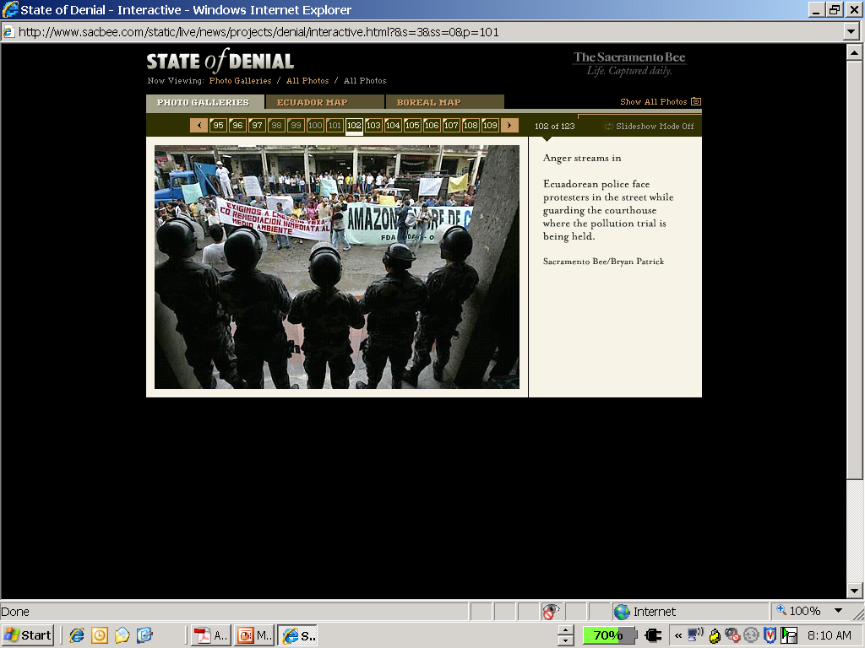
Oil, Ecology, and Culture

Slide 18
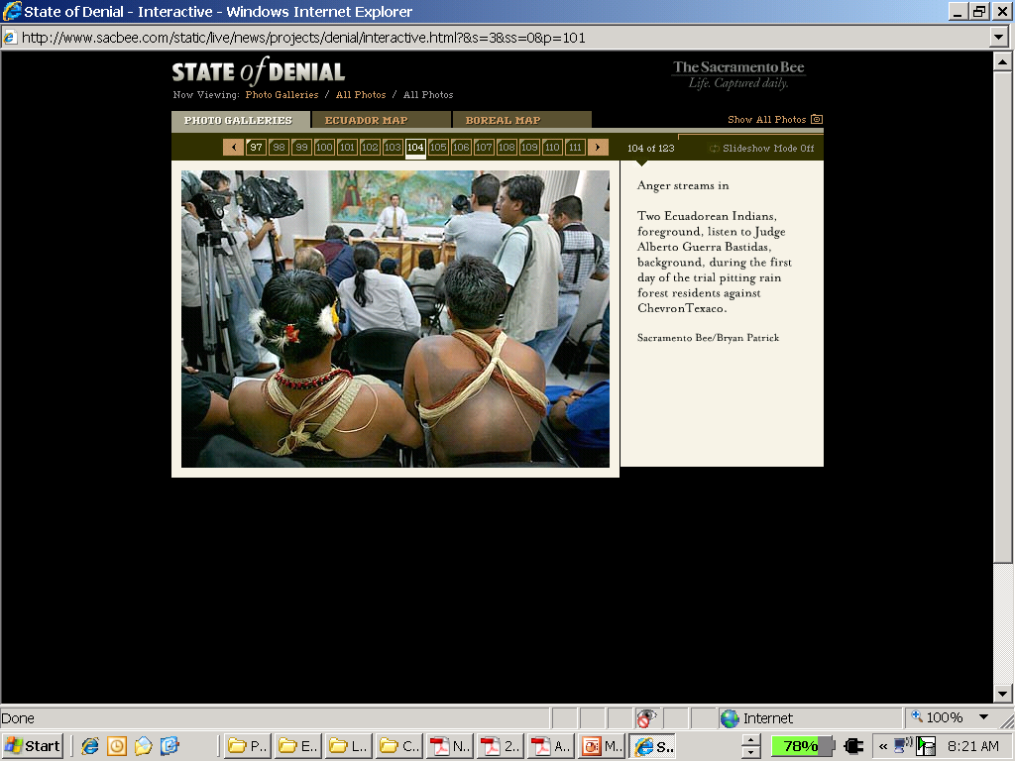
Oil, Ecology, and Culture

Slide 19
“Forum non conveniens-blocking” Statutes
Tellez v. Dole: case of banana workers affected by use of DBCP pesticides
Law No.364 of Nicaragua -- to facilitate the prosecution of lawsuits for damages filed by people whose health has been adversely affected by the use and application of the DBCP pesticide

Slide 20
Law No. 364
Defendants must pay US $100,000 deposit per plaintiff
Law 364 conclusively determined that DBCP caused sterility
The only question to be litigated is whether a plaintiff worked on a banana plantation and is sterile
The Supreme Court of Nicaragua upheld the Law as constitutional

Slide 21
Tellez v. Dole in trial court
Half million dollars awarded for each plaintiff
But Dow/Dole investigated for fraud
By plaintiffs’ lawyer
Verdict thrown out

Slide 22
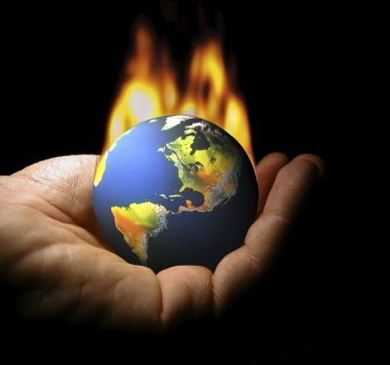
Corporate Accountability for Climate Change

Slide 23
Connecticut v. Am. Elec. Power
US Court of Appeals for 2nd Circuit Decision of Sept. 21 2009
“Public nuisance” case
Case not precluded by political question doctrine
Case will go forward to trial now

Slide 24
Kivalina v. ExxonMobil
Village will have to be relocated, as a result of climate change, at a cost estimated up to $400 million
District court dismissed case
Claims not justiciable under the political question doctrine
On appeal to U.S. Court of Appeals for 9th Circuit

Slide 25
In US courts:
Comer v. Murphy Oil USA
Fifth Circuit, reversing the district court, the panel unanimously found:
  property owners had standing
  case not precluded by political question doctrine in alleging nuisance, trespass and negligence claims
  against oil companies for climate change leading to sea level rise and property damages
  however, conspiracy claim not allowed

Slide 26
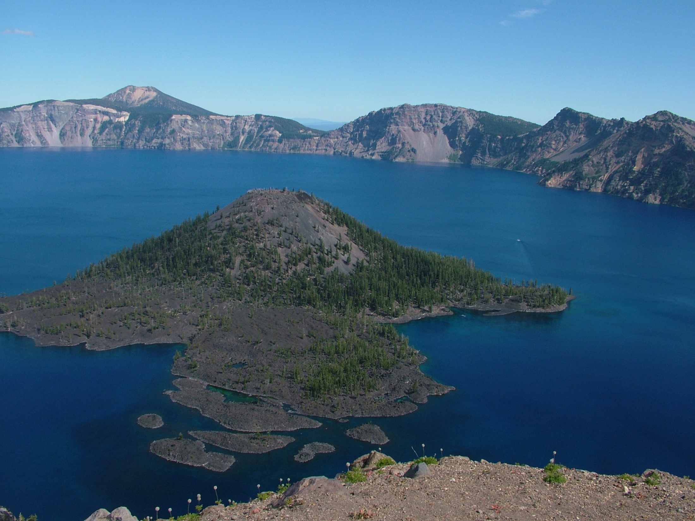
Conclusions
Corporations will be held accountable in various ways for human rights abuses including environmental rights and degradation of the environment

Slide 27
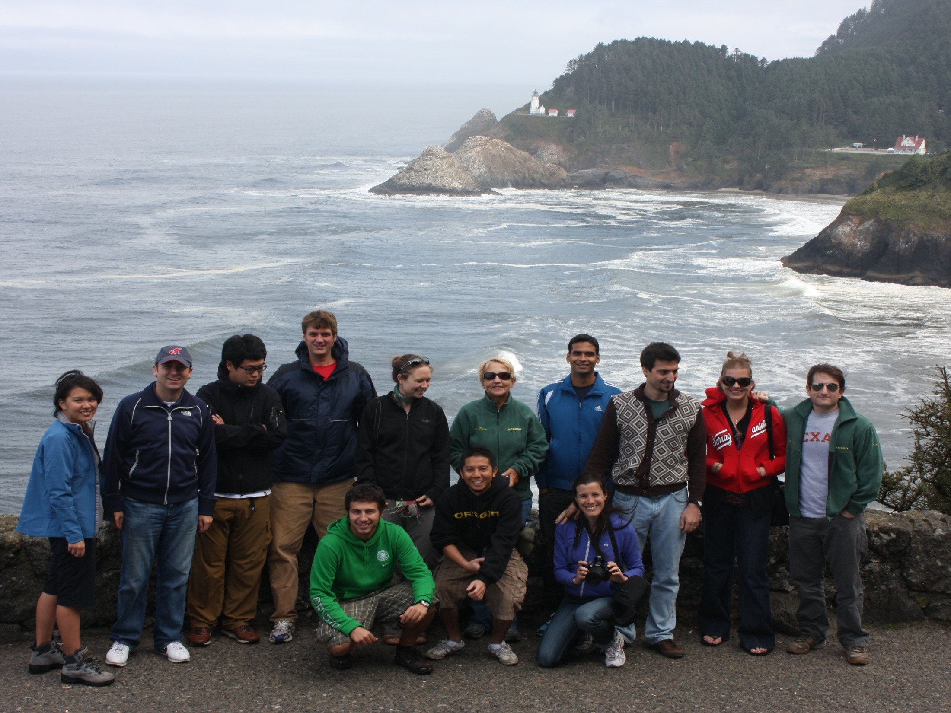
The Oregon LL.M.
In Environmental and Natural Resources Law
http://llm.uoregon.edu

