Slide 1

Should
Environmental Rights
Be Enforceable in Courts? (No?)
LL.M. Program
Prof. John E. Bonine
University of Oregon, U.S.A.

Slide 2
Biography
6 years in national government EPA
  In charge of air pollution law for the USA
Since 1978: 32 years as environmental law professor
1978: Co-founded first law school Environmental Law Clinic in the world
1989: Founder of Environmental Law Alliance Worldwide (ELAW), www.elaw.org
1991: Founded ENVLAWPROFESSORS list

Slide 3
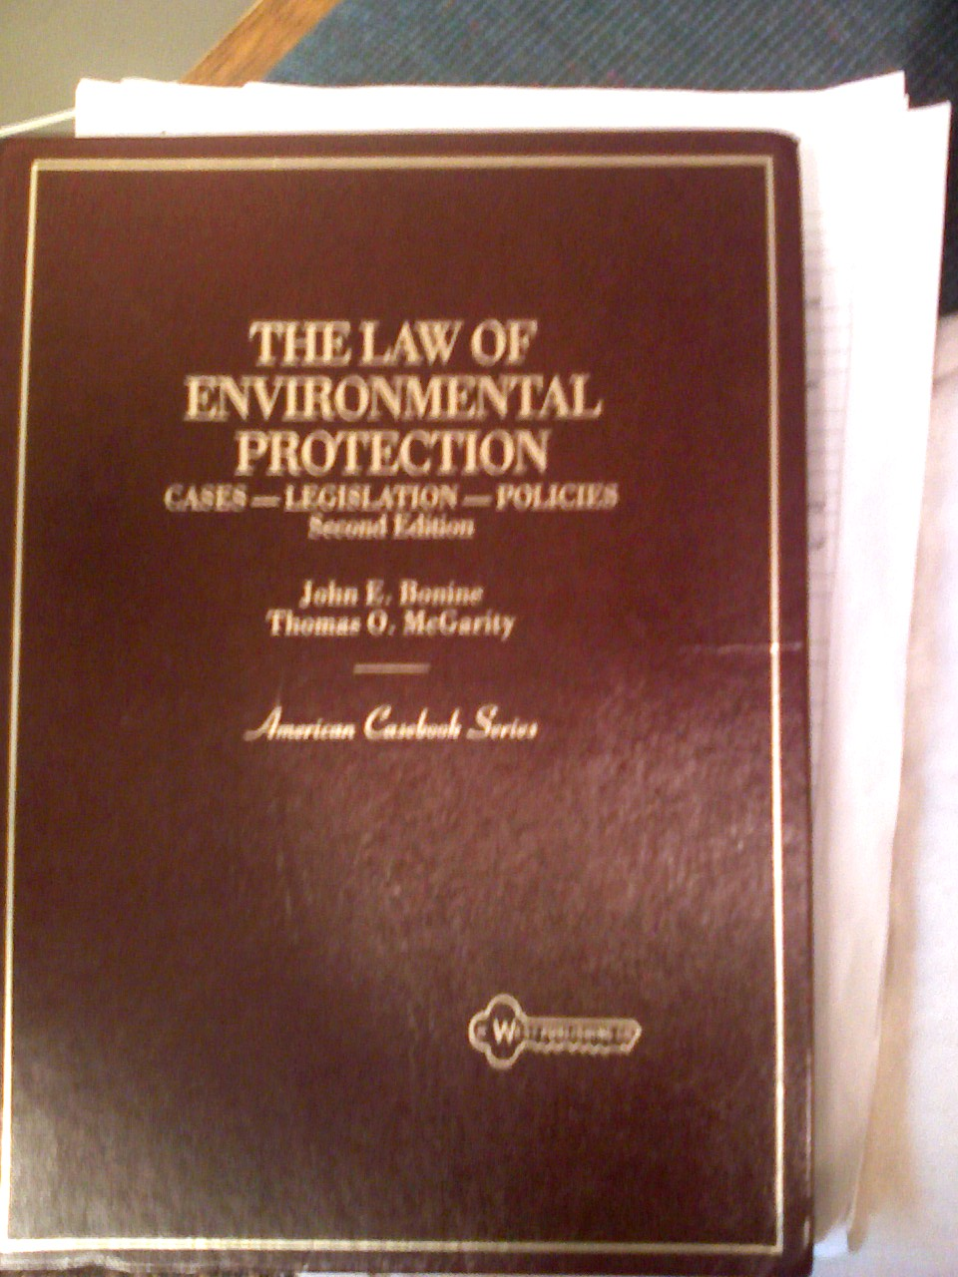
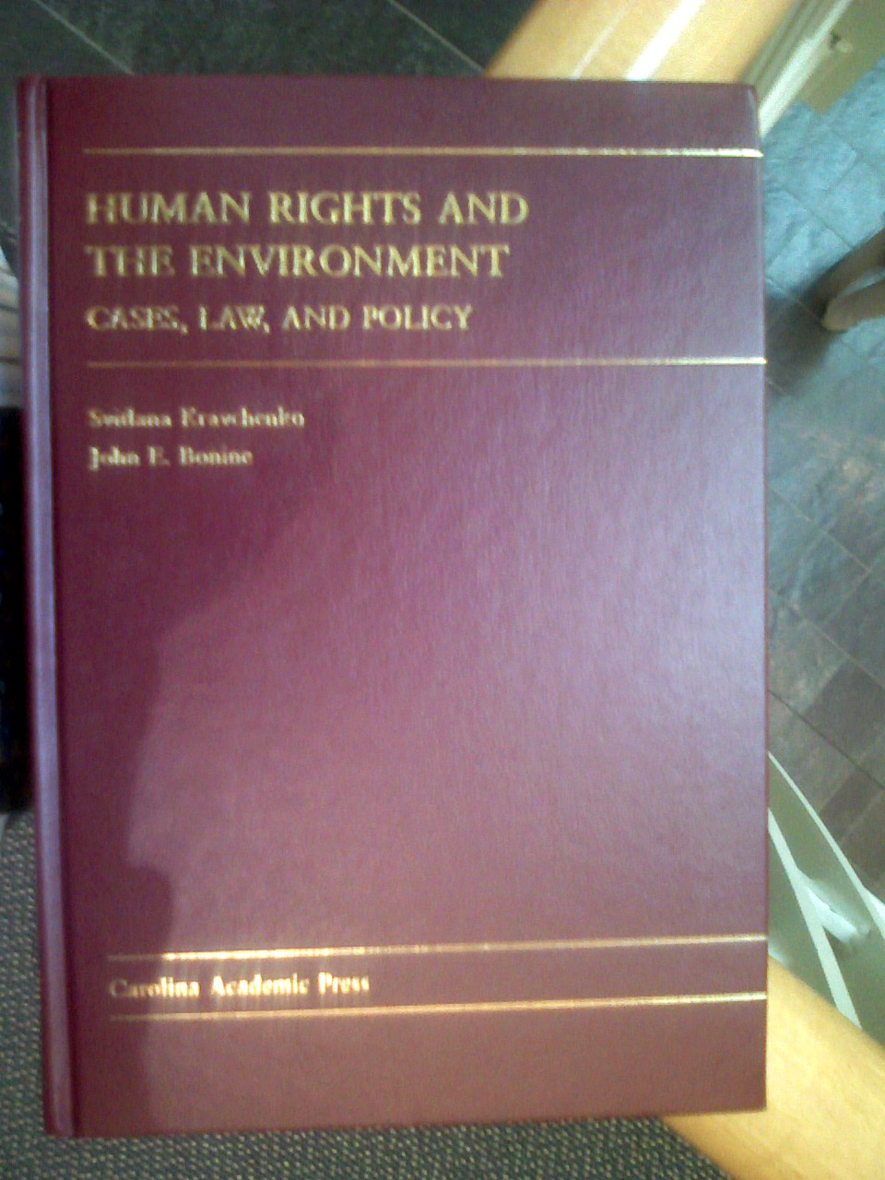
Evolution of Thinking
Laws & Cases Rights and Cases
(1984, 1992) (2008)

Slide 4
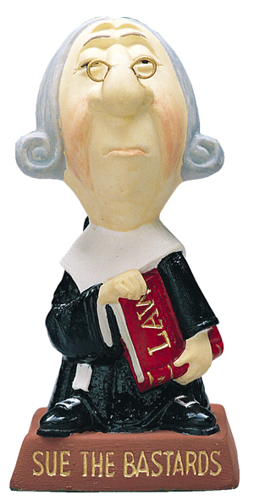

Slide 5
Environmental Rights or Environmental Policy?
More than 100 constitutions have recognized an “environmental right” –for decades!
  So what? Does that make a difference in reality?
  In only a few do individuals use the courts to vindicate that right.
If a supposed “right” is used only to affect government policy, it is not a right - a “policy.”
  Or a “policy right” or “political right”
A true “legal right” exists only if the person holding the right can get an order from a court of law against a person or body who is violating the right.

Slide 6

Possible defendants & causes of action (“claims” in court)?
Actions against public authorities (governmental bodies)
  Administrative law: “Judicial review” of action
    Suit for denial of procedural rights
    Suit for denial of substantive rights

Slide 7
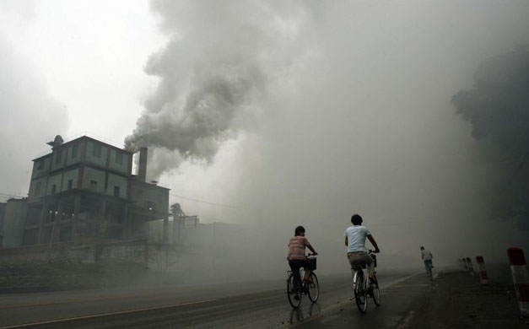
Possible defendants & causes of action (“claims” in court)?
Actions against private parties (e.g., polluters, developers)
  Civil or criminal law
    Civil cases for compensation
    Civil cases for injunctions
    Civil or criminal cases for punishment

Slide 8
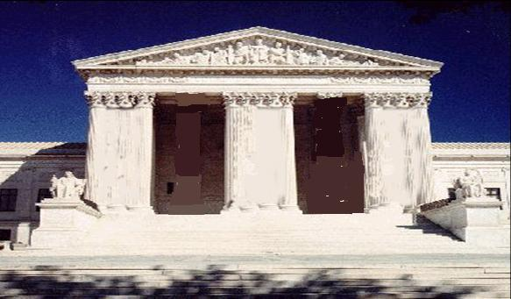
Possible “rights” & results
Procedural rights (three pillars) (against public authorities)
  Right to receive information
  Right to participation
  Right to seek justice

Slide 9
Procedural right of access to justice
Lago Chungara Case (Chile)
  “any citizen” of Chile can sue (constitution)
Oposa v. Factoran (Philippines)
  children can sue for future generations (constitution)

Slide 10
Substantive rights (environment, water)
What court action can a citizen get from a substantive environmental right?
  Against public authority
    Order blocking (overturning) government action?
    Order forcing positive government action?
  Against private enterprise
    Order to reduce pollution to a certain level?
    Order granting compensation?
    Order blocking a proposed project?

Slide 11
Arguments Against Substantive Rights - 1
Citizen enforcement of “environmental rights” is anti-democratic.
  Invites undemocratic courts to define rights, rather than democratic legislatures.
    Same problem with allowing common law tort lawsuits, instead of governmental regulation.
    Same problem with citizen enforcement of
(Response?)

Slide 12
Arguments Against Substantive Rights - 2
Special-interest groups set the priorities for enforcement.
  May spend court time on unimportant issues.
  Results in under-enforcement in important areas.
(Response?)

Slide 13
Arguments Against Substantive Rights - 3
Substantive rights promote weak, sloppy thinking – no intellectual rigor
  They encourage untrained lawyers to take cases that should be brought only after education or experience
  Typical example: Oregon lawyer against timber cutting
(Response?)

Slide 14
Arguments Against Substantive Rights - 4
Procedural rights have a better chance of winning in courts
  Judges do not want to make social policy
  Judges are more willing to enforce procedures because it seems “neutral”
(Response?)

Slide 15
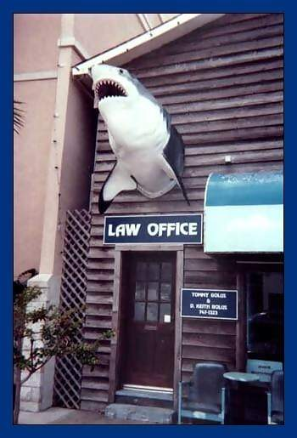
Arguments Against Substantive Rights - 5
Public interest lawyers?

Slide 16







Business environmental lawyers in USA:
  20-30,000
Government environmental lawyers in USA:
  ~2,000
Citizens’ environmental lawyers in USA:
  ~750

Slide 17
Substantive “rights” cases
Montana
Korea Constitutional Court

Slide 18
Substantive stat
Montana
Korea Constitutional Court

Slide 19
International human rights theories
Council of Europe Recommendation (1993)
  Member states should extend “legal aid or any other form of assistance to all judicial [cases] . . . .” Recommendation No. R (93).
Recent Inter-American Commission study

Slide 20
European Court of Human Rights
Judicially ordered legal aid for NGO lawsuits
  Steel & Morris decision, European Court of Human Rights (Article 6, European Convention)
  “Equality of Arms” principle

Slide 21

Who deserves a lawyer?
Notes:
Public interest environmental litigation in the United States did not start in Washington, D.C., or New York City.
It did not start because some lawyers in suits wanted to be involved in shaping policy for the nation.
It started with a passion to save a fish, a yearning for the continued peace of a remote valley, and a love for the springtime songs of birds.

Slide 22
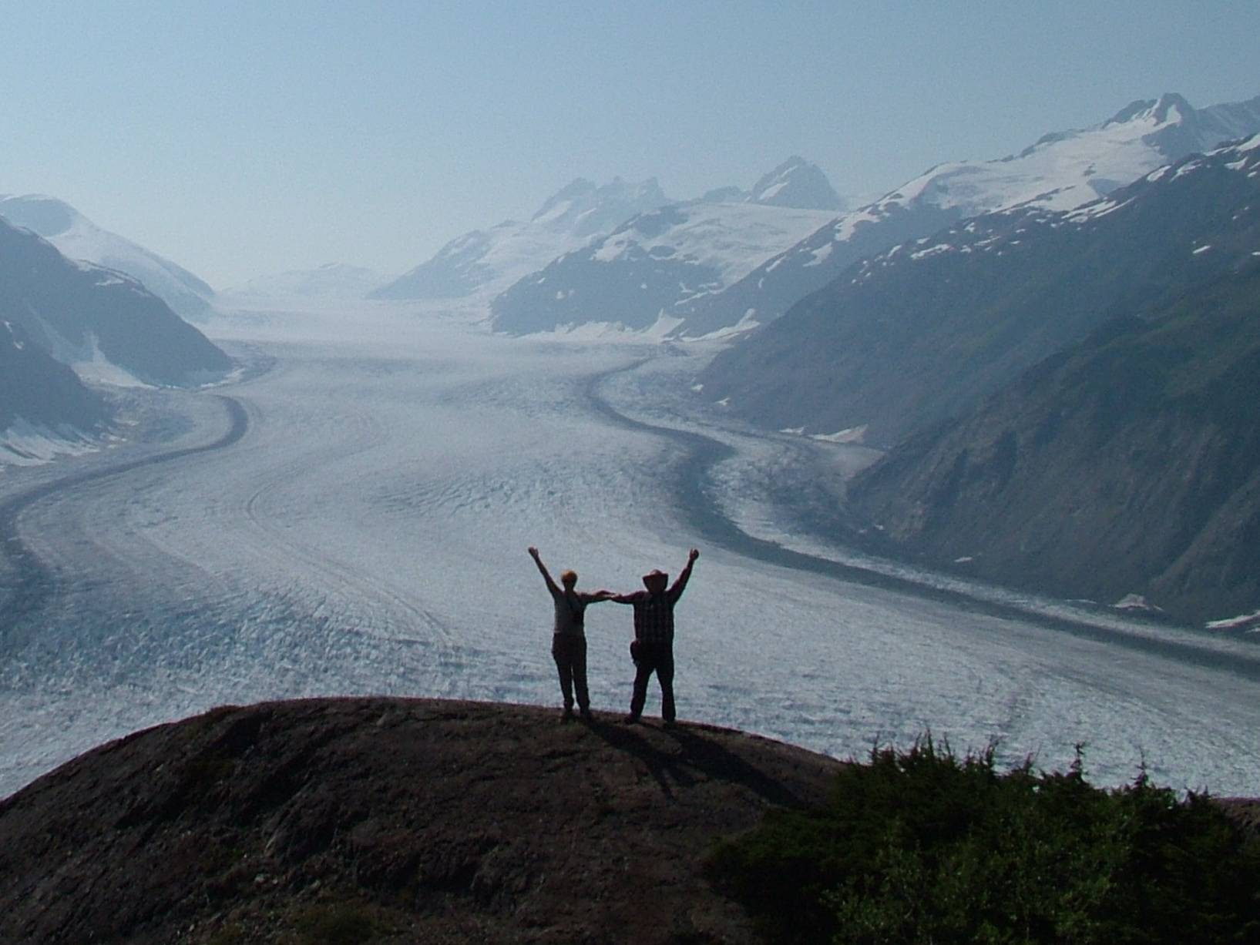
How long?
Notes:
Perhaps this is behind Thoreau's dictum: In wildness is the salvation of the world.

Slide 23
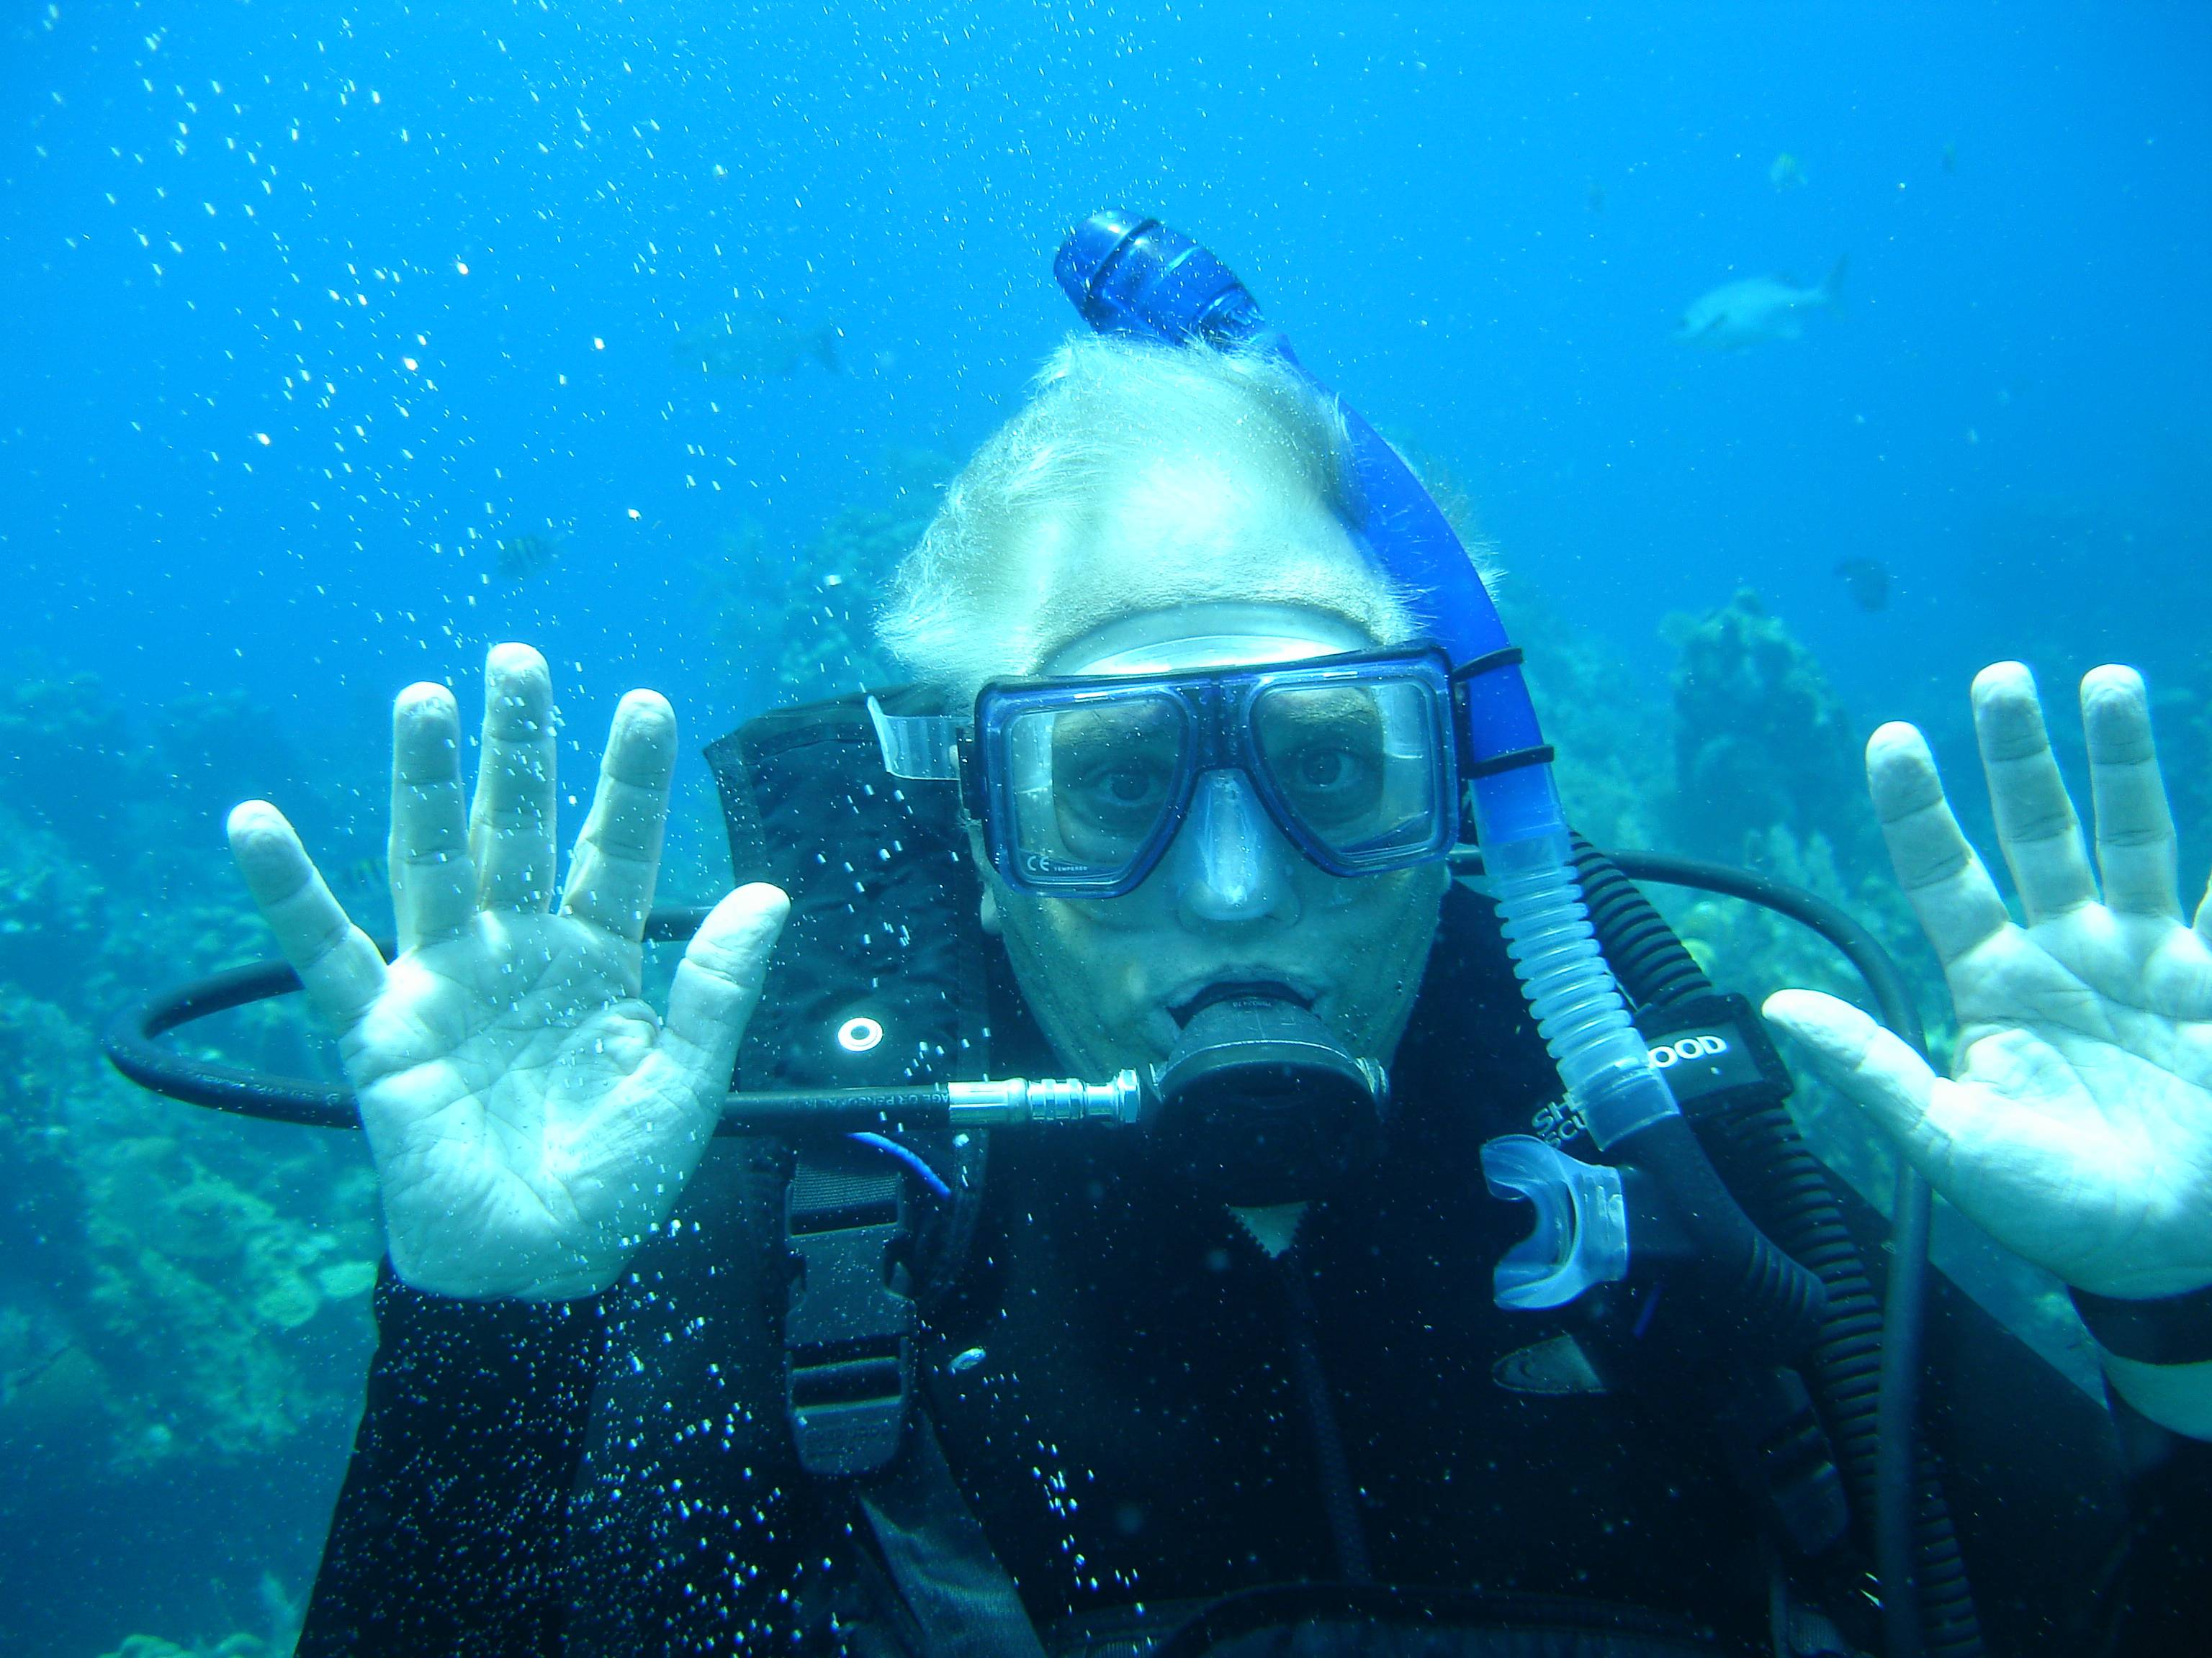
Future Academy Colloquia?

Slide 24


Slide 25


