Slide 1
Public Participation on The Protection of CORAL REEF in
Kepulauan Seribu Indonesia
Yanti Fristikawati
Faculty of Law Atma Jaya Catholic University

Slide 2
Kepulauan Seribu (Thousand Island)
50 km off the north coast west Java
105 islands (76 coral islands) :
- 11 residential island
- 48 islands for tourism
237 coral species
Year 1982 declared as National Marine Park

Slide 3
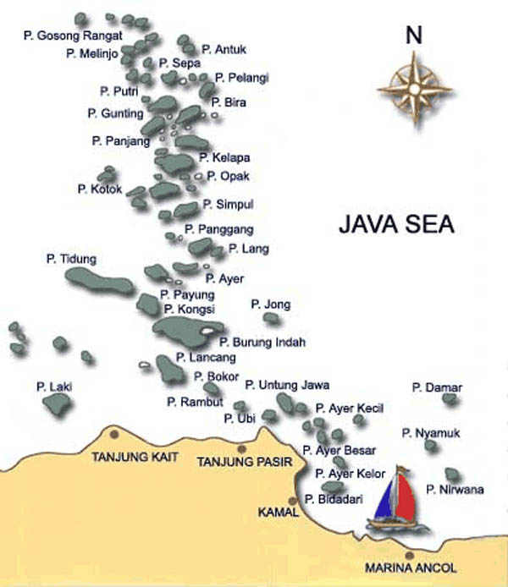

Slide 4
Coral Reef Damage in
Kepulauan Seribu
deposition of rubbish and sedimentation on the reefs, (Domestic waste)
physical destruction of reefs by fish bombing, cyanide fishing, coral mining, and dredging, and
decreasing water quality through industrial pollution and nutrient enrichment

Slide 5
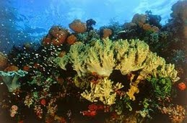
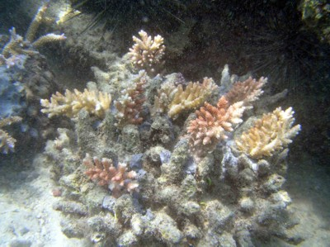

Slide 6
Law Number 23 Year 1997
Article 6
Every person is obliged to preserve the continuity of environmental functions and protect and combat environmental pollution and damage
Article 7
1. The community has the same and the broadest possible opportunity to play a role in environmental management.

Slide 7
increasing independence, community empowerment, and partnership
giving growth to community capability and initiative;
increasing community responsiveness in carrying out social supervision;
providing suggestions;
conveying information and/or conveying reports.

Slide 8
Law Number 5 Year 1990 on Conservation of The Natural Resources and Its Ecosystem
Article 4 : Conservation of the living natural resources and its ecosystem is responsibility and obligation of the Government and the community
(1) People participation in conservation of the living natural resources and its ecosystem is directed and motivated by the Government through various effective and efficient activities.
(2) In developing the people participation as contemplated in paragraph (1), the Government grows and improve awareness in conservation of the living natural resources and its ecosystem among the people through education and counselling

Slide 9
Environmental Protection
- Divided into four Zone
Core zone only for research
Protection zone research and tourism
Buffer zone for Tourism
Profitable zone for exploitation of natural resources and traditional fishing
- Public Participation
- Regulation

Slide 10
Public Participation in
Kepulauan Seribu
Coral Reef transplantation
Artificial Coral Reef
Change the fisherman tools
Seek other income ( such as artificial coral)
(Government,UNDP, UNESCO, Ngo’s, Bussines man)

Slide 11
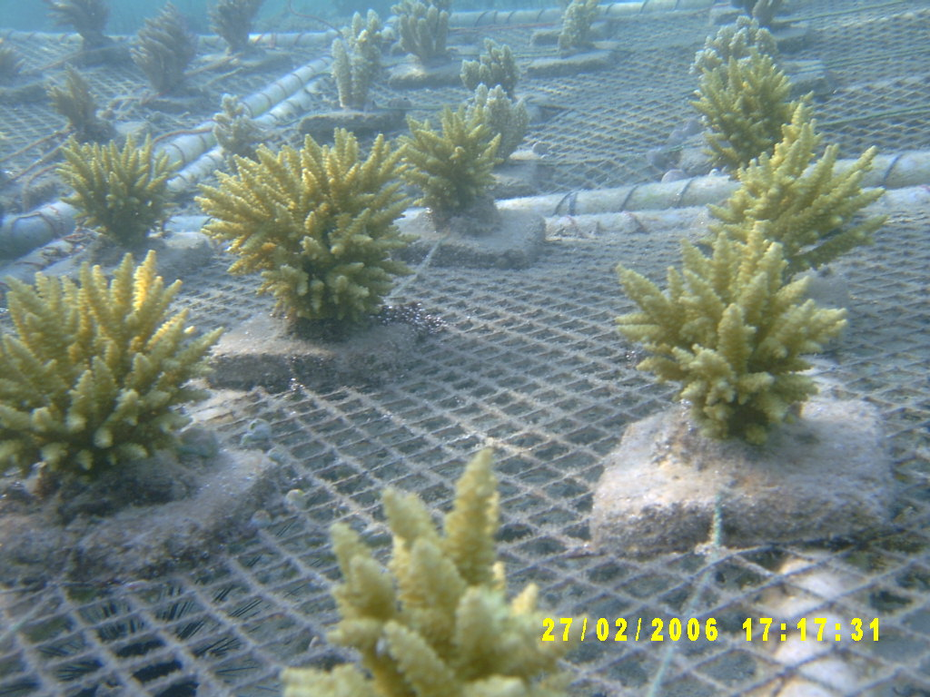

Slide 12
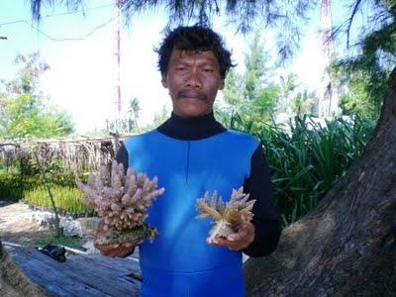

Slide 13
Conclusion
There are some way to protect the environment such as : regulations (Law no 23/1997 and law No 5/1990)
and public participation (Including the awareness of local peoples)
Government and local people can be hand in hand to Protect marine environment in Kepulauan Seribu
Public participation in Kepulauan Seribu : Coral Reef transplantation, artificial coral, change the unenvironmental fishing .

Slide 14
Thank You
TERIMA KASIH

