Slide 1
Opportunities and Challenges in the Reform of China’s Protected Areas Law: Lessons from Yunnan’s new National Parks
Feja Lesniewska
School of Oriental and African Studies
University of London
4 November 2009
7th Annual Colloquium of the IUCN Academy of Environmental Law, Wuhan, China

Slide 2
Selected National Laws and Policies
1956 Dinghu Shan Nature Reserve, Guangdong Province
1979 Notice of Strengthening, Planning and Scientific Investigation in Nature Reserves
1981 Forest Law – protected areas recognised as legal entities
1985 Management Approaches of Nature Reserves for Forest and Wildlife Law
1987 Principles on China’s Ecological Conservation
1988 Law of Wild Animal Protection
1994 China’s Agenda 21
1994 China Biodiversity Action Plan
1994 Rules for Conservation Management of Geological Relics
1994 Regulations for Nature Reserves
1998 Forest Law revised
1999 Sloping Land Conversion Programme and Natural Forest Protection Programme

Slide 3
Selected International Laws
(including soft)
Ramsar Wetlands Convention 1971
World Heritage Convention 1972
CITES 1973
Convention on Biological Diversity 1992
UN Framework Convention on Climate Change 1992
UN Convention on Desertification 1992
UN Agenda 21 1992
Stockholm/Rio Principles 1992
Forest Principles 1992/UNFF NLBI 2007

Slide 4

Notes:
If only it were so simple – a matter of ethics!

Slide 5
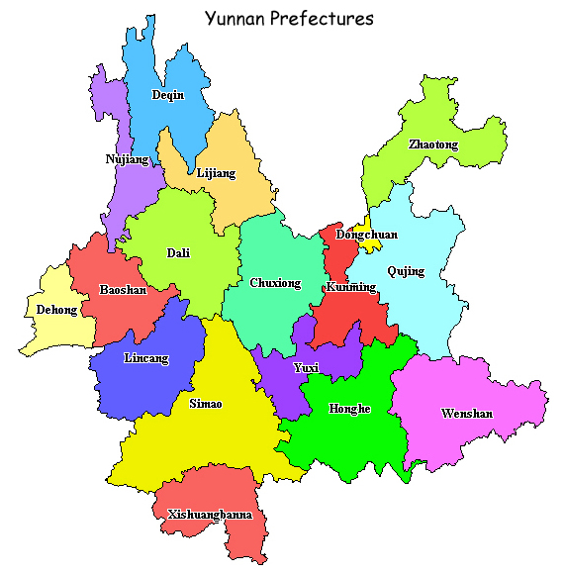
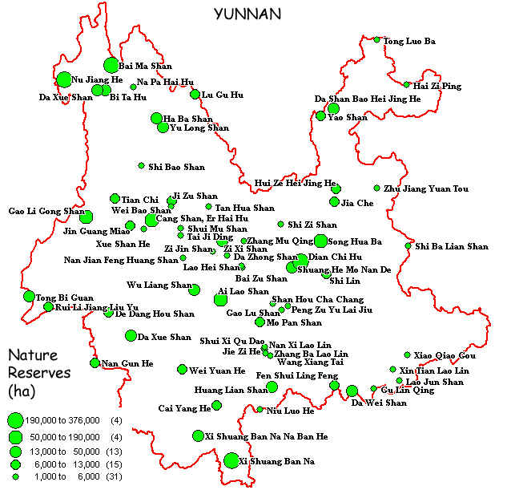
Yunnan prefectures and Nature Reserves

Slide 6

The Golden Promise – win-win-win?
‘National Parks will be the most attractive paradise for a scientific & cultural experiment in Yunnan where [we will] have a multi-win of ecological protection, society improvement and economic development’
Mr He, TNC Zhongdian Policy and Regulation Advisor, 24 July 2008

Slide 7


Meli – a view of the future

Slide 8



Slide 9


Slide 10
National Park Masterplan
Need to:
Protect the biome and habitats
Develop the community economy
Planning the functional zones
Strengthen the capacity of the national park
Strengthen policy, law and regulation

Slide 11
The benefits of Pudacao National Park
Increased conservation area
Introduction of skilled management techniques
Environmental education for local communities
Economic benefits to local communities – ecotourism, park related jobs

Slide 12
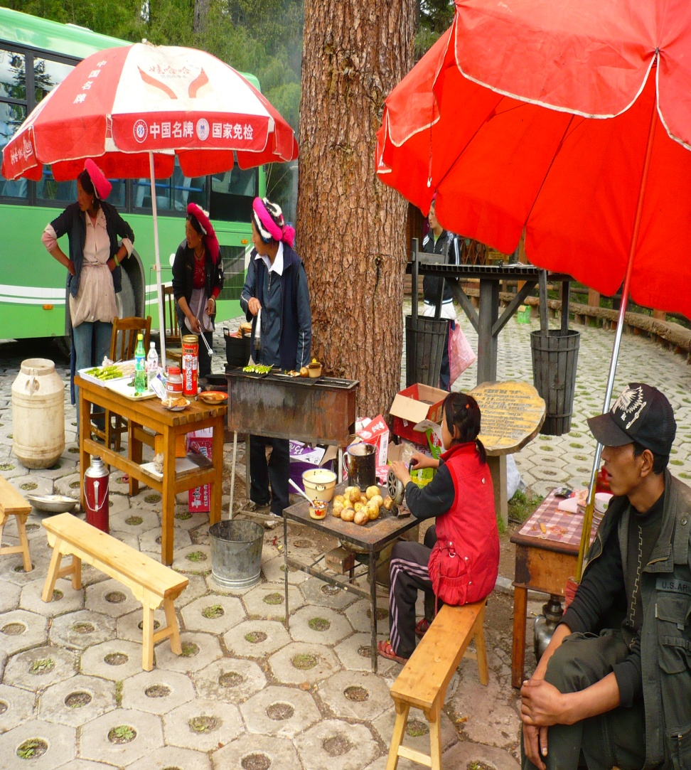
Economic benefits to local communities?
“What…distinguishes this park [from a typical Chinese nature reserve] is that the local communities are already benefiting from it because they are preferentially employed for jobs within the park.

Slide 13

Conclusions
Limited community participation
Poor transparency in reform process
Continued legal void on National Parks management
International actors leverage more power than local communities

Slide 14

Thank You for Your Attention
Thank you for your attention

