Slide 1
Sustainability and Regulatory Regimes for Biofuels in Southern Africa
Presented by:
Geoff Stiles
Technical Advisor/Biofuels & Bioenergy
SADC Secretariat
Presented to:
BIOFUELS: LEGAL AND POLICY DIMENSIONS IUCN Academy of Environmental Law and
The Law Foundation of Ontario
18 June 2010

Slide 2
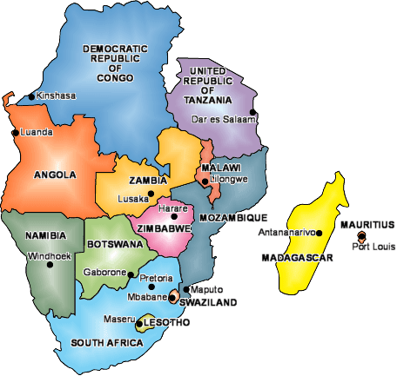
The Southern African Development Community (SADC)
15 countries (including Seychelles)
Founded in 1980
Restructured in 1992 and again in 2001.
Secretariat in Botswana
Council of Ministers meets annually
Annual sectoral meetings as well.
Strong emphasis on trade and infrastructure development.

Slide 3
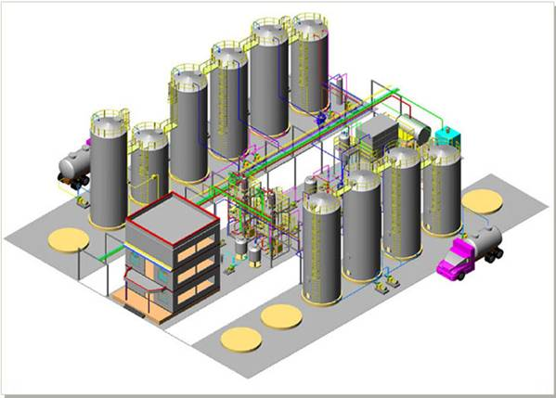
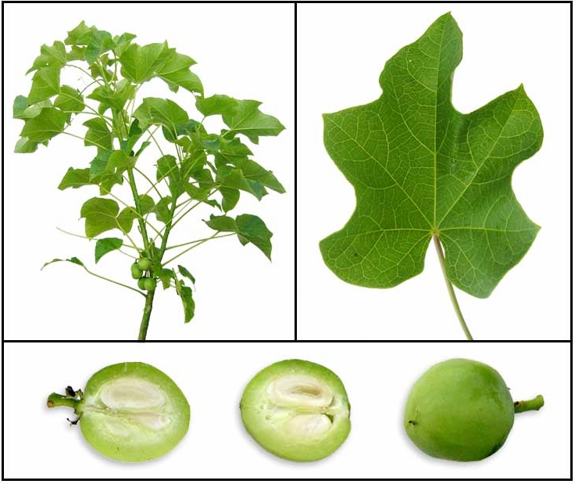
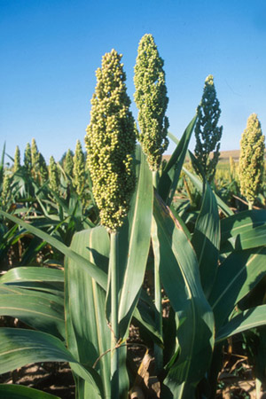
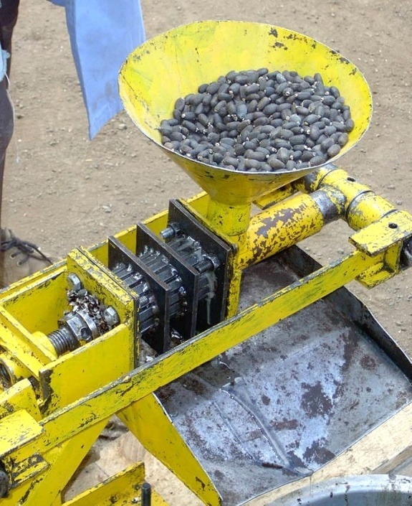
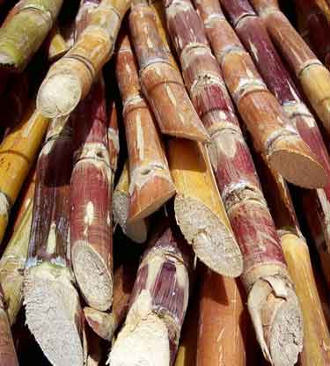
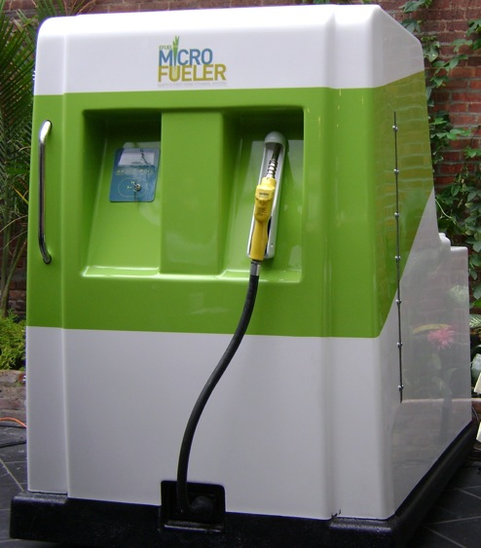

Slide 4
Overview: Policy and Regulation
Most SADC member states are committed to developing biofuel strategies addressing
  Sustainability issues
  Rural economic development
  Energy access
A few, e.g. South Africa, Mozambique and Tanzania, are also considering how to attract investment, balancing need for FDI against potential adverse impacts.
No SADC member states are considering major environmental and social impact criteria, in contrast to the EU.

Slide 5
State of Play: Production
Bioethanol is by far the major biofuel in the region with sugarcane molasses the main source.
  Malawi (18m litres/a) and more recently Zimbabwe (15 m litres/a, down from 40 m in 1980s) are producing ethanol already.
  Tanzania, Zambia and Mozambique (with existing sugar plantations) are exploring the use of molasses for bioethanol. (Mozambique could produce enough ethanol from existing molasses by-product to achieve a 21%blend!)
  In 2007 Swaziland introduced a pilot bioethanol programme that is expected to scale up in 2010. (Imported flexi-fuel pilot car 2009).
Biodiesel is being produced only on a very small scale:
  Mozambique 1 million litres from coco oil in 2008 but has since focused on use of coconuts for food.
  South Africa has a small programme for producing from waste cooking oil, and in Zambia a mining company is producing small amounts from jatropha for fleet use.

Slide 6
State of Play: Sustainability Issues
The issues surrounding the ‘food for fuel’ and sustainability are being debated within each Member State, with little inter-state dialogue.
  Some States, notably Tanzania and Mozambique, have developed detailed criteria to avoid direct conflict with food production through spatial planning initiatives.
  South Africa has banned the use of crops which are deemed unsustainable or “alien”, e.g. maize and jatropha.
  Botswana is currently developing its own investment guidelines which includes sustainability criteria and required environmental studies.
  SADC has adopted a regional framework for sustainability, Member States are expected to use the regional scheme as a basis for national level schemes.
  Most States have indicated they will be developing sustainability criteria to guide future biofuel investments but the results so far are variable.

Slide 7
State of Play: Land Suitability
Land suitability assessments, specifically for biofuel investments, are missing in most Member States.
  Only Mozambique has undertaken a structured assessment for identifying suitable land based on locally important criteria such as water, settlements, transportation and soils.
All investors visiting Member States need to know where suitable land exists that has been assessed and sanctioned by the state.
Most Member States have done land zoning for food crops so have been using those as guides for biofuel.
  A preliminary land zoning for biofuels has been completed for Tanzania, based on a similar exercise in Kenya.

Slide 8
State of Play: Strategies and Standards
Only two Member States, South Africa and Mozambique, have developed national biofuels strategies.
  Others are in advanced stages: Swaziland, Zambia, Malawi and Tanzania.
  Both existing strategies target large-scale production models but include rural empowerment as key conditions for investment.
Several Member States are developing biofuel technical quality standards, generally based on international standards.
  South Africa has already published standards for bioethanol and biodiesel.
  Malawi and Zambia are also in the process of publishing standards.

Slide 9
State of Play: Financial Incentives
There is slow development of financial incentives to attract foreign and national investment.
  South Africa, Tanzania and Zambia have prepared a range of incentives to stimulate investment, including rebates on fuel levies and tax incentives.
  Malawi is also reviewing this but initial indications show that biofuels are being lumped together with fossil fuels for tax/levy treatment.
  Botswana is considering a full exemption from levies for biofuels producers.
  Generally speaking, direct grants or subsidies are not a popular option, most governments preferring the taxation route.

Slide 10
Summary of Findings
Most SADC countries are developing policies to deal with biofuels, typically focusing on the following issues:
  Technical fuel standards
  Blending ratios
  Pricing
  Land suitability assessment
  Sustainability issues
  Role of traditional land tenure
The most active countries in this regard have been Mozambique, South Africa, Tanzania, Angola and Botswana.

Slide 11
Table 1: Country Crop Selection
Crops | Malawi | Zambia | Tanzania | Mozambique | Botswana | Swaziland | Zimbabwe | South Africa | Angola | DR Congo
Sugarcane | YES | YES | YES | YES | NO | YES | YES | YES | YES | YES
Sweet sorghum | YES | YES | YES | YES | YES | YES | YES | YES | NO
Cassava | NO | NO | NO | NO? | NO | NO | NO | NO | NO
Jatropha | YES | YES | YES | YES | YES | YES | YES | NO | ? | ?
Sunflower | NO | YES | NO? | NO? | YES | NO | NO | YES | YES
Soy | NO | YES | NO? | NO? | YES | NO | YES | YES | YES
Castor | NO | YES | YES | NO | NO | NO | NO |  | NO
Palm oil | NO | YES | YES | NO | NO | NO | YES |  | YES | YES
Coconut | NO | NO | NO | YES | NO | NO | NO | NO | NO | NO
Ground nut | NO | NO | NO | NO | NO? | NO | YES | NO? | NO | NO
Cotton | NO | YES | NO | NO | NO | NO | YES | NO | NO | NO

Slide 12
State of Play Major Recommendations
Roll Out SADC Sustainability Framework for Biofuels
Increased Biofuel Research and Development
Increase Yields and Optimising Agricultural Production
Pro-farmer Approach
Biofuel Standards and Certification
Explore Carbon Market entry points
Develop Investment Guidelines
Agro-ecological Land Zoning
Establish National Biofuel Task Forces
Communication Strategies needed.

Slide 13
Case Study: Mozambique
Finalised Biofuels Policy and Strategy in 2009
Given huge potential for biofuels the strategy includes national blending (B2-5, E5-10) and export of excess.
Lots of investment interest (biofuel land requests) resulted in a stalled land allocation process in favour of results from a land-zoning exercise. Results too low level of detail, exercise is now in 2nd phase (1:250 000), funded by donors and expected to be finished in 5 years.
4 projects approved by the council of ministers (>10 000ha). One closed (ProCANA), others ongoing. 4-5 smaller projects ongoing (1000>10 000). Few community/NGO projects.

Slide 14
Mozambique, continued...
Feedstock: sugar cane + sweet sorghum / coconut + jatropha
Standards under development.
Largest involvement of international cooperation, but still low (mainly GTZ, Dutch, DFID, Solidaridad)
Institutionalised process to develop national sustainability criteria.

Slide 15
Case Study: South Africa
Finalised Biofuels Industrial Strategy in 2007
Focus on development in previously disadvantaged areas of the country, i.e. old “homelands”
Limited benefits to biofuel industry, “incentive is received at the pump”, encouraging blending but not producing.
Set a target of 2% penetration of biofuels in the national liquid fuel supply, or 400 million litres p/a, within 5 years.
    Deemed to be a level that “would not jeopardize food security.”

Slide 16
South Africa, continued....
Financial incentives:
  Increase biodiesel fuel levy exemption from 40% to 50%
  100% fuel tax exemption for bio-ethanol due to multiple uses.
Restrictions: No maize or jatropha.
Standards: SANS 465:2005 for bioethanol as fuel ethanol component. SANS 1935:2005 exists for biodiesel to be used as B5, and higher up to B100.
Only one major biodiesel project and one new ethanol project has been implemented since 2007.

Slide 17
Case Study: Botswana
Extremely arid country, annual rainfall 200-600mm.
  Agriculture mostly cattle-based, with substantial meat processing industry.
  Only a few areas suitable for large-scale agriculture.
Undertook detailed assessment study in 2007, identifying two pathways:
  Ethanol production from sweet sorgum in northwest (higher rainfall).
  Biodiesel production from animal fats, replaced by jatropha in long run.
  Recommended that both forms of biofuel will only be competitive if government reduces the current fuel levy by 50% for bio-ethanol and 75% for bio-diesel.
.

Slide 18
Botswana, continued....
Adopting South African technical standards for both fuels, as all petroleum is sourced from them.
National Development Plan for 2010 calls for:
  Implementation of a biodiesel project intended to produce 50 000 000 litres of biodiesel per annum by 2016.
  Development of about 70 000 ha of land for feedstock production.
Currently developing a medium-scale biodiesel processing plant with potential capacity of 20,000 litres/day or 4-5 million litres/annum.
  Able to handle both vegetable oils and unprocessed animal fat
Now reviewing jatropha option and will probably scale down the forecast crop production levels and plant size.

Slide 19
Challenges and Gaps for the SADC Region
Lack of uniform technical standards for biofuels.
Uneven application of sustainability issues in national strategies/policies (perhaps unavoidable).
Lack of targeted land suitability assessments in some member states.
Financial barriers to biofuels development, particularly at petroleum prices below $70/barrel.
Need to identify unique environmental issues around biofuels to include in EIA requirements.

Slide 20
Challenges and Gaps/2
Sustainability monitoring needs to be structured and incorporated in national regulations.
Dominance of large-scale over small-scale, community-based projects in some member states. Socio-economic benefits might not materialise.
Overwhelming number of jatropha developments in the region, often without adequate research to develop locally-adapted varieties and without careful land suitability assessments. Little regional coordination of research.

Slide 21
Thank you!
Geoff Stiles
SADC Energy Division
Gaborone, Botswana
+267 72 114 173
Geoff.stiles@gtz.de

Slide 22
SADC Biofuels
Sustainability Guidelines

Slide 23
Draft Guidelines: Guiding Principles
The guiding principle of the SADC framework is the development of a biofuel industry that throughout the value chain promotes:
  respect for, and inclusion of, SADC citizens in the biofuel production,
  the protection and sustainable management of biodiversity and natural resources, and
  a sustainable economic approach contributing to overall development and social well-being.
Concepts based on a combination of RSB and EU criteria, recognising need to contextualise for SADC

Slide 24
Specific Principles/1
Biofuel production shall follow national relevant law and policies and, where applicable, international law.
Biofuel production shall be guided by free prior and informed consent by relevant stakeholders.
Biofuel production shall contribute positively to rural development through:
  non-violation of human and labour rights, promotion of decent work and the well-being of workers
  social and economic development of indigenous, local and rural people and communities
  decentralized value-added processing and local participation in the entire value chain

Slide 25
Specific Principles/2
Biofuel production shall contribute positively to local and national food security.
Biofuel production shall respect formal and customary land rights and land use rights.
Biofuel production shall contribute positively to national energy security.
Biofuel production shall contribute positively to protect natural resources, ecosystems that provide essential services and biodiversity.
Biofuel production shall contribute positively to availability and quality of water and air.

Slide 26
Specific Principles/3
Biofuel production shall not lead to deforestation or forest degradation and where possible contribute to rehabilitation of degraded land.
Biofuel production shall contribute positively to climate change adaptation and mitigation.
Biofuel production shall contribute positively to reduction of greenhouse gas emissions.
Agro-ecological zoning should provide guidance on what feedstock to use and where to plant them.

