Slide 1
PUBLIC PARTICIPATION AND SOCIAL IMPACT MANAGEMENT IN PERU’S EXTRACTIVE SECTOR
Prof. Lila Barrera-Hernandez
University of Calgary, CA
Lila.kbh@gmail.com

Slide 2
BACKGROUND
In situ resources vested in State
Surface rights unclear
Private Investment Promotion Regime in place
Foreign investment encouraged
Shared authority
- Ministry of Energy and Mines
- Regional Governments
Renewed emphasis in the private investment model

Slide 3
THE PROBLEM
June 2007: 75 cases of social conflict
March 2008: 93 cases of social conflict
July 2008: 147 cases of social conflict
About 2/3 related to extractive activities
About 2/3 in areas where the majority of the population lives below the poverty line
“CONFLICT SITUATIONS” = threat to human life, integrity or health; damage to private or public property; impairment to free movement of people or things; impairment to the exercise of public authority; or, public services’ stoppage.
(SOURCE: Defensoría del Pueblo, Unidad de Conflictos Sociales, available at: www.defensoria.gob.pe).

Slide 4
THE SOLUTION
  Creation of OFICINA GENERAL DE GESTION SOCIAL/ General Social Management Bureau (OGGS)
Formulation of policies and plans that promote harmonious relations between companies, civil society, regional authorities, and other government bodies;
Assistance with regulatory development;
Promotion of conflict resolution, and agreements between parties;
Promotion and elaboration of social studies;
Assessment and advice in relation to EIAs;
Provision of general advise on social issues;
Participation in public hearings as required by the EIA process;
Training and capacity building; and,
Design and promotion of international cooperation .

Slide 5
OGGS ACCOMPLISHMENTS
Regulations
- Supreme Decree 012-2008-EM
- Ministerial Resolution 304-2008 MEM/DM
Best Practices (ongoing)

Slide 6
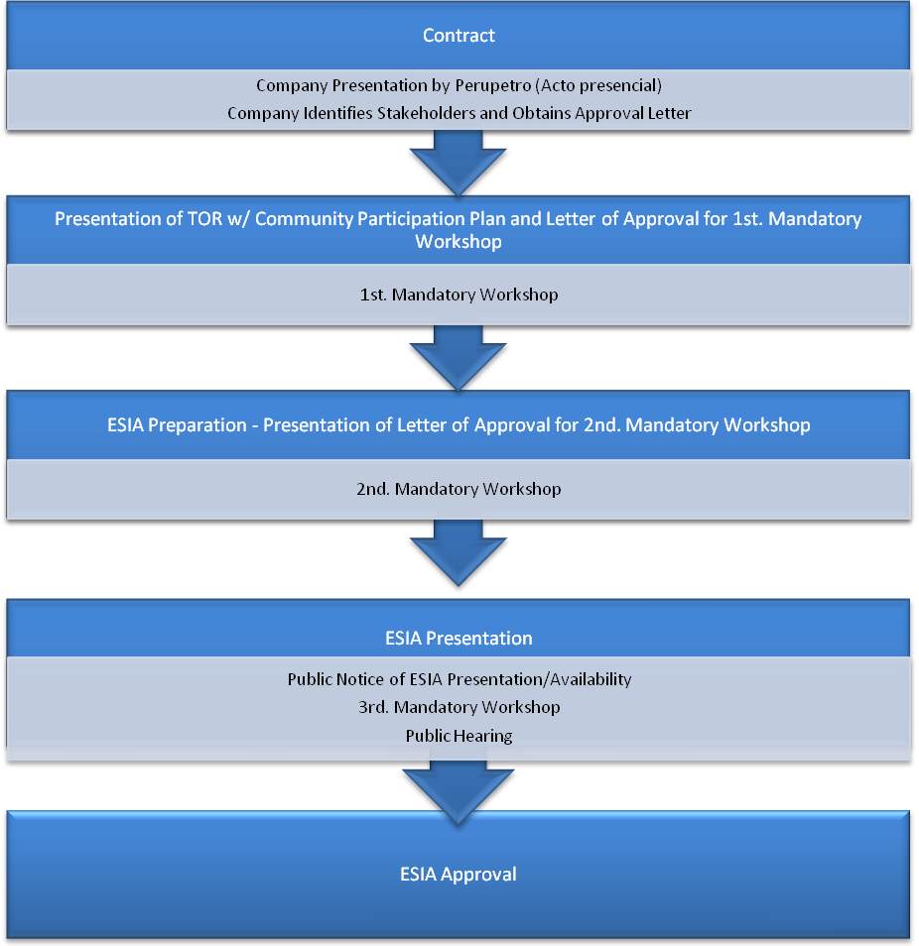
DECREE 12-2008: PUBLIC PARTICIPATION IN OIL AND GAS

Slide 7
CHALLENGES
Revise mandates to level playing field
Expand opportunities for participation
Enhance sectoral coordination

Slide 8
RELEVANT DEVELOPMENTS
Creation of Environment Ministry
Push to weaken communal lands’ regime
“El perro del hortelano.”

Slide 9
¡GRACIAS!
THANK YOU!
Lila.kbh@gmail.com

