Slide 1
Governance Perspectives From Central Asia and the Island of Borneo
Transboundary Conservation of Mountain Biodiversity in a Climate Change Impacted World
Michelle Lim University of New England2010
IUCN Colloquium 16 September 2010

Slide 3
Effective Transboundary Conservation

Slide 5
Transboundary Conservation of Mountain Biodiversity
Why?
How?
So What?
Transboundary Conservation of Mountain Biodiversity

Slide 6
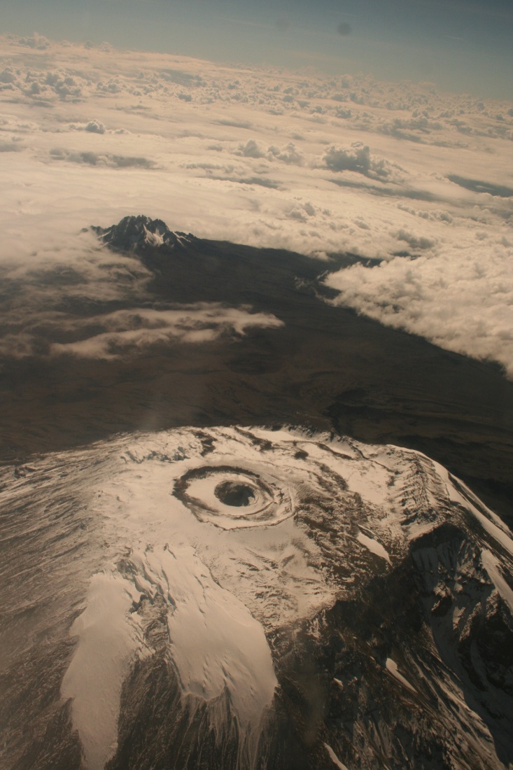
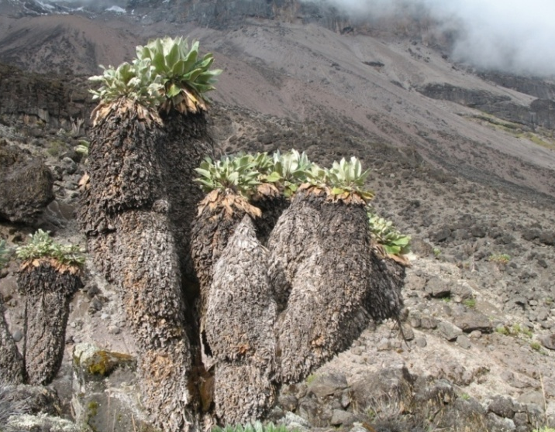
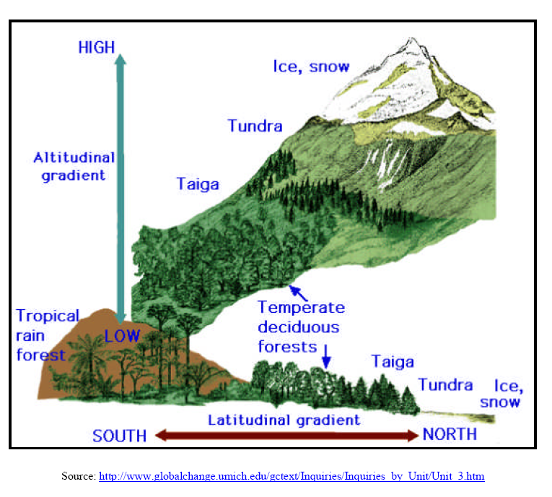
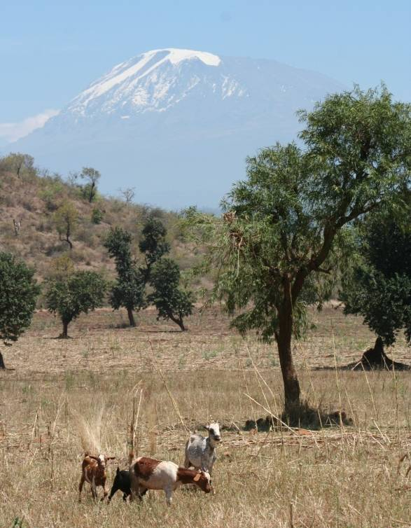
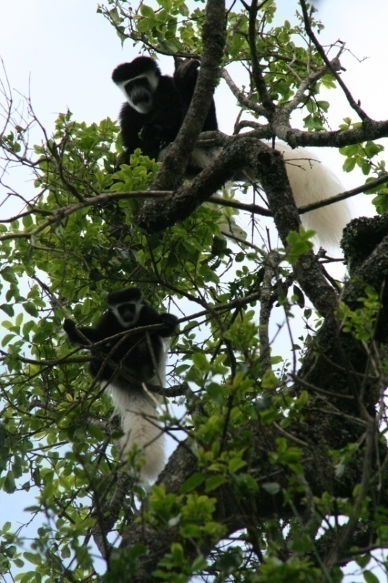

Slide 7
The Task

Slide 8
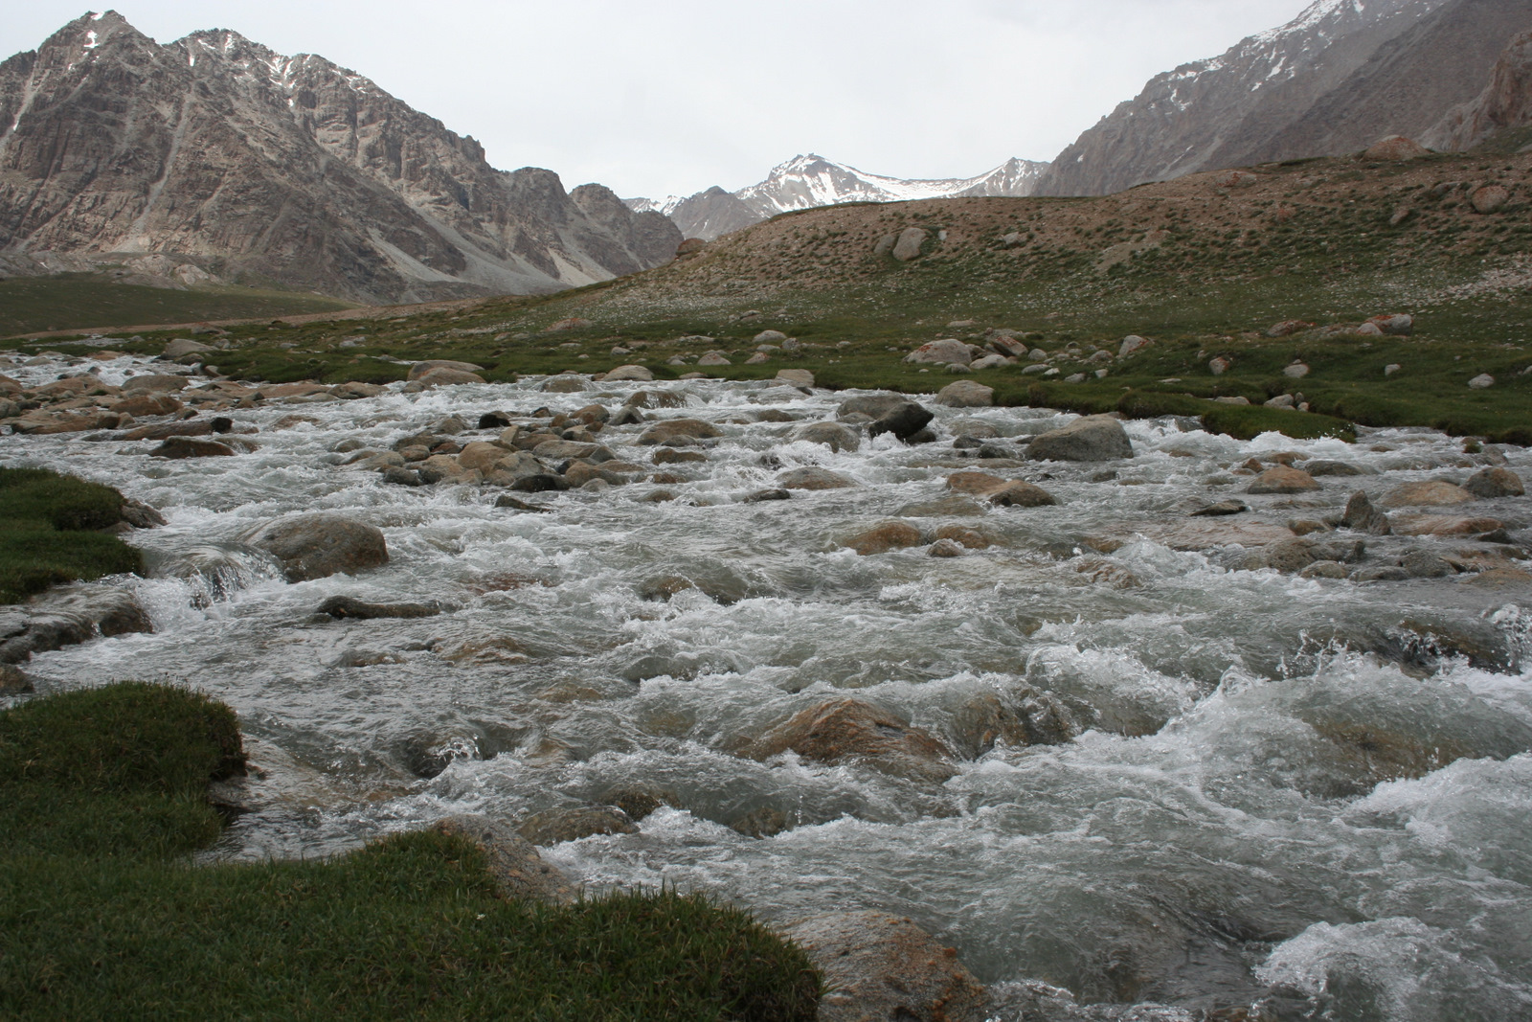
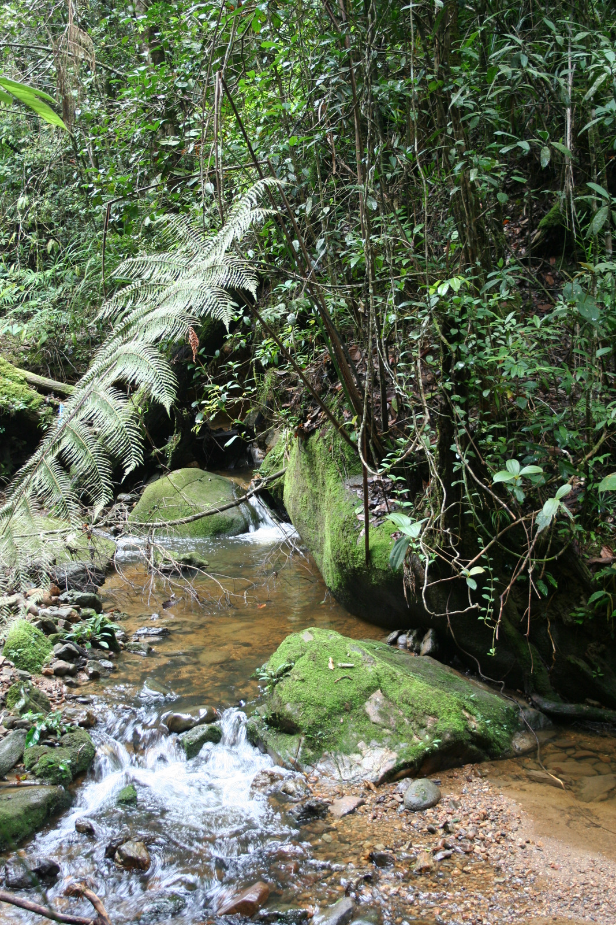
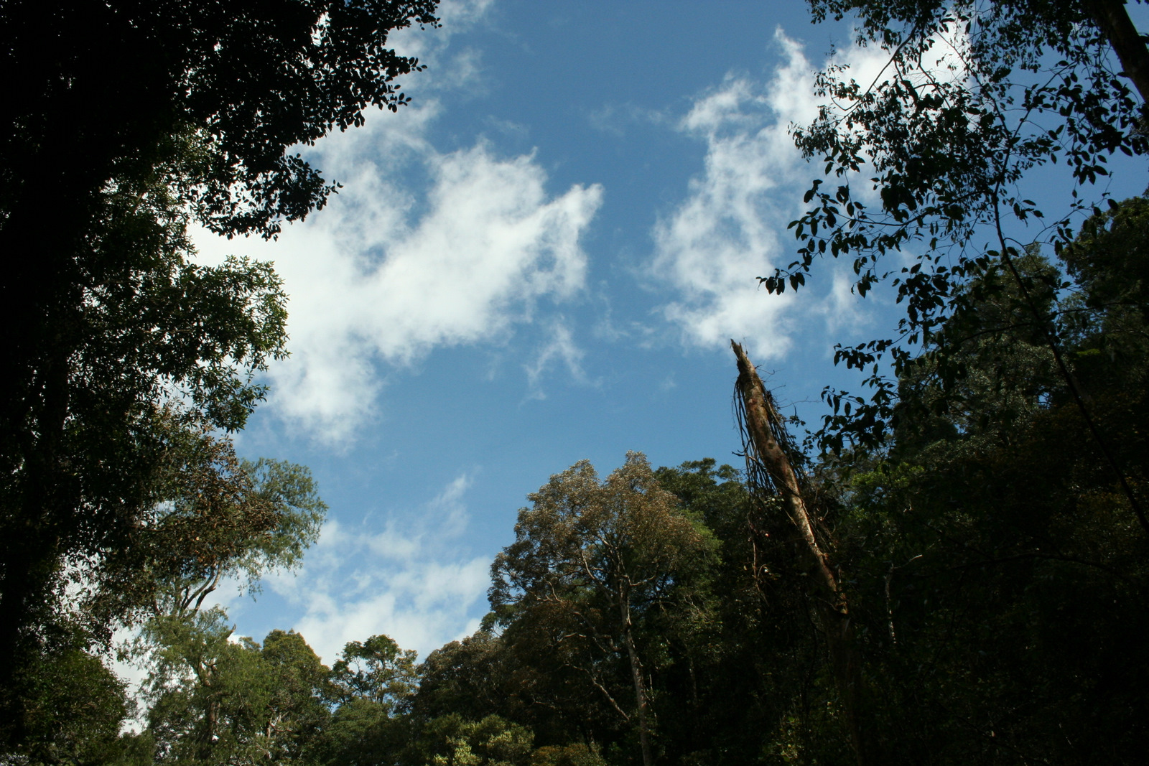
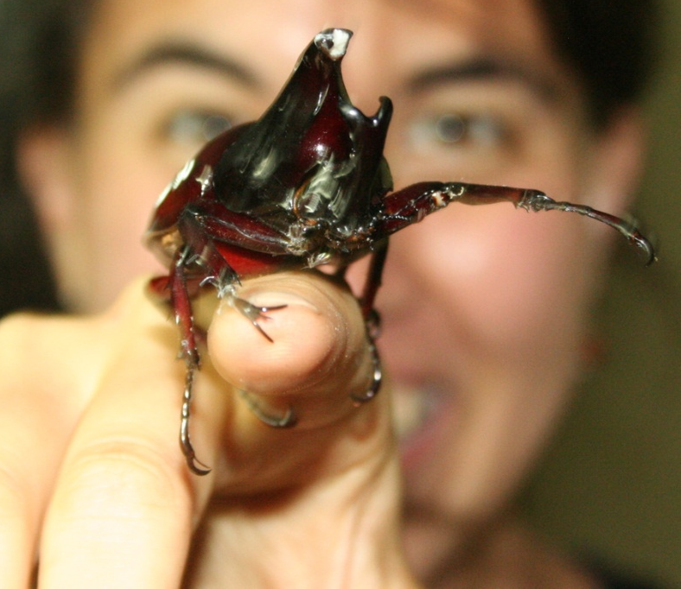
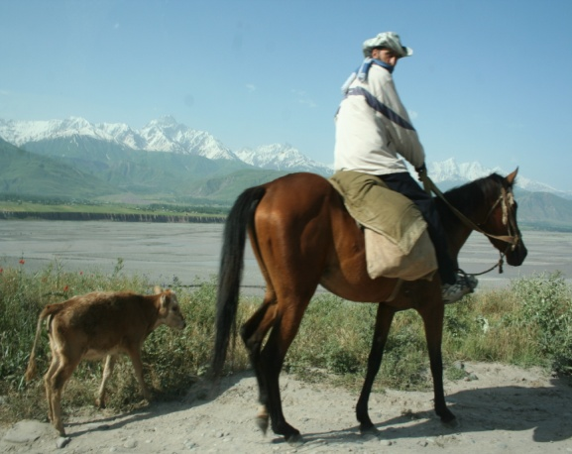
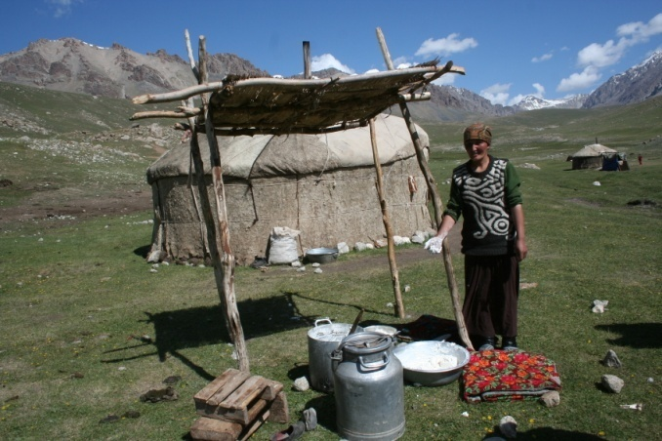

Slide 10
11 Criteria for the Effective Transboundary
Conservation of Mountain
Biodiversity
+1
11 Criteria for Effective Transboundary Biodiversity Conservation
11 Criteria for the Effective Transboundary
Conservation of Mountain
Biodiversity
Mountain

Slide 11
Operates at Each Level of Political Organization

Slide 12
Regional organizations /conventions
Multiple ministries
HQ of NR dept./ line ministry
Province
District
Local Managers
Country 1
Country 2
Levels of Authority in Transboundary Collaboration (van der Linde et al 2001)

Slide 13
2. Has Political Buy-In
3. Costs and Benefits Distributed Equitably
4. Integrated Ecosystem Approach which Incorporates Available Science
5. Objective of Conservation Explicit
6. Good Governance is Practiced
7. Clear Success Indicators and Ongoing
M & E

Slide 14
Legal Instruments that Enable the Process
Designated Institutions at Each Level
Operates in Consideration of
Capacity
11.Complexity Recognized and
Appropriate Resources Secured
12.Meaningful Incorporation of
Mountain Specificities

Slide 16
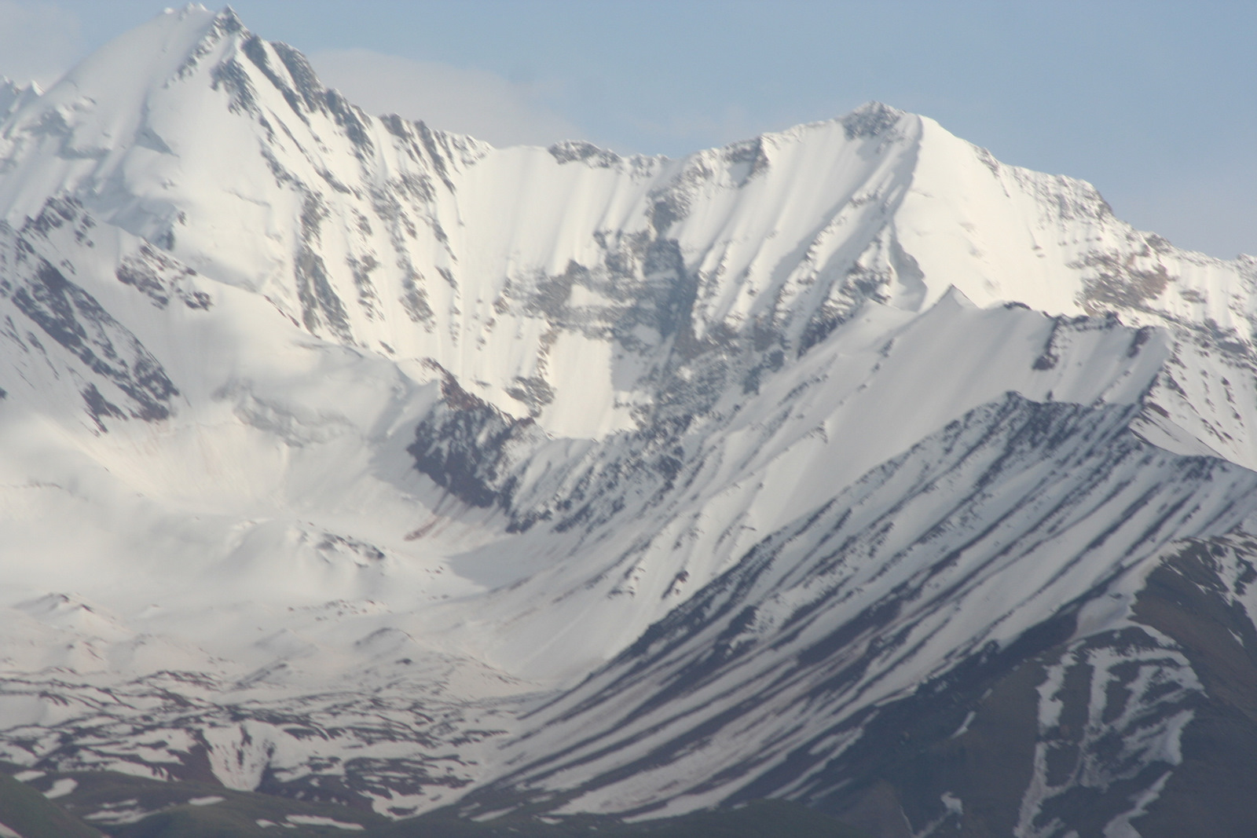
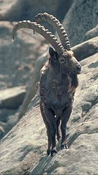
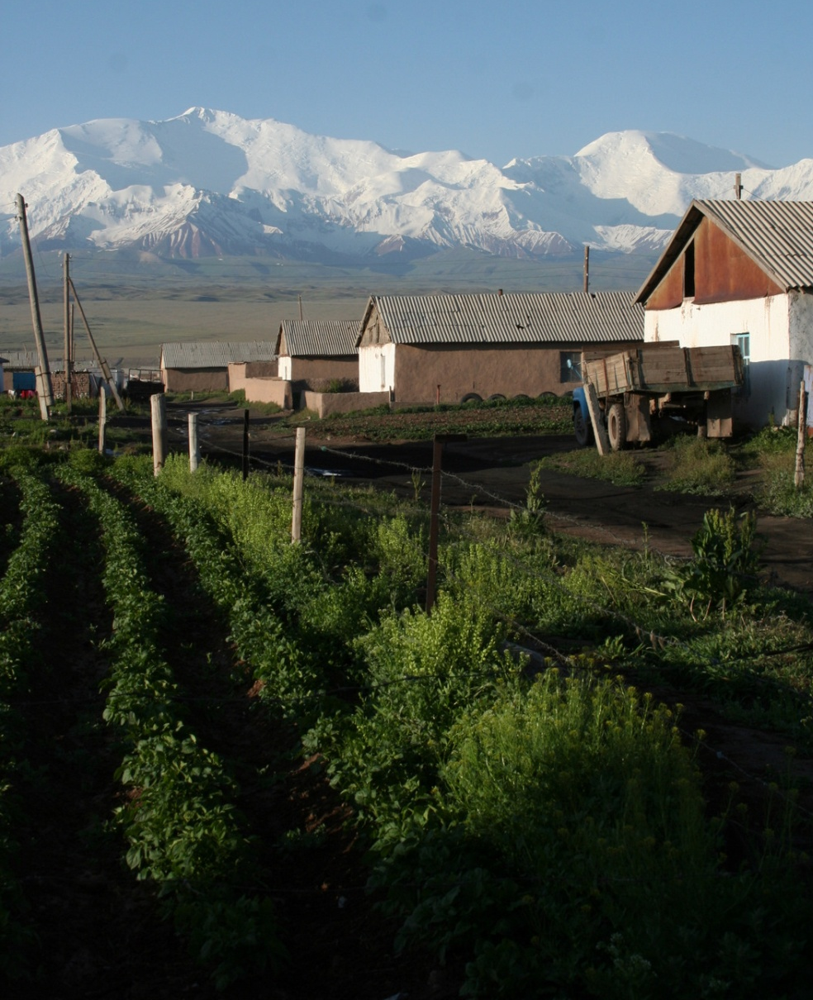
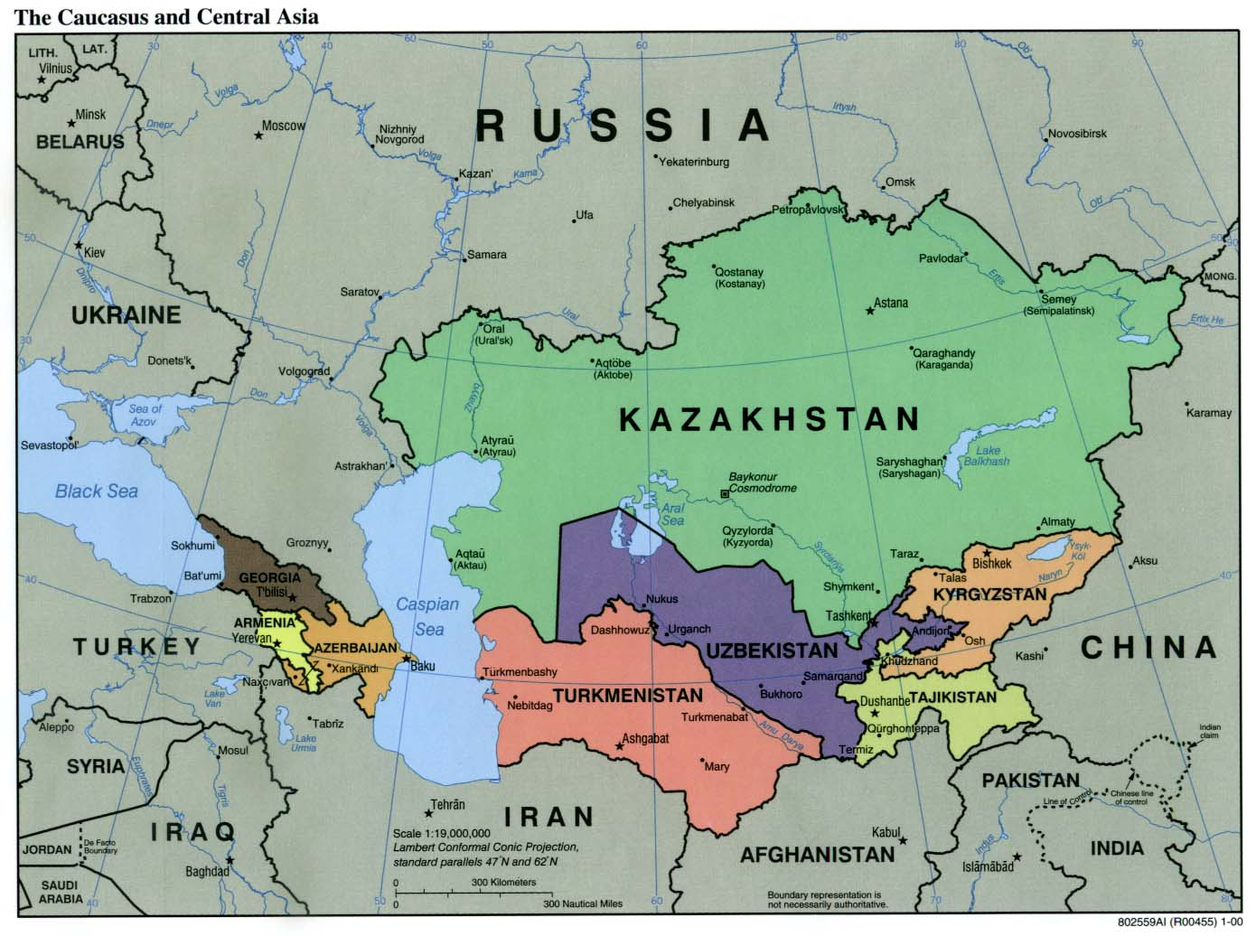

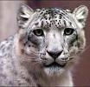
PALM Project

Slide 17
PALM Project and 11 (+1) Criteria
8. Existence of Legal Instruments that Enable the Process
Integrated Ecosystem Approach
5. Objective of Conservation Explicit
12. Upland-Lowland Dynamics
11. Complexity Recognized and Appropriate Resources Secured
+
-
5. Objective of Conservation Explicit

Slide 19
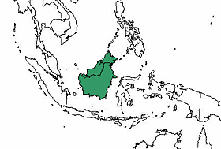
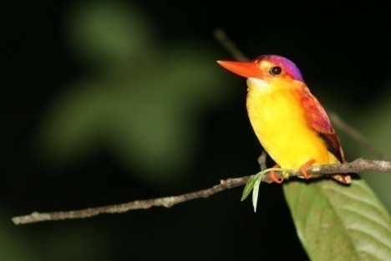
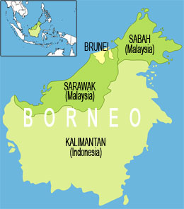
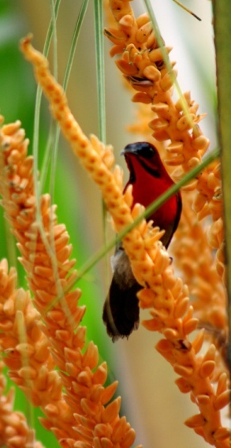
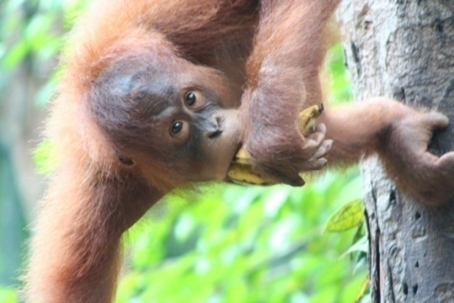
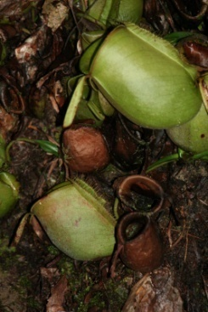
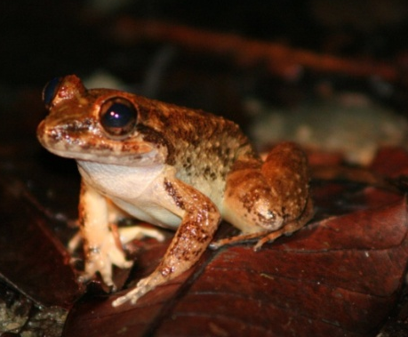
The Heart of Borneo

Slide 20
‘Heart of Borneo and 11(+1) Criteria
+
5. Objective of Conservation Explicit
8. Legal Instruments
Designated Institutions
2. Political Buy-In
-

Slide 22
Significance
Mountains & Transboundary Approaches
Distilled Set of Criteria
Existing and Future Initiatives
Transferability

Slide 24
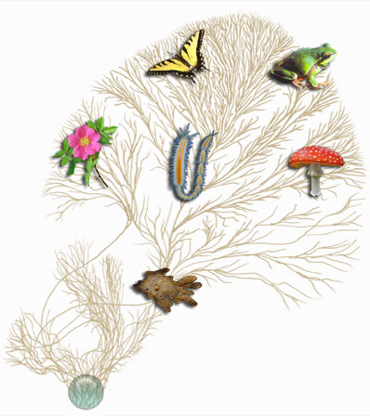

…..Infinity and Beyond!!!!
Биоразнообразие
Биоразнообразие
تنوع حيوي
Bioanuwai
تنوع حيوي
Bioanuwai
生物多样化
Biodiversidad
生物多样化
Biodiversidad

Slide 25
Dank u wel !!!

