Slide 1
Adaptive Management for Climate Change and Biodiversity Protection:
The Canadian Mackenzie Valley Pipeline Case
Jamie Benidickson and Heather McLeod-Kilmurray
University of Ottawa
IUCN Academy of Environmental Law 8th Annual Colloquium
Ghent 14-17 September, 2010
LINKAGES BETWEEN BIODIVERSITY AND CLIMATE CHANGE
IUCN Academy of Environmental Law, Sept, 2010
Benidickson & McLeod-Kilmurray, U of Ottawa

Slide 2
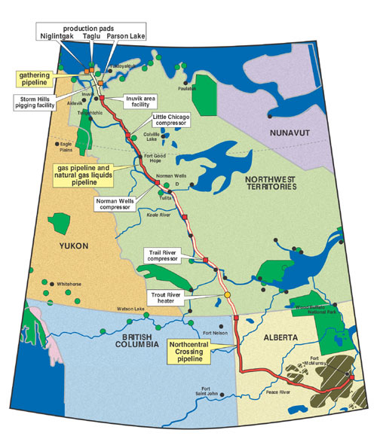
IUCN Academy of Environmental Law, Sept, 2010
Benidickson & McLeod-Kilmurray, U of Ottawa

Slide 3
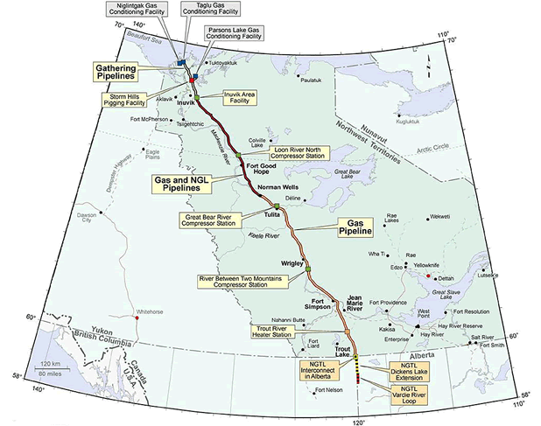
IUCN Academy of Environmental Law, Sept, 2010
Benidickson & McLeod-Kilmurray, U of Ottawa

Slide 4
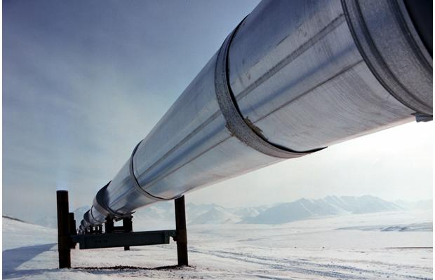
The PROJECT
The Mackenzie Gas Project is:
a 1,196-kilometre pipeline system along the Mackenzie Valley
linking northern natural gas producing wells to southern markets, and to …an existing natural gas pipeline system in northwestern Alberta.
[it] crosses four Aboriginal regions in Canada's Northwest Territories
IUCN Academy of Environmental Law, Sept, 2010
Benidickson & McLeod-Kilmurray, U of Ottawa

Slide 5

Berger Inquiry 1977
“critical habitats and critical life stages – on the tracts of land and water of limited size that are vital to the survival of whole populations of certain species at certain times of the year.”
“[l]ack of precise biological knowledge …[is] a major impediment both to prediction of the impact of pipeline development and to the formulation of protective measures”
Thomas R. Berger
IUCN Academy of Environmental Law, Sept, 2010
Benidickson & McLeod-Kilmurray, U of Ottawa

Slide 6
MacKenzie Gas Project - Critics
“carbon dioxide from the Mackenzie gas project and the fuel's end use would push Canada's greenhouse gas emissions 10% further away from its Kyoto Protocol commitment.”
the Pipeline is “a basin-opening project that will create a petro-economy throughout much of the Mackenzie Valley”
it “represents the single most important driver for Canada’s energy policy and energy investment by industry for the next 25 years.”
IUCN Academy of Environmental Law, Sept, 2010
Benidickson & McLeod-Kilmurray, U of Ottawa

Slide 7
EA Process
Joint Review Panel appointed by the Mackenzie Valley Environmental Impact Review Board, the Inuvialuit and the federal Minister of the Environment.
5 years to complete the assessment
115 days of hearings
Panel report released December 30, 2009.
IUCN Academy of Environmental Law, Sept, 2010
Benidickson & McLeod-Kilmurray, U of Ottawa

Slide 8
Panel Findings
“The construction and operation of a buried non-ambient temperature gas pipeline in a permafrost environment has no direct precedent in North America. It could thaw frozen ground and freeze unfrozen ground, destabilizing terrain and disrupting water courses. The project thus poses distinctive engineering and environmental challenges.”
“[i]n view of the limited experience of constructing and operating such a pipeline in a northern environment, the Panel considers that there is a need for
  conservatism in project design and construction methods,
  caution in impacts prediction and mitigation, and
  well-designed and effectively implemented monitoring programs.” (Executive summary at 7)
IUCN Academy of Environmental Law, Sept, 2010
Benidickson & McLeod-Kilmurray, U of Ottawa

Slide 9
ADAPTIVE MANAGEMENT
“a decision making process based on trial, monitoring, and feedback …[A]daptive management recognizes the imperfect knowledge of interdependencies existing within and among natural and social systems, which requires plans to be modified as technical knowledge improves.”
IUCN Academy of Environmental Law, Sept, 2010
Benidickson & McLeod-Kilmurray, U of Ottawa

Slide 10
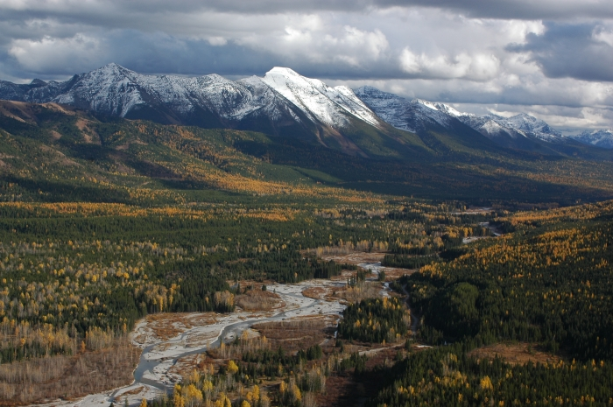
AM in Canadian jurisprudence
“AM techniques and the PP are important tools for maintaining ecological integrity”
but AM “counters the potentially paralyzing effects of the precautionary principle.”
Canadian Parks and Wilderness case
IUCN Academy of Environmental Law, Sept, 2010
Benidickson & McLeod-Kilmurray, U of Ottawa

Slide 11
Canadian EA Agency
Operational Statement on AM
while a likely technological or scientific improvement during the project can be considered in an EA where it would enhance mitigation, “it is insufficient to assert that implementation of an unidentified future measure, developed as a result of adaptive management, constitutes mitigation of a predicted adverse environmental effect [and] commitment to adaptive management is not a substitute for committing to specific mitigation measures in the EA.”
IUCN Academy of Environmental Law, Sept, 2010
Benidickson & McLeod-Kilmurray, U of Ottawa

Slide 12
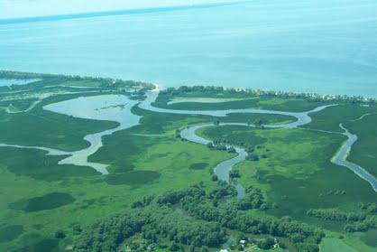
Statutory Foundations in the Canadian Environmental Assessment Act
s. 38 (5) The results of follow-up programs may be used for implementing adaptive management measures or for improving the quality of future environmental assessments.
IUCN Academy of Environmental Law, Sept, 2010
Benidickson & McLeod-Kilmurray, U of Ottawa

Slide 13
Function of “Follow-up Programs”
support the implementation of adaptive management measures to address previously unanticipated adverse environmental effects;
[Follow-up Programs under the Canadian Environmental Assessment Act (CEAA,, 2007,)p.1]
IUCN Academy of Environmental Law, Sept, 2010
Benidickson & McLeod-Kilmurray, U of Ottawa

Slide 14
Implementing Adaptive Management
[insert figure 18.3]
IUCN Academy of Environmental Law, Sept, 2010
Benidickson & McLeod-Kilmurray, U of Ottawa

Slide 15
Types of Monitoring
Compliance Monitoring (relating to regulatory requirements or commitment and policy targets)
Impact (Effects) Monitoring
Cumulative Impact Monitoring (The objective of cumulative impacts assessment is to determine, at a regional level, whether conditions are getting better or worse as indicated by the status of selected VCs.[553])
IUCN Academy of Environmental Law, Sept, 2010
Benidickson & McLeod-Kilmurray, U of Ottawa

Slide 16
Environmental Management Plans
Environmental Protection
Heritage Management
Vegetation and Reclamation
Water Resources
Waste Management
Chemicals and Fuel Handling
Emergency Response
Ballast Water
Air Quality and Emissions
Wildlife Management
Access Management
Decommissioning and Abandonment [Figure 18.1]
IUCN Academy of Environmental Law, Sept, 2010
Benidickson & McLeod-Kilmurray, U of Ottawa

Slide 17
Objectives of Integration
Integration must also take place to ensure a given follow-up
program provides the essential information for determining
whether predictions are verified, mitigation measures are
working, and above all, that remedial action is taken that is clearly
informed by the results of monitoring and follow-up. [565]
IUCN Academy of Environmental Law, Sept, 2010
Benidickson & McLeod-Kilmurray, U of Ottawa

Slide 18

The Rational Basis for Adaptive Management
Project-level and cumulative impacts monitoring are necessarily
hypothesis-driven, otherwise adaptive management is nothing
more than a process of trial and error. [566]
IUCN Academy of Environmental Law, Sept, 2010
Benidickson & McLeod-Kilmurray, U of Ottawa

Slide 19
Recommended Elements of Monitoring Programs
[Rec 18-3]
• identification of monitoring objectives and means of achieving verifiable results capable of guiding remedial action;
• formulation of clearly stated research questions capable of testing impact predictions;
• key measurable indicators linking Mackenzie Gas Project activities to outcomes, and thresholds or reference levels to identify Project effects;
• strategies and protocols for data collection and quality control;
• a design that is compatible with and able to contribute to the Cumulative Impact Monitoring Program;
• protocols for data compilation, storage, control and access;
• provision for data analysis and assessment; and • reporting procedures and schedules.
IUCN Academy of Environmental Law, Sept, 2010
Benidickson & McLeod-Kilmurray, U of Ottawa

Slide 20
Components of Adaptive Management [Rec 18-5]
• provision for regular review of adaptive management effectiveness, adjustment of related monitoring and responses to focus on significant continuing concerns;
• collaboration with participants in related assessment, planning and adaptive management work, especially where cumulative impacts may be involved; • sharing of findings among participants in monitoring and among stakeholders and others involved in selecting, designing and applying
adaptive responses;
• a transparent process for setting and adjusting monitoring and management priorities;
• implementation and contingency plans and resources to enable responsive action especially in areas where effect predictions are thought to be uncertain and where predictive errors may have serious
consequences; and
• clearly defined impacts thresholds, where possible, to clarify where and when adaptive responses will be necessary.
The Panel recommends that the design of adaptive management approaches pay particular attention to the valued components identified as priorities through the scenario-based cumulative impacts assessment exercise.
IUCN Academy of Environmental Law, Sept, 2010
Benidickson & McLeod-Kilmurray, U of Ottawa

