Slide 1
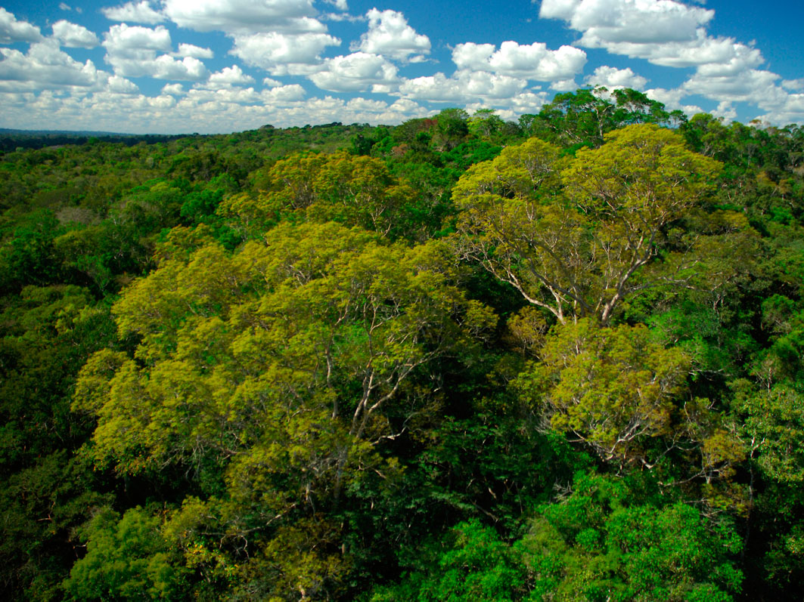
REDD+: A Benefit for Biodiversity?
Dr. Christina Voigt
Oslo, Norway

Slide 2
Forests
Biodiversity
Climate change
Mitigation
REDD+

Slide 3
REDD+ Risks for Biodiversity
Forest Definition
Leakage
Scope
Reference Levels

Slide 4
Legal Mechanisms
Safeguards
Stakeholder Participation
Global architecture

Slide 5
…when undertaking activities referred to in paragraph 3 below, the following safeguards should be promoted and supported:
(e) Actions that are consistent with the conservation of natural forests and biological diversity, ensuring that actions referred to in paragraph 3 below are not used for the conversion of natural forests, but are instead used to incentivize the protection and conservation of natural forests and their ecosystem services, and to enhance other social and environmental benefits; (FCCC/AWGLCA/2010/14, chapter 6, para 2)

Slide 6
When undertaking REDD+ actions Parties shall:
[Ensure] [Promote] actions that are consistent with the conservation of biological diversity [, and do not provide incentives for conversion of natural forests][, including safeguards on the conversion of natural forests] and enhance other social and environmental benefits [, including [environmental][ecosystem] services], complementary to the aims and objectives of relevant international conventions and agreements (Non-paper No. 39, Para 4(f))

Slide 7
Also requests that a developing country Party aiming to undertake activities referred to in paragraph 3 above, [provided that support is made available,] in accordance with national circumstances and respective capabilities, develop:
(c) A robust and transparent national forest monitoring system for the monitoring and reporting of the activities referred to in paragraph 3 above [, and the safeguards referred to in paragraph 2 above], with, as appropriate, subnational monitoring and reporting as an optional interim measure...

Slide 8
Legal Mechanisms
Safeguards
Stakeholder Participation
Global architecture

Slide 9
Challenges
Political self-interest
Strategic bargaining
Sovereignty Issues
REDD+ finance: fast start and long term

Slide 10
Possibilities
Bilateral Agreements
CBD Cooperation
Voluntary Crediting, Minimum Standards (Voluntary Carbon Market)

