Slide 1
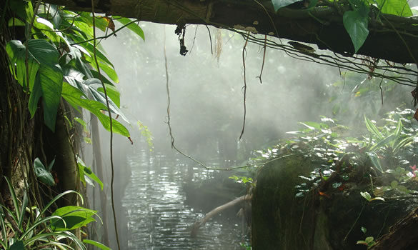
Climate Change and Biodiversity:
Impact, Synergy, and Confluence
Professor Svitlana Kravchenko
University of Oregon, USA
Ghent Colloquium - September 2010

Slide 2
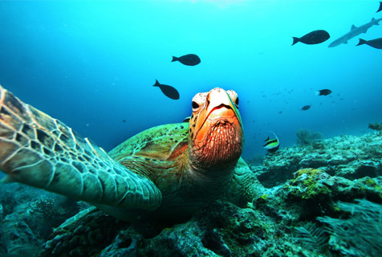
Global Biodiversity Outlook-3
Based on 110 national reports - a wake-up call for humanity
Extinction rates up to 1,000 times higher than the historical background rate
We failed 2010 target to reduce biodiversity loss
“Business as usual is no longer an option to avoid irreversible damage to biodiversity
“Biodiversity loss and climate change must be addressed with equal priority and close cooperation”

Slide 3
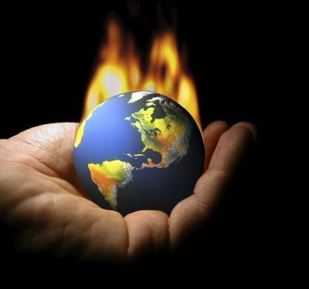
Climate Change Impact on Biodiversity
Climate change is a major cause
of biodiversity loss
20-30% of biodiversity loss with temperature rise of 2-3 degrees

Slide 4
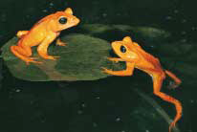
Climate Change Impact on Biodiversity
Shifts in geographic ranges and in
the timing of life cycles -> species’
ability to survive
Temperature rise -> impacts on coral reefs, glaciers, and forest ecosystems
Conservation strategies should integrate climate change by modeling regional shifts

Slide 5
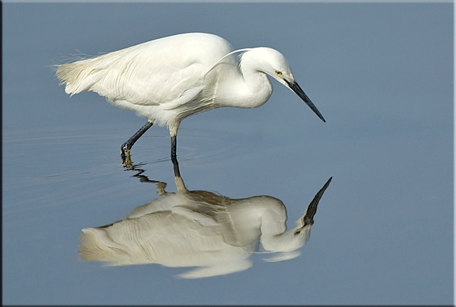
The Little Egret, commonly found in Mediterranean Europe, is now a regular visitor in Irish coastal ecosystems

Slide 6
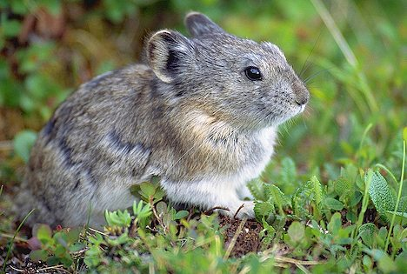
Pika
Pika is the first mammal in North America known to fall victim to global warming
It resides in areas with cool alpine climate
As temperatures rise due to increasing GHG emissions, pika moves to higher elevations or migrates northward in an attempt to find suitable habitat ; at risk of extinction.
US FWS declined to give federal protection as threatened under the ESA in Feb. 2010

Slide 7
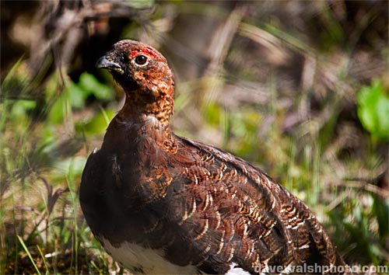
Ptarmigan
Endemic to alpine regions of western North America
The greatest threat to the survival of ptarmigan is climate change due to a gradual loss of alpine habitats
Their plumage is mottled grey, brown and black in the summer

Slide 8
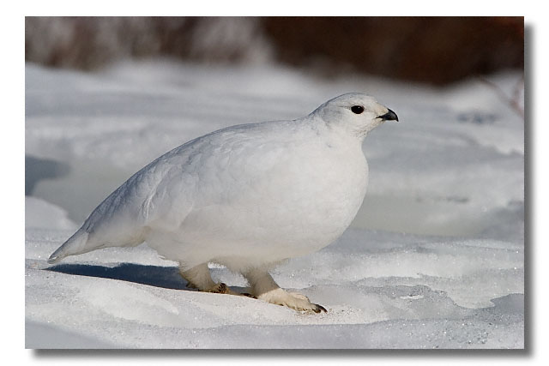
Ptarmigan in winter
and pure white in the winter to aid camouflage
Warmer winter temperatures and the movement of treeline upslope to higher elevations, until there’s no more room to rise, will cause ptarmigan habitat to become unsuitable
It depends on alpine habitat, which is shrinking in hotter temperatures
Center for Biodiversity filed Scientific Petition to US FWS to earn federal protection for the as threatened under the Endangered Species Act in 2010

Slide 9
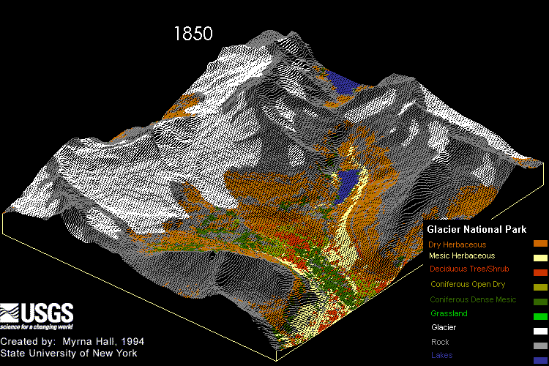

Slide 10
UNESCO World Heritage Convention
Natural heritage is “natural sites or areas of outstanding universal value from the point of view of science, conservation or natural beauty”
In 2005 five petitions seeking to have
  Sagarmatha National Park (Nepal),
  Huascaran National Park (Peru),
  the Great Barrier Reef (Australia)
  the Belize Barrier Reef Reserve System
  Waterton International Peace Park
included on the List of World Heritage in Danger because of climate change impact

Slide 11
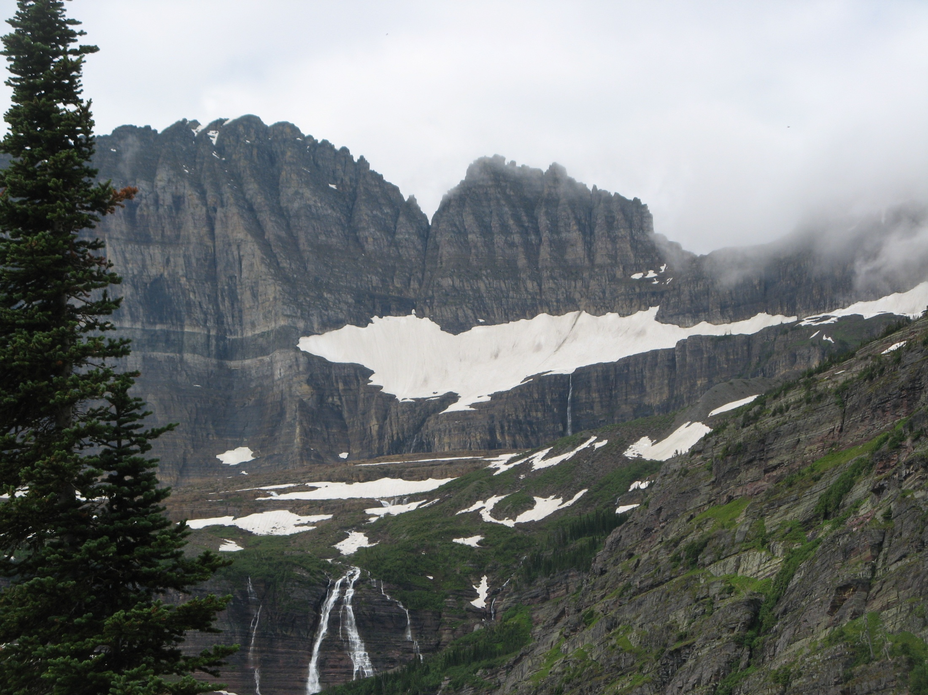
Petition to UNESCO World Heritage Committee
The Role of Black Carbon in Endangering
World Heritage Sites Threatened by
Glacial Melt and Sea Level Rise (by EarthJustice, Jan.29, 2009)
This petition calls on the WHC to take action to protect the outstanding universal values of World Heritage Sites most vulnerable to global warming
Placing climate-threatened sites on the List of World Heritage in Danger
Advance research and mitigation strategies

Slide 12
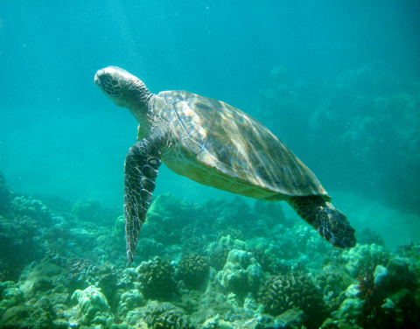
Climate Change and Ocean Acidification
The greatest threat to the health of our oceans occurring at a frightening rate
Adverse effect of marine ecosystems and coral reefs, marine animals with a shell
U.S. EPA invokes Clean Water Act to evaluate ocean acidification and water quality criteria
In response to a petition from the Center for Biological Diversity seeking stricter pH criteria for ocean water quality and guidance from the agency for states to help protect U.S. waters from further acidification.

Slide 13
Impact of dams on biodiversity
EPL v. Cabinet of Minister of Ukraine
27 ha specially protected area «Granitno-stepove Pobyzha” allocated for “Energoatom” company
Water reservoir for operation of Tashlytska hydro-accumulative electric facility
Endemic plant species listed in Red Book of Ukraine are covered by water and destroyed

Slide 14
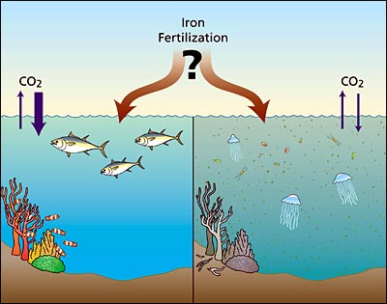
Intentional introduction of iron to the upper ocean to stimulate a phytoplankton bloom.
Intended to enhance biological productivity, which is likely in decline as a result of climate change
Can benefit the marine food chain and remove carbon dioxide from the atmosphere
Controversy remains
The London Dumping Convention, non-binding resolution in 2008 ; CBD in Nagoya?

Slide 15
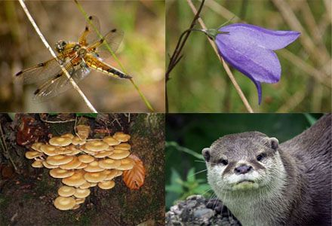
Mitigation and adaptation
Conservation and enhancement of terrestrial, coastal and marine ecosystems as carbon sinks
Slowing deforestation and forest degradation
Alternative energy and impact on ecosystems (wind farms and impact on birds, dams and lost biodiversity of flooded land)

Slide 16
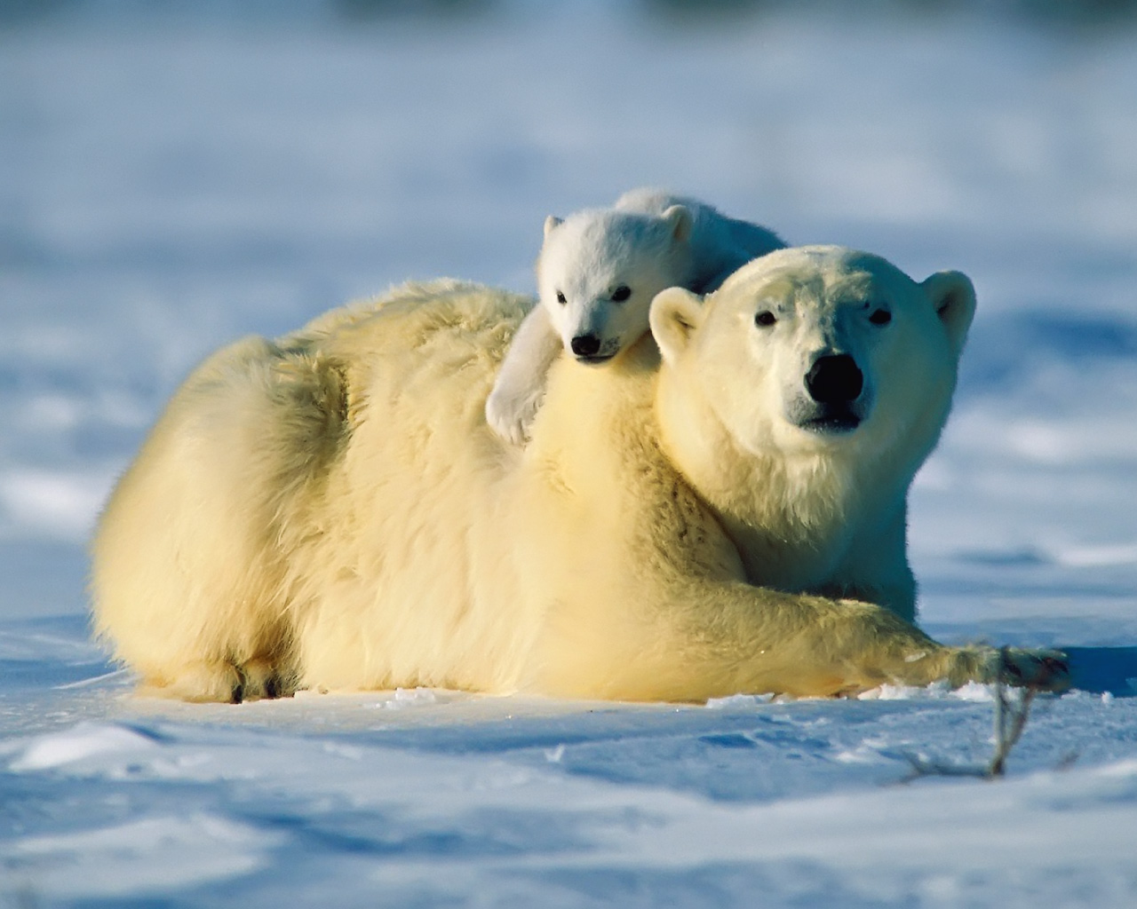
Synergy between biodiversity and climate change
Integration of biodiversity considerations into implementation of the UNFCCC
Integration of climate change impacts on biodiversity into implementation of the CBD
UNFCCC objective: stabilization of GHG to allow ecosystems to adapt to climate change
Biodiversity management can contribute to climate change mitigation and adaptation

Slide 17
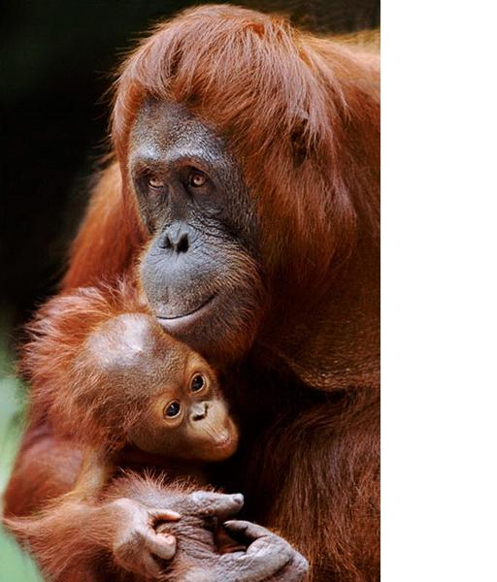
Confluence between human rights, climate change, and biodiversity
Climate change impacts full enjoyment of human rights
Climate change has “human face”
Strong language of human rights treaties can be used for combating climate change and protecting biodiversity (indigenous people)
Human rights institutions have been used to defend human rights of victims caused by environmental degradation (Awas Tingni in IACHR)

Slide 18
Regional Human Rights Courts
The European Court of Human Rights: violation of the right to privacy and family life and the right to life related to degradation of the environment:
  Lopez Ostra v. Spain
  Guerra v. Italy
  Oneryildiz v. Turkey
The Inter-American Commission of Human Rights: violation of the rights of indigenous people (Inuit Petition)

Slide 19
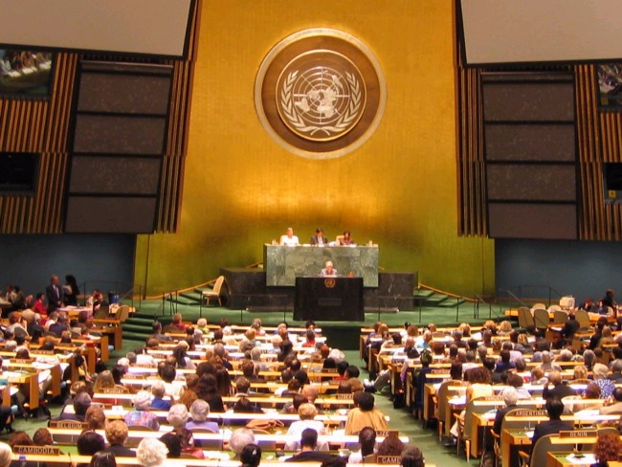
Human Rights Council
The Maldives Petition and the UN Human Rights Council’s Resolution 7/23 “Human Rights and Climate Change”: global warming impacts the full enjoyment of human rights
The Report of the Office of the HCHR on the relationship between climate change and human rights

Slide 20
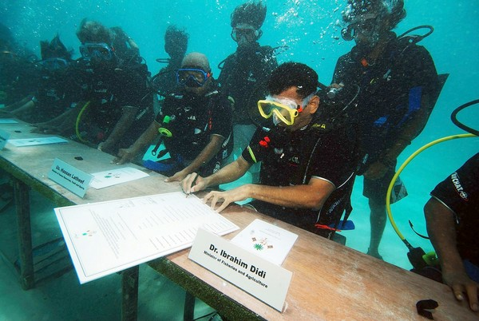

Slide 21
Using procedural rights
Access to information, public participation in decision making, - Art. 4 and 6 of UNFCCC
Human rights treaties (ICCPR, European and Inter-American Conventions, African Charter)
Rio Declaration, principle 10
In global and regional MEAs, including the Aarhus Convention
In case law (Claude Reyes v. Chile, Öneryildiz v. Turkey)

Slide 22
PP in EIA: Maptapud, Thailand
Government of Thailand promoted petrochemical industries in Maptapud
Article 67 of Thailand’s 2007 Constitution: the right of a person to participate in projects that may seriously affect communities and the quality of the environment
27 Maptapud residents successfully used the right of PP in EIA to stop the construction of 65 industrial projects emitting GHG
The Supreme Administrative Court in December 2009 declared these projects unconstitutional and granted an injunction

Slide 23
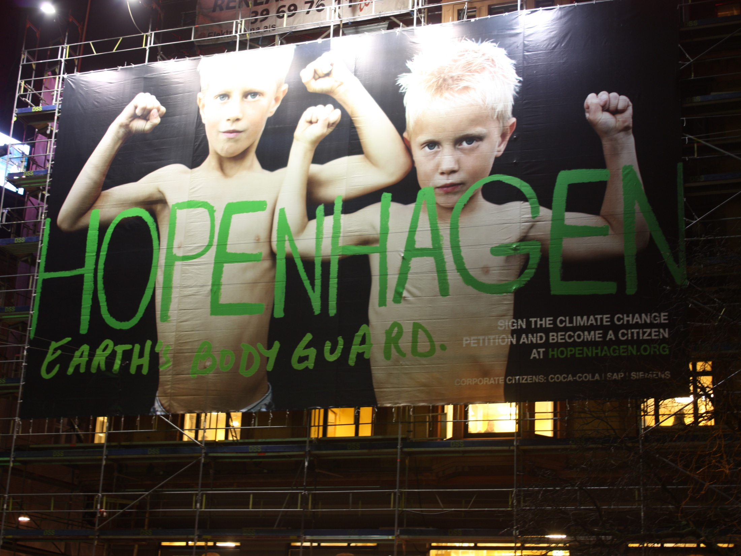
Procedural rights in post-Copenhagen treaty
Working Group Human Rights and Climate Change
Draft proposals for negotiation text prepared by the Ad Hoc WG LCA
Existing language in the shared vision recognizes climate impacts’ implications for the full enjoyment of human rights
We suggested including “access to information, full, early and effective participation, and access to justice with respect to climate change adaptation and mitigation actions.”

Slide 24
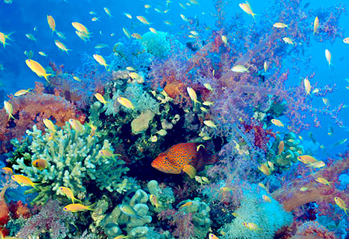
Global Biodiversity Outlook-3
Communication and involvement
Strategies will only be effective if they genuinely involve the people closest to the resources they are designed to protect
Often the best solutions will be driven by local demand

Slide 25
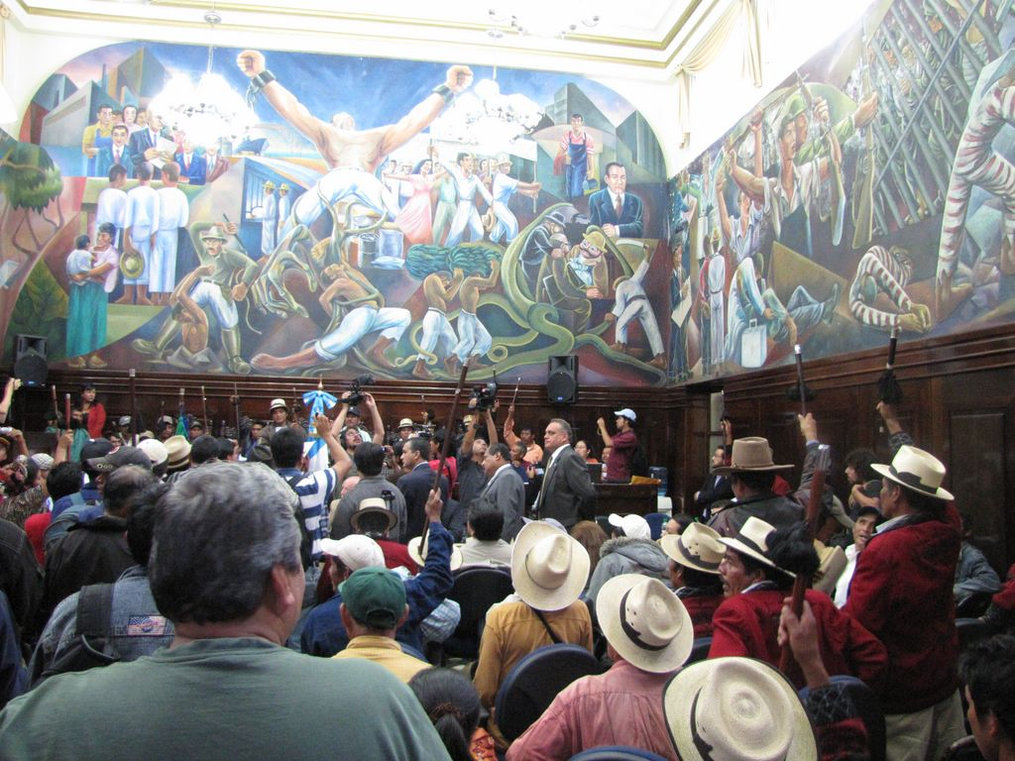
Procedural rights and Biodiversity
Cartagena Protocol
  AIA procedure
  Right to information
  Public participation
  Education and awareness
Declaration of Rights of Indigenous People
  Prior informed consent
  Consultation

Slide 26
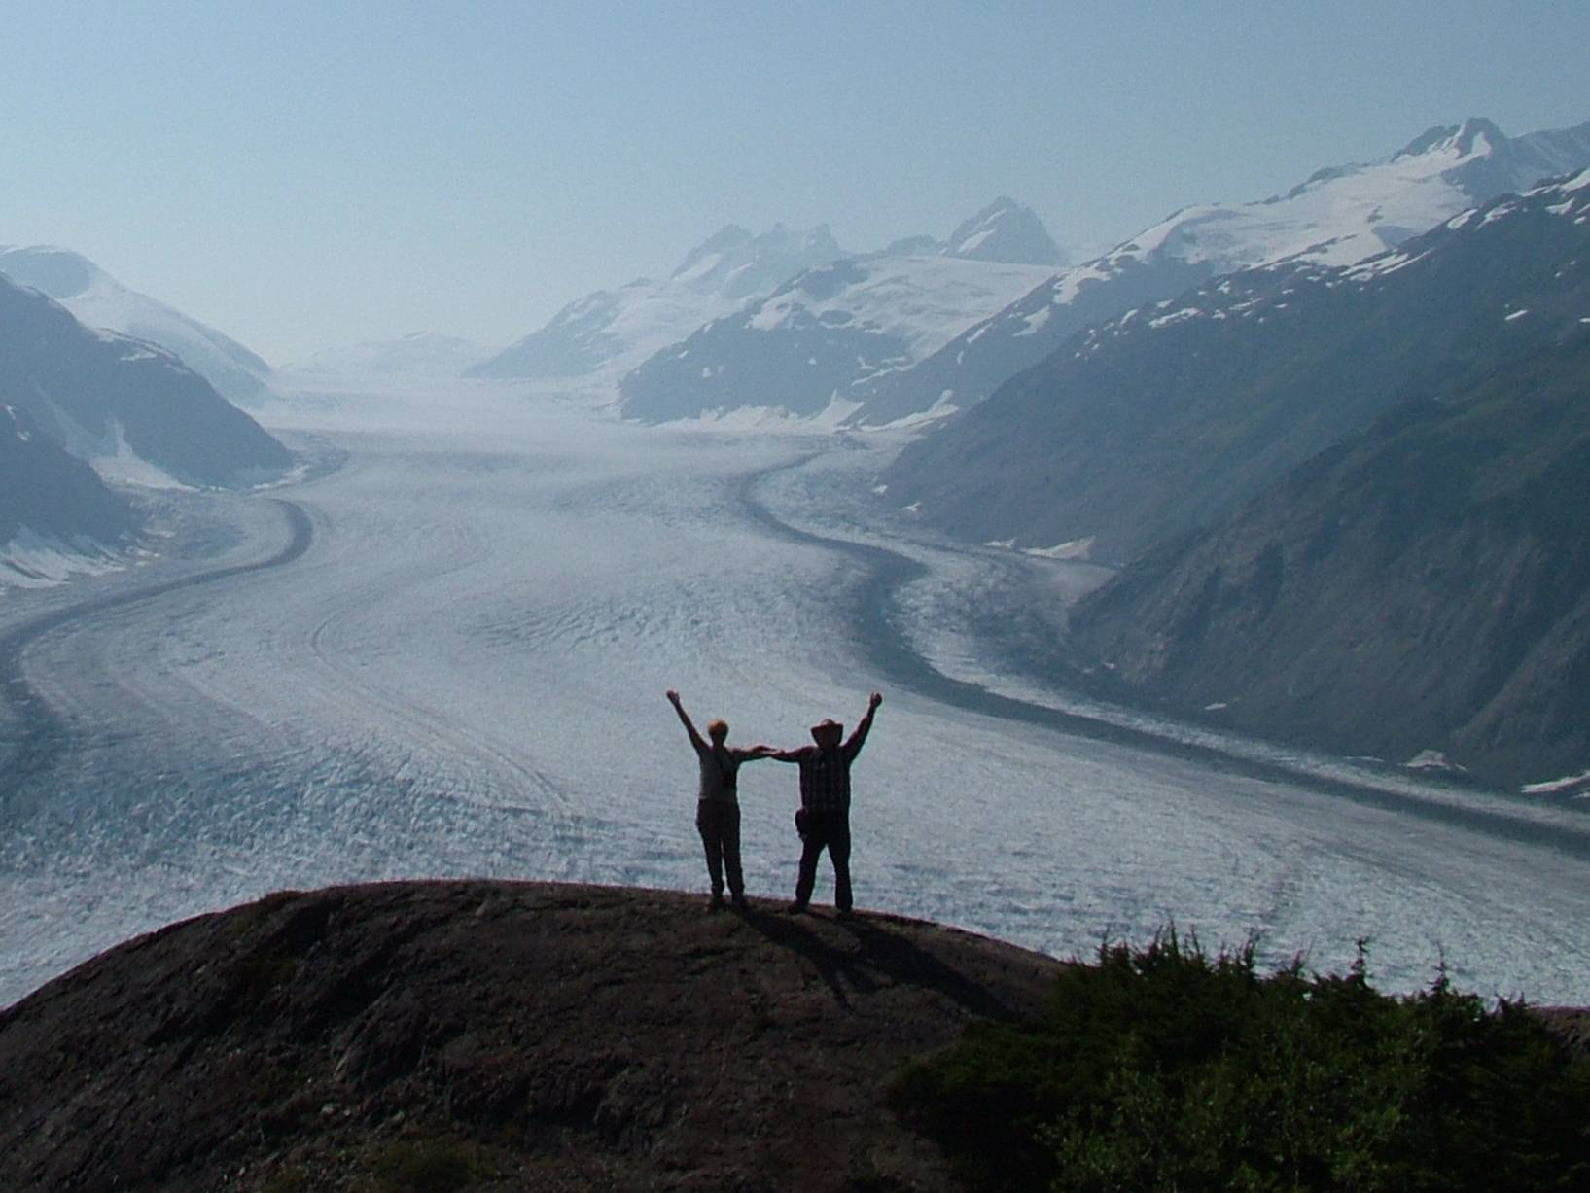
Conclusion
The protection of biodiversity, mitigation of and adaptation to climate change will benefit from using human rights institutions and tools
It is not easy but worth to explore and try
It does not replace MEAs and domestic environmental laws but is an additional tool

