Slide 1
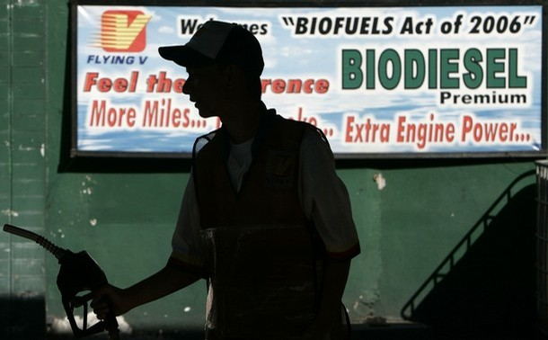
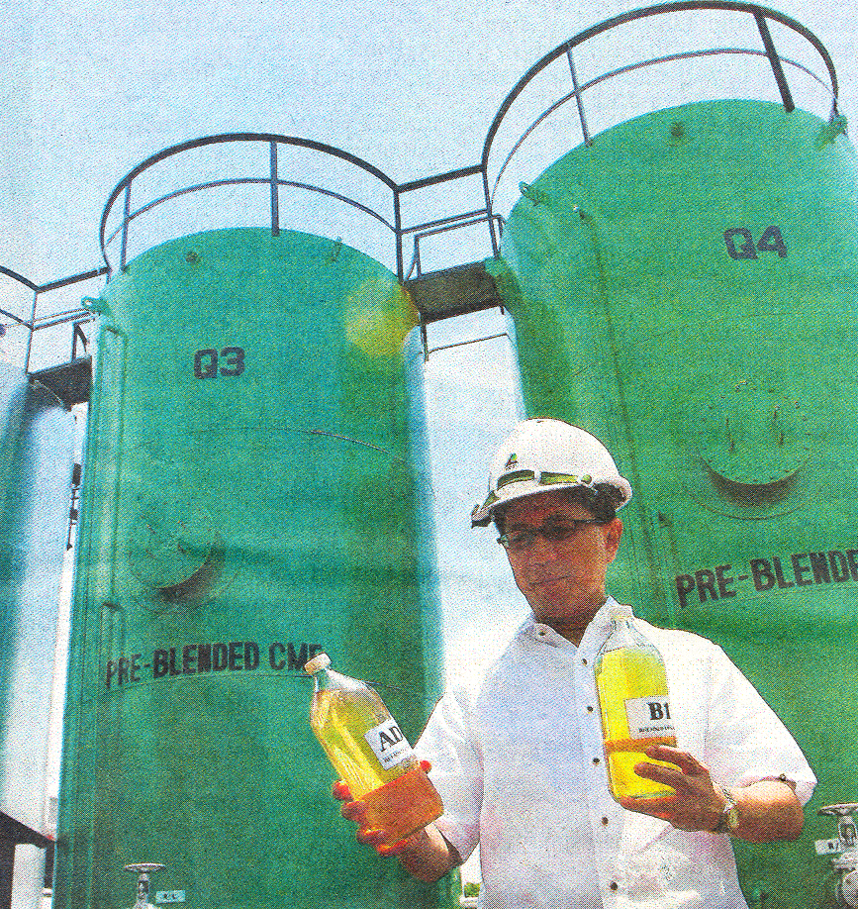
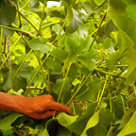


The Salience of Discourse Coalitions in Biofuels Policymaking: The Philippines Case
Marvin Joseph Montefrio
PhD Candidate (Environmental and Natural Resources Policy)
SUNY College of Environmental Science and Forestry
MPA Student (Environment and International Dev’t)
Maxwell School of Citizenship and Public Affairs
Syracuse University
Notes:
A pleasant afternoon to everyone. My name is Marvin and I am PhD candidate at the State University of New York College of Environmental Science and Forestry. What I am presenting this afternoon is based on an article my adviser and I recently published at the Journal of Environment and Development. The Philippines is an interesting case for us to consider, because unlike the earlier cases that we heard a while ago, the Philippine biofuels program is still in the nascent phase. This afternoon I am specifically going to talk about the biofuels policy in the Philippines, with particular emphasis on the process of policymaking. I am hoping that my sharing of the Philippine biofuels experience will provide insights for us to consider for future development of biofuel laws and policies around the world.

Slide 2
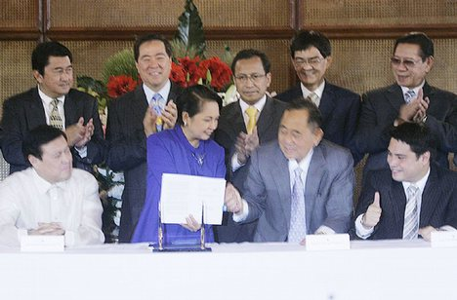
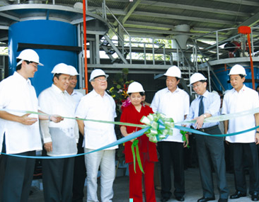
The Biofuels Act of 2006 (RA 9367)
◆
First in Southeast Asia
◆
Fuel Blend Mandates
◆
Motivated by:
Volatile Oil Prices
http://wn.com/Jose_de_Venecia,_Jr
Global Climate Change
Air Pollution
Declining Rural Sector
www.Chemrez.com
Notes:
In early 2007, the Philippines enacted Republic Act 9367 or commonly referred to as the Biofuels Act of 2006. This act is considered to be a landmark achievement in the realm of environmental policy not just in the Philippines, but in the Southeast Asian region as well. The legislation is considered to be one of the first in Southeast Asia, which specifically mandates, among others, the fuel blends of biofuels to be used in all gasoline-based and diesel-based land transport vehicles in the Philippines, the sources of feedstock to be used for biofuels production, and the incentives needed to spur local and foreign investments in this burgeoning industry. The main motivation for the creation of the biofuels act is a confluence of the salient issues of global climate change, volatile oil prices, air pollution in the urban areas of the Philippines, and the perceived need to revitalize the rural and agricultural sector.

Slide 3
Biofuels Policy Development Timeline
Republic Act 9367
IRR
Alcogas Program
Memorandum Circular 55
1970
1980
1990
2000
2010
House Bill 4629
Senate Bill 2226
Notes:
The Philippine government’s recent foray into biofuels is not entirely novel. In the late 1970s, as a response to the oil crisis, the Philippine government, through Executive Order No. 580, initiated a bioethanol program referred to as the Philippine National Alcogas program. In 1981, the program was expanded to include the production of biodiesel from coconuts, the country’s prime export commodity at that time and until now. In 1983, however, the alcogas and coconut diesel programs were discontinued because of falling prices of petroleum.
There was then an almost two decades of hiatus before the biofuels idea became salient again in the Philippine politics. In 2004, then president Gloria Macapagal-Arroyo instituted Memorandum Circular 55, which required all diesel-powered government vehicles to run on a 2% blend of coconut diesel. This was soon followed by a bill that was passed in the house of representatives in 2005. In 2006, the senate followed suit leading to a swift enactment of the Biofuels Act in 2007. Immediately after enactment of the Biofuels Act, the food vs. fuel issue erupted, which then influenced the crafting of the Act’s rules and regulations.
What interests me the most about the case of the biofuels Act is not precisely the content of the legislation, but more specifically the process, the actors, and the issues involved in the creation, the swift passing, and the continual transformation of the biofuels policy in the Philippines.

Slide 4
Research Questions
◆
What are the issues raised and the actors (or coalitions of actors) that emerged during the policy-making process?
◆
Are there issues and coalitions that did not fully develop?
◆
What are the reasons why these issues and coalitions remain marginalized?
Notes:
This then led me to the following research questions:
First, what are the issues and what types of actors (or coalitions of actors) were involved in the process?
Second, what is the salience of the issues and the actors involved? Are there specific issues and coalitions that were weak in terms of influencing the legislation?
Third, if there are weak issues and coalitions, what is the reason behind this? Why do they remain weak in the biofuels policymaking process in the Philippines?
I believe that for us to be able to come up with better biofuel policies, there is a need for us to understand the processes that influence and limit the development of more sustainable biofuel laws and policies.

Slide 5
Coalitions and the Policy Process
◆
Coalition building (Marsh and Rhodes, 1992)
Coalitions Building
Consensus about a Policy Issue
◆
Two dominant theoretical perspectives:
Advocacy Coalition Framework
(Sabatier and Jenkins-Smith)
Discourse Coalition
(Hajer)
Notes:
The analysis of coalitions is important in understanding the policy process. According to Marsh and Rhodes, “consensus about an issue within a policy network is a product of a continuing process of renegotiation characterized as coalition building.” This means that coalitions are significant in the dynamics of change in policy processes and outcomes. There are two dominant theoretical perspectives relating to coalition formation in the context of policy formation – Sabatier and Jenkins-Smith’s Advocacy Coalition Framework and Martin Hajer’s Discourse Coalition. I will not be talking about advocacy coalitions and for this paper I specifically used the discourse coalition framework to answer my research questions.

Slide 6
Discourse Coalitions
◆
Struggle for Discursive Hegemony → What is Reality?
◆
Discourse
Ideas, concepts, categorizations
Production
Meanings of Physical and Social Realities
Reproduction
Transformation
◆
Storylines → common narratives and given meanings
Notes:
If you don’t mind, in this slide I will be indulging myself with a socio-political theory, which is central to my analysis of the biofuels policymaking process. According to Hajer, the policymaking process can be conceived as a “struggle for discursive hegemony or dominance in which actors try to secure support for their definition of what is real and what is important.” Discourse here is defined as a ensemble of ideas and concepts that are produced, reproduced and transformed in a particular set of practices through which various meanings of physical and social realities are created. Hajer purports that these meanings are united into common storylines or narratives that are articulated by various actors and coalitions in the policy process. The best way of imagining this is that policymaking is argumentative, where communication of knowledge and ideas is essential in maintaining the legitimacy and authority of coalitions.

Slide 7
Methodology
◆
Content analysis of official government documents and 200+ newspaper articles from top three broad sheets
◆
Jenkins and Sabatier’s (1993) coding frame to identify the major themes, actors and issues
◆
Used major themes, actors and issues to identify Discourse Coalitions
Notes:
To answer my research questions, I conducted content analysis of official documents and newspaper articles pertaining to biofuels in the Philippines. The official government documents included the relevant laws and regulations, transcripts of congressional hearings, speeches, bills, resolutions and committee reports of the 13th and 14th Congress of the Philippines, as well as documents released by relevant administrative agencies. According to Jenkins and Sabatier, the analysis of newspaper articles is an accurate measure of salience of issues discussed in the policymaking process. I then conducted content analysis of more than 200 newspaper articles from the top three broadsheets in the Philippines. All these materials were analyzed for major themes that pertain to coalitions and the storylines or narratives that these coalitions advocate. These themes were then the basis for the identification of discourse coalitions, the salience of the issues they champion, and how these issues manifest in the legislation.
In my analysis, there were four major coalitions involved in the biofuels policy-making process.

Slide 8
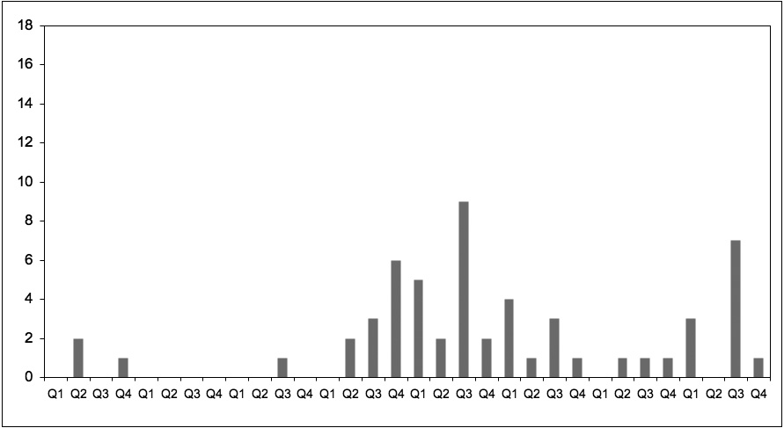
The Technical Coalition
Start of E5/B2 Mandate
Biofuels Act Ratified
House Bill Approval
2002
2003
2004
2005
2006
2007
2008
2009
Notes:
First is the technical coalition that was composed mostly by commercial entities that are affected by the biofuels policy. This includes petrol and automotive companies that were concerned about the impact of the proposed biofuels blend to their operations. This graph shows the number of newspaper articles that specifically talked about the technical issues of biofuels. This became very salient in 2005 and 2006, just before the enactment of the biofuels act. As a result, many of the concerns raised by this coalition was incorporated in the legislation.

Slide 9
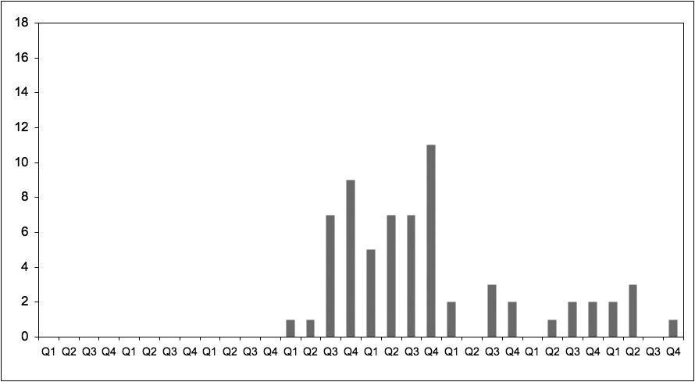
The Biofuels Proponent Coalition
Biofuels Act Ratified
House Bill Approval
2002
2003
2004
2005
2006
2007
2008
2009
Notes:
The second coalition, the biofuels proponent coalition, is composed of government and private entities that were particularly interested in pushing the enactment of the proposed Biofuels Act. The concerns or issues of the biofuels proponent coalition is the swift passing of the Biofuels Act, arguing that this legislation needs to be enacted as soon as possible to address the issues of rising oil prices and global climate change. Also, members of this coalition argue that without the legislation, investors would not be incentivized to come in and jumpstart the industry. So notice that this coalition peaked in 2006, just before the enactment of the biofuel act. The coalition was successful in expediting the formation of the policy by persistently pushing the congress to pass the bills.

Slide 10
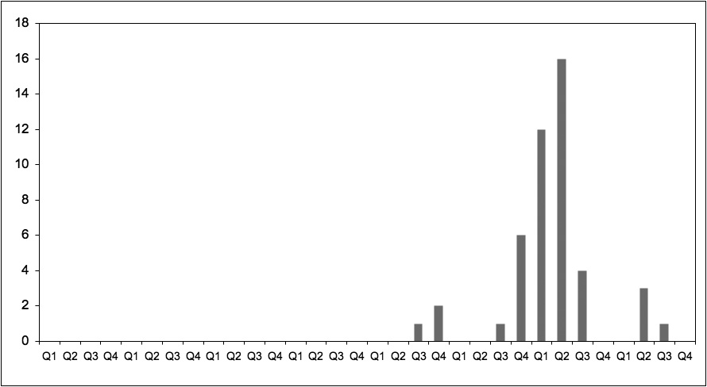
The Food Security Coalition
Resolution for suspension filed
New IRR
Michel’s Statement to the Philippine Government
Ziegler’s Statement to the UN
Biofuels Act Ratified
2002
2003
2004
2005
2006
2007
2008
2009
Notes:
The third is the food security coalition, which peaked a year after the enactment of the biofuels act. This was catalyzed by a series of criticisms of the biofuels policy not just in the Philippines, but also throughout the world. The ideas for questioning the biofuels act was primarily instigated by Dr. Jean Ziegler’s report to the United Nations regarding food insecurity and the comment of a nobel prize laureate, Dr. Michel, regarding the dangers of the biofuels policy in the Philippines. Both these well-known personalities were quoted quite significantly in debates in the house of representatives and the senate. Some members of the congress proposed a moratorium for the implementation of the biofuels act, but this was eventually turned down by the majority. However, this coalition was not at all a failure, as they were able to influence significant changes in the implementing rules and regulations (IRR) of the biofuels act.

Slide 11
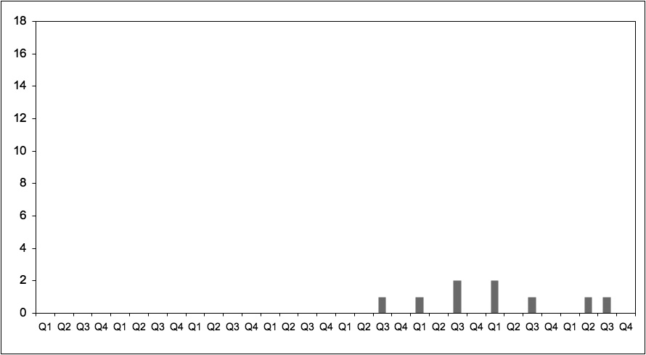
The Forest Conservation Coalition
Biofuels Act Ratified
2002
2003
2004
2005
2006
2007
2008
2009
Notes:
The final is the forest conservation coalition, composed primarily of non-government organizations and a few members of the congress. This coalition is notably dismal, as you can see here in this graph, as they were not able to push the issues of destructive land use conversion to become salient in policy discussions. Interestingly, even though Dr. Ziegler and Dr. Michel, as well as several other reports from Indonesia and Brazil, mentioned the potential of biofuels to cause clearing of forests, only about one or two legislators brought this issue in the congressional sessions. There seems to be no discussion in the media as well, and certainly in any other government documents that I exhaustively reviewed. Much of the discussion centered on the food versus fuel debate.

Slide 12
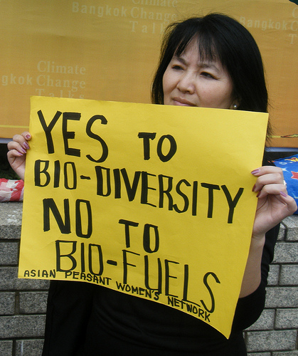
Why is the Forest Conservation Coalition weak?
◆
No perceived direct socio-economic impact at national level
◆
Conflicting sustainable identities of biofuels
◆
Diminutive value of forests among policy-makers
www.itsgettinghotinhere.org
Notes:
I have three propositions to explain the dismal activity and weak salience of the forest conservation issue and coalition.
First, there seems to be a lack of perceived direct socio-economic impact, at least in the context of policy actors residing in the capital of the Philippines. Those who are directly impacted, the upland populations, simply do not have access to the policymaking process. There seems to be no strong representation of upland populations at the national level.
Second, biofuels have conflicting identities that continue to create a divide among policy actors. To many policy elites, the issue of global climate change is particularly more salient than biodiversity protection, although many scholars argue a clear connection between the two. Coalition actors are torn between the “good” side of biofuels and the “bad” side of it. Even environmental NGOs have no clear advocacy for or against biofuels, particularly at the height of the biofuels policymaking in the Philippines.
Third, policymakers see the state of the country’s forest to be of low value. A quote that best captures this is the comment by a senator during one of the sessions on biofuels. I quote, “I know biofuels is being questioned in Europe and the United State, but we have to give biofuels a chance for a uniquely Filipino setting. We do not have any more forest to cut, unfortunately. Only 5% left. So we will definitely not cut our few remaining forests anymore.” In this statement, it is striking how policymakers completely ignored secondary forests that are of high value and that are quite prevalent in many upland regions in the Philippines.

Slide 13
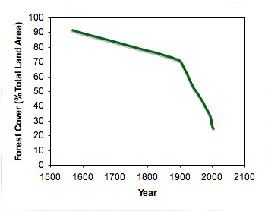

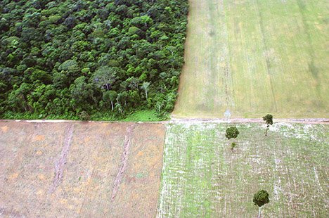
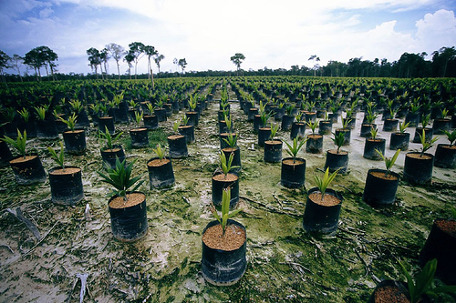
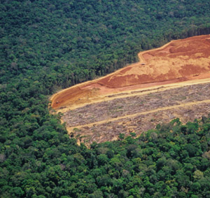
The need for Biodiversity Protection Coalition
◆
Philippines one of the 17 megadiverse countries in the world. 50% endemic to country.
◆
Degradation: >70% of total forests
◆
Degradation cases in Indonesia and Brazil
Notes:
Why is there a need for a strong forest conservation coalition? To date, the Philippines is one of the 17 megadiverse countries in the world, and also identified by UNESCO as a biodiversity hotspot. Although primary growth forests have been degraded significantly, there still remains secondary growth forests that are of high biodiversity value. Moreover, some of the pristine forested areas of the Philippines are actively targeted by the investors and the Philippines government for biofuels development. There is then the risk that the inadequate treatment of this issue in the biofuels policymaking process makes the future of forested uplands more precarious.

Slide 14
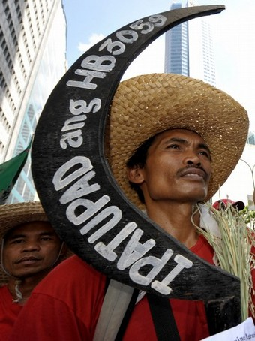
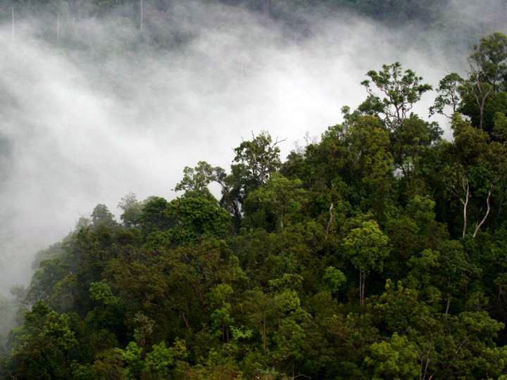
Recommendations
◆
Policies supporting forest conservation
◆
Importance of secondary forests
◆
Political capacity of upland communities
Notes:
In light of the findings of my research, I arrived at several recommendations.
There are several policies that are being proposed that may increase the salience of the forest conservation coalition. An example is the National Land Use Act, which provides much attention to the upland regions of the country. Reinvigorating discussions in these policies may support further discussions on biodiversity-related issues connected to biofuels. The passing of the National Land Use Act may accord more importance to secondary forests.
There is also a need for policymaking to be aware of the political capacity of upland communities. Since the devolution and decentralization of much of the governance of natural resources in the country, which until now is still considered incomplete and incoherent, national level coalitions that particularly advance upland interests have been dissolved. Therefore there is no representation of upland populations in much of the policymaking at the national level.
With these three recommendations in mind, I end my presentation.

Slide 15
Thank You!
Maraming Salamat Po!

