Slide 1
Not as much water as you might think
Jamie Benidickson
Faculty of Law,
University of Ottawa

Slide 2

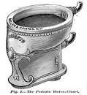
The Water Closet Revolution

Slide 3


Low Flush Options: a) gravitational b) orbital

Slide 4
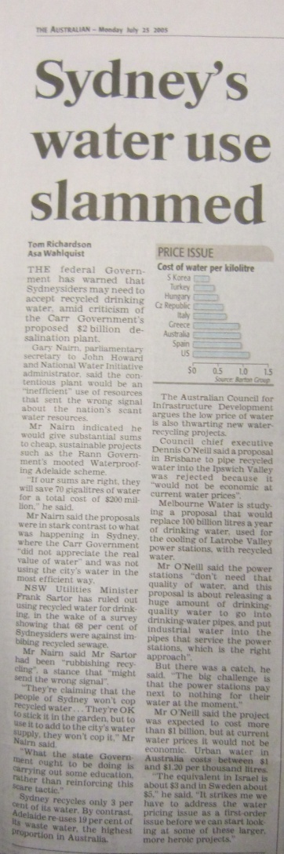
The Australian, July 25, 2005
“The federal government has warned that Sydney may need to accept recycled drinking water, amid criticism of the Carr Government’s proposed $2 billion desalination plant.”

Slide 5
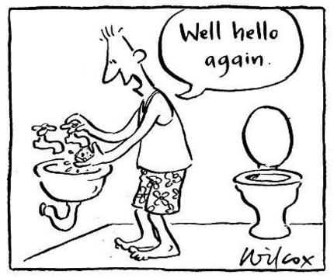
Toilet to Tap
Source: Wilcox, Sydney Morning Herald

Slide 6
Rose George,
The Big Necessity
Four in ten people have no access to any latrine, toilet, bucket or box.... Instead they defecate by train tracks and in forests. They do it in plastic bags and fling them through the air in narrow slum alleyways. If they are women they get up at 4 a.m. to be able to do their business under cover of darkness for reasons of modesty, risking rape and snakebites.

Slide 7
Sub-Saharan Africa:
MDG re Sanitation
2015 Target:
32% + (68% x .5)=66%
2004 Results:
@37% vs. interim goal 52%
Average Performance 1990-2004
7.1 million/yr
Required Performance
2004-2015
34.5 million/yr

Slide 8
“With half the population of developing regions without sanitation, the 2015 target appears to be out of reach”
At the current rate of progress, the world will miss the target of halving the proportion of people without access to basic sanitation. In 2008, an estimated 2.6 billion people around the world lacked access to an improved sanitation facility. If the trend continues, that number will grow to 2.7 billion by 2015.
In 2008, 48 per cent of the population in developing regions were without basic sanitation. The two regions facing the greatest challenges are sub-Saharan Africa and Southern Asia, where 69 per cent and 64 per cent of the population, respectively, lack access.

Slide 9
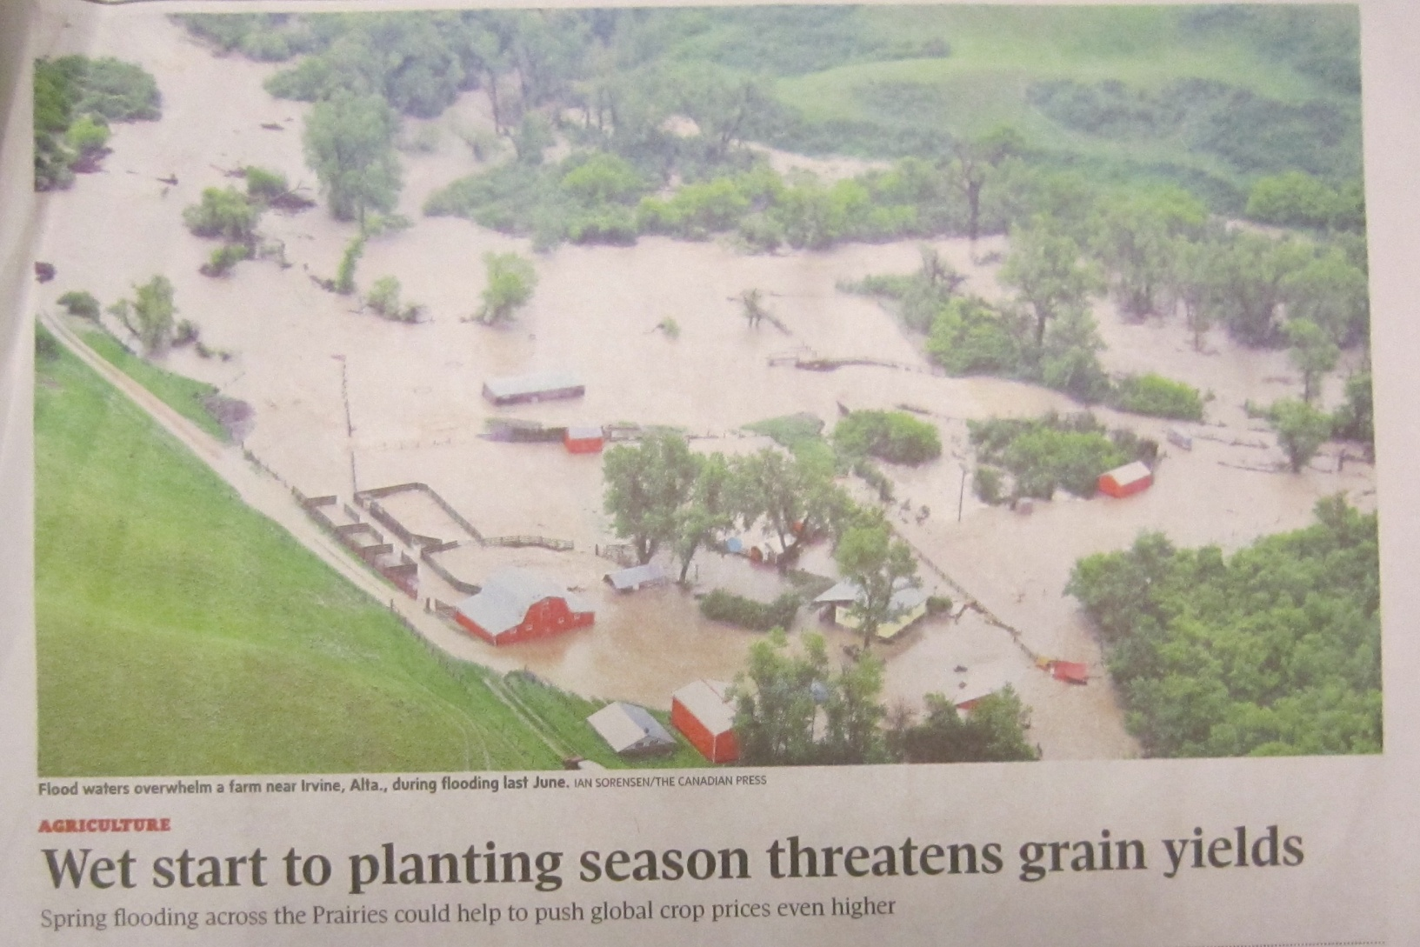
Agriculture not aquaculture

Slide 10
Some Questions We Have in Common
Why is it difficult
to change water law?
Why is it possible
to change water law?

Slide 11
1860s The Confederation Era:
Fisheries Law and Water
Lime, chemical substances or drugs, poisonous matter, (liquid or solid) dead or decaying fish, or any other deleterious substance, shall not be drawn into, or allowed to pass into, be left or remain in any water in any water frequented by …fish
Fisheries Act, 1868

Slide 12
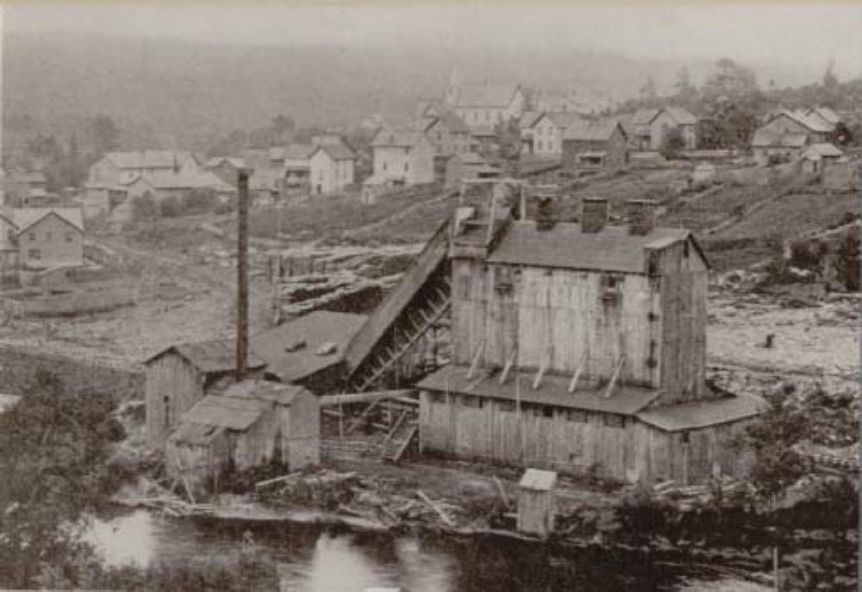
1870s
The Lumber Trade
“…no owner nor tenant of any saw-mill, nor any workman therein, nor other person or persons whosoever, shall throw …any sawdust, edgings, slabs, bark or rubbish …into any navigable stream or river.”
An Act for the better protection of Navigable Steams and Rivers, S.C. 1873, c. 65, s. 1

Slide 13
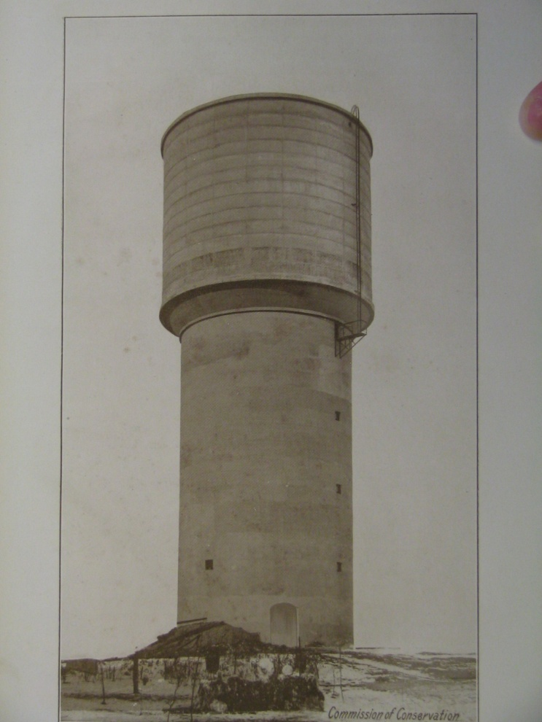
1870s
Municipal Waterworks

Slide 14
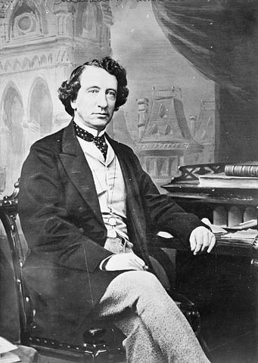
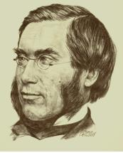
1880s
Intergovernmental Disputes
The Rivers and Streams Act
Controversy

Slide 15
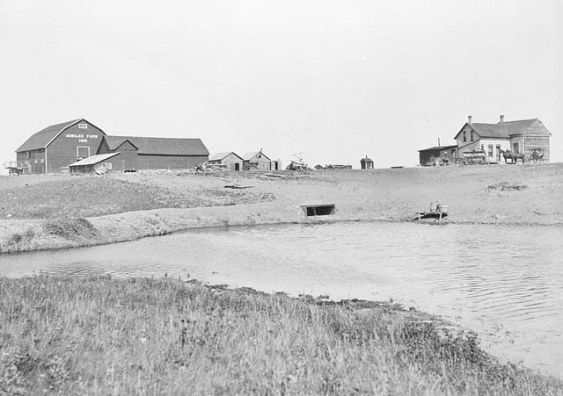
1890s
Irrigation and Western Water Law
“The property in and the right to the use of all the water at any time in any river, stream, watercourse, lake, creek, ravine, canon, lagoon, swamp, marsh …shall, for the purposes of this Act, be deemed to be vested in the Crown…”
North-West Irrigation Act, S.C. 1894, s. 4

Slide 16
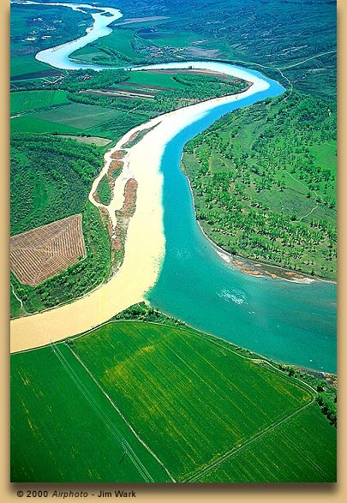
1900s
International Waters
The United States of America and … Great Britain… to prevent disputes regarding the use of boundary waters …between the United States and the Dominion of Canada ...along their common frontier… have resolved to conclude a treaty …
1909 Boundary Waters Treaty

Slide 17
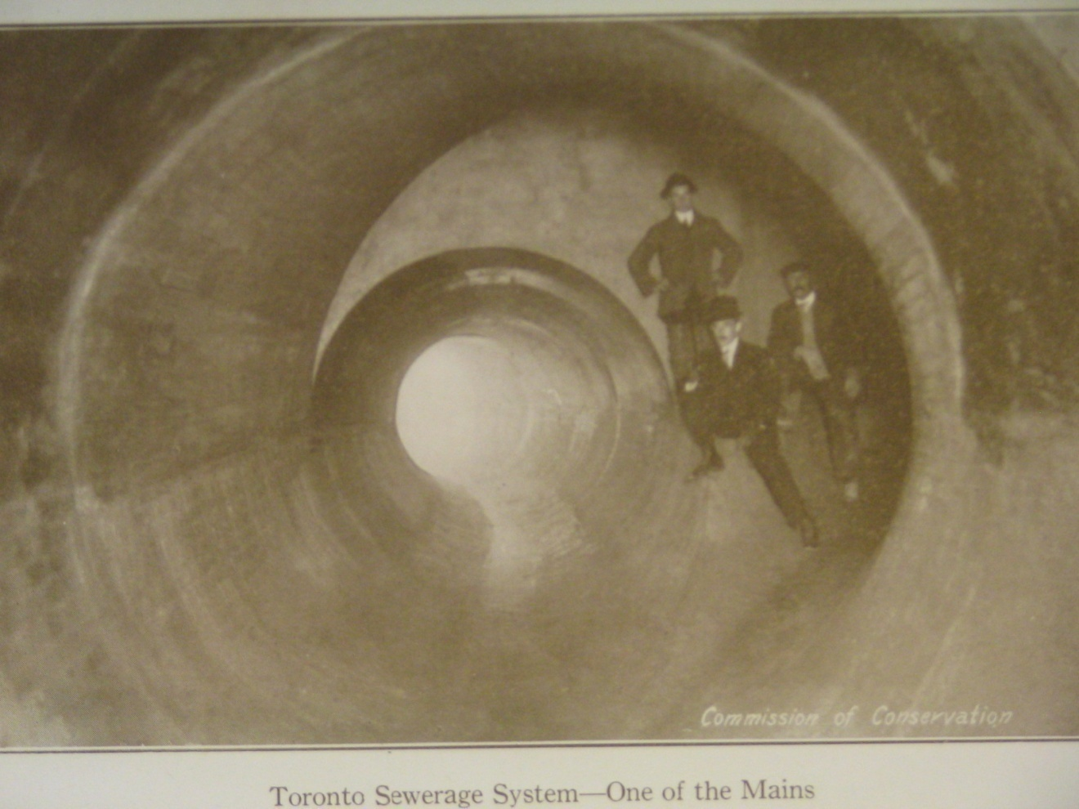
1900s
Sewerage

Slide 18
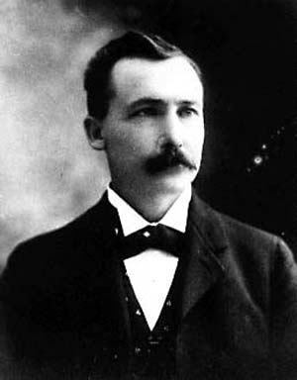
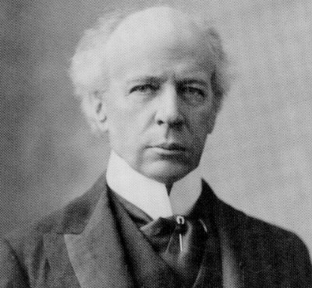
1910s
The (First)Conservation Era
Each generation is entitled to the interest on the natural capital, but the principal should be handed on unimpaired.
Canada's Commission on Conservation (in 1915)
Notes:
I wonder if there is any text setting up the commission on/of conservation that could be used, especially something referring to water

Slide 19
1920s
Pollution and the Courts
“Pollution is always unlawful and, in itself, constitutes a nuisance.”
Supreme Court of Canada, 1928

Slide 20
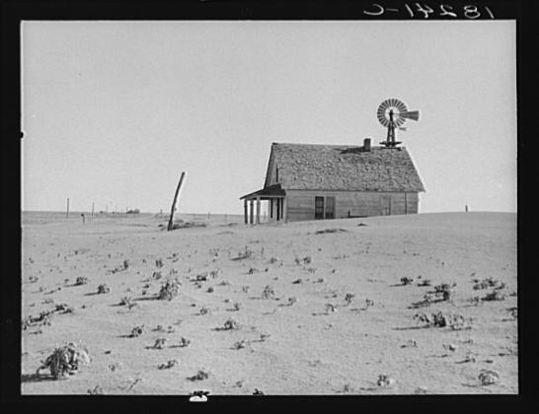
1930s
Water and Security
The …committees …shall …advise …as to the best methods to …to secure the rehabilitation of the drought and soil drifting areas…and to develop …systems of farm practice, tree culture, water supply, land utilization and land settlement that will afford greater economic security…
Prairie Farm Rehabilitation Act, S.C. 1935, s. 4

Slide 21
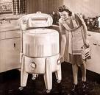
1940s
Clothes In, Nutrients Out

Slide 22
1950s
Water Crimes
“Had the Criminal Code made adequate provision for the prevention of the pollution of streams… it is entirely likely that the present pollution … would not have occurred.”
Saskatchewan Premier T.C. Douglas

Slide 23
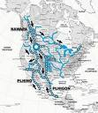
1960s
North American Water and Power Alliance
“a shortage of water – or an excess of consumptive use”

Slide 24
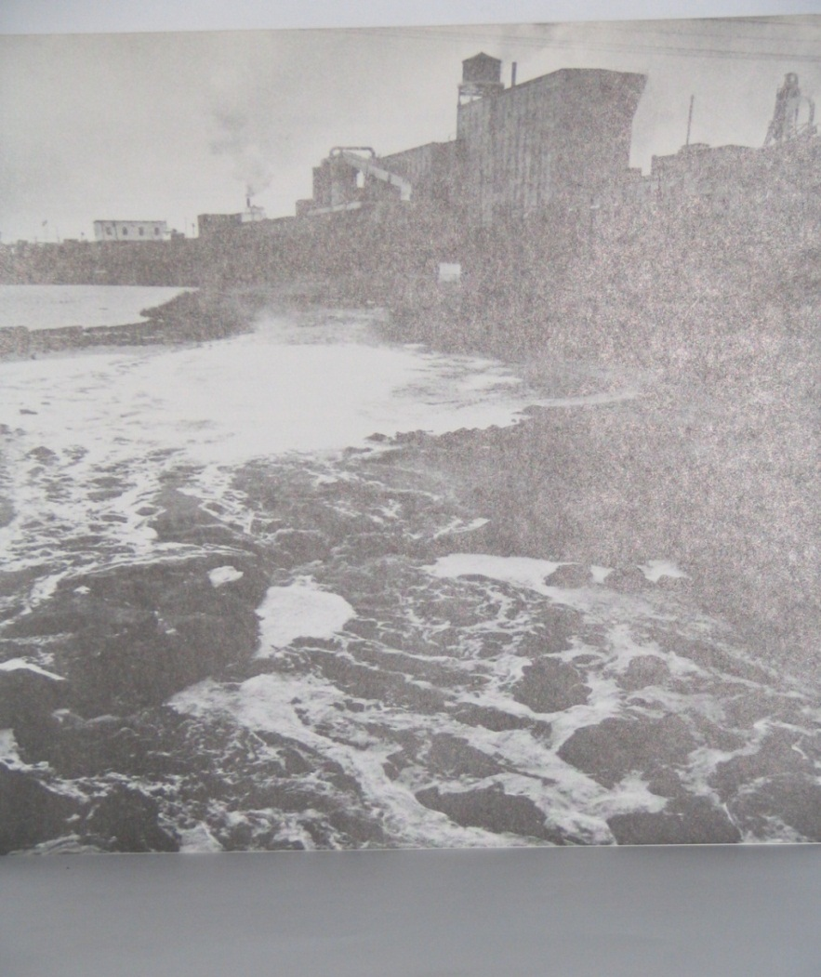
1970s
Mercury Contamination

Slide 25
1980s
Federal Water Policy
Strategies
Water Pricing
Science Leadership
Integrated Planning
Legislation
Public Awareness

Slide 26
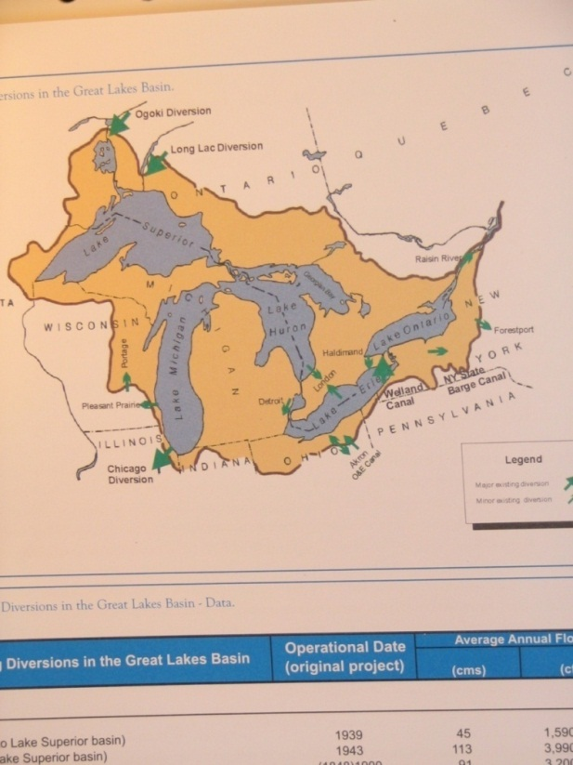
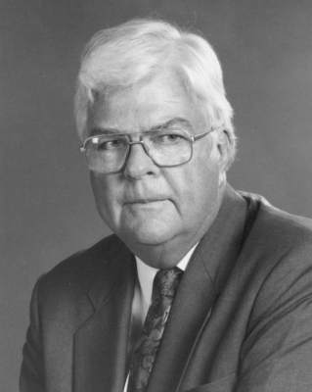
1990s
NAFTA and Water

Slide 27
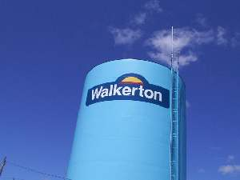
2000s
Walkerton

Slide 28
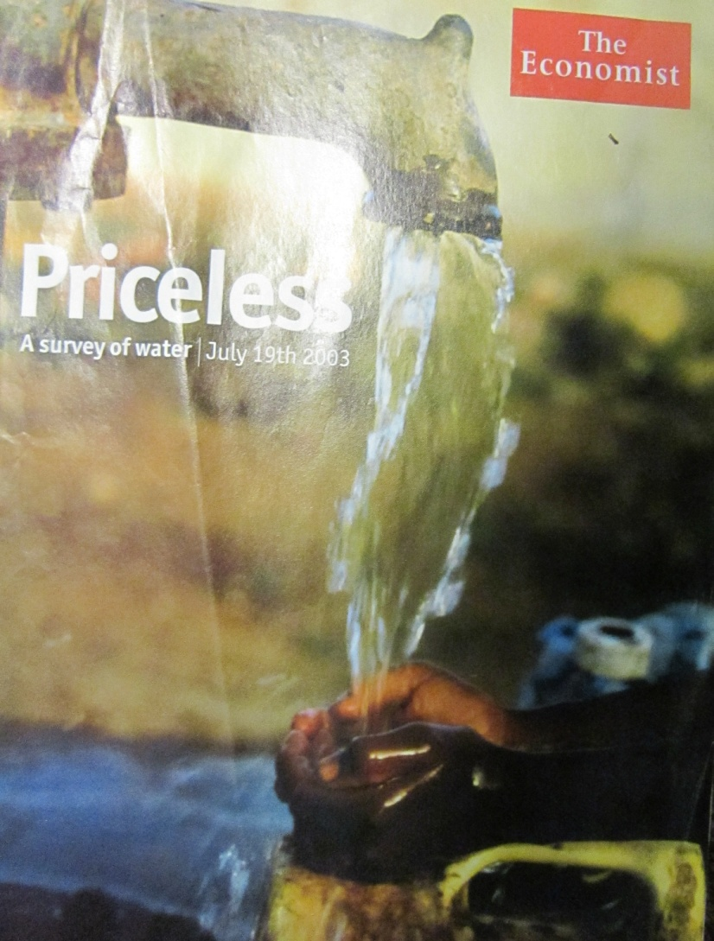
What makes you think you can keep it?
“Canada, Austria and Ireland have more water than they can possibly use.”
The Economist,
19 July 2003

Slide 29
The Three Bears and the Water Supply
“...7% of the world’s renewable water supply meets the ecological needs of about the same proportion of the world’s landmass, so from an ecological perspective, we have no water to spare.”

Slide 30
Water Security in the 21st Century
Ecosystem protection
Economic productivity
Integration of Quality and Quantity
Equity
Conservation
Climate Change and Variability
Trans-boundary allocation decisions

Slide 31
Aldo Leopold and the Land/Water Ethic
“the individual is a member of a community of interdependent parts”
…
“the land ethic simply enlarges the boundaries of the community to include soils, waters, plants and animals, or collectively, the land”

Slide 32
River Basin Management Plans: Article 13
1. Member States shall ensure that a river basin management plan is produced for each river basin district lying entirely within their territory

Slide 33
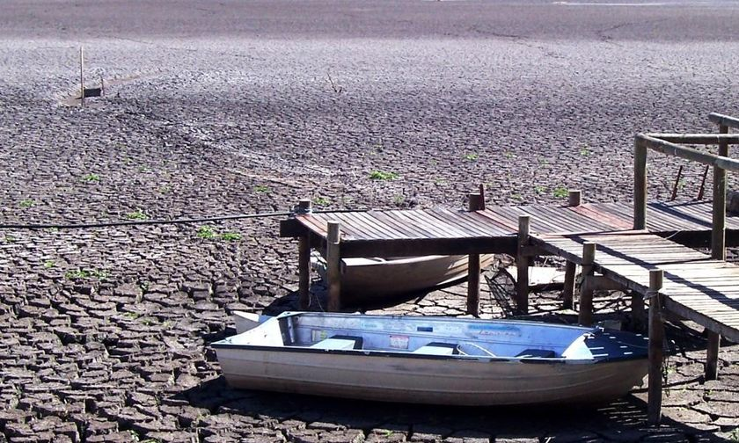
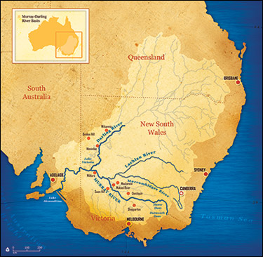
Murray River on a Bad Day and
The Murray-Darling Basin

Slide 34
Murray Darling:
Water Trading Framework
Murray-Darling Basin Commission
(V; NSW;SA)
Interstate Allocation (historic) and Cap (healthy, working river initiative)
Licensing of entitlements
high security (95%); regular
Trading
intra-state (within Allocation)
inter-state (requires adjustment of Allocation)

Slide 35
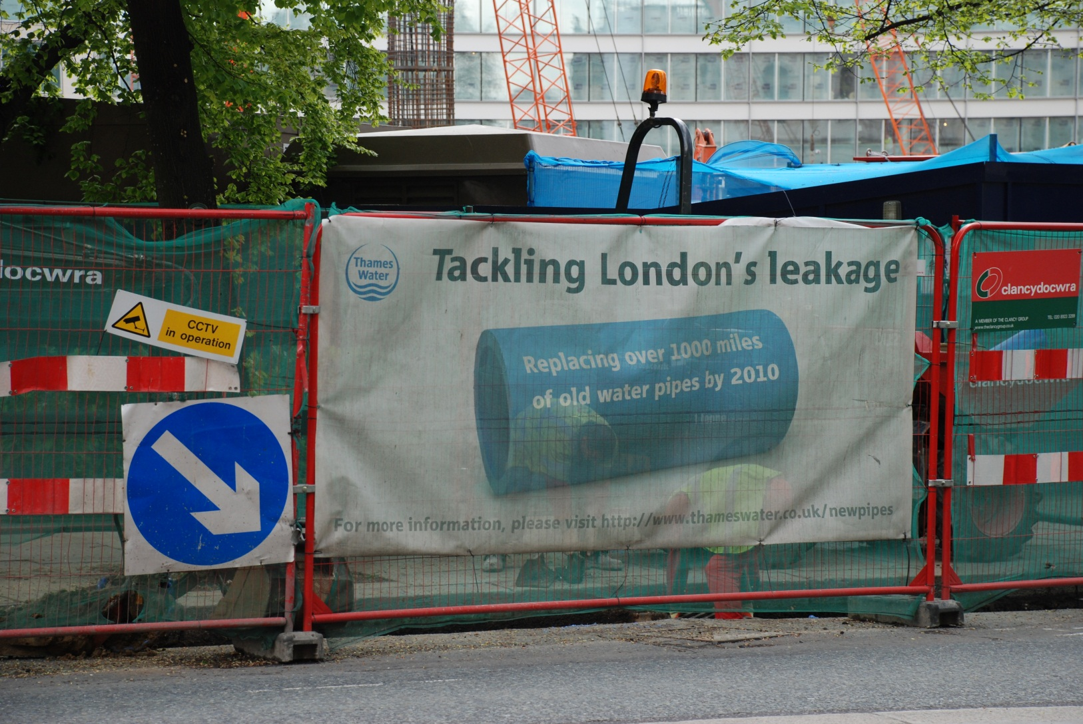
London Water and Climate Change

Slide 36
Water Rights in South Africa

Slide 37
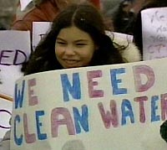
First Nations Water Supply

Slide 38
Canadian Water Sustainability Index
Freshwater Resources
Ecosystem Health
Infrastructure
Human Health/ Well-being
Community Capacity

Slide 39
Full Cost of Water Services
“source protection costs, operating costs, financing costs, renewal and replacement costs, improvement costs associated with extracting, treating or distributing water to the public”
Sustainable Water and Sewage Systems Act, S.O. 2002 c. 29

Slide 40
Source: Statistics Canada, Agricultural Water Use Survey 2007, Methodology Report (Ottawa: Environment Accounts and Statistics Division, 2009) at 24.
Notes:
Note: Data was missing for Quebec, Ontario and Atlantic Region for the “No Practices” category. You had asked if these figures were with respect to irrigation or with respect to all farm functions. I could not find a direct answer from the study but the survey question used, which is produced below, suggests that the questions concerned irrigation practices.
Irrigation Practices and Water Sources
The following questions ask about irrigation practices AND water sources for the operation during the 2007 growing season.
10. Which of the following practices were used for the purpose of water or energy conservation?
(Mark all that apply)
Wind breaks
Leaving stubble on fields (e.g., minimum tillage, direct seeding)
Watering at night or in the morning
Pressure reduction
Water or energy saving nozzles
Other energy saving methods or devices (specify) ___________________________________
No practices don

Slide 41
Great Lakes Basin Sustainable Water Resources Agreement (2005)
The need for all or part of the Exception cannot be reasonably avoided through the efficient use and conservation of existing water supplies;
The Exception shall be limited to quantities that are considered reasonable for the purposes for which it is proposed.

Slide 42
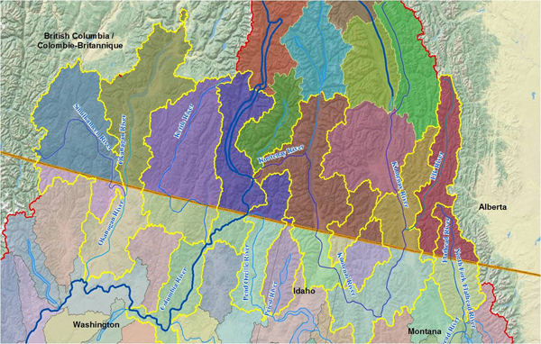

International Joint Commission
Watershed Initiative

Slide 44
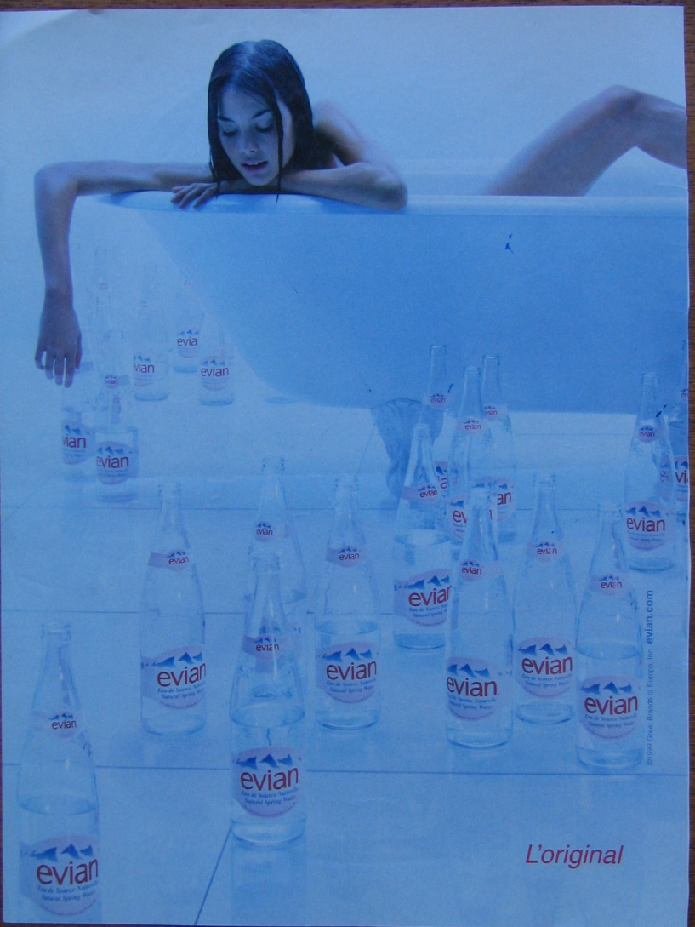
2000s Basic Necessities

