Slide 1
Iucnael Colloquium
South Africa - July 2011
Riparian Forest Legal Protection
& Water Resources Conservation in Brazil
IMPACTS ON QUALITY AND QUANTITY OF AVAIBLE WATER
Ms.Carolina Dutra* (Unisantos)
Ms. Maurício Duarte dos Santos* (Unimonte)
Dr. Vladimir Garcia Magalhães (Unisantos)
Ms. José Carlos Loureiro da Silva (Unisantos)

Slide 2
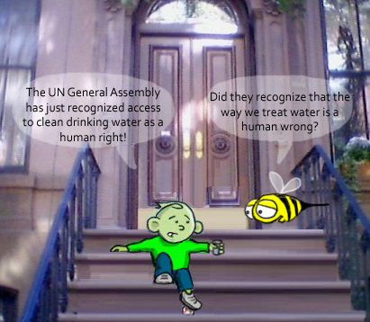

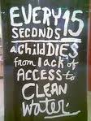


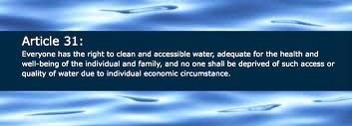
Water is Life: a Human Right, not a Privilege
Water is a human right (and wrong) © Joe Mohr
Movement behind Article 31,
a proposed addition of Right to Water
to the Universal Declaration of Human Rights

Slide 3
Water resources in brazil
Quantity and Quality
√ 13% of the Planet’s freshwater;
√ 50% of Latin America’s freshwater;
x Pollution and shortage of water in several regions.
Legal Framework
Water Code of 1934 (private ownership system);
Federal Constitution of 1988 (access to water, requisite to dignified life);
National Water Policy (Federal Law n. 9433/97, sustainability of water uses).
Water protection depends on riparian forest conservation!

Slide 4

Riparian Forest
Legal Regime
Forest Code (Federal Law n. 4.771/1965);
Permanent preservation area – “APP” (article 1);
Recognition of its environmental service.
“Article 1 – The existing forests in the national territory and the other forms of vegetation, recognized as a utility to the lands where it grows, are common interest goods to all of the country’s inhabitants, putting into practice property rights, having the limitation that general legislation and specially the present one establishes.
§ 2 – Considering the purpose of this Code, it is understood as:
II – permanent preservation area: the protected area in terms of 2nd and 3rd articles of this Law, covered or not by native vegetation, with the environmental function of preserving water resources, the landscape, the geological stability, biodiversity, the fauna and flora gene flow, to protect the soil and to ensure the well-being of human population” (free traduction).

Slide 5
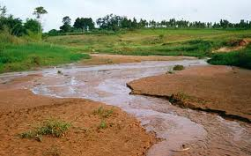
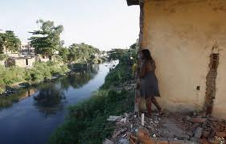
Riparian forest deforestation: impacts
Riparian forests in Brazil are being increasingly destroyed!
Few regional and local studies, but no national statistics!
Impacts of the riparian area deforestation:
Silting of rivers and changes on their courses;
Grounding of wetlands;
Erosion;
Leaching;
Loss of biodiversity (fauna and flora);
Loss of ecological corridors;
Greenhouse gases emission;
Increased vulnerability to natural disasters.

Slide 6
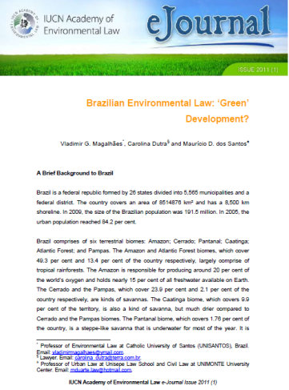
Decreasing Legal Protection:
More Impacts!
A proposal for a “New” Forest Code
has started to be voted by National Congress Info: Brazilian Report
IUCN E-Journal 2011
Proposal of Changes | Science’s Position
Art. 4, I: change the reference border of the strips along with the water streams, starting on the border of the lower bed of the natural water course (no more on the higher margin). | This change in the reference border would mean losing 60% of protection for these areas.
Art. 4, I, a: reduction of APPs from 30 to 15 meters for rivers with up to 5m of width. | These strips amount to over 50% of the extension of the drainage network. Such reduction would result in a decrease of 31% in the areas protected by riparian APPs.
Art. 4, §1: The lowlands will be excluded of protected areas concept. | Increasing vulnerability of the environment to disasters, especially by floods and erosion.
Art. 5: Reduction of protected areas in artificial reservoirs | The Conama’s Resolution 302 will be revoked and this reduction could be defined on each environmental license.
Art. 3, §1: The Project creates the possibility to the Federate States to increase or decrease up to 50% the APP’s strips. | This change will lead to a non-uniform system.

Slide 7
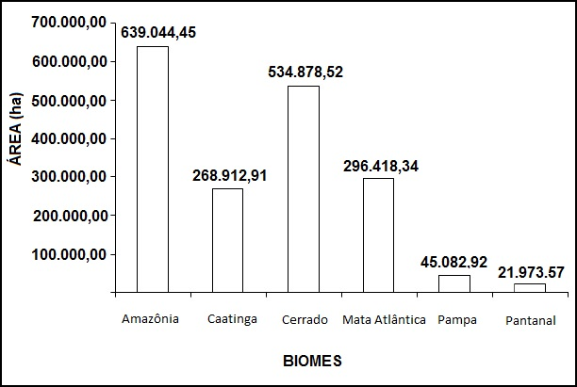

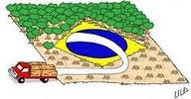
Decreasing Legal Protection: More Impacts!
Estimates of protected areas and loss of agricultural areas according to current and proposed legislation
Area equivalent to reduction of riparian forest of rivers with
5m of width according to proposed legislation in biomes
*Source: Sparovek, G. Esalq/USP – 2011 | Permanent Protection Areas |  | Unprotected Natural Vegetation | Loss of Agricultural Areas
 | Required | To restore
Current Forest Law | 190 | 55 | 134 | 97
Proposed Law | 135 | 0 | 156 | 0
*Source: Climate Observatory
Can you imagine
a reason for it?

Slide 8

Conclusion
National Policy on Water Resources and Forest Code:
Interaction? Harmonization?
Future Scenario:
Disasters?
Source: Greenpeace.

Slide 9

Many Thanks!
Carolina_dutra@terra.com.br mduarte.law@hotmail.com

