Slide 1
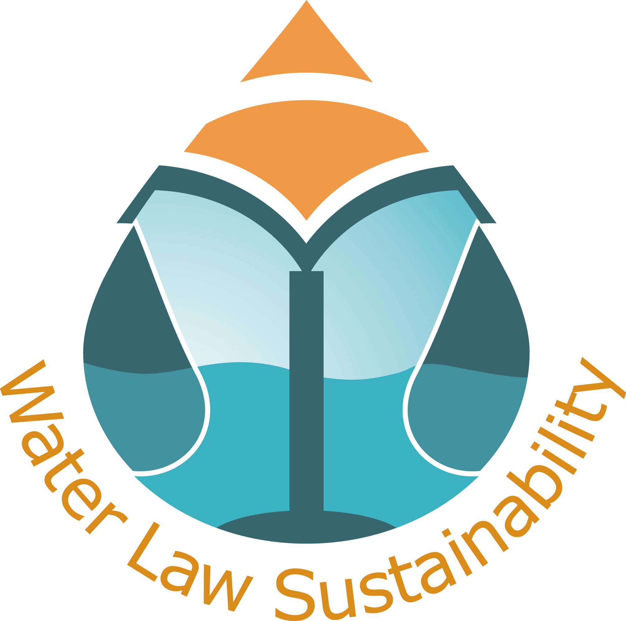
9th Annual Colloquium of the IUCN
Academy of Environmental Law
Water and the Law: Towards Sustainability
THE RIGHT TO WATER AND TO HYDRIC
SUSTAINABILITY IN THE BRAZILIAN LEGAL SYSTEM
Eastern Cape, 03 – 07 July 2011
Heline Sivini Ferreira, PhD
Maria Leonor Paes Cavalcanti, LLM
Patryck de Araújo Ayala, PhD

Slide 2

OBJECTIVE
Brazilian water context
Fundamental right to life and to live in an ecologically balanced environmental
Fundamental right to water
Hydric sustainability
Notes:
Basically, our intention here is to demonstrate that even without provision in the Brazilian Constitution, the right to water can be considered as a fundamental right, and, based on that premise, analyse if our water legal system can provide any level of environmental sustainability.

Slide 3
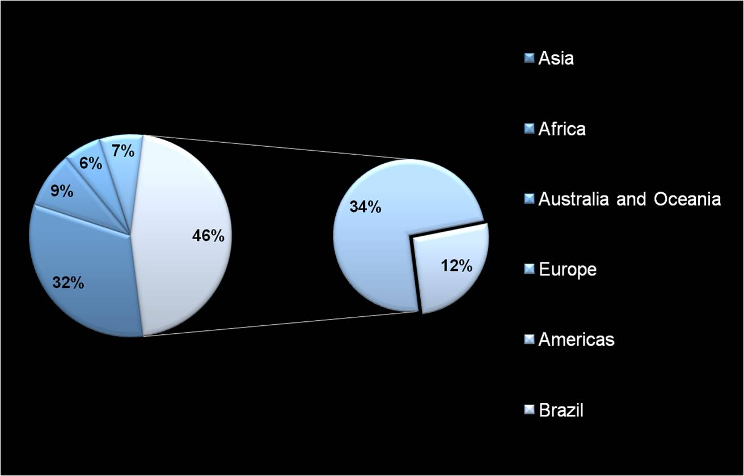
WATER DISTRIBUTION WORLDWIDE
Source: Water National Agency
Notes:
In a first moment, I would like to present you some data about water in the Brazilian context.
On this pie chart, we can see how the water is distributed worldwide. Occupying almost half of the South American continent, Brazil comprises 12% of the total water available in the world.

Slide 4
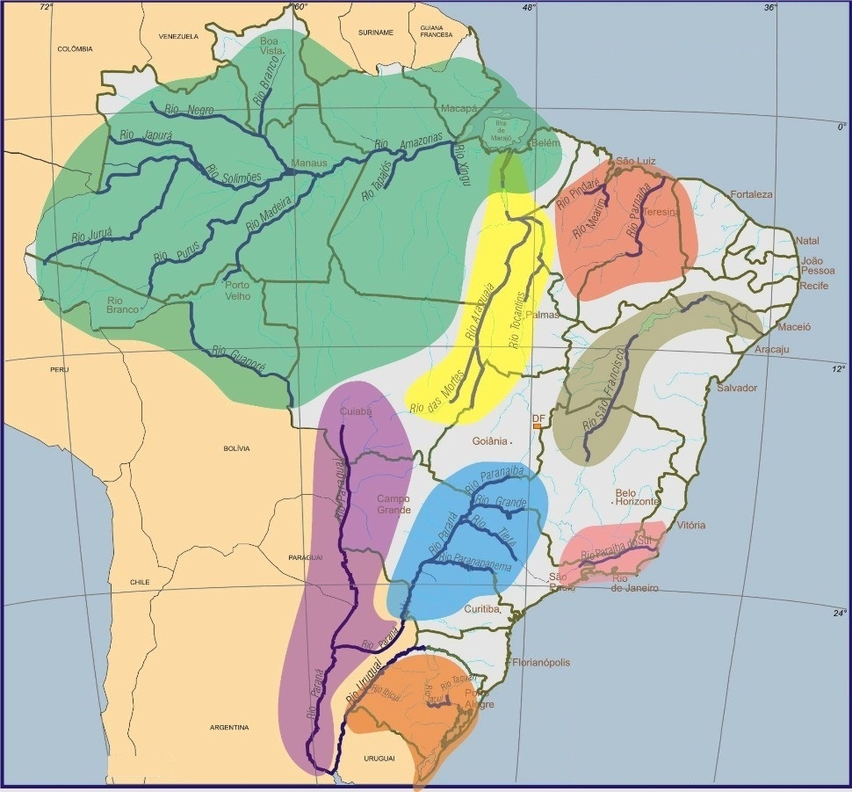
BRAZILIAN BASINS
There are twelve hydrographic regions
in Brazil.
Amazon Basin
Northeast Basin
São Francisco Basin
Tocantins-Araguaia Basin
East Basin
Tietê-Paraná Basin
South Basin
Paraguay Basin
Source: Water National Agency
Notes:
This water is distributed along 12 hydrographic regions, and on this map we can see the seven main Brazilian basins, some of them shared with other countries, as Argentina, Paraguay, Uruguay, Peru and Bolivia.
But I would like to call your attention to São Francisco and Amazon Basins:
- the São Francisco Basin, shown in greyish yellow, because it is located in the driest Brazilian region.
and the Amazon Basin, shown in green, because it is the largest basin in the world.
Despite of being a rich country in hydric resources, distribution of water in Brazil is very unequal in terms of geography and population.
Just to give you and idea, while the Amazon State has 74% of water availability, the Amazon Basin is inhabited by less than 5% of the population.
On the other hand, the Northeast region, where is located the São Francisco Basin, presents a scenario of quantitative insufficiency. According to the Water National Agency, each habitant have access to less than 500 cubic meters of water a year, what indicates a restriction situation according to the United Nations Organization.

Slide 5
WATER SUPPLY IN BRAZIL
Source: Brazilian Institute of Geography and Statistics (2000/2010)
Notes:
According preliminary data from the Brazilian Institute of Geography and Statistics:
there are 5% more houses with piped water supply in 2010 than there was in 2000;
6% less houses using water wells and springs in 2010;
but from 2000 and 2010, almost the same number of houses are still served with water from sources not identified. It means that about 14 million people can be using contaminated or polluted water, for example.
* Average: 3.5 people living in each house.

Slide 6
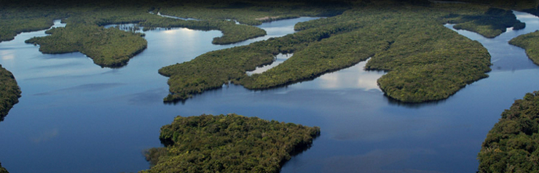
WATER AS A HUMAN RIGHT
UN Resolution 64/294
In 2010 the General Assembly of the United Nation formally recognized water and
sanitation as human rights.
Notes:
Having said that, I would like to consider water on the international legal context before to analyze it in the Brazilian scenario.
Although in 2010 the General Assembly of the United Nations formally recognized the human right to water and sanitation.
In the opportunity, the representative of Brazil said the right to water and sanitation was intrinsically connected to the rights to life, health, food and adequate housing.
Unfortunately the human right to water content was not specified, what can make its implementation even harder.

Slide 7
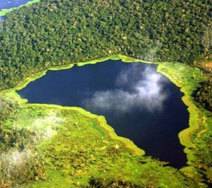
WATER AS A HUMAN RIGHT
Committee on Social, Economic and Cultural Rights
General Comment n. 15 (2002)
Availability
Accessibility
Quality
Affordability
Notes:
Despite of that, interpreting the UN Resolution with the General Comment n. 15 from the Committee on Social, Economic and Cultural Rights, the content to the human right to water can be defined through four main elements: availability; accessibility; quality; and affordability.
The right to have an equal access to drinking water in sufficient quantity and quality to meet people’s basic needs leave us with a reference to analyze the Brazilian context: there is a minimum level of benefits to be assured.
* Comment: entitles everyone to sufficient, safe, acceptable, physically accessible and affordable water for personal and domestic uses.
* International Covenant on Economic, Social and Cultural Rights.

Slide 8
THE RIGHT TO A HEALTHY ENVIRONMENT
Brazilian Federal Constitution, article 225
All have the right to an ecologically balanced
environment. Which is an asset of common use and
essential to a healthy quality of life,
and both the Government and the community
shall have the duty to defend and preserve it
for present and future generations.
Notes:
The Brazilian Constitution establishes a fundamental right to an ecologically balanced environment, an asset of common use, unique and indivisible.
According to the Constitution, this balanced environment is important for a good quality of life, but thinking ahead, I would say that a healthy environment is essential for life itself.
And its our duty, as Government and society, to protect it for present and future generations.

Slide 9

THE CONCEPT OF ENVIRONMENT
Act 6.938/1981
Environment means any/and or all of the conditions, laws, influences and interactions of a physical, chemical
and biological nature, that permit, shelter and govern
life in all its forms.
Notes:
Based on that, I mean:
in the fact that the environment is a diffuse right;
is important for a good quality of live;
and is vital to life and the continuity of life
it is possible to conclude that water resources can’t be used with no restrictions.
The interests of present and future generations of life in all its forms must be taken into account.

Slide 10

BRAZILIAN WATER LEGAL SYSTEM
Act n. 9.433/1997
Water National Policy
Act n. 11.145/2007
Sanitation National Policy
Notes:
In addition to this reality, Brazil has defined an infra-constitutional order to protect water resources.
In 1997, Brazil has established a Water National Policy which recognizes water as a limited natural resource with economic
Value and establishes that under situations of scarcity, human consumption and the watering of animals shall be priority uses of water resources
Ten years later a Sanitation National Policy entered into force stating that sanitation services, including water supply, must be provided considering universal access, public health and environmental protection.

Slide 11
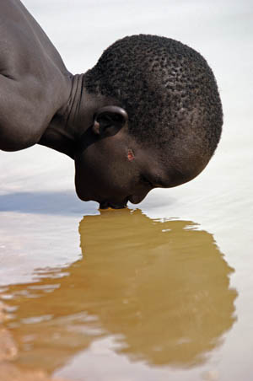
THE FUNDAMENTAL RIGHT TO WATER
Water is a basic human need, which is directly related
to the right to live.
A healthy environment is a essential condition for living,
and the water is part of this
asset of common use.
The right to water is a fundamental right.
Notes:
Considering that:
the right to water is connected to other fundamental rights,
- supported and enhanced by the infra-constitutional legal system,
it should be recognized as a fundamental right, even though the Brazilian Constitution does not expressly do that, as the South African Constitution do, for instance.

Slide 12

HYDRIC SUSTAINABILITY?
The Brazilian water legal system recognizes the
minimum core of existence principle.
HOW ABOUT ENFORCEMENT?
Notes:
Recognized as a fundamental right and a basic living being need, we can suggest that the Brazilian legal system has a similar approach to the one presented by the General Comment n. 15 from the Committee on Social, Economic and Cultural Rights on the International Covenant on Economic, Social and Cultural Rights: water resources are part of what it should be understood as a minimum core of existence.
Apparently, Brazil has a hydric sustainable legal system. But how about enforcement?

Slide 13
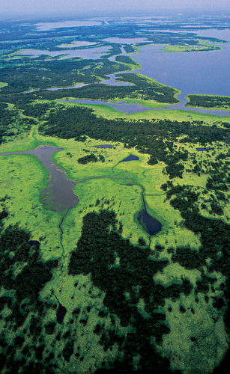
THE LACK OF ENFORCEMENT
Coordination gap between
Environmental Policies and Acts
Flexibility of Environmental
Policies and Acts
Resistance from national
courts to innovate
Notes:
Brazil do faces some challenges on enforcement matters. Just to illustrate:
1) There is coordination gap between Environmental National Policies and Acts.
The Pesticides Act, for instance, does not ensure an efficient control over the use of these substances in agriculture, what reflects directly on the quality of water supply.
2) The Environmental Policies and Acts are becoming more flexible in term of protection.
The Project to change the Forest Code, for example, is threatening important areas to the protection of water supplies.
According to the Institute of Applied Economic Research, 47 million hectares of natural reserves could no longer be legal reserves. As a result, ecosystem services as water supply could be compromised.
3) It seems to be a kind of resistance from the courts to go beyond the ordinary.
Talking about national jurisprudence, specifically in the higher courts, there is not a single row clearly mentioning the fundamental right to water.
On the other side, we can not deny there are some decisions suggesting that some natural resources, due to its scarcity and finitude, deserve an enhanced protection. And that is the case of water resources. It also took into consideration the sustainability principle.

Slide 14
CONCLUSIONS
Even without being expressly recognized by the Constitution,
the right to water can be considered as a fundamental right in Brazil.
The water Brazilian legal system seems to recognize
the minimum core of existence principle.
Despite facing enforcement problems, water is under protection in the Brazilian legal system and some courts have already recognized the importance of its maintenance to present and future generations.
In this context, the minimum core of existence should be used
to assure the fundamental right to water and reinforce
water sustainability Brazil.
Notes:
Even without being expressly recognized by the Constitution, the right to water can be considered as a fundamental right in Brazil.
The water Brazilian legal system seems to recognize the minimum core of existence principle.
Despite facing enforcement problems, water is under protection in the Brazilian legal system and some courts have already recognized the importance of its maintenance to present and future generations.
In this context, the minimum core of existence should be used to assure the fundamental right to water and reinforce water sustainability Brazil.

