Slide 1
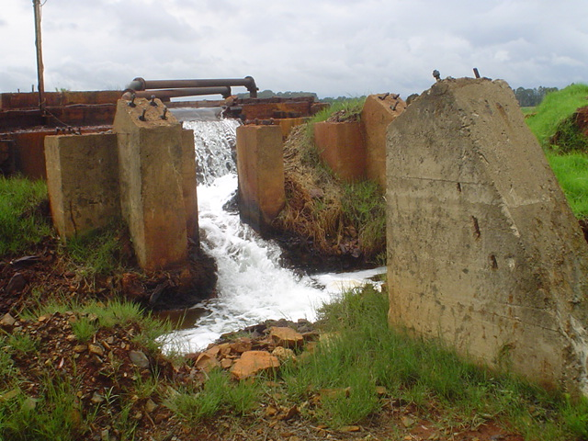
Professor Tracy Humby, University of the Witwatersrand
AMD on the Witwatersrand Gold Fields: A Case Study on the Imposition of Moral Responsibility and Legal Liability for Historically-Caused Pollution

Slide 2
Argument
Historically-caused pollution poses enormously difficult issues regarding the allocation of legal liability for preventing and/or remediating such pollution.
The imposition of legal liability in the present – even where the law is clear that liability exists for historically-caused acts of pollution – is inextricably bound up with the construction of the morality of such past acts. Legal liability will not be pursued unless the past conduct is seen as morally reprehensible. The legality of past conduct plays a critical role in our assessment of its morality.

Slide 3
Argument
The construction of the morality of historical acts of pollution takes place discursively – through the use of language that reflects but in part also constitutes the past and our perceptions of it.
This is a contested process because different interest groups will offer competing constructions of the past.

Slide 4
Argument
Legal scholars can play a constructive role in these discursive contestations by highlighting the lineage of legal authority applicable to the acts of pollution at the time.
In the case of AMD on the Witwatersrand, however, in addition to proving that there were legal obligations on mining operators to treat polluted mine water, one would need to prove that they foresaw the impacts of their operations on future generations in order to hold them both morally responsible, and legally liable in terms of current laws.

Slide 5
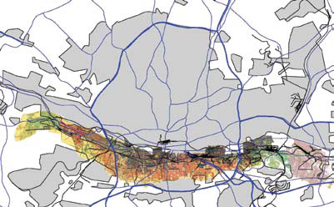
The historically-caused pollution: AMD on the Witwatersrand
Map showing the entire mined-out reefs on the Witwatersrand (McCarthy, 2010: 12).
Notes:
The Witwatersrand is an area in Gauteng, undergirding the city of Johannesburg that stretches from Roodepoort in the west to Germiston in the east. The area contains a number of gold-bearing reefs that were deposited about 2 800 million years ago, when the Earth’s atmosphere contained no oxygen. Certain minerals deposited along with the gold dissolve in the contemporary atmosphere. The most significant of these for purposes of the generation of acid mine drainage is iron sulphide, also called pyrite or ‘fools gold’ (McCarthy, 2010: 5).
Gold was discovered on the farm Langlaagte in March 1886. Within a few months the gold-bearing reefs had been tracked the full 50km length of the Witwatersrand from east to west.

Slide 6
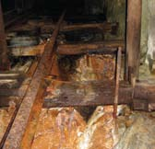
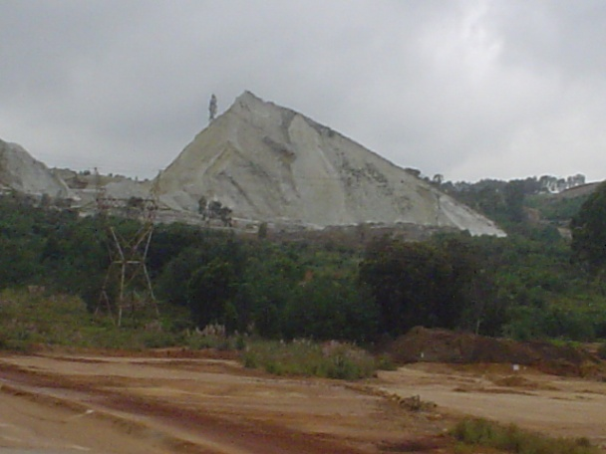
The historically-caused pollution contd
Air and water enter the mined-out void. During mining operations continuous pumping ensures that the works are not flooded.
Crushed rock from which gold has been extracted (but not iron pyrite or other minerals) is brought to the surface.
Notes:
The early miners very soon discovered that traditional ‘pick-and-shovel’ methods were inadequate to mine Witwatersrand gold. More and more sophisticated methods of mining the gold at ever deeper levels – up to 4km below the surface – developed over the next few decades.
In time a labyrinthe of underground shafts, tunnels and wider mined-out areas was created. The interconnections between these workings resulted in three large interconnected ‘basins’ underlying the Witwatersrand: namely, the Western, Central and Eastern Basins respectively.
During mining operations water was prevented from staying in the underground basis by continuous pumping operations. When the mines on the Witwatersrand started closing in the 1950s due to declining profits, mines had to assume the responsibility to pump the water of adjacent mines, until no operators were left and the void began to fill.

Slide 7
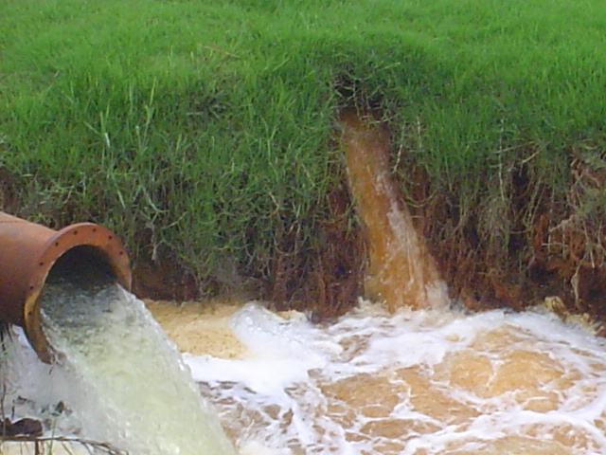
The historically-caused pollution contd
When iron pyrite is exposed to oxygenated water it forms sulphuric acid. Other minerals dissolve in the acidic water. The resulting run-off is acid mine drainage (AMD): Low in pH, high in dissolved minerals and sulphates, it is both toxic and corrosive.
Notes:
After cessation of pumping the three Basins slowly began to fill with AMD. The Western Basin flooded first with the first decant occurring in 2006. The Central and Eastern Basins are in the process of filling. It is predicted that the Central Basin will flood within the next 12-24 months should pumping stations not be established to pump the water and treat it at surface.
The significant risks associated with AMD include: (1) increased seismicity in areas where old mines have flooded – that many of these are densely populated is a problem; (2) contamination of shallow groundwater sources down-gradient of the flooded voids. These include dolomitic aquifers that provide clean water to the Cradle of Humankind World Heritage site; (3) geotechnical impacts at lower-lying levels; (4) deleterious eoclogical impacts on fauna and flora where the AMD has decanted into surface sources; (5) the salinization of regional river systems, specifically the Crocodile and Vaal river systems; (6) deleterious health impacts on communities reliant on untreated water resources.

Slide 8
The scale of the problem
Pumping and treatment of more than 150Ml/d across all three basins, ingress control and monitoring.
Financial implications: Capex – R441 660 668; annual operating costs of R121 255 000; ingress control R626 261 506.
In March 2011 DWAE was given a provisional allocation of R225 000 000 in the national budget vote to tackle the problem.
Notes:
There are a variety of technical solutions to deal with the problem. In the short-term a team of experts appointed by the government in 2010 has recommended both pumping of water from the mine voids to maintain ECL and treatment of the water with limestone; and (2) ingress control.

Slide 9
Legal liability for historically-caused pollution
Host of laws potentially applicable – section 28 of the National Environmental Management Act 107 of 1998 is the centrepiece.
Section 28(1) initially provided as follows:
  ‘Every person who causes, has caused … significant pollution or degradation of the environment must take reasonable measures to prevent such pollution or degradation from occurring, continuing or recurring, or, in so far as such harm to the environment is authorised by law or cannot reasonably be avoided or stopped, to minimise and rectify such pollution or degradation of the environment.’

Slide 10
Legal liability for historically-caused pollution
In Bareki v Gencor 2006 (1) SA 432 (T) the court held that the duty in terms of s 28(1) was strict and that the common-law presumption against the retrospective operation of laws prevented this duty from being applied to acts of pollution prior to the commencement of NEMA. The court said:
‘If the Legislature intended attaching new legal consequences to past conduct by creating severe strict liability retrospectively, one would have expected that such an intention would have been made clear.’

Slide 11
Legal liability for historically-caused pollution
That the legislature did intend for this duty of care to apply to retrospective acts of pollution became clear after a 2009 amendment to s 28 inserted s 28(1A) which provides:
(1A) Subsection (1) also applies to a significant pollution or degradation that-
(a) occurred before the commencement of this Act;
(b) arises or is likely to arise at a different time from the actual activity that caused the contamination …

Slide 12
Legal liability for historically-caused pollution
NEMA further entrenches an octopus-like liability for pollution prevention and remediation measures that extends to landowners, tenants, users of land (s 28(2)) and – where the State has taken measures itself and seeks to recover costs – from an even wider potential group of actors (e.g. anyone who ‘directly or indirectly contributed to’ the pollution or degradation) (s 28(8)).

Slide 13
Enforcing legal liability for historically-caused pollution: Discursive contestations
Government policy and media statements on this issue initially centred on the application of the polluter pays principle to ensure that mining companies assumed responsibility for all costs arising from the impact of their operations on the environment (White Paper on Environmental Management in SA; White Paper on a Minerals and Mining Policy for South Africa).

Slide 14
Enforcing legal liability for historically-caused pollution: Discursive contestations
Until quite recently the Minister responsible for Minerals, and key officials and commentators have been insisting that the ‘polluter will pay’.
Post IMC Team of Experts report (Dec 2010): A significant shift to conceding that the State must take primary responsibility for funding and implementing the solutions.

Slide 15
Enforcing legal liability for historically-caused pollution: Discursive contestations
On ‘possible’ partnerships with the private sector the ToE Report held: ‘The State will fund and operate measures to manage AMD in the Western, Central and Eastern Basins via one or more of its agencies. In the short term the mining industry is expected to contribute some of the costs.

Slide 16
Enforcing legal liability for historically-caused pollution: Discursive contestations
In the medium to long term the country should explore the viability of an environmental levy on all operating mines to fund the environmental legacies of the mining industry, including the management of acid mine drainage’ (at 80).
The policy thus appears to be shifting, allocating liability to the taxpayer and current operators. NEMA’s ‘octopus-liability’ potential to pursue past operators and the social actors who drove them is thus seemingly being abandoned.

Slide 17
Enforcing legal liability for historically-caused pollution: Discursive contestations
This shift can possibly be ascribed to the emergence of a ‘benefit discourse’ encapsulated in the following statement of Prof Terence McCarthy:
‘Finally, while it would be easy to point fingers at the mining sector, the present problem is the result of over a century of mining by literally hundreds of companies, the majority of which have long since ceased to exist. Clearly, they cannot be held responsible (and financially liable) for footing the bill. In reality, taxes on past mining activities have benefitted all of us – the infrastructure we enjoy in the Gauteng City Region has been funded in no small part by mines that are now defunct. As such, the bulk of the bill must come from the national fiscus – existing mines that continue to contribute to the problem must also contribute on a pro rata basis, as must local and provincial spheres.’

Slide 18
Enforcing legal liability for historically-caused pollution: Discursive contestations
Related to these shifts, there appears to be a pervasive perception that previous mining operators functioned in a regulatory vacuum insofar as the impact of mining on the environment is concerned. At the Parliamentary hearings on AMD held last week, for instance, the DMR’s legal official claimed that ‘there was historically no legislative protection for the environment’.
All of this allows for AMD to be presented as ‘essentially ownerless’ and as a ‘legacy liability’ (CEO, Rand Uranium before the Parliamentary hearings on AMD held on 28 June 2011)

Slide 19
Enforcing legal liability for historically-caused pollution: Discursive contestations
Statements such as these effect an erasure of the mining companies, their directors, managers, shareholders (individual and institutional) and lenders who created the conditions necessary for the massive generation of AMD on the Witwatersrand. It renders them invisible both as regards the imposition of moral responsibility and legal liability.

Slide 20
Legal liability for treating AMD: The light of legal authority
Mining companies have had a statutory obligation not to discharge polluted water for more than 70 years, if not longer.
  Mines and Works Regulations (promulgated in terms of this s 4(1)(l) of the Mines and Works Act 12 of 1911): Regulation 7(b) stated “In no case may water containing any injurious matter in suspension or solution be permitted to escape without having been previously rendered innocuous.” Regulation 157 stated that the mine manager was deemed responsible for compliance with the regulations.

Slide 21
Legal liability for treating AMD: The light of legal authority
In a 1951 case, Rex v Marshall and Another [1951] 2 All SA 440 (A) the Appellate Division found unanimously that a mining company allowed “unwholesome” and highly acidic water to issue and seep down from evaporation ponds and fields into a spruit which then introduced the contaminants into a stream. In that case, Fagan JA upheld a decision by the magistrate’s court that found the mine manager and resident engineer guilty and imposed a fine on each of them.

Slide 22
Legal liability for treating AMD: The light of legal authority
Regulation 5.9.2 of the 1970 Regulations promulgated in terms of the Mines and Works Act, 1956 provided, similarly to its 1937 counterpart: '(i)n no case may water containing any injurious matter in suspension or solution be permitted to escape without having been previously rendered innocuous'.
This regulation remained in force by virtue of s 68(2) of the Minerals Act, 1991.
Section 38(1)(e) of the MPRDA, 2002 affirms a legal responsibility to remedy the effects of environmental pollution inside and outside the mining area.

Slide 23
Legal liability for treating AMD: The light of legal authority
This knowledge, however, does not necessarily cast the mining entrepreneurs of the past in a negative light, because at the time they did pump water out of the basins to ensure that the works were not flooded and were therefore legally compliant. Because of the continuing pumping operations AMD did not have a chance to form.
Moral sanction of their conduct is rather related to their walking away in the knowledge that they were leaving other operators and future generations to deal with the problem they had created.

Slide 24
Conclusion
Assessment of the morality of the actions of past actors and the extent to which they might be held legally liable for the costs of remediating AMD in terms of current laws must, therefore, shift to the foreseeability of this problem on their part (as well as successive National Party-led governments).
This invokes the need for further legal historical research.

