Slide 1
‘LAND USE PLANNING and WATER LAW: Discordant Regulatory Provisions on Wetlands Conservation in Nigeria’
By:
Margaret OKORODUDU-FUBARA
Professor of Environmental Law
Obafemi Awolowo University, Ile-Ife, Nigeria.

Slide 2
Presented @
IUCN ACADEMY OF ENVIRONMENTAL LAW 2011 COLLOQUIUM: SOUTH AFRICA
Theme… “WATER AND THE LAW: TOWARDS SUSTAINABILITY”
Venue… Mpekweni Beach Resort, Eastern Cape, SOUTH AFRICA
Date… 3 – 7 July, 2011

Slide 3
Outline
Nigeria… geo-ecological profile
Global threat of water scarcity
Drivers of water crisis in Nigeria
Protection of wetlands
Legal regime on wetlands in Nigeria
Exemption of ‘traditional uses of wetlands’
Discordant features of Nigeria’s wetlands regime
Way forward

Slide 4
NIGERIA… geo-ecological profile
Total land area …923,773 sq. km
Population… 150m
Borders… north/Rep. of Niger; west/Rep. of Benin; east/Rep. of Cameroon and south/the Atlantic Ocean
Abundant renewable and non-renewable natural resources
… fishery, rare species of wild life, timber, mineral resources, food crops, water…
Thick mangrove/rain forests zones in the south tapering into savannahs/semi-arid ecosystems in the north

Slide 5
Geo-ecological profile (2)
2 major plateaux (Jos and Udi), and the north central high plains
Sedimentary rocks in the lowland areas…the Sokoto plains, Chad Basin, Niger-Benue trough, west and south-east areas of Nigeria, and coastal margins and swamps; picturesque mountainous waterfalls
Prominent soft rocks along the Niger Delta, Niger-Benue trough and Lake Chad Basin

Slide 6
Geo-ecological profile(3)
2 major rivers… ‘Niger’ and ‘Benue’
Confluence of both rivers at Lokoja
Taper into a network of creeks and tributaries to form the Niger Delta… opens out into the Gulf of Guinea
Other tributary rivers drain into the Niger-Benue trough and Lake Chad
Major rivers… Cross, Imo, Ogun, Osun, Benin, Qua Iboe, etc. empty directly into the Atlantic Ocean
Most small rivers are seasonal

Slide 7
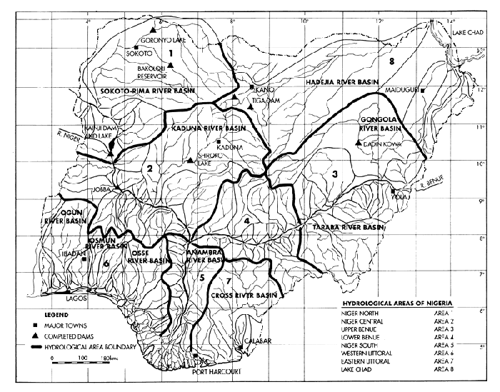

Slide 8
Global threat of water scarcity
Over 1b of the world’s population of app. 6.1b lack access to portable water
Scarcity… lack of enough water (quantity) or lack of access to safe water (quality)
Acute situation defined globally by vivid evidence of economic and physical water scarcity
MDG – 7 target 10 to halve, by 2015 proportion of people without sustainable access to safe drinking water and basic sanitation

Slide 9
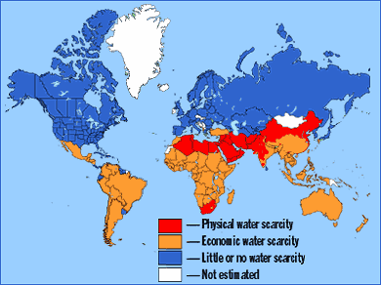

Slide 10
Global threat of water scarcity(2)
Impediment to realization of MDG 7
5m people die each year from poor drinking water, poor sanitation, or dirty environment
About half global population suffer water-related diseases – diarrhea, schistosomiasis, trachoma, ascaris, guinea-worm, or hook-worm – (WHO)
Water scarcity exacerbated by growing urbanization, population and needs for water in agriculture, industry and households
Looming water warfare

Slide 11
Nigeria- Drivers of water scarcity
Population growth
Rapid urbanization
Increase in household and industrial uses
Lack of infrastructure to supply, manage and conserve water from natural water resources… rivers and aquifers
Absence of good water management… weak institutional, administrative, legal and regulatory frameworks
Climate Change, drought etc.
Lack of awareness!
DEGRADATION OF WETLANDS!!!

Slide 12
Degradation of wetlands and water scarcity- the nexus
Wetlands degradation …prominent amongst drivers of water scarcity, but often ignored
Ecological, economic and social benefits threatened
Hydrological values undermined
Freshwater reservoirs around springs, streams, creeks, etc. at risk
Wetlands …“kidneys” of natural water systems… Forests … “lungs” of the world…. they perform natural pollution filtering functions

Slide 13
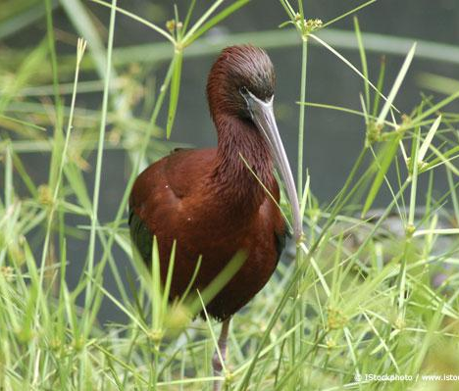
Hadejia Nguru Wetlands
Migrant Eurasian Palearctic bird

Slide 14
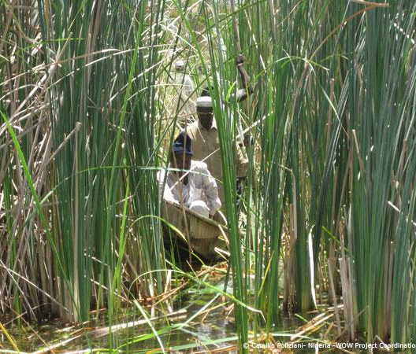
Degraded wetland
How ‘wise’ is the statutorily required “wise use” of wetlands under national law and the country’s ratified Ramsar Convention? Can this effectively protect Nigeria’s wetlands under extant regulations?

Slide 15
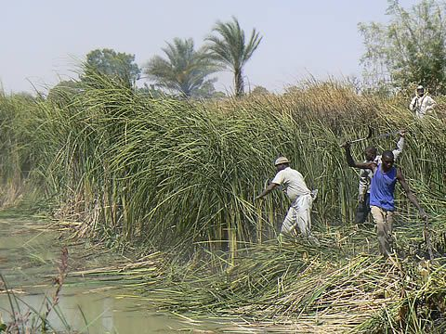
Invasive species
Pilot projects undertaken to
remove silt and Typha grass plants along the river course to improve inflow to Lake Chad
Reduce flooding, and
Increase agricultural productivity.
The invasive species, Typha grass, impinge on farming and fishing activities making life difficult for inhabitants and those who depend on the wetlands for sustenance.

Slide 16
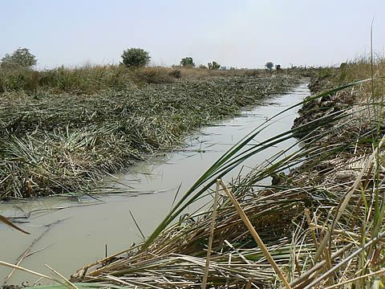

Slide 17
“Wetlands”…are
“…important landscape features because they hold and slowly release flood water and snow melt, recharge ground water, act as filters to cleanse water of impurities, recycle nutrients and provide recreation and wildlife viewing opportunities for millions of people.” ……………..USEPA.

Slide 18
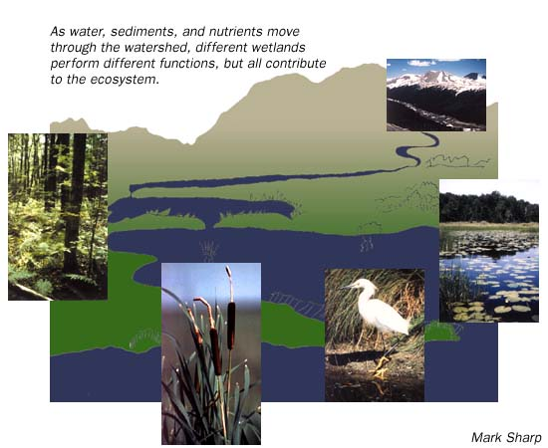
-- courtesy US EPA
The interconnectivity of wetlands and ecosystems.

Slide 19
What are wetlands?
Certainly wetlands are not ‘wastelands’, and they are definitely not puddles or water pits… they are unique hydrological ecosystem very critical for sustainable life for mankind on planet earth, and rightly qualify as the ‘subject’ of and ‘matter’ of protection under the “Ranking” international environmental treaty …. The Convention on Wetlands of International Importance especially as Waterfowl Habitat, Ramsar, 1971.
To confirm Ramsar’s “Ranking” status, note that the treaty predates the seminal global Stockholm Conference, 1972 and several leading MEAs on natural resources conservation, which no doubt drew inspiration from the Ramsar Convention, 1971.

Slide 20
Defining Wetlands…Ramsar Art.1.1
Ramsar Convention, 1971… Art. 1.1 defines wetlands as areas of… “…marsh, fen, peat land or water, whether natural or artificial, permanent or temporary, with water that is static or flowing, fresh, brackish or salt, including areas of marine water the depth of which at low tide does not exceed six metres”

Slide 21
Ramsar Art.2.1
The definition is extended further for purpose of ‘wetlands’ to be included in Ramsar List of internationally important wetlands, i.e. “…may incorporate riparian and coastal zones adjacent to the wetlands, and islands or bodies of marine water deeper than six metres at low tide lying within the wetlands.”

Slide 22
Nigeria…wetlands defined
Reg. 33 S.I. 26 of 2009 …“Wetlands” means areas permanently or seasonally flooded by water where plants and animals have become adapted; and include swamps, areas of marsh, banks of rivers, vegetation, areas of impeded drainage, or brackish salt”
Cf. “Fadama”…Hausa name for irrigable land – usually low-lying plains underlay by shallow aquifers found along Nigeria’s major river systems

Slide 23
Fadama Projects I, II, & III
World Bank funded projects
Project sites…the land is fertile and water easily accessible
Fadamas have also been the scene of conflict among farmers, fishermen, and pastoralists vying for land, water and grazing resources
Fadama projects aim to unlock the potential in man and land in a sustainable and equitable manner thereby contributing to reduce rural poverty.

Slide 24
Protection of Wetlands
Why do we need national laws/regulations and global treaties to protect wetlands?
The preamble to Ramsar captures the rationale for wetlands protection
Adequacy or otherwise of Nigeria’s wetlands regime

Slide 25
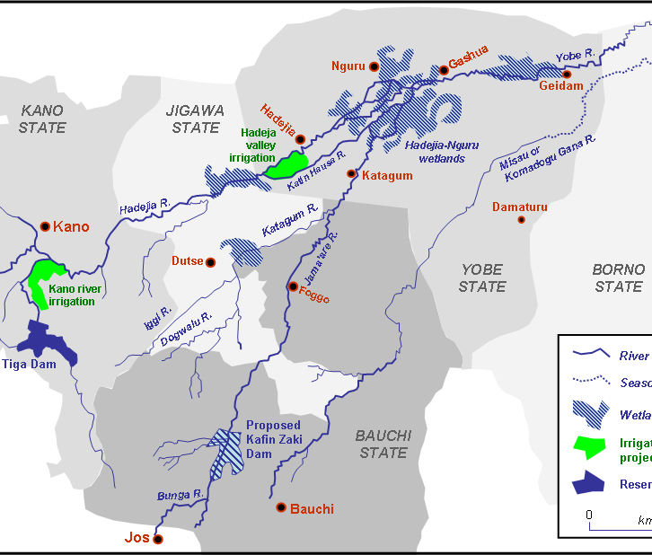
Hadejia Nguru Wetlands
Yobe River catchment area, showing location of the Hadejia Nguru Wetlands.
-Wikipedia

Slide 26
Nigeria’s Wetlands on Ramsar List
Hadejia – Nguru Wetlands
Lake Chad Wetlands
Apoi Creek Forests
Baturiya Wetland
Dagona Sanctuary Lake
Foge Islands
Lower Kaduna-Middle Niger Floodplain
Maladumba Lake
Oguta Lake
Pandam and Wase Lakes
Upper Orashi Forests

Slide 27
Legal regime on wetlands-Nigeria
Land Use Act
Endangered Species Act
Oil in Navigable Waters Act
River Basin Development Authority Act
Sea Fisheries Act
Solid Minerals Act
Petroleum Act
Petroleum Regulations
Environmental Impact Assessment Act

Slide 28
Legal regime…(2)
National Environmental Standards and Regulations Enforcement Agency (Establishment) Act, 2007
National Environmental (Wetlands, River Banks and Lake Shores Protection) Regulations, 2009
National Environmental (Protection of Watershed, Mountainous, Hilly and Catchment Areas) Regulations, 2009 … S.I. 26

Slide 29
Legal regime…relevant MEAs(3)
Act Regarding Navigation and Economic Cooperation between the States of the Niger Basin, 1963
Convention on the Development of the Lake Chad Basin, 1964
African Convention on the Conservation of Nature and Natural Resources, 1968
Convention on the Protection of the World Cultural and Natural Heritage, 1972
Convention on the Prevention of Marine Pollution by the Dumping of Wastes, 1972

Slide 30
Legal regime…relevant MEAs(4)
Ramsar Convention, 1971
AEWA Agreement
Convention on International Trade in Endangered Species, 1973
Convention on the Conservation of Migratory Species of Wild Animals, 1979
Convention for Cooperation in the Protection and Development of the Marine and Coastal Environment of the West and Central African Region, 1981
Convention on the Law of the Sea, 1982
Convention on Biological Diversity, 1992

Slide 31
Wetlands legal protection pre-2009
Nigeria party to Ramsar treaty
Currently 11 (eleven) Listed sites nationwide
FMEnv/NESRA maintains list of sites
NESRA agency with jurisdiction over all sites
National Wetlands Committee
Federal with participation of States and Local governments protect Nigeria’s wetlands
Skeletal statutory provisions on wetlands protection prior to 2009.

Slide 32
Pre-2009
Options of federal and state governments protective measures
Institutional and organizational arrangements
Skeletal legislations and government policies
Land designation as National Parks or Forest Reserves
Private conservation easements
Interventions by non-government organizations …NCF, etc.
Reflection of Ramsar obligations into national law and policy

Slide 33
S.I. 26 of 2009
S. 34 National Environmental Standards and Regulations Enforcement Agency (Establishment) Act, 2007 mandates the Minister of Environment to make Regulations pursuant to the federal statute.
30th September, 2009 Minister signed into law for the first time in the nation’s history a regulation targeted at and directly related to wetlands protection in Nigeria, the National Environmental (Wetlands, Riverbanks and Lake Shores Protection) Regulations, 2009 …S.I. 26, 2009.

Slide 34
S.I. 26 2009: Objectives
Conservation/wise use of wetlands and their resources
Conservation of water catchments and flood control
Sustainable use of wetlands for ecological/tourism purposes
Protection as habitats for species of fauna and flora
Minimize and control pollution

Slide 35
Regulating Wetlands… S.I. 26 2009
Key guidelines: Reg. 3 (a) – (d)
Sustainable utilization of Nigeria’s wetlands
EIA on all activities in wetlands
Incorporation of wise use of wetlands into national and local approaches
Application of best practices for conservation of wetlands

Slide 36
S.I. 26 2009… Management of Wetlands
Federal/States/Local governments collaboration
Reg.4 : Compilation of Inventory of wetlands, inspection of wetlands/ involving the public/convening meetings of local inhabitants and stakeholders
Reg. 5: Furnishing of particulars on intra-state wetlands by state governments/oversight-enforcement action
Reg. 7: Declaration of Specially Protected Areas
Reg.6: Role of Local govts./ensuring compliance with and enforcement of the Agency’s Wetlands Regulations/ conduct public awareness campaigns on wise use and conservation of wetlands

Slide 37
S.I. 26 of 2009… Protection of Wetlands
Reg. 8 (1)… Control of the use of Wetlands
“A person desiring to carry out any of the regulated activities listed in the Second Schedule or extract any wetland produce in a wetland shall make an application as set out in Form A of the Third Schedule to these Regulations”
NOTE… exclusion of “traditional uses of wetland resources” Reg. 8(2)(a)-(e)

Slide 38
S.I.26 of 2009…. Protection of Wetlands (2)
Reg. 9 (1) & (2)… Wetlands resource use permit
“Subject to the provisions of these Regulations, a person shall not carry out an activity in a wetland without a permit issued by the Agency.
Any person intending to carry out an activity listed in the Second Schedule to these Regulations shall apply to the Agency for a permit in Form A of the Third Schedule to these Regulations.”
NOTE… subject to payment of fees prescribed by NESREA

Slide 39
Regulated Activities in a Wetland …Regs. 8 & 9
Brick making
Recreation activities, i.e. sport fishing, maintenance of green spaces
Cultivation
Drainage
Commercial exploitation of wetlands
Sewerage filtration
Fishing, using fish gear and weirs, fish farming and other aquaculture
Construction of transport/communication facilities , i.e. roads, railways, telephone lines
Burning
Any unsustainable activity of commercial or trade nature
QUERRY…What is an “unsustainable activity of commercial or trade nature?”

Slide 40
Exemptions… Traditional uses of Wetlands resources
Reg. 8 (2) (a) – (e)
Subject to sustainable utilization the following “traditional uses of wetland resources” are exempted from application of S.I. 26 of 2009:
Medicinal, edible plants, and other non-wood forest produce
Cultivation of an area lower than 25% of the area of the wetland
Fishing, using traps and baskets
Collection of invertebrates, e.g. periwinkles, oysters, snails, crabs, etc. and
Collection of water for domestic use
NOTE… some of these exemptions may fall/degenerate to the level of an “unsustainable activity of commercial or trade nature.”

Slide 41
S.I. 26 of 2009…. Protection of Wetlands/Offences
Reg. 14 (1) & (2)
“Every land owner, occupier or user of property contiguous to a wetland shall have a duty to prevent the degradation or destruction of the wetland and shall maintain the values of the wetland.
Any person who fails, neglects or refuses to protect a wetland under sub-regulation (1) of this regulation commits an offence.”

Slide 42
Reg. 30… Offences(2)
“A person commits an offence if he –
Reclaims or drains a wetland
Erects, constructs, places, alters, extends, removes or demolishes any structure that is fixed in, under or over a wetland
Disturbs a wetland by drilling or tunneling in a manner that has or is likely to have an adverse effect on wetland
Deposits in, on, or under any wetland a substance in a manner that has or is likely to have an adverse effect on a wetland
Destroys, damages or disturbs any wetland in a manner that has or is likely to have an adverse effect on any plant or animal or its habitat

Slide 43
Reg. 30… Offences(2)
Introduces any exotic plant or animal in a wetland
Removes soil from or burns any wetland resource in a wetland
Carries out any unauthorized activity in a protected wetland
Carries out activities provided for in regulation 20 without a permit (i.e. to use a river bank or lake shore)
Fails, neglects or refuses to protect a lake shore or a river bank from environmental degradation in accordance with these Regulations
Contravenes any of the provisions of these Regulations.”

Slide 44
A Comparative Analysis
US Wetlands Protection
Nigeria Wetlands Protection
Fed. Govt (US EPA/US Army Corps of Engineers) protect wetlands through regs ( s. 404 Clean Water Act) program
Restoration of degraded wetlands
Economic incentives and disincentives e.g. tax deductions for selling or donating wetlands to qualified organization; ‘Swampburster’ provisions of Food Security Act; Cooperative programs
Acquisition , e.g establishment of national wildlife refuges
Relatively new experience in comparison with the US
S.I. 26 of 2009…introduce new responsibilities and duties for wetlands protection
Defined objectives on regulations of wetlands and wetland resources
Thrusts …command and control structure…strictly punitive in tone
No incentives…economic or otherwise

Slide 45
Comparative Analysis (2)
US Wetlands Protection
Nigeria Wetlands Protection
States enact laws regulating activities in wetlands
Counties/towns adopt local wetlands protection ordinances/development permit system
Integrated watershed protection initiatives.. Partnership of Federal, state, tribal, and local govts., non-profit organizations and private land owners
NESRA takes lead in management and control of wetlands
Subsidiary roles of states and local government
Federal permit system
Constitutional conflicts?

Slide 46
Gaps in Law and Policy
Agenda 21: call for concerted/coherent mechanisms for management of the environment
Linkage of critical components bonding environmental protection with sustainable development:
Message from Agenda 21… law as instrument to achieve balance between environment and development/socio-economic consideration

Slide 47
Agenda 21: Components
Law as a tool of environmental control/management
Policies/Strategies*
Environment/Sustainable development: two faces of same coin
Laws/Institutions*
Economic institutions/Market incentives*
Environmental laws to promote sustainable development
Information gathering/Assimilation/Dissemination*
Capacity building*
Institutions/machinery *

Slide 48
Agenda 21: Tools
Develop essential analytical tools
Data bank*
EIA/EA*
Law instrument to achieve balance between environment/development
Education*
Community Involvement*
R&D/Technology transfer*
Financing*
Vital Socio-economic considerations

Slide 49
Discordant Regulatory Provisions
Query….
Can the country’s environmental Laws and Regulations on the protection of wetlands promote the overriding objective of sustainable development?
Yes and No.
S.I. 26 and its related Regulations exhibit very serious disconnects.

Slide 50
Reg. 24 S.I. 26 of 2009
“Every land owner or user in whose land a river bank or lake shore is situated shall have a duty to prevent and repair degraded river banks and lake shores through the following or any other measures –
(a) soil engineering
(b) agroforestry
© mulching
(d) grassing
(e) control of livestock grazing; and
(f) terracing.”

Slide 51
S.I. 26 of 2009
Reg. 25…Protection Zones for River Banks
Sub-reg. (4) “Each Local Government shall determine watering points and routes for animals to have access to the water in each river.”
Reg. 26…Protection Zones for Lakes
Sub-reg. (3) “Each Local Government shall determine watering points and routes for animals to have access to the water in each lake.”

Slide 52
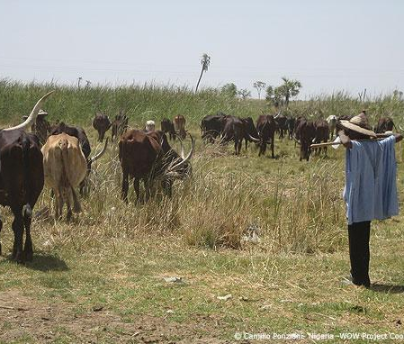
Herdsmen
Grazing cattle on wetlands completely oblivious of extant regulations controlling use of wetlands resources.

Slide 53
S.I. 27 of 2009…Reg. 4
Restriction on the use of watersheds, mountainous, hilly and catchment areas…
“(1) A person who desires to –
(a) graze livestock
(b) establish a camping or other recreational facility for tourist purposes
© plant or cultivate crops
(d) carry out mining activities; or carry out any development activity requiring an Environmental Impact Assessment (EIA);
…in a watershed, a mountainous, hilly or catchment area shall submit an application endorsed by the Chairman of the Local Government Area to the Agency, subject to these Regulations in the form prescribed in the Second Schedule to these Regulations.”

Slide 54
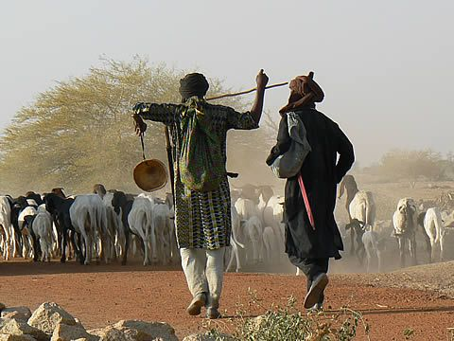
Grazing Livestock
Do they give a damn whether or not they are S.I. 26 2009 or S.I. 27 2009 Regulations compliant?
What are the incentives, economic or otherwise for these people?
Has govt any demonstrable role to spur citizens’ compliance?
Implications for sustainable/wise use of wetlands.

Slide 55
S.I. 27 of 2009…Reg. 9
“(1) The Agency in collaboration with the State shall restrict grazing in watersheds, mountainous, hilly and catchment areas that are identified as threatened by environmental degradation.
“(2) The Agency in collaboration with the State and Local Government may issue an order prescribing the maximum number of animals that may graze or may be permitted to graze on any particular area of land.

Slide 56
S.I. 27 of 2009…Reg. 9
“(3) Any order issued under sub-regulation (2) of this regulation shall be communicated to the target audience through the appropriate channel.
(4) A person shall not cause or permit any livestock belonging to him or under his control to graze on any watershed, mountainous, hilly or catchment area in respect of which there is in force an order made by the Agency prohibiting grazing.
“(5) Any person who causes or permits any livestock belonging to him or under his control to graze on any such watershed, mountainous, hilly or catchment area in contravention of sub-regulation (4) of this regulation commits an offence.”
Reg. 10 “Offences / Penalties
…revocation of permit
…liable to imprisonment or fine(#200,000/#1m corporate body + #50,000 per day offence subsists.)

Slide 57
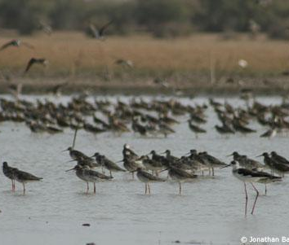
Nigeria’s Wetlands threatened
Nigeria’s shrinking ecosystem highlighted during World Wetlands Day – Feb. 2, 2011. The UN Food and Agriculture Organisation reports, that as ‘Nigeria joined other countries of the world to celebrate World Wetlands Day, what may mark the difference is that Nigeria’s wetlands are in ruins.” WHY???

Slide 58
Matters Arising
Laws/regulations are important…but alone cannot protect Nigeria’s threatened wetlands
Massive wetlands loss in the country
Drivers of wetlands degradation on the rise at govt./ corporate and individual levels
Sustainable development/environment protection and socio-economic problems targets of laws/regulations
.. Many of these laws are grossly people-insensitive

Slide 59
S.I 26 & S.I. 27.. Disconnects
Herdsmen roam the length and breadth of country to graze cattle mindless of extant laws and regulations
Lack of compliance with national wetlands protection laws/regulations
No economic options for segment of regulated community
Regulations silent on economic/market incentives

Slide 60
“Threat to Security”
Events of mid-May, 2010 in Jos, Plateau State, Nigeria
Govt. finding of ‘indiscriminate grazing of cattle by Fulani herdsmen’
Finding a solution to incessant violence in the State
Regulations profoundly out of touch with reality of regulated community
Measures required to make compliance with wetlands regulations effective

Slide 61
The Missing Link
Laws must be anchored by strong and viable enabling pillars…this is presently lacking
Federal govt. must assume upfront and unequivocally responsibility for protection of wetlands and make the Regulations viable
Targeted programs and activities
Borrow a leaf from (i) international treaties, & (ii) developed countries’ experience …
Nigerian govt must take the lead and give the maximum support to make regulations practicable and same time people sensitive.

Slide 62
US… Clean Air Act: as a clear example
“S.101 [7401] (a) The Congress find –
………
(3) that the prevention and control of air pollution at its source is the primary responsibility of States and local governments; and
(4) that Federal financial assistance and leadership is essential for the development of cooperative Federal, State, regional and local governments to prevent and control air pollution.”

Slide 63
Missing link (2)
Nigeria’s wetlands regulations …restrictive and prohibitive mechanism
Fall out …regulatory impact at variance with specified goals/long term objective
Cp. S.I. 27 of 2009
The Law/Regulations …not simply a goal, but an enforceable mandate
“Federal/State institutional machinery” creating partnership of shared responsibilities and resources

Slide 64
Sustainable Development
Consider socio-economic implications of regulated issues in context of legal instrument
Entrench implementation and compliance programmes in wetlands regulations
Linkage between environmental instruments and socio-economic instruments
Cp. Art. 1 CBD; Art. 3 UNFCCC

Slide 65
Re-Examining S.I. 26 2009 Approach
Deployment of command and control mechanism…not best option
Strictly punitive approach to wetlands protection is counter-productive and purpose-defeating
Agency will find it difficult to enforce this Regulation
Critical inadequacies of logistics and internal capacity.

Slide 66
Re-examine…
Govt.’s paramount duty to care for the people and the environment
Combine ‘command/control’ mechanism with facilitative measures to yield ‘sustainable’ compliance for sustainable development
Govt. is not just there to wield the big stick on ‘erring’ persons
The regulated community should be given facilitative incentives and support for maximum compliance with wetlands regulations

Slide 67
Way Forward
Retrofit national laws and policy as viable tools of the intent and spirit of man to secure the conservation/sustainable utilization of wetlands/water resources for benefit of present and future generations
Evolve comprehensive national management plan for wetlands
Economic incentives
Water trading/Payment for Ecosystem Services schemes (cp. Carbon trading) to promote sustainable/ wise use of wetlands

Slide 68
Way Forward (2)
Wetlands education/public sensitization
Promote wetlands loss research/restoration projects
Evolve national policy of marketing territorial landscape (wetlands) for ecotourism
Avoid laws/regs that cannot be effectively implemented or enforced
Enhance compliance morality/capacity of regulated community.

Slide 69
Way Forward (3)
Revisit the Ramsar Convention, 1971 – 2011: 40 years of existence
Time to consider a viable Protocol to the Ramsar Convention
To put teeth into the seminal natural resource protection/conservation treaty
To sharpen the Ramsar Convention to make it more effective at global and national levels
Overall to promote sustainable development and enhance the integrity/values of wetlands for life on Earth.

Slide 70
Questions…..

