Slide 1
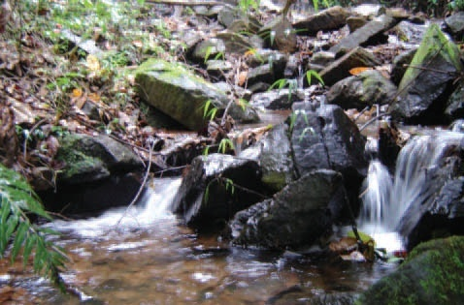
COMMITTEES (PCJ) OF HIDROGRAPHICAL BASINS OF RIVERS PIRACICABA, CAPIVARI E JUNDIAÍ IN BRAZIL.
  SILVIA ELENA BARRETO SABORITA
  EDSON RICARDO SALEME
  SAO PAULO - BRAZIL

Slide 2
COMMITTEES OF BASINS
COLLECTIVE DECISIONS FOR THE RIGHT CHOICES IN THE CORRECT AND SUSTEINABLE USE OF THE WATER RESSOURCES

Slide 3
PURPOSE OF THE PAPER
This paper analyzes the progress attained in managing water resources after the establishment of PCJ Committees, an important tool to manage water resources in a decentralized and participative way.
The brazilian governamental agency of waters (ANA) indicated the need for working in a harmonious and integrated way in PCJ Basins. This institution supports the mutual management of water resources.

Slide 4
The constitution of the basin
Here we are focusing the establishment of the Committees in Piracicaba, Capivarí and Jundiaí River Basins.
These basins and its sources are located in one of wealthiest regions of Brazil, both economically and socially.

Slide 5
Costitutional and legal regulation
-As these rivers run through more than one State, they´re considered a Federal domain, as the article 20 of brazilian Constitution indicates.
- Under the decree of May 20, 2002, based upon the Law Nº 9.433-97, the domain of Jaguarí and Camanducaia rivers belongs to the Federal Union.
- Federal, regional, state and municipal laws are involved the conflict of laws aimed to environmental protection and water resources.

Slide 6
SOLUTION OF PROBLEMS AND MANAGEMENT OF THE BASIN
The need for further discussions on the implementation of water resources public policies, and on charging for use of water at these three rivers basins, as a way to preserve, rationalize and implement the investments to be made.
The basins were already managed by PCJ consortia, which performed an important role in the process of modernization and decentralization of water resources management of these basins.

Slide 7
PCJ AND CONSORTIUM
The PCJ Consortium is a management model based on those adopted in Europe. It has legal personality and a skilled technical staff;
however, with the difficulties found in several agro-industrial sectors that wanted to waive the charging for use of water, and the position advocated by some agencies, such as the Departamento de Águas do Estado de São Paulo (Water Department of the State of São Paulo), which wanted to withhold 50% of the amount collected from São Paulo State, have made the problem even worse.
All those problems culminated with the need of the creation of the Committee of Piracicaba, Capivari and Jundiaí Rivers Basin, what would establish a regional waters management system.

Slide 8
IMPORTANCE OF THE COMITTEES
The first objective of the Committees were to promote administrative management of regional water resources, and they have a rather great decision-making power, especially because of civil society participation.
Other objective is to conduct programs and projects, having financial autonomy, its own technical staff and equipment, as well as the capacity to contract services, etc.; however, these actions are restricted to its members.

Slide 9
DUTIES OF THE COMITEES
The existence, discussions and deliberations on allocation of financial resources derived from the Fundo Estadual de Recursos Hídricos (FEHIDRO) , a state fund created to provide financial support to the state policy on water resources, were the culminating points of the Committee.
- FEHIDRO – Created by the Law 7.663/91 – the fund finance programs and projects predicted in state plan on water resources and on basin plans.

Slide 12
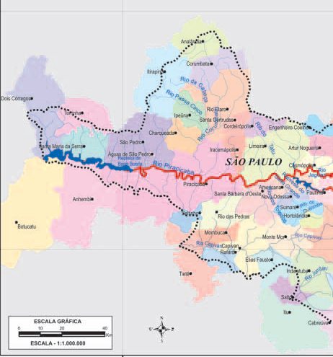
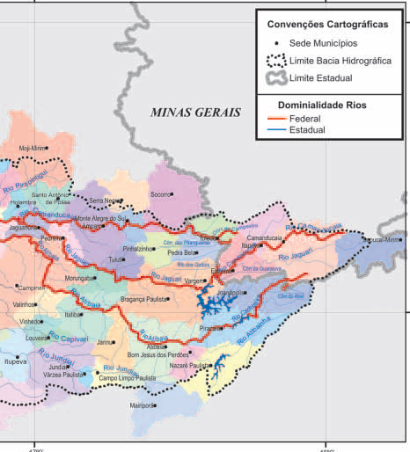

Slide 14
MANY ACTORS IN COLABORATION
The CHB-PCJ Committee and PCJ – FEDERAL Committee were created, working in an articulated way and promoting the rapport between Minas Gerais State, São Paulo State and Federal Government.
The practice of an integrated management, decentralized and participative in the region aims to minimize difficulties relating to water jurisdiction. Two committees were formed in order to deal with the most appropriate decisions for the region to be applied in watersheds.
It is important to notice that they are not private goods, but public bodies of regional geographic goods, and aren´t under a specific domain, granting the participation of Federal PCJ, integrating the representatives of Minas Gerais, São Paulo and Union

Slide 15
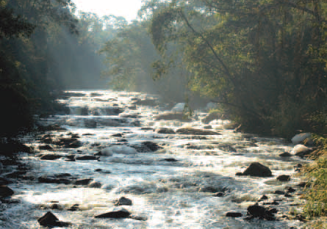
Basins (PCJ) resulted in a work of true social inclusion of the population, rural producers, industries, government agencies with the implementation of public policies, witch denotes a major breakthrough in shared managements

