Slide 1
Law, Water and Sustainable Development:
Framework of Nigerian Law
Olawale Ajai

Slide 2
Agenda
Hydrology and Water Resources of Nigeria.
Customary Law of Water & Watercourses.
Water Legislation.
Water Management & Governance Issues.
Environmental Protection and Sustainable Development.
Riparian Law.
Conclusions.

Slide 3
Hydrology and Water Resources of Nigeria.
Nigeria is a well watered country in West Africa.
Surface water resources potential - 267.3 bn m3; Groundwater potential - 51.9 bn m3.
Total water bodies - 15.9% of the total area of the country.
Nigeria’s water courses are shared internationally and domestically.
Federal, State and Local Governments have exclusive legislative powers, as well as concurrent responsibility for water resources.

Slide 4
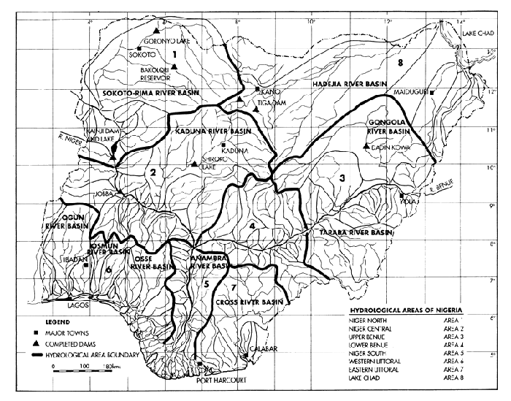

Slide 5
Customary Law of Water & Watercourses
Customary land title confers rights to all products of the land, including water resources.
Large bodies of water are regarded as common property.
Small water bodies within family or individual, improvement of a spring or other water source, including impoundment of small pools of water in owned by family or individual.
Studies show that the traditional method of settling water related conflicts is the most effective of all the methods.
There is a right of easement to streams or rivers on land that abuts them.
The owner of the land is restricted from clearing his land up to 50 yards to the stream for conservation purposes so that it would not dry up.
In Lake Ndakolowu use of nets is prohibited because of a legend that the local shrine abhors splashing sounds
Where a shrine is a part of a water course it is usual to restrict ingress or use of it.
Land owners allow even strangers, such as the nomadic Fulani, to use water bodies on loan for grazing.

Slide 6
Water Legislation
Federal Govt. - water from sources affecting more than one State as may be declared by the National Assembly.
Sea fisheries.
Maritime shipping and navigation on inter-state waters.
State Govt.’s – inland waters & fisheries.
Local Govt.’s – sewage & development of non-mineral natural resources.
- 1999 Constitution.
The Water Resources Act vests the right to the use and control of all surface and groundwater and of all water together with the bed and banks in any watercourse affecting more than one State in the Government of the Federation.
River Basins Development Authorities (RBDA) Act – 12 RBDA’s promote comprehensive development of surface and underground water resources for multi-purpose use.
The National Inland Waterways Authority Act -all the major internal waters draining into Atlantic Ocean are Federal navigable waterways.
Fisheries & other legislation – EIA, State Water Authority’s (SWA’s), etc.

Slide 7
Water Management & Governance Issues
The interface between customary and statutory law – practicality, acceptance & subsidiarity principle.
Prevalence of Top-down issues still.
Modern Water & Sanitation policies – balance environ. & development, public-private partnerships, stakeholder education, participation & access.
Water management institutional structure – inchoate, over-centralized, lack of holism & integrated management.
Lack of resources, weak database and weak law enforcement.
Water Resources Bill pending.
Inadequate community participation & private sector involvement.
Lack of genuine participative democracy ab initio – a clog to Sustainable development.

Slide 8
Environmental Protection and Sustainable Development
National Policy on the Environment - Agenda 21 inspired.
Pollution of water sources by urban domestic and industrial waste is a major problem.
Industry, especially oil & gas heavier polluters.
Public infrastructural deficits - landfills, sewage facilities, effluent treatment plants, etc.
Biodiversity loss through development activity grim.
Right to water –likely judicial innovation – Privatization?
Rule based approach v quality standards approach – which way Africa?

Slide 9
Riparian Law
Amachree v Kalio - held that by the common law of England and natural law all persons were entitled to use tidal and navigable rivers for ordinary purposes, including fishing and that the customary law was to similar effect as no strong contrary proof had been made out. (Probably wrongly decided.)
Followed in recent Attorney General of the Federation v Attorney General of Abia State & others.
Customary laws in shared watercourses is nearly identical or at least broadly analogous to the principles of freedom of navigation, limited territorial sovereignty and broad notions of equity in the use of shared watercourses recognized in international and comparative law.
Niger Basin Authority & lake Chad Basin Convention – subscribe to principle of equitable utilsation & integrated management.
Poor performance of Basin Authorities due to lack of resources & poor national management of water resources by member countries – Fine principles in Conventions are ‘paper tigers ‘.

Slide 10
Conclusions
Customary law is fairly sophisticated and is perhaps more widely observed by the greater majority in their rural communities and fisheries but is inadequately interfaced and integrated with the statutory law. Need to redress situation. An over-engineered, complex licensing and intricate system of trading of water rights may be a recipe for failure.
2. Unless and until the culture of poor governance and corruption is curtailed it is difficult to expect sustainable natural resources management of any sort in developing countries.

Slide 11
Conclusions
3. Privatization and market based arrangements remain ideologically and perhaps also culturally controversial.
If the experience of the deregulation of the telecommunications sector of Nigeria is anything to go by then deregulation should more efficiently provide and democratize access to sufficient water resources in the country.
4. Water resources represent a cheap and vital building block for sustainable economic activity, from inland transportation to rain-fed or irrigation agriculture, to micro or mini water works, commercial boreholes, to fish farming, tourism, community forestry, etc.
Should be reprioritized as the key driver of the economy and sustainable development initiatives.

