Slide 1
Analysis of Urban Wastewater Management in China:
Analysis of Urban Wastewater Management
in China:
Analysis of Urban Wastewater Management
in China:
from Law and Policy Dimension
Mingde Cao & Mingming Liu
Mingde Cao, Professor, Dr., China Univ. of Political Science & Law, Director of Climate Change & Natural Resources Law Center
Mingming Liu, Lecturer, Dr.

Slide 2
Introduction
With the rapid development of Chinese economy, the current wastewater treatment system and mechanism need to be improved to meet the demand of environmental protection.
This presentation is divided into three parts:
The first part is the introduction of the present situation and problems of China urban wastewater management. This section will explore what we have achieved in wastewater treatment and some problems in the aspects of efficiency, industrialization and sustainability of wastewater.
1 of 2

Slide 3
Introduction
The second part will make an analysis of policy and legal problems in dealing with China urban wastewater management. This section will discuss these problems by exploring management methods, supervision system of enterprises based on field research.
The third part will put forward policy and legal advice for wastewater management. This section will propose the concept of sustainable wastewater governance.
2 of 2

Slide 4
1.1 Present situation of China’s urban wastewater treatment
China has made dramatic improvement in the perspectives of wastewater treatment facilities and its environment benefits during the implementation of “China’s eleventh five-year plan.

Slide 5
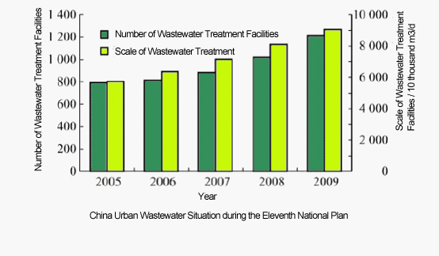
Rapid increase of wastewater treatment facilities

Slide 6
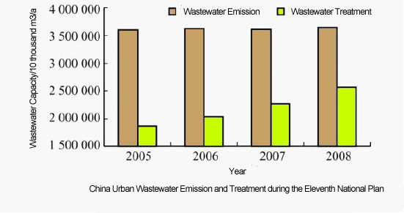
Dramatic environment improvement
of wastewater treatment facilities

Slide 7
1.2 Existing problems in dealing with urban wastewater disposa
Unbalanced regional wastewater treatment capacity
Low rate of centralized wastewater treatment and low load rate
End-of-Pipe wastewater treatment
Insustainability: environmental pollution, energy consumption, etc.
Obstacles for industrialization of wastewater treatment
Existing problems in dealing with urban wastewater treatment

Slide 8
Unbalanced regional wastewater treatment capacity
According to statistics, among 665 city, 141 of them haven't built wastewater treatment plants, these cities mainly located in Northeast and middle parts of China. The reality is that the water environment pollution in these areas is more serious. Among 1,600 counties, 72% of it has not built wastewater treatment plants, which caused the treatment rate very low, only 32%, less than half of the urban wastewater treatment capacity; More than 17,000 towns do not have wastewater disposal facilities.

Slide 9
Low rate of centralized wastewater treatment and low load rate
Though China has increased 65 million tons wastewater emission per day, the urban centralized wastewater treatment rate only increased from 52.95% to 75.25%, still remaining at a lower level. Meanwhile, the related wastewater treatment system needs to be improved. In many areas, especially in mid- western parts, it is difficult to build wastewater treatment plants, but more difficult to run it even after being built. In the period of "11th five-year” period, the average load rate of national wastewater treatment plants has increased 6.2 percentage points, reached 77%, but some areas such as Hainan, Guizhou, Jiangxi, Jiangsu, Guangxi, Hunan, Shanxi, Helongjian, the average load rate is lower than the national average load, which occupied ¼ of total national provinces and autonomous regions.

Slide 10
End-of-Pipe wastewater treatment
On one hand, the source controlling is not strict enough. The industrial wastewater pretreatment facility does not operate normally. The Phenomenon of secret emissions is widespread.
On the other hand, decentralized wastewater treatment focusing on the source control is an effective mode to realize the re-use of the wastewater. But, it is very difficult to promote the decentralized wastewater treatment in China. Because China mainly concentrated on centralized wastewater treatment, investing lots of resources to construct large-scale wastewater treatment plants, many wastewater treatment plants have been built but seldom used.

Slide 11
Insustainability
The rate of wastewater reuse is low. In 2009, China urban wastewater reuse rate is only 8.6%.
Second pollution of sludge was severe. Monitoring data showed that 80% of sludge caused secondary pollution.
The urban wastewater treatment plants had low efficiency.

Slide 12
Obstacles for industrialization of wastewater treatment
The wastewater treatment is not industrialized enough.
Supporting facilities were backward, and the amount of wastewater sewerage is weak.
The wastewater treatment fee is hard to support enterprise to run wastewater treatment facilities.

Slide 13

2. The Analysis of existing policy & legal problems on China urban wastewater management
The main issues of urban wastewater management departments
Problems with means of urban wastewater treatment

Slide 14
2.1 The main issues of urban wastewater management departments
The construction department is only responsible for the building and operation of wastewater treatment, and charges the wastewater treatment fee. The environment protection department is only responsible for the wastewater emissions of entity, and charges the wastewater discharge fee. In reality, the construction department does not ensure wastewater treatment facilities can normally and standardly operate. The environment protection department is favorable to charge more wastewater discharge fee, and the excessive wastewater emissions often lead to the higher operation costs of wastewater facilities. Thus, many wastewater treatment facilities are not operated after being built.

Slide 15
2.2 Problems with means of urban wastewater management
Command-and-Control instruments
Market-Based instruments
Problems with supervision of urban wastewater treatment enterprises

Slide 16
Command-and-Control instruments
Discharge Standards
Out of date
Lack of scientific bases
Legal vacancy
Imperfect standards system
wastewater charges
China wastewater discharge units have to submit two types of wastewater charges: wastewater treatment charge and pollutants emission charges. Article 19 in “Water Pollutant Prevention Law” provides that “to those who emit wastewater to urban wastewater concentration disposal facilities and pay wastewater treatment fee, they don’t need to pay it again (non excessive standard pollutant discharge fee)”. Thus, pollutant discharge units can avoid paying the use of environmental capacity resources after paying wastewater treatment charge, and this obviously ignored the value of environment.

Slide 17
Market-Based instruments
No unified regulation for wastewater emissions trading scheme
Wastewater charges impeded the production of market demand of emission rights
Government’s intervention impedes the effective function of emission trading scheme

Slide 18

3. Reform law and policy to promote wastewater sustainable governance
Perspective of Government
Perspective of Market
Perspective of Society

Slide 19
Perspective of Government
Wastewater management: from the end-of-pipe management to the entire process control
Planning: from isolation to integration of the water supply and drainage
Standard system: the combination of science and applicability

Slide 20
wastewater management: from the end-of-pipe management to the entire process control
Wastewater management must be transformed from mere attention on the end management of wastewater to the entire process management of combination of the source control and recycling economy.

Slide 21
planning: from isolation to integration of the water supply and drainage
When planning the urban water resources, wastewater reuse should be an important part of the integrated urban water management, and we should synthetically arrange water supply, water conservation, drainage, wastewater treatment and the facilities planning, construction and management of recycled water.

Slide 22
Standard system: the combination of science and applicability
The standards should be determined according to the size of wastewater treatment facilities, the local economy, and environmental development level.
It is necessary to improve sludge standards and local standards.

Slide 23
Perspective of Market
Promotion of the emission trading scheme
fairly determine the initial allocation of emission rights.
clearly define the position and function of emission exchange
trading rate is the decisive factor of a successful emission trading
Industrialization of wastewater treatment
introduce the competitive mechanism
set the scope of industrialization of wastewater treatment between market and government.
supervision over wastewater treatment
market entrance
regulation of operation
regulation of price
market withdraw

Slide 24
perspective of society
public-private-partnership in wastewater treatment
public participation

Slide 25
conclusion
Although China’s government has made great investment in wastewater treatment, the environmental effects of wastewater treatment facilities are limited due to the outdated wastewater management. It is better to reform as follows:
Coordinate the functions among different departments of wastewater management
Make use of market mechanism
Encourage private initiatives in wastewater treatment and reuse

Slide 26
Thank you
THE END
Mingde Cao & Mingming Liu
IUCN ACADEMY OF ENVIRONMENTAL LAW 2011 COLLOQUIUM

