Slide 1
Environmental
Flow Law in Canada
WWF is working to embed environmental flow protection in BC’s New Water Sustainability Act
Linda Nowlan
WWF-Canada
Vancouver, BC

Slide 2
What are Environmental Flows?
Environmental flows describe the quantity, timing, and quality of water flows required to sustain freshwater and estuarine ecosystems and the human livelihoods and well-being that depend on these ecosystems.
Brisbane Declaration on Environmental Flows endorsed by more than 800 delegates from 57 countries in 2007

Slide 3
Why Flows Matter
Water flow regimes are widely recognized as the “master variable” for aquatic ecosystem health and are a key factor in sustaining native biodiversity and ecosystem integrity.
Just like blood pressure in the human body, the flow and movement of water in a river is the key component of ecosystem health.

Slide 4
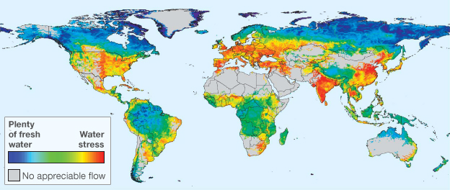
Global threats to human water security and river biodiversity. Nature, 2010

Slide 5
Flows and the Law
Growing trend to “Green” Water Law
2010 UNEP report catalogued laws from around the world
Many legal techniques available to protect environmental flows

Slide 6
Environmental flow protection driving water law reform
Legal regime determines extent to which the various characteristics of hydrological regimes can be altered by human activities.
Environmental flow protection emerging in Canada, particularly in water stressed regions such as southern Alberta.
No consistent approach across the country.
Provincial water laws often are silent on the issue.
Opportunity to include protection in new laws, such as BC’s proposed Water Sustainability Act

Slide 7
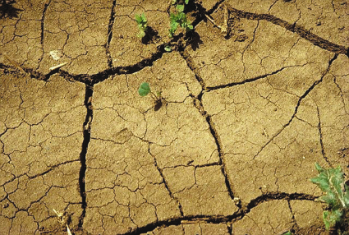
“Instream flow needs have fallen through the cracks in Canada.” Flow Canada

Slide 8
Key Legal Tools
Allocation (licensing) of water often considered the key legal tool
Laws to protect ecosystem services, like the Fisheries Act, may be more important
Water management plans may also have provisions on flows

Slide 9
Jurisdiction over Water in Canada
Canadian federal system: ‘no one level of government can provide a complete framework for protecting water resources.’
Provinces have the jurisdiction to allocate water.
Provincial water allocations that diminish natural instream flows may ‘impinge upon’ federal responsibilities to protect fisheries, biological diversity, and transboundary and interjurisdictional water bodies.

Slide 10
CPR for Canadian Rivers
Conserve Wild Rivers
Protect Multi-use Rivers
Restore Overused Rivers

Slide 11
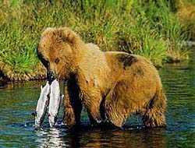
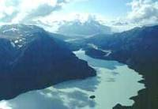

Conserve Wild Rivers

Slide 12
Wild and Scenic Rivers
1968 US Wild and Scenic Rivers Act passed to preserve rivers “in free-flowing condition to protect the water quality of such rivers and to fulfill other vital national conservation purposes.
3 levels of protection:
  “Wild” rivers are free of dams, generally inaccessible except by trail, and represent vestiges of primitive America.
  “Scenic” rivers are free of dams, with shorelines or watersheds still largely primitive and shorelines largely undeveloped, but accessible in places by roads.
  Recreational” rivers are readily accessible by road or railroad, may have some development along their shorelines, and may have been dammed in the past.

Slide 13
Fisheries Act - Provisions to Protect Environmental Flows
20 Fish-ways to be made as Minister directs, Ensures safe passage for fish.
22 Minister may make orders for to the owner or occupier of an obstruction to provide a sufficient flow of water to permit the safe and unimpeded descent of fish.
27 Ensures the unobstructed passage of fish through a waterway.
32 Prohibits the destruction of fish by any means other than fishing.
35 Prohibits works or undertakings that result in the harmful alteration, disruption or destruction (HADD) of fish habitat, except when authorized by the Minister or his delegate.

Slide 14
Example of Provincial Law:
BC Fish Protection Act
New Tools in1997:
Sensitive Streams , 15 streams listed
Community Streamflow Licences
–not in effect
No New Dams on Listed Rivers

Slide 15
Protect Working Rivers
Water Law Tools:
  Usually Related to Allocation
  Flow Considerations in Licensing
  Integrated Water Management Plans (implemented through licensing)
  Conservation Licences, Reserves and Restrictions
  Presumptive Flow Standard?

Slide 16
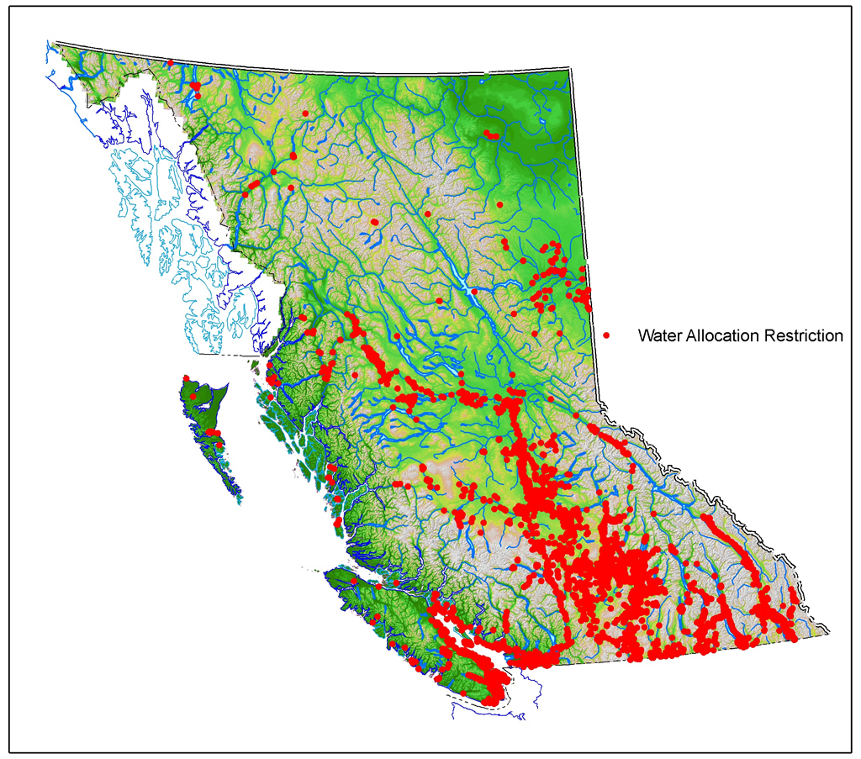
44,000
Current
Water
Licences
Source: BC MOE Living Water Smart 2008
Notes:
Licensing or Permitting most important tool. There are approximately 44,000 current licences held by 26,000 different licencees in the province with about half for domestic purpose.

Slide 17
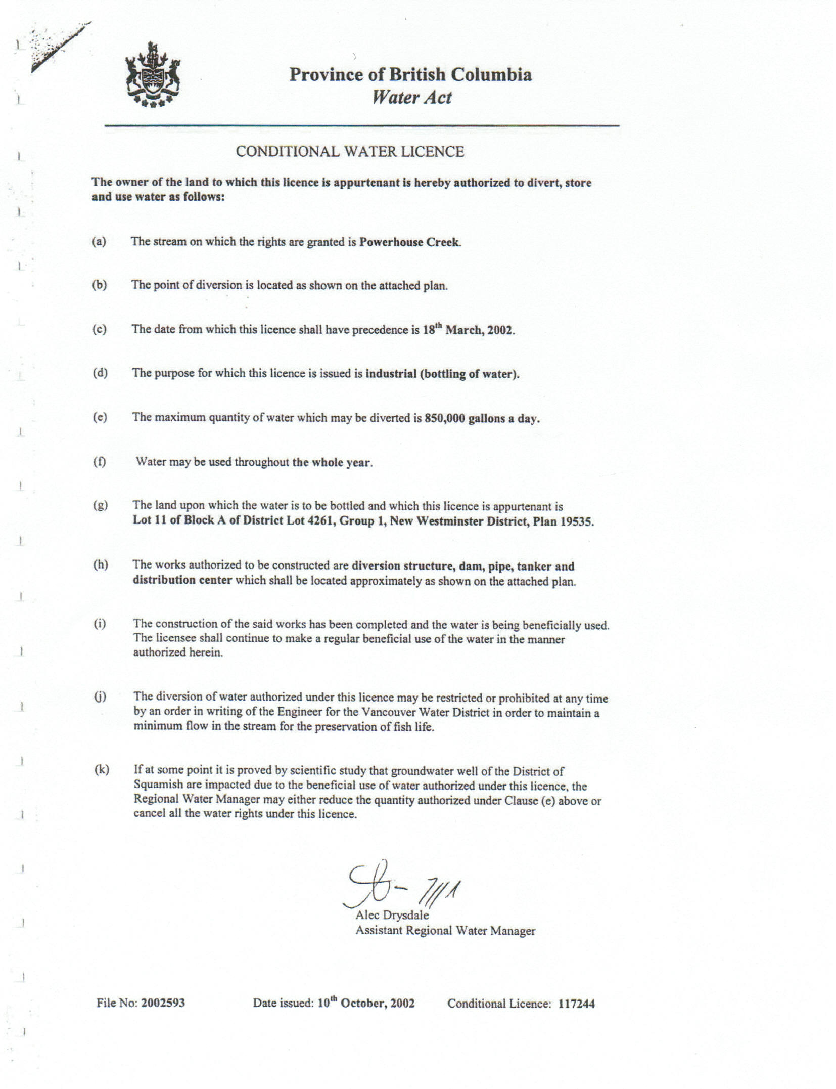

Slide 18
Presumptive Flow Standard
Many good intentions to protect environmental flows have stalled …about which method for environmental flow assessment is appropriate or ‘best’ .These real and perceived hurdles have too often resulted in doing nothing to protect environmental flows, leaving the vast majority of rivers on the planet vulnerable to over‐exploitation
Protecting 80% of daily flows will maintain ecological integrity in most rivers. A higher percentage of flow (90%) may be needed to protect rivers with at‐risk species and exceptional biodiversity
Richter, B. D., Davis, M. M., Apse, C. and Konrad, C. (2011), A presumptive standard for environmental flow protection. River Research and Applications, 27: n/a. doi: 10.1002/rra.1511

Slide 19
WWF’s Four Requirements for a new Water Act
Protection of
environmental flow is key.
Ensure that surface water
& groundwater management
are integrated across BC.
Improved Governance.
Manage licensing in a watershed to limit the accumulated impact of multiple users.
Notes:
84% of people polled had not seen or heard anything about the BC provincial government’s initiative to modernize and improve rules for protecting and managing our water

Slide 20
BC Water Sustainability Act
7 Policy Directions:
Protect stream health and aquatic environments
Consider water in land-use decisions
Regulate groundwater use
Regulate during scarcity
Improve security, water use efficiency and conservation
Measure and report, and
Enable a range of governance approaches.

Slide 21
Consider water in land-use decisions
New Provincial Water Objectives (PWOs) will guide decision makers considering land and resource uses.
PWOs will focus on issues such as
  access to water,
  conflicts among users,
  protecting flows and ecosystem health, and
  cumulative impacts.

Slide 22
Protect stream health and aquatic environments
BC government proposes to consider instream flow guidelines in new licence applications for both surface and groundwater
  Application to existing 44,000 licences not clear
  ‘Consider’, rather than ‘require protection of’ flow needs

Slide 23
Further Change Required
Environmental flow protection should be applied to all rivers and streams in the province, not just those in chronic problem areas
  New Law Needs to Incorporate Presumptive Flow Standard to preserve BC’s freshwater into the future

Slide 24

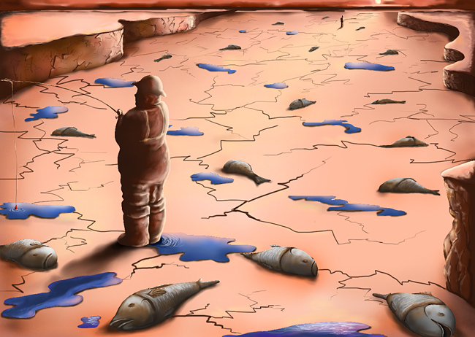
Restore Degraded Rivers- Legal Tools
Canadian Geographic, October 2010

Slide 25
Example: Water Use Plans
Conflicts between BC Hydro water use and fish habitat needs
Background events (all legal):
  Litigation
  Complaint to CEC
  Ward report on non25compliance
  Downton Lake Special auditor
Goal of the WUP process: achieve consensus on a set of operating rules that satisfies the full range of water use interests at stake
Water Use Plans have been prepared for 30 BC Hydro facilities
Results: voluntary reductions in BC Hydro’s licences, more flows for fish, minimal reduction in power generated
Notes:
Background events demonstrated that a better way had to be found to manage water resources in the Province

Slide 26
How concerned are you about the IMPACT OF water SHORTAGES in the next 10 years on...

Slide 27
New Directions for E-Flow
Protection in Canada?
Wild Rivers:
Federal law or policy
  Wild Rivers Act?
  New DFO policy?
Multi-Use Rivers:
Enhance flow considerations in provincial water licensing:
    Set presumptive flows for interim protection
    Consider ‘sustainability boundary’ approach
    Water management plans with mandatory content

Slide 28
    Other New Directions?
      Overused Rivers:
      Trading with safeguards in place
      Water rights acquisitions
      Water trusts
      Licence reviews and cancellations
      Voluntary reductions

