Slide 1
Legal Framework for Equitable and Sustainable Utilisation of the Nile River Waters: Agreement of the Riparian States for Cooperative Basin Management
Mekete Bekele Tekle
Addis Ababa University School of Law
ETHIOPIA

Slide 2
Sponsored by NWU
I would like to thank
the Vice-Chancellor of
North-West University (NWU)
&
Prof. Willemien du Plessis (NWU)
for sponsoring my participation.

Slide 3


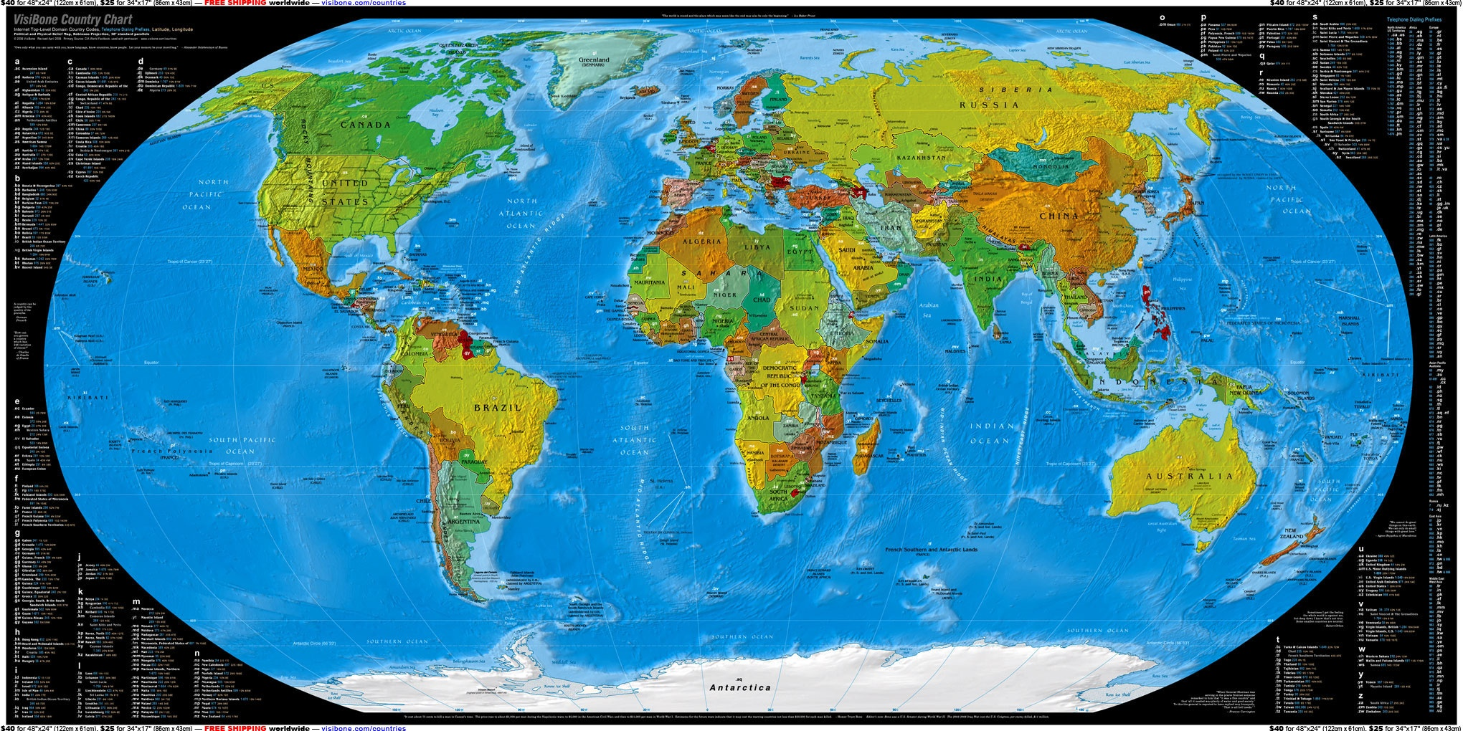
9th Colloquium of the IUCN Academy of Environmental Law

Slide 4
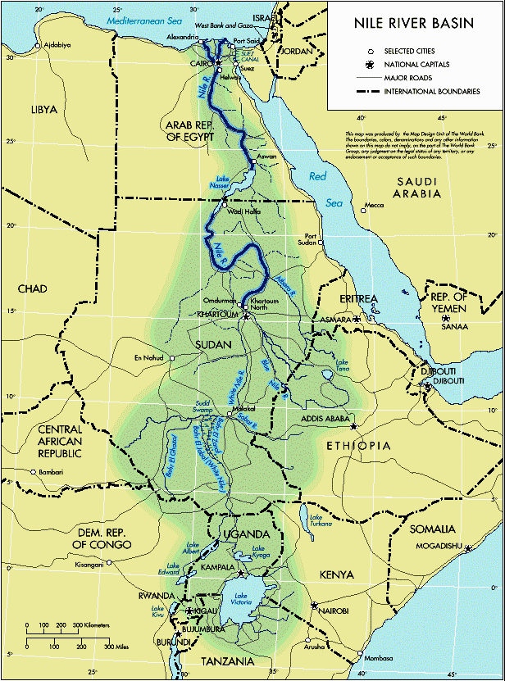
Riparian States
1. Egypt
2. Sudan
3. Eritrea
4. Ethiopia
5. Uganda
6. Southern Sudan
7. Kenya
8. Tanzania
9. Burundi
10. Rwanda
11. DR Congo
Notes:
Nile Basin Countries

Slide 5
Some Facts about Nile River Basin
The longest river in the world (6,800 k/m)
2nd most shared river in the world , shared by 11 countries, (Danube is first with 13 countries)
86% of Nile water is from the Blue Nile/Abbay (Ethiopia)
Egypt and Sudan Claim the entire flow of the Nile waters
About 40% of the entire population of the basin countries depend on Nile waters for their livelihood.
Upstream countries are less developed as compared to downstream ones - all with poverty alleviation agenda.
All riparian states are planning for more water projects – mega dams for irrigation &/or hydropower

Slide 6
The Nile Treaties & Agreements
Protocol between Britain and Italy (1891);
Treaty between Britain and Ethiopia (1902);
Britain and Congo [Modifying 1894 Agreement of Brussels] (1906);
Agreement between Britain, Italy and Ethiopia (1906);
Exchange of notes between Britain and Italy (1925);
Nile water agreement (1929);
Convention between Britain and Belgium (1934);
Exchange of memos Egypt & Britain (on behalf of Uganda) , 1949 – 1953;
Egypt and the Sudan Nile Agreement (1959);
Exchange of memoranda between Egypt and Uganda (1991);
Framework for General Cooperation , Egypt and Ethiopia in 1993;
Egypt and Uganda Agreement for controlling water hyacinth (1998); and
Cooperative Framework Agreement of Nile Basin States (2010
The 1902, 1929 and 1959 agreements are particularly intriguingly for they totally ignore the interest of upstream riparian states.

Slide 7
Nile Treaties & Agreements Cont’d
  One of the oldest treaties that is being invoked by the downstream riparian states is the 1902 Treaty (Ethiopia and Britain), which its Article III reads as:
  “His Majesty the Emperor Menelik II, …, engages himself towards the Government of His Britannic Majesty not to construct or allow to be constructed any work across the Blue Nile, Lake Tana, or the Sobat, which would arrest the flow of their waters except in agreement with His Britannic Majesty’s Government and the Government of Sudan“.

Slide 8
Nile Treaties & Agreements Cont’d
The other old treaty is the 1929 Nile Agreement between Britain & Egypt. The Agreement:
grants Egypt 55. 5 BCM of water (of 84 BCM – total), - the remaining understandably goes to Sudan.
Gives Egypt the rights to on-site inspectors at the Sennar dam, no works would be developed along the river or on any of its territory, which would threaten Egyptian interests.
The downstream countries argue that this colonial treaty be respected by upstream countries.

Slide 9
Nile Treaties & Agreements Cont’d
The 1959 Agreement for the Full Utilization of the Nile Waters (Egypt & Sudan):
  55.5 BCM for Egypt and 18.5 BCM for the Sudan [10 BCM of Nile waters is estimated to evaporate]
  The treat provides for a dispute resolution through a permanent Joint Technical Committee
  stipulates water claim of upstream countries would not exceed 1-2 BCM/year.
  Any additional claim claims should be met by a unified Egyptian/Sudanese front.

Slide 10
Nile Treaties & Agreements Cont’d
The Sudan - Ethiopia agreement (1991) :
The two countries are committed to the principle of equitable utilization of the waters of the Blue Nile and Atbara rivers.
Establishment of a technical joint committee to exchange data and to explore co-operation Sudan has moved away from the ‘united front’ with Egypt.

Slide 11
Nile Treaties & Agreements Cont’d
The1993 Egypt & Ethiopia Agreement on Framework for General Cooperation. Accordingly:
neither country would do anything with the Nile that causes ‘appreciable harm’ to the other.
to consult and co-operate in projects of mutual advantages such as projects that would enhance the volume of flow and decrease the loss of water through a comprehensive and integrated development schemes.
N.B. Ethio-Sudan & Ethio-Egypt agreements are not treaties.
Ethiopia is not a party to any Nile Treaty so far.
The 1902 treaty is colonial while the 1929 & 1959 treaties exclude Ethiopia.

Slide 12
Negotiations over the Nile
Since the 1960s Nile riparian states were involved in negotiations and consultations on the principles of equitable use of the water. The main fora for the negotiations were:
  Ndugu (1959-1960s)
  HYDROMET (1967-1992)
  TECONILE (1992-1998)
  NBI (1999 - to date)
  CFA (1997 – to date, parallel to NBI)

Slide 13
Ndugu
Ndugu (Swahili) – “brotherhood” was proposed by Egypt as an extension of the Permanent Joint Technical Commission of 1959 Nile Waters Agreement.
It was formed to discuss issues like: Nile waters, agriculture, resource development, and promotion of economic, technical, and scientific among members.
Members: Burundi, Central African Republic, Egypt, Rwanda, Sudan &Zaire.

Slide 14
Hydromet (1967 – 1992)
Hydro Meteorological Survey (Hydromet) of the Upper Nile region to enable and enhance the data collection of the hydrology and meteorology of the Nile River and the lakes.
  Regulating floods of the equatorial lakes region
  Capacity building in terms of water experts of member countries
The members of Hydromet were: Uganda, Kenya, Tanzania, Egypt, Ethiopia and Burundi.

Slide 15
The TECCONILE (1992 – 1999)
The Co-operation for the Development and Environmental Protection of the Nile (TECCONILE) - replaced the Hyromet and it was intended as a transitional arrangement for the continuation of technical co-operation on the Nile River Basin.
Members: Egypt, Rwanda, Sudan, Tanzania, Uganda & Zaire
Observers: Burundi, Ethiopia & Kenya

Slide 16
Nile Basin Initiative (NBI)
The NBI aimed at achieving sustainable socio-economic development through equitable utilization of, and benefit from, the common Nile water resource.
There are programs for the realization of the shared vision, objectives, trust and capacity building as well as two sub-basin Strategic Action Programs with the objective of Investment and action on the ground.

Slide 17
Shared Visions of the NBI
Socio-economic and Benefits Sharing
Confidence-Building and Stakeholder Involvement
Efficient Water Use and Drainage
Water Resources Planning & Management
Regional Power Trade (hydropwer)
Nile Transboundary Environmental Action
Etc.,

Slide 18
NBI…
The two sub-basin programs Are:
Eastern Nile Subsidiary Action Program
(ENSAP) – with Ethiopia, Eritrea, Egypt and Sudan as members .
Nile Equatorial Lakes Subsidiary Action Program (NELSAP) - with Burundi, DRC, Rwanda, Kenya, Tanzania and Uganda as members.

Slide 19
The Nile Basin Initiative (NBI)
In 1997 the Basin states established a forum for a legal and institutional arrangement to forge a partnership of all the riparian states.
In 1998 all riparian states, except Eritrea, joined the dialogue to facilitate the process of sustainable development and management of the Nile resources
In 1999 the Nile Basin Initiative (NBI) was officially launched in Dares Salaam (Tanzania).

Slide 20
NBI …
In 2003 a negotiation was started for Cooperative Framework Agreement (CFA) – negotiation for the equitable utilisation of the Nile waters.
  The draft CFA was negotiated by a Panel of Experts from the riparian countries who endeavored for creating a win-win situation for all basin states towards ensuring equitable & sustainable utilisation of the waters.
  The experts completed their task of drafting the CFA in 2008 and submitted the draft to the Nile CoM (Council of Ministers) for the finalization of the contentious articles in the draft.

Slide 21
Major Principles of the CFA
Sustainable development (Articles 6)
Subsidiarity (Article 10)
Equitable and reasonable utilization (Article 4)
Prevention of the causing of significant harm [Obligation not to cause significant harm] (Art. 5)
Information concerning planned measures (Art. 8)
Environmental impact assessment and audits (Art. 9)
Water security (Art. 14)
  Article 14 (b) not to adversely affect the water security and current uses and rights of any other Nile Basin State.

Slide 22
Art. 6 – Sustainable Development
Protection and conservation of the Nile River Basin and its ecosystems
1. Nile Basin States shall take all appropriate measures, individually and, where appropriate, jointly, to protect, conserve and, where necessary, rehabilitate the Nile River Basin and its ecosystems, in particular, by:
  (a) protecting and improving water quality within the Nile River Basin,
  (b) preventing the introduction of species, alien or new, into the Nile River system which may have effects detrimental to the ecosystems
  c) protecting and conserving biodiversity within the Nile River Basin;
  (d) protecting and conserving wetlands within the Nile River Basin;
  (e) restoring and rehabilitating the degraded natural resource base.
2. … States shall … take steps to harmonize their policies in relation to the provisions of this article.

Slide 23
Article 10 - Subsidiarity
Planning and implementing project as per the principle of subsidiarity as stated under Art. 3(3) … development and protection of the Nile River Basin water resources is planned and implemented at the lowest appropriate level] Nile Basin States shall:
  (a) allow all those within a State who will or may be affected by the project in that State to participate in an appropriate way in the planning and implementation process;
  (b) make every effort to ensure that the project and any related agreement is consistent with the basin-wide framework.

Slide 24
Article 4
Equitable and reasonable utilization
Nile Basin States shall in their respective territories utilize the water resources of the Nile River system and the Nile River Basin in an equitable and reasonable manner.
…. Each Basin State is entitled to an equitable and reasonable share in the beneficial uses of the water resources of the Nile River system and the Nile River Basin.

Slide 25
Article 5
Obligation not to cause significant harm:
1. Nile Basin States shall, in utilizing Nile River System water resources in their territories, take all appropriate measures to prevent the causing of significant harm to other Basin States.
2. Where significant harm nevertheless is caused to another Nile Basin State, the States, whose use causes such harm shall, in the absence of agreement to such use, take all appropriate measures, having due regard to the provisions of Article 4 above, in consultation with the affected State, to eliminate or mitigate such harm and, where appropriate, to discuss the question of compensation

Slide 26
Article 8
Planned measures
1. Nile Basin States agree to exchange information through the Nile River Basin Commission.
2. Nile Basin States shall observe the rules and procedures established by the Nile River Basin Commission for exchanging information concerning planned measures.

Slide 27
Article 9
Environmental impact assessment and audits
4 (1). For planned measures that may have significant adverse environmental impacts, Nile Basin States shall, at an early stage, undertake a comprehensive assessment of those impacts with regard to their own territories and the territories of other Nile Basin States.
4 (5). Nile Basin States shall carry out audits of measures existing at the date of the entry into force of this Framework….

Slide 28
Article 14 – Water Security
… Nile Basin States recognize the vital importance of water security to each of them… also recognize … the cooperation management and development of waters of the Nile River System will facilitate achievement of water security and other benefits. Nile Basin States therefore agree, in a spirit of cooperation:
(a) to work together to ensure that all states achieve and sustain water security;
(b) … the unresolved Article 14(b) is annexed to be resolved by the Nile River Basin Commission within six months of its establishment.

Slide 29
Contentious Issues of the CFA
Notification on Planned Measures-provision agreed upon later in Kigali (2007) Art. 8 “… Nile Basin States exchange information on planned measures…”
Status of existing agreement/existing uses- clear upstream/downstream division on the issues of “existing”, “acquired” or “historical” rights claims.
  Provision on existing agreements and its replacement by the concept of “water security” (May 2006 Nile-CoM meeting)
  Considered to offer a compromise solution (keeping silent on “existing agreement/use)

Slide 30
Contentious Issues…
Water Security - an emerging concept subject to different interpretations:
  Defined in the CFA as the right of getting reliable access to and use of the waters of the Nile by all basin states
  Upstream countries adopted a version that “water security” be based in light of equitable utilization and no significant harm
  Egypt and Sudan insisted that this to be replaced by a provision that would oblige riparian countries to recognize “current uses and rights of riparian states (reservation made)-back to their original position!!

Slide 31
Contentious Issues…
Expectations of reaching agreement on the “water security” provision failed after many negotiations
At a Nile-CoM meeting in June 2007, it was noted that continued negotiations on the provision of “water security” would not bear fruit.
Decision was made to adopt the text on water security supported by all upper Nile riparian countries with the inclusion of a reservation provision by Sudan and Egypt
It was further agreed to refer the matter to Heads of States/Governments of the respective NB countries to try to resolve the outstanding issue

Slide 32
Negotiations on Water Security
In May 2009, an extra-ordinary Nile CoM meeting was called in Kinshasa to try to resolve the impasse by then Chair of Nile-CoM (DRC)
Three options were tabled at the meeting:
  delete the provision on “water security” and adopt the CFA;
  reopen the negotiations on “water security”;
  defer the provision on “water security” and adopt the CFA and try to resolve the outstanding issue once the NB commission is established

Slide 33
… Water Security
Sudan walked out of the meeting and Egypt reiterated its previous position, including provision on planned measures;
All upstream countries decided to adopt the CFA by annexing the contentious provision on “water security” (Art 14b) and seek resolution of the issue within 6 months after NBC is established (Egypt made reservation to this decision)
Article 14(b) not to significantly affect the water security of any other Nile Basin State, [all agreed except Egypt & Sudan]
Egypt proposed Article 14(b) to be replaced by: (b) not to adversely affect the water security and current uses and rights of any other Nile Basin State.
Egypt and Sudan made several statements objecting to Kinshasa decision claiming it was in violation of the “consensus” principle … and opening up negotiations on planned measures.

Slide 34
… Water Security
Post-Kinshasa: Nairobi (July 2009)-decided to clean-up CFA text and move to signature (Sudan and Egypt objected)
Nile-CoM meeting (Alexandria, July 2009)-decision made to give an additional six months to enable countries “to move forward together”
Mandate given to Nile TAC/NC to recommend basis for moving forward together (also advise on transitional arrangement to NBC and procedures for signing the CFA

Slide 35
… Water Security
Three Technical Advisory Committee (TAC)/NC meetings were held in Uganda (Sept, 2009), Tanzania (Dec., 2009) and Sharm El Sheik (April 2010);
No agreement between upstream/downstream countries on the basis of moving forward together
Position of upstream countries-Kinshasa decision
Position of downstream countries- Kinshasa decision in violation of the “consensus” principle; reiterated same position on Art.14b and opening up agreed upon issues.
Sharm-el-Sheik Meeting: positions remained same.
All upstream countries decided to sign the CFA in Entebbe, Uganda on May 14, 2010.

Slide 36
Current Status of the CFA
To date six countries have signed the CFA (Ethiopia, Kenya, Tanzania, Uganda, Rwanda and Burundi); three countries DRC; Sudan and Egypt have not yet signed {Eritrea was not in the negotiation and South Sudan yet to come on board}
Art.42 of CFA requires six countries to ratify the agreement and deposit the instrument with AU Ratification may take some years and on-going cooperation under the NBI can continue.

Slide 37
Current Status…
However, Sudan and Egypt currently seem to undermine on-going cooperation under the NBI
Sudan has officially declared that it has “frozen” cooperation under the NBI (AA Nile-CoM meeting ;
Egypt seems to have followed suit
On-going cooperation under the NBI particularly on-going projects under the EN seem to be in danger of collapsing

Slide 38
The Possible Future Options
Option 1:
Upper riparian countries may accede to the demands of lower riparians – unlikely option
Option 2: Sudan +(Southern Sudan) and Egypt may renounce their current position and accept the cooperation on the basis of CFA – the best option.

Slide 39
Possible Options….
Option 3:
Upper riparian countries may act unilaterally to the prejudice of lower riparian countries – likely option
Option 4:
With the emergence of SS as an upper & middle riparian state, and with the coming into power of a new regime in Egypt, a request for a renegotiation of CFA my be requested - a likely or an unlikely option.

Slide 40
Optimistic Conclusion
It is much hoped that all riparian States would come to a common definition of “water Security” and agree to sign the Cooperative Framework Agreement (CFA) to make the equitable and sustainable utilisation of the Nile waters a reality. Nile waters are enough for all of the vital needs of the riparian states if managed and used sustainably.
“There is a sufficiency in the world for man's need but not for man's greed.”
(Mohandas K. Gandhi)

Slide 41

Dankie!

