Slide 1
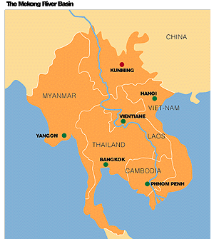

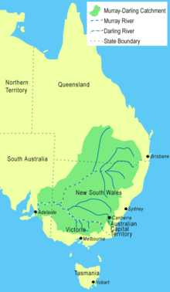
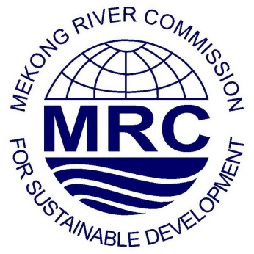

WHEN RATIFICATION SPEAKS LOUDER THAN AID:
Why Australia ratifying the UN Watercourses Convention can ‘aid’ water governance and resource management in the Mekong River Basin and beyond

Slide 2
UN Watercourses Convention
    Key over-arching legal document developed for international watercourses
      AIM: ‘ensure the utilisation, development, conservation, management and protection of international watercourses and the promotion of the optimal and sustainable utilisation thereof for present and future generations... taking into account the special situation and needs of developing countries’
    Provisions codify processes for transboundary water governance
      Notification and consultation for planned measures
      Sharing of data and information between states
      Provides legal mechanisms for redress - arbitration
      Allows scope for incorporating past/future regional water agreements
      Seeks to integrate existing, recognised general principles and rules of law
      Equitable and reasonable utilisation and participation
      No significant harm
      Obligation to cooperate

Slide 3
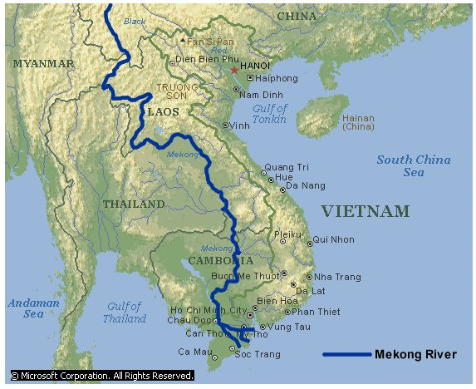
The Mekong River & Mekong Agreement
Mekong River
Spans six countries
Largest freshwater fishery in the world
Approximately 60 million people rely on its resources
Mekong Agreement
Treaty (1995) governing planning, use and development of Mekong River water resources
Vietnam, Lao PDR, Thailand and Cambodia (downstream) are parties
China and Myanmar (upstream) are NOT parties
Treaty formed the Mekong River Commission (MRC)

Slide 4
Status of the Convention and position of Mekong states and Australia
  CURRENT STATUS
      Adopted by the UN General Assembly in 1997
        One of the most widely supported agreements ever (103 states in favour)
      NOT in force
        24 parties have ratified/acceded (including 3 states in past 5 months)
        Need a further 11 for it enter into force
MEKONG STATES
Lao PDR, Cambodia, Viet Nam, Thailand voted in favour of its adoption
SIGNIFICANTLY: China one of three states who voted against its adoption
Myanmar absent
AUSTRALIA
Voted in favour of its adoption
Labour party currently in government supported its ratification at the time of their election in 2007.

Slide 5
Developments highlighting Australia and Mekong states’ Convention status
MEKONG
  Deferment by MRC of final approval on Xayaburi Dam in April 2011
AUSTRALIA
  AusAID Mekong water policy and program cycles ending 2011/2012
  Independent Review of Aid Effectiveness released in July 2011
  Murray-Darling Basin Authority plan in to be released in June 2011
GLOBAL
  Stagnation of UN Watercourses Convention which Australia and the majority of Mekong (specifically downstream) states support

Slide 6
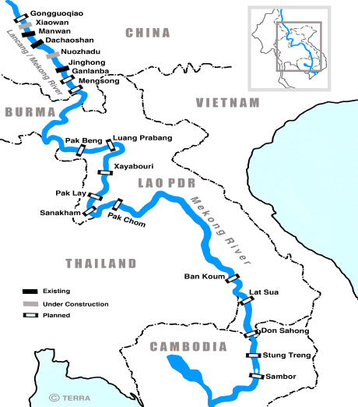
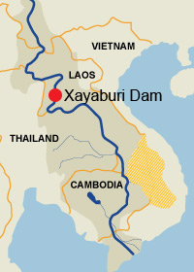
The Xayaburi Dam & hydropower plans
RECENT DECISION
Deferral for 6 months
Moratorium sought but not g
LEAD UP TO DEVELOPMENTS
MEKONG RIVER COMMISSION
PLANNED DEVELOPMENTS

Slide 7
Australia’s Aid Policies in the Mekong
  AusAID WATER PROGRAMS IN THE MEKONG
    - Australian Mekong Water Resources Program
        2007-2011
        2009-2012
    - Australian Greater Mekong Sub-region Program
      2007-2011
      KEY FOCUS AREAS
      - Capacity-building
      - Environmental change
      - Food security
      - Hydropower assessment
      - Transboundary engagement
      - Corporate social responsibility
    AusAID & MRC
    OBJECTIVES
      Strengthen institutions
      Improving availability of reliable knowledge
      Making more informed decisions
    ACTIVITIES
      Funding
      - Largest bilateral donor
      Capacity building and knowledge sharing
        - Twinning of domestic integrated water
        management programs in Australia with national
        government institutions and MRC representatives
        - Murray-Darling Basin Authority
        - CSIRO

Slide 8
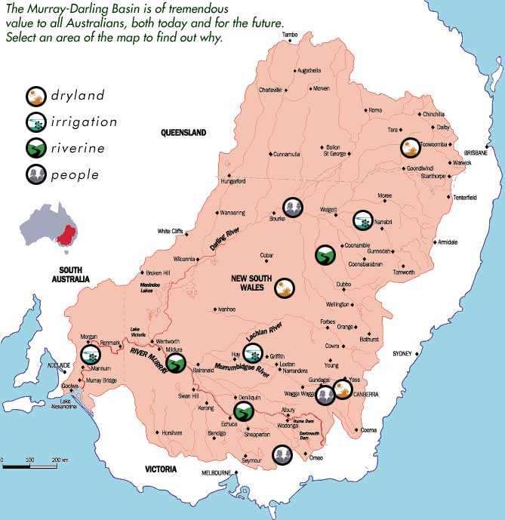
Convention’s application in Australia
Murray-Darling River Basin
Spans 4 states and 1 territory
Primary source of water and farmland industry
Highly regulated with dams and irrigation schemes
Severe environmental degradation downstream due to history of uncoordinated upstream planning/usage
Murray-Darling Plan
Due for release in July 2011
Controversy over perceived prioritisation of environment over existing industries
Group of scientists commissioned to advise are threatening to boycott Plan
Legal principles and procedures contained in the Convention are DIRECTLY applicable to the Plan and would be of benefit if ratified

Slide 9
Possibilities for the Convention beyond Australia and the Mekong
Reigniting interest in a stagnated Convention
Despite promises to accede, distinct failure to ratify the Convention
Australia ratifying would draw renewed attention to Convention entering force
Application to states without international watercourses
Push by NGOs to lobby states without international watercourses to ratify
Australia ratifying the Convention shows its application to such nations with:
  Aid policies and programs in regions with international transboundary watercourses
  Domestic transboundary watercourses where legal principles and procedures would apply
Contributing to global security
Convention can aid security in regions with transboundary water resource disputes

Slide 10

Why Australia should ratify the Convention
MEKONG
It supports, complements, and increases the accountability of AusAID’s water policies in the Mekong
Greater credibility in lobbying MRC and national governments to follow due process on the Xayaburi
AUSTRALIA
Convention’s legal principles and procedures are applicable to domestic transboundary watercourses
Voted in favour of adopting Convention and Labour party supported ratification at time of election
Embedding aid policies/programs in international law supports justification for an increased aid budget
GLOBAL
As a leader, must ‘walk the talk’ by ratifying and in-turn reignite global push for it entering into force

Slide 11
Potential drawbacks or reasons for Australia not to ratify the Convention
Ratifying the Convention serves no specific purpose
  A nation without international watercourses ratifying Convention would draw attention to it again
  Embedding aid in international law improves accountability and adds justification to increasing aid
  Hypocritical if it cannot manage domestic transboundary watercourses
  Legal principles/procedures are transferable and would aid management of Murray-Darling River
  Australia has moral obligation as leader in water management to start practicing what it preaches
  Focus on over-arching ‘hard’ law ignores role of Mekong Agreement & ‘soft’ law
  Convention would add another layer of law to strengthen water governance in the Mekong
  Yes, focus on ‘soft’ law is important and needs to be strengthened, but it still needs a baseline
  Threaten political/economic relations with countries in the region
  Convention is broader than Mekong so unlikely to be construed by China as a hostile measure

Slide 12
Thank you & further information
WEB
United Nations Convention on the law of the Non-Navigational Uses of International Watercourses
http://untreaty.un.org/ilc/texts/instruments/english/conventions/8_3_1997.pdf
AusAID Mekong Program
www.ausaid.gov.au/country/mekong-water-resources.cfm
Mekong River Commission
www.mrcmekong.org
Murray-Darling Basin Authority & Plan
www.mdba.gov.au
Oxfam Australia’s work in the Mekong
www.oxfam.org.au/explore/infrastructure-people-and-environment/save-the-mekong
EMAIL
Oxfam Australia
Michael Simon, Lead – People, Infrastructure & Environment (PIE): michaels@oxfam.org.au
Jessica Rosien, Funding Institutions - PIE: jessicarosien@oxfam.org.au
PERSONAL
remykinna@gmail.com

