Slide 1


A Sour Mess: the Crisis of Acid Mine Drainage in South Africa- the Public Trust and Lessons in Liability
Loretta Feris (UCT)
Louis J. Kotzé (NWU)

Slide 2
Disclaimer
Quoting Marius Pieterse:
“I am an academic, I want to know how it works in theory!!”

Slide 3
Background
SA’s water resources are in short supply and disproportionately spread
Mining once the mainstay of SA economy
Threatened by AMD- legacy left by defunct mines and a continuing by-product of existing mining
Will severely affect the sustainability of development in SA

Slide 4
Structure
Extent and nature of the AMD problem
Reinterpreting the PT doctrine
  What is State’s role as custodian of water
  Private sector obligations and liabilities
Conclusion

Slide 5
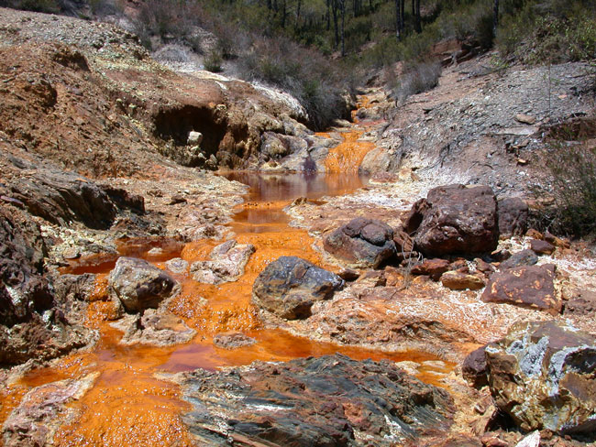
How sour is the mess?
AMD - rock containing sulphide minerals and tailings disposal areas exposed to air and water: highly acidified water.
Acidic water contains elevated concentrations of highly toxic heavy metals such as manganese, aluminium, iron, nickel, zinc, cobalt, copper, lead, radium, thorium and uranium.
SA’s water scarcity means : Limited dilution potential
During operation of mine acid water pumped, treated, re-used. But at mine closure/abandonment it decants as AMD

Slide 6
How sour is the mess?
Parliamentary Briefing: “The volume of acid mine water currently coming to surface in the West Rand goldfield near Krugersdorp is sufficient to fill at least 10 Olympic-size swimming pools (2,500 m3 each) every day”

Slide 7
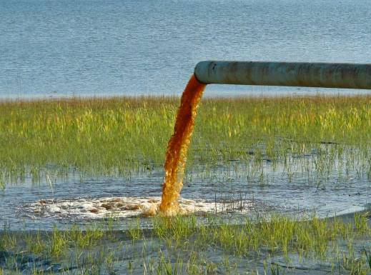

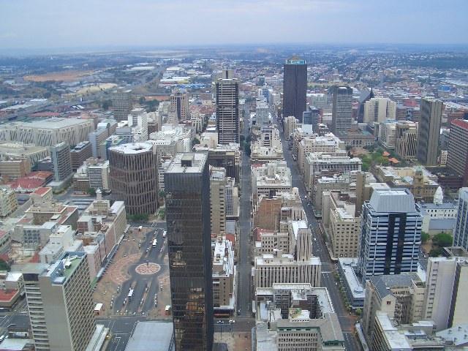
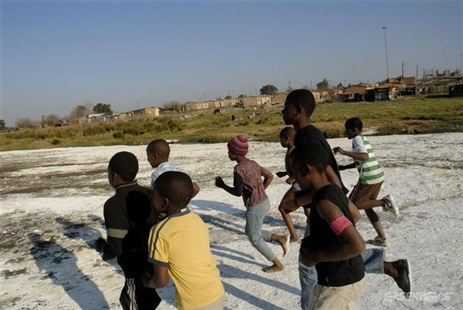
Impacts

Slide 8
What legal problems does it create?
The nature of the problem complicates legal response:
  The problem is historical
  Enforcing the polluter pays principle
    administrative liability & criminal liability
  Fragmentation
  Political agendas...

Slide 9
Public sector obligations
Constitutional mandate for public trust
  Directly through s24 – environmental right
  Implied through s27 – right to access to water
Encapsulated in:
  National Environmental Management Act
  National Water Act
  Mineral and Petroleum Resources Development Act

Slide 10
Public trust
Evolution of SA Water law:
  part of the commons under indiginous customary law
  Roman Dutch law water as res publicae
  British rule introduces riparian rights
  Retained during Apartheid
  Public trust by way of Constitutional mandate

Slide 11
What is Public Trust in SA Water Law?
Van der Schyff summarises the operation of the doctrine in American law as a public right in property where certain rights vest in the citizens of America as an entity, but American citizens can demand the realisation and protection of that interest as individuals
But not yet clear in SA law

Slide 12
Public Trust in SA Legislation
NEMA: “[T]he environment is held in public trust for the people, the beneficial use of environmental resources must serve the public interest and the environment must be protected as the people's common heritage.”
White Paper:
  Creates an obligation to provide for the basic needs of citizens
  “After providing for the basic needs of citizens, the only other water that is provided as a right, is the Environmental Reserve - to protect the ecosystems that underpin our water resources, now and into the future (Principle 9). It is the duty of national Government, as part of its public trust function, to assess the needs of the Environmental Reserve and to make sure that this amount of water, of an appropriate quality, is set aside.
  An obligation to ensure that water allocation for downstream users in shared-river basins is respected.
In essence as trustee of water as a national asset the South African government has ultimate responsibility in dealing with any threat to that asset.

Slide 13
How does a state execute its trusteeship?

Slide 14

1. Designing good laws
NEMA
  Principles
  S28: historical liability and criminal liability
  Personal liability for directors
NWA
  S19 duty of care and liability (Harmony Gold Mining v Regional Director , Department of Water Affairs and Forestry, 2006 )
  Criminal liability
MPRDA
  Duty to prevent , minimise, remediate mining pollution
  Director liability
  Criminal liability

Slide 15
2. Implementation and enforcement
Amendments to NEMA to address fragmentation not implemented
Slack enforcement
  According to Minister of Water Affairs: approximately 200 mines operating without water use license

Slide 16
3. Extending public trust obligations to private sector
Public trust is about burden-sharing
Implies the involvement and contribution of private sector, i.e. mines in what would be traditional public governance efforts
The horizontality of the Public Trust doctrine
S8(2)
S24(a)

Slide 17
McCarthy v Constantia Property Owners Association
Judge Dennis Davis:
“Section 8(2) provides that the provision in the Bill of Rights binds all natural and juristic persons, if and to the extent, that it is applicable, taking into account the nature of the right and the nature of any duty imposed by the right. Whatever the interpretation of this opaque phrase, it is clear that its intention was to extend the scope of application of the Bill of Rights. In short, the Bill of Rights was not only designed to introduce the culture of justification in respect of public law but intended to ensure that the exercise of private power should similarly be justified. Accordingly the carefully constructed but artificial divide between public and private law which might have dominated our law prior to the constitutional enterprise can no longer be sustained in an uncritical fashion and hence unquestioned application.”

Slide 18
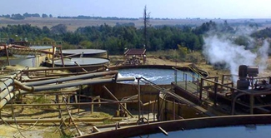
3. Extending public trust obligations to private sector
Who shoulders the obligation of historical legacies for AMD?
  State , i.e civil society
  Mining industry & stakeholders, i.e financiers, developers, shareholders?
R225 million set aside for AMD treatment
Industry-wide levy to pay for pumping and treatment

Slide 19
Conclusion
State to revisit its obligations in terms of the Public Trust doctrine:
  Where possible -use laws against known historical polluters
  Reinterpretation and extension to include obligation on private sector
    Requires innovative mixture of governance tools such as taxes/levies and self-regulatory initiatives

