Slide 1
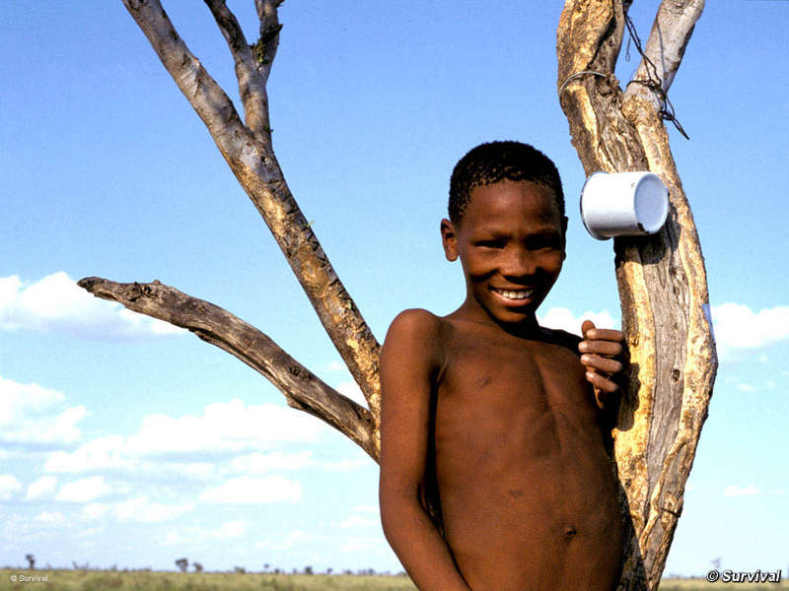

The Endless Struggle of Indigenous Peoples in Protected Areas
Considering the Bushman’s Struggle for Water Rights in the Central Kalahari Game Reserve
Alexander Paterson
Alexander.Paterson@uct.ac.za
Notes:
Paper considers string of recent cases -
Sesana & Others vs AG
Mosetlanyane & Others vs AG (High Court and Court of Appeal)
But before I reflect on them – good to briefly set the theoretical and practical context.

Slide 2
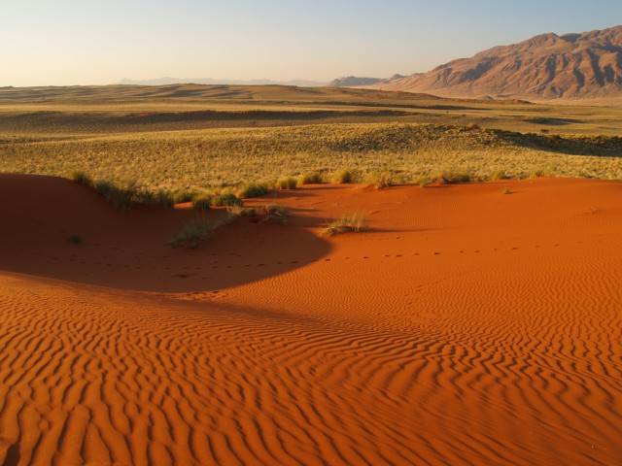
a shifting discourse
exclusionary
protectionist
state-centered
the historic approach

Slide 3
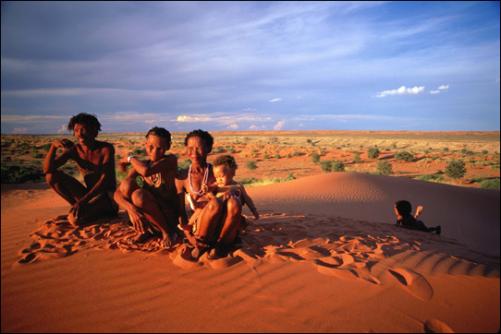
a shifting discourse…
the contemporary approach
inclusive
participatory
human-centered

Slide 4
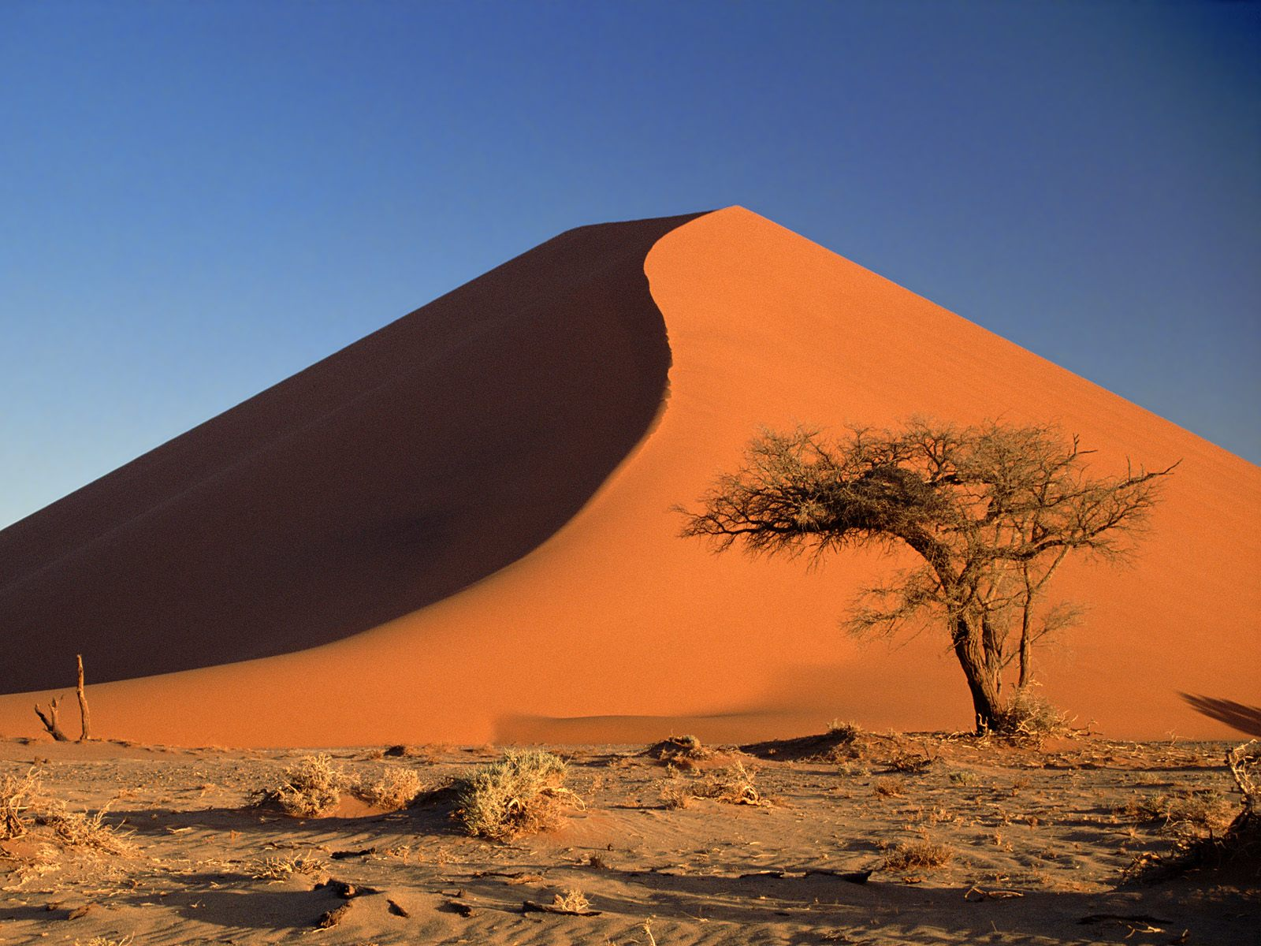
Changing International Context for PA
factors driving the shift
ecology
systems thinking
adaptive management
participatory management
human rights
land rights
resources rights
Indigenous peoples
not = tragedies
property
communal tenure
access
new conservation ethics
sustainable use
benefit-sharing
state
protected areas governance
private
shared
indigenous
Notes:
ECOLOGY
Systems thinking – need to look at systems as a whole – rather than reduce to smallest components and analyse each in order to understand the whole
Participatory management – human part of the ecological system – social ecological systems – and therefore need to invlove them in its management
Adapative management – need to adopt flexible management approach as do not have all the scientific knowledge and therefore need to be able to adapt management approach to suit shifting realities and circumstances.
HUMAN RIGHTS
Universal Declaration of Human Rights (1948) - origins
Universal Convenant on Economic, Social and Cultural Rights (1966) – given impetus through
ILO Convention No 169 Concerning Indigenous and Tribal Peoples in Independent Countries (1989) – first comprehensive statement
United Nations Declaration on the Rights of Indigenous Peoples (2007) – most comprehensive recent statement (mimics much of what is in ILO Convention)
Reflected in many texts developed by IUCN, UNEP, WWF
Caring for the Earth: A Strategy for Sustsinable Living (1991)
IUCN Policy on Social Equity in Conservation and Sustainable Use (2000)
Principles and Guidelines on Indigenous and Traditional Peoples and Protected Areas (Beltran – 2000)
IUCN POW on Implmentation of Article 8j
PROPERTY
debunking of Hardin’s Tragedy of the Commons (1968) that communal property regimes lead to unsustanable use of common pool reosurces
draw clear distinction between nature of the resource and property regime regulating it
communal property regimes can operate effectively to conserve resources (Berkes, Feeny, Ostrom, Mkcay, Bromley & Murphree)
PROTECTED AREAS GOVERNANCE
IUCN Guidelines for Aplying Protected Areas Management Categories (2008) Dudley – introduced four governance typologies and protected areas governance matrix

Slide 5
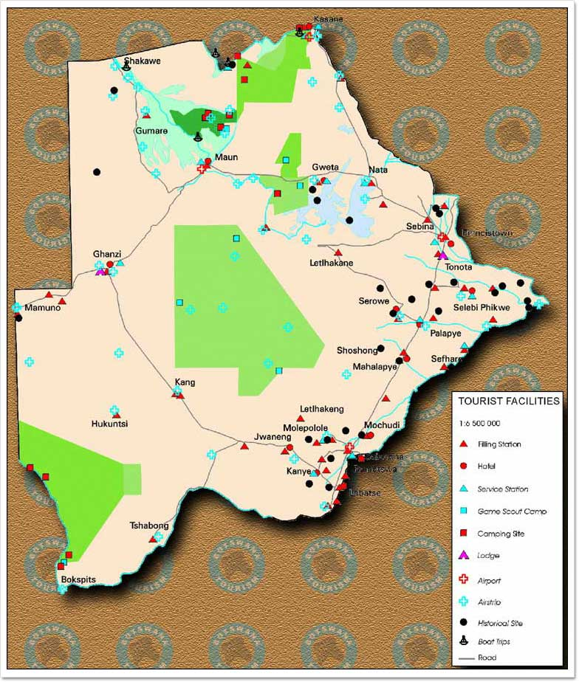
realising the shift!
1961
CKGR established
land rights
1980
+
diamonds discovered
resource rights
1986
Mothomelo
water
Govt policy to relocate
Kaudwane
2002
VS
steps to actively relocate
conservation
terminate services
Central Kalahari Game Reserve
water
prevented access
Notes:
1961
CKGR established – rationale (to house Kalahari Bushmen but given political sensitivity of establishing native reserves given SA regime – decided to extend to cover conservation – named a Reserve)
At time created = largest in Africa (now third)
52800 km2 (1/16 of the country) – size of Belgium
following creation about 700-1000 San continued to reside within reserve and undertake their hunter gatherer livelihood
Very dray with limited and unreliable rainfall
Residents originally lived nomadic lifestyle but over time created permanent settlements (Gugamma, Kikao, Mothomelo & Molapa)
Mothomelo the largest – 2001 = 245
Mothomelo about 100km from Kaudwane
Kaudawne established in 1997 to resettle residents from the Reserve
1980’s
Diamonds discovered
Systematic process initiated by Government to move Bushman out
1985 – De Beers drills borehole for prospecting purposes at Mothomelo – borehole subsequently used for supplying water to community (Municipality maintained and provided fuel to run and transported water to other residing in the Reserve
1986
Ministry of Commerce and Industrial Circular (1986)
social and economic development of settlements in CKNR be immediately frozen
viable alternate sites be identified outside the reserve and the residents should “be encouraged – not forced” to move their
Government should provide them with incentives to move
Need for stricter regulation of the game reserve
Focus on conservation interests within the reserve
Nonetheless continued to provide water and health services
Continued to maintain the borehole at Mothomelo
1996
Government formed Reference Group
Consultations with the community to relocate
Assurances that would not terminate services
2000
National Parks and Game Reserve Regulations (28 of 2000)
Regulations confirmed, assumed and/or facilitated human settlement in the Reserve
Made provision for designation of Community Use Zones – designated for communities living in or adjacent to the CKGR.
None finalised as dependant on Management Plan and no Mgt Plan finalised
2002
Decision to terminate services
Emptied the water tanks and sealed the bore holes
police presence during the relocations and some stories of intimidation
terminated special game licences previously issued to Bushman to hunt in the reserve

Slide 6
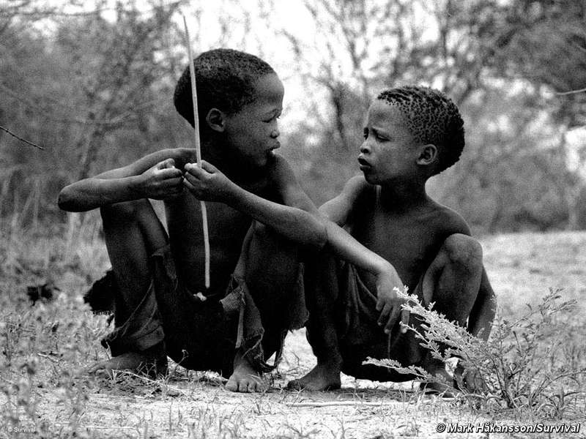
the legal wrangle
2006
lawful possession and occupation
Land
High Court
Sesana vs AG
unlawful forced deprivation
prevention of access unlawful
termination of services not unlawful
not obliged to restore services
2010
High Court
Mosetlanyane vs AG
no good without water
Water
sought confirmation from govt
2011
Court of Appeal
water rights issues
Mosetlanyane vs AG
access issues
Notes:
FOLLOWING SESANA CASE
some return
but no water – borehole sealed, pumps removed
sought some clarity fro the government – none forthcoming
International NGO willing to fund recommissioning of pump but community uncertain about whether had a right to recommission and sink other boreholes and/or whether contractors would be given access
Not want to commission contractors before have legal certainty
Therefore went to Court again – Applicants in this case were two residents at Mothomelo (also previously applicants in the Sesana Case)
COURT A QUO
In rather confused judgment – Justice Walia dismissed their application holding that they had no authomatic water rights as a result of their occupation of the land and therefore they would have to apply for a Water Right under the Water Act (section 6)
APPEALED THIS DECISION

Slide 7
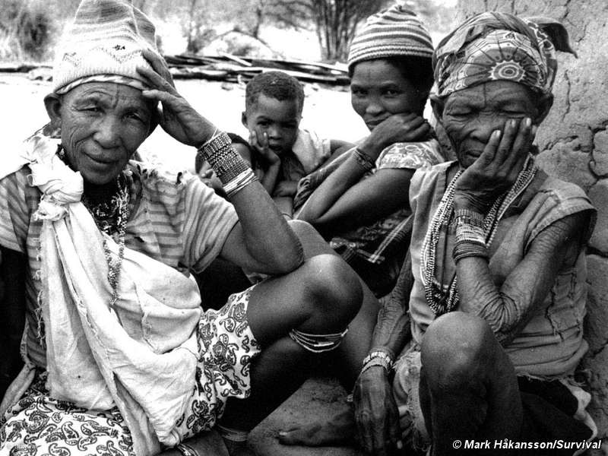
Mosetlanyane vs AG (Crt of Appeal)
the orders sought
the refusal/failure of the Govt to permit them to
re-commission the borehole at their own expense for domestic
purposes was unlawful/unconstitutional
the refusal/failure of the Govt to confirm that they have
a right to sink one or more boreholes in the CKGR and abstract
water therefrom was unlawful/unconstitutional
refusal/failure to confirm that if they paid the prescribed
fee, their contractors could enter the CGGR to do their work was
unlawful/unconstitutional

Slide 8
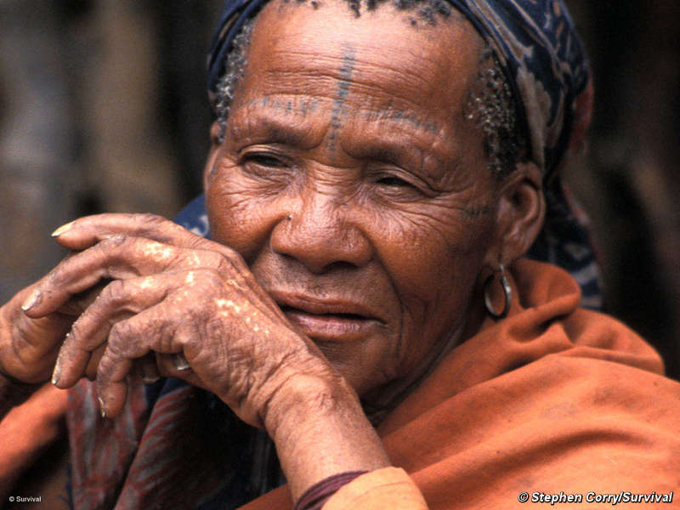
the arguments
statutory interp
S 6
S 9
…the owner/occupier of any land
may without a water right … sink
or deepen any borehole…and use
water therefrom for domestic
purposes
Water Act
Subject to the foregoing provisions,
no person shall divert, abstract, use …
except in accordance with a water
rights granted under this Act.
human rights
Constitution
S 7
No person shall be subjected to
torture or to inhuman or degrading
punishment or other treatment
Notes:
Statutory Interpretation
A Quo
conflict between the two leading to ambiguity
Interpretation Act – where conflict – later provision prevails
therefore needed a right
Appeal Court
Court a quo clearly misdirected itself as to the relationship between S 6 and 9
Wording clear – section 9 subject to section 6
Therefore no need for water right
Rejects Respondents additional argument
not a borehole but a prospecting hole and therefore section 6 does not apply – has been used as a borehole for decades!

Slide 9
statutory interpretation
S 6
S 9
Water Act
the borehole is a “borehole”
applicants are lawful occupiers
section 9 clearly subject to section 6
therefore have automatic right to abstract and use water from borehole for domestic purposes
need not apply for a water right
court a quo misdirected itself
to hold otherwise would render occupation of many citizens dependent on groundwater for livelihood meaningless
Notes:
Borehole is a “borehole” – not a “prospecting hole” – as used since 1986 as borehole
Applicants are lawful occupiers (confirmed in Sesana Case)
Section 9 subject to section 6 (“subject to the foregoing provisions) and therefore no need to invoke Interpretations Act
To hold otherwise would render occupation meaningless as provision specifically created to enable occupiers to inhabit land in arid climate

Slide 10
human rights
S 7
Constitution
court a quo – not address as not satisfactorily pleaded
nature of the right
  absolute – not qualified
  the question whether person subjected to inhumane or degrading treatment involves a value judgment
  court entitled to refer to international instruments when making value judgment
    UNCES&CR General Comment 15 (2002)
    UN GA Resolution 64/292 (2010)
not be subjected to inhuman
or degrading treatment
right to water
Notes:
Court Questioned why court a quo not address and feel sufficiently pleaded
Dealing with first generation right not to be subjected to inhumane or degrading treatment
No water rights (second generation) in the Constitution and therefore had to rely on section 7
Looked at nature of the rights
absolute
no limitations or qualifications
question whether subjected to cruel and inhumane treatment involves a value judgment
Court entitled to refer to international Instruments to give effect to right
Court considered:
UN Committee on Economic, Social and Cultural Rights Report on Substantive Issues Arising in the Implementation of the UN Covenant on EC&CR (1966) (which specifically recognised right to water and that states should take measures to specifically provide assist indigenous peoples access to water resources.) – General Comment 15 – 2002
International Covenant on Economic, Social and Cultural Rights(1966)
"The human right to water entitles everyone to sufficient, safe, acceptable, physically accessible and affordable water for personal and domestic uses. An adequate amount of safe water is necessary to prevent death from dehydration, to reduce the risk of water-related disease and to provide for consumption, cooking, personal and domestic hygienic requirements. ”
UNGA Resolution 64/292 (July 2010) – expressly recognised right to safe and clean drinking water as fundamental human right

Slide 11
human rights…
triggered in this case
  considered uncontested plight of community in CKGR
  impact of termination of water services resulted in degrading treatment
  rejected Govt’s arguments
    not obliged to provide services
    if want services can simply relocate
    Bushman authors of own discomfort
Govt must stop inflicting degrading treatment
  not a positive obligation to provide services
  must simply not stop Bushman effectively seeking to help themselves
Notes:
Plight of the Community
Human suffering
Dire lack of water
Dependant on sourcing from few melons and squeezing from roots
weak, sickness, ill health (dizziness)
Not sufficient water to cook or clean with
Rejects Governments arguments
irrelevant that Govt not statutorily obliged to provide services – as only concerned with their actions precluding community accessing water at their own cost
Latter two arguments ridiculous – effectively saying you can live there as long as do not extract water other than from plants

Slide 12
the outcome
applicants have right at own expense to:
  re-commission Mothomelo borehole
  sink one or more boreholes inside CKGR
  to service, repair and maintain boreholes
  to use abstracted water for domestic use
  to bring borehole equipment, machinery and storage tanks into the CKGR
  to contract third parties to assist them to do so
Govt must issue permits to third parties to allow entry for above purposes
Govt can direct to leave if:
  reasonable grounds for believing non-compliance
  after written notice and reasons to community

Slide 13
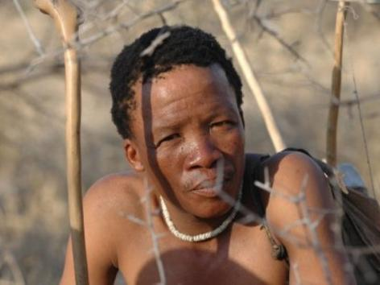
a few comments
somewhat fortunate litigants?
a human rights case?
playing advocate, attorney & judge!
reversal in conservation ideology!
Notes:
FORTUITOUS LITIGANTS (in limine challenges)
Not properly before the Court – had their been a failure/refusal
Non-joinder of state institutions with direct interest – conservation authorities and water authorities
Matter brought against the wrong party – AG no power to issue access permits or grant water rights
(Water Allocation Tribunal, Department of NP and NR’s)
THE CONSTITUTIONAL RIGHTS
substantive right only given consideration as almost afterthought in final of four cases
good example of court seeking to forge remedy using right outside its ordinary context (not even use right to life - article 4)
failure to consider broader array of relevant international instruments having headed down the value judgment road
ILO Convention 169 on Rights of Indigenous and Tribal Peoples in Independent Countries (1989)
Convention on the Rights of the Child (1989)
Convention on the Elimination of all Forms of Discrimination Against Women (1979)
United Nations Declaration on the Rights of Indigenous Peoples (2007)
African Charter in Human Rights
largely decided on issue of statutory interpretation (probably need not even have addressed the constitutional issue)
COURT PLAYING JUDGE, ADVOCATE AND ATTORNEY
Neither party raised the section 6 vs section 9 argument
Introduced by Justice Walia mero motu in the 2010 case
ILO Convention 169 on Rights of Indigenous and Tribal Peoples in Independent Countries (1989)
Art 15 - The rights of the peoples concerned to the natural resources pertaining to their lands shall be specially safeguarded. These rights include the right of these peoples to participate in the use, management and conservation of these resources.
Convention on the Rights of the Child (1989)
Article 24 1. States parties recognize the right of the child to the enjoyment of the highest attainable standard of health and to facilities for the treatment of illness and rehabilitation of health … 2. States parties shall pursue full implementation of this right and, in particular, shall take appropriate measures: (c) To combat disease and malnutrition, including within the framework of primary health care, through, inter alia, (…) the provision of adequate nutritious foods and clean drinking water (…
Convention on the Elimination of all Forms of Discrimination Against Women (1979)
Art 14(2) – states parties shall ensure women the right to “enjoy adequate living conditions, particularly in relation to … water supply’
United Nations Declaration on the Rights of Indigenous Peoples (2007)
Art 25 - Indigenous peoples have the right to maintain and strengthen their distinctive spiritual relationship with their traditionally owned or otherwise occupied and used lands, territories, waters
Art 32(2)- States shall consult and cooperate in good faith with the indigenous peoples concerned through their own representative institutions in order to obtain their free and informed consent prior to the approval of any project affecting their lands or territories and other resources, particularly in connection with the development, utilization or exploitation of mineral, water or other resources
African Charter in Human Rights (Art 24)

Slide 14
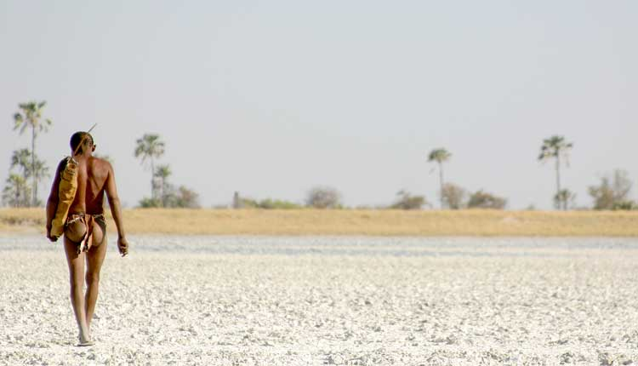
a lonely road for the San to travel
“In conclusion, it seems to me that this case invites this concluding comment. This Court has been invited to resolve a dispute, which at first blush is about the termination of water and other named services to a few hundred people, who are demanding access to a specified piece of land and the right to hunt in that piece of land. While that is indeed correct, this dispute cannot be resolved, will not be resolved, unless the Respondent acknowledges and addresses its deeper context, its nub, and its heart. The case is ultimately about a people demanding dignity and respect. It is a people saying in essence, ‘our way of life may be different but it worthy of respect. We may be changing and getting closer to your way of life, but give us a chance to decide what to carry with us into the future.”
Notes:
Judge in the Sesana Case (2006)
Something we all need to remember in forging future legal frameworks

