Slide 1

Water Management Strategies
Government’s responsibilities as public trustee

Slide 2
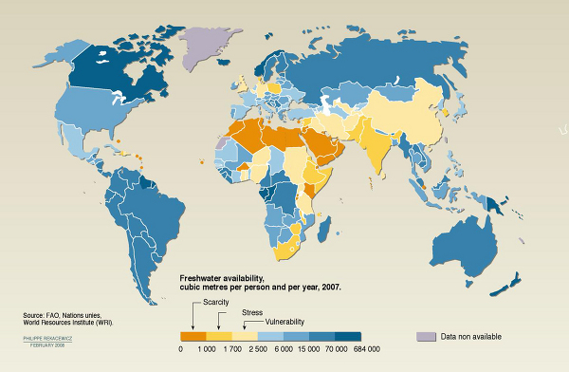

Slide 3
History of legislation of water in SA

Slide 4
SECTION 3 OF THE NATIONAL WATER ACT
(1) As the public trustee of the nation’s water resources the National Government, acting through the Minister, must ensure that water is protected, used, developed, conserved, managed, and controlled in a sustainable and equitable manner, for the benefit of all persons and in accordance with its constitutional mandate.

Slide 6
 | RES PUBLICAE | PUBLIC TRUST DOCTRINE | TRUSTEESHIP
DEFINITION | State management Public use | State is trustee Public is beneficiary | State is trustee Public interest
PROBLEMS | Antiquated Irrelevant Inconsistent | Applied differently from State to State Uncertain | Uncertain: how do we interpret these duties in section 3?
CONCLUSION | Not necessary | Assumption that it is incorporated into our legislation is potentially wrong | Best route: can be interpreted and developed on a case-by-case basis. Can develop in terms of Constitution and modern requirements

Slide 7


Slide 8
Public Trusteeship?
Content of duty
Standard
Protect
Use
Develop
Conserve
Manage
Control
SUSTAINABLE
EQUITABLE
BENEFIT
CONSTITUTIONAL

Slide 9
Standard: satisfying elements of sustainability

Slide 10
Beneficial to community
Improve Infrastructure
Promote Constitutional values (dignity, etc.)
Redress socio-economic, power inequalities
Community involvement
Social

Slide 12
Further standards of interpretation?
Company law - trustee?
  Fiduciary duties?
  Good faith?
Administrative law?

Slide 14
Balance out these responsibilities?
Actively involve local communities in decision-making process
Duties + Standards

Slide 15
Conclusions?
Trusteeship: rely on the legislation
and Constitution
Other considerations:
  develop idea of community
  involvement

