Slide 1

ANCESTRAL LANDS AND WATER
Dr. Rafael González Ballar
July, 2011

Slide 2
The San Salvador Protocol on Economic and Social Rights (1999) contains a clear standard, objective and important article 11 in the evolution of environmental protection in general.
1. Everyone shall have the right to live in a healthy environment and to have access to basic public services.
2. The States Parties shall promote the protection, preservation, and improvement of the Environment”.

Slide 3
American system of human rights, territorial rights of indigenous and tribal peoples are mainly based on Article XXIII of the American Declaration of the Rights and Duties of [American] Declaration and Article 21 of the American Convention on Human Rights (the American Convention).
"While none of these articles refers specifically to the rights of indigenous and tribal peoples, the Commission and Court have interpreted the two provisions in a way that protects such rights on their land and natural resources, that is, on their territories. "

Slide 4
In a comprehensive manner… "is a right to the territory that includes the use and enjoyment of their natural rights. It relates directly, even as a pre-requisite, with the right to a dignified existence, food, water, health, life, honor, dignity, freedom of conscience and religion , freedom of association, rights of the family.
" Court has determined that the culture of the indigenous community members corresponds to a particular lifestyle of being, seeing and acting in the world, up from its close relationship with their traditional lands and natural resources, not only these are their main livelihood, but also because they constitute an integral part of their worldview, religion and, therefore, their cultural identity… " In a comprehensive manner…

Slide 5
Why if we have at the Inter American Human Rights System, since (1947), The Inter American Charte of Social Guaranties, article 39, or the Inter American Democratic Charte (2001), article 15 and finally article 11 in the San Salvador Protocol, the interpretation of the concept of ancestral lands or territories becomes more important?

Slide 6
The first answer is linked to a historical aspect. The concept of ancestral lands or territories came first. The ratification by the number of States required in the Protocol was obtained (1999) after the Inter American Commission and the Court started the interpretation of the concept.
The second is that the San Salvador Protocol in article 1 guaranties:“The States Parties to this Additional Protocol to the American Convention on Human Rights undertake to adopt the necessary measures, both domestically and through international cooperation, especially economic and technical, to the extent allowed by their available resources, and taking into account their degree of development, for the purpose of achieving progressively and pursuant to their internal legislations, the full observance of the rights recognized in this Protocol.”

Slide 7
The other aspects that need to be taken in account are related to the structural weakness of most of the Latin American environmental legislation:
Very little use in our environmental legislation of the concept of “ balanced development” and good governance in the legal system.
Insufficient use or link to technical, and social considerations in the solution of environmental conflicts.
Very severe deficiencies in the institutional management of environment.
Very weak legislation and guaranties for the protection of water.

Slide 8
The interpretation made by the IAC and the Court of the concept of ancestral lands and territories is more comprehensive than the article 11 by itself. In a very positive approach they have protected :The Geographic Scope of Indigenous Property Rights, Legal Title and Registration Legal Certainty of Title to Property Delimitation and Demarcation of Ancestral Territory, Possession and use of Territory, Effective Security against Third Party Acts and Claims, Legal Conflicts over Territorial Property with Third Parties, The Right to Restitution of Ancestral Territory, Right to Basic Services and Development , Exercise of the Spiritual Relation to Territory and Access to Sacred Sites, Protection from Forced Displacement.
The basic argument of the IAC is that with indigenous conflicts “ FAILURE TO SECURE PROPERTY RIGHTS IMPAIRS THE ENJOYMENT OF OTHER HUMAN RIGHTS.” The first argument starts with the Right to Life .

Slide 9
“ The life of members of indigenous and tribal communities “fundamentally depends” on the subsistence activities – agriculture, hunting, fishing, gathering ‐ that they carry out in their territories including continued utilization of traditional collective systems that “are in many instances essential to the individual and collective well‐being, and indeed the survival of, indigenous peoples.” The failure of the State to guarantee indigenous communities’ right to ancestral territory can imply a failure to comply with the duty to secure the life of their members; such was the case of the Yakye Axa community: “the State, by not ensuring the right of the Community to its ancestral territory, has failed to comply with its duty to guarantee the life of its members, as it has deprived the Community of its traditional means of subsistence, forcing it to survive under appalling conditions and leaving it at the mercy of State assistance. The State violates article 4.1 of the American Convention in relation to article 1.1, when it does not adopt “the necessary positive measures within its powers, which could reasonably be expected to prevent or avoid risking the right to life of the members of an indigenous community”.

Slide 10
the Inter‐American Court has quoted General Comment 14 of the UN Committee on Economic, Social and Cultural Rights, on the right to the enjoyment of the highest attainable standard of health.
The right to health is the second important argument .

Slide 11
The third important interpretation is on economic and social aspects.
“The lack of access to lands and resources also limits the enjoyment of other economic and social rights. The UN Committee on Economic, Social and Cultural Rights’ General Comments on the rights to adequate food and water specify that point: “In the case of indigenous peoples, access to their ancestral lands and to the use and enjoyment of the natural resources found on them is closely linked to obtaining food and access to clean water. In this regard, said Committee on Economic, Social and Cultural Rights has highlighted the special vulnerability of many groups of indigenous peoples whose access to ancestral lands has been threatened and, therefore, their possibility of access to means of obtaining food and clean water.”

Slide 12
The most important argument in our presentation is the right to their natural resources.
“Many indigenous and tribal peoples live in areas rich in living and non‐living resources, including forests that contain abundant biodiversity, water, and minerals. Historically, the desire of non‐indigenous society for such resources has resulted in the removal, decimation or extermination of many indigenous communities.”

Slide 13
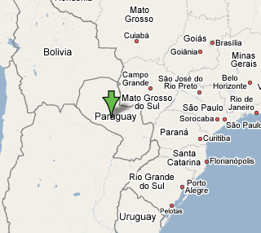
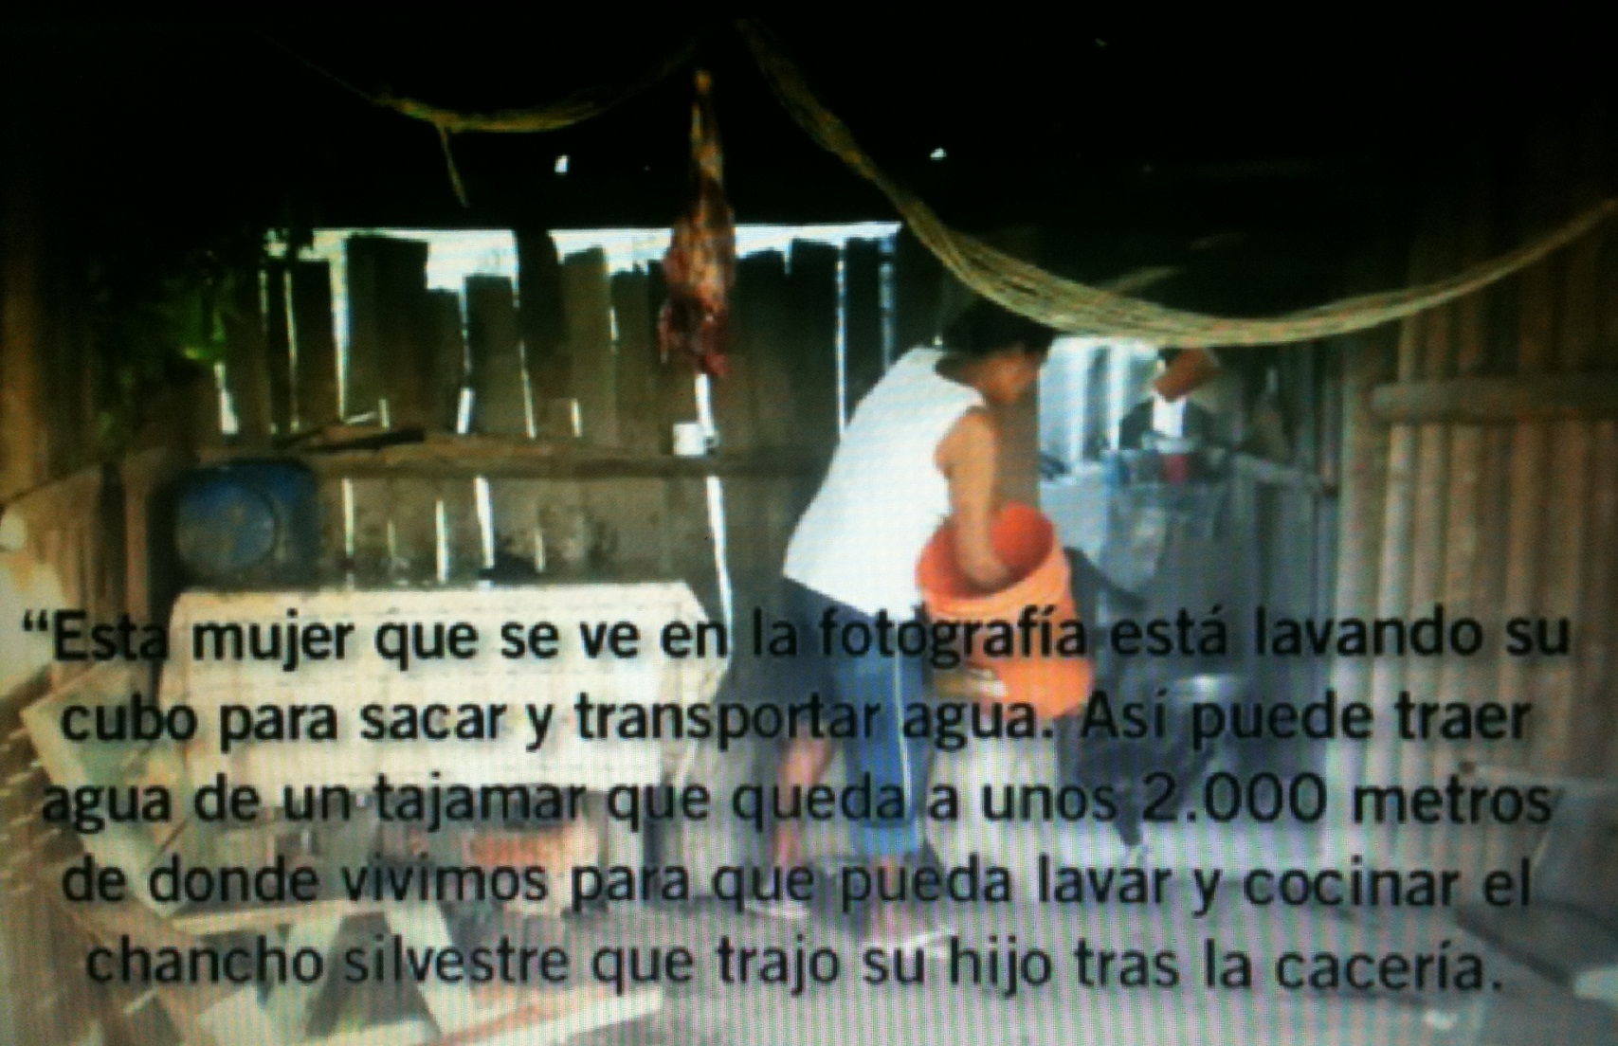
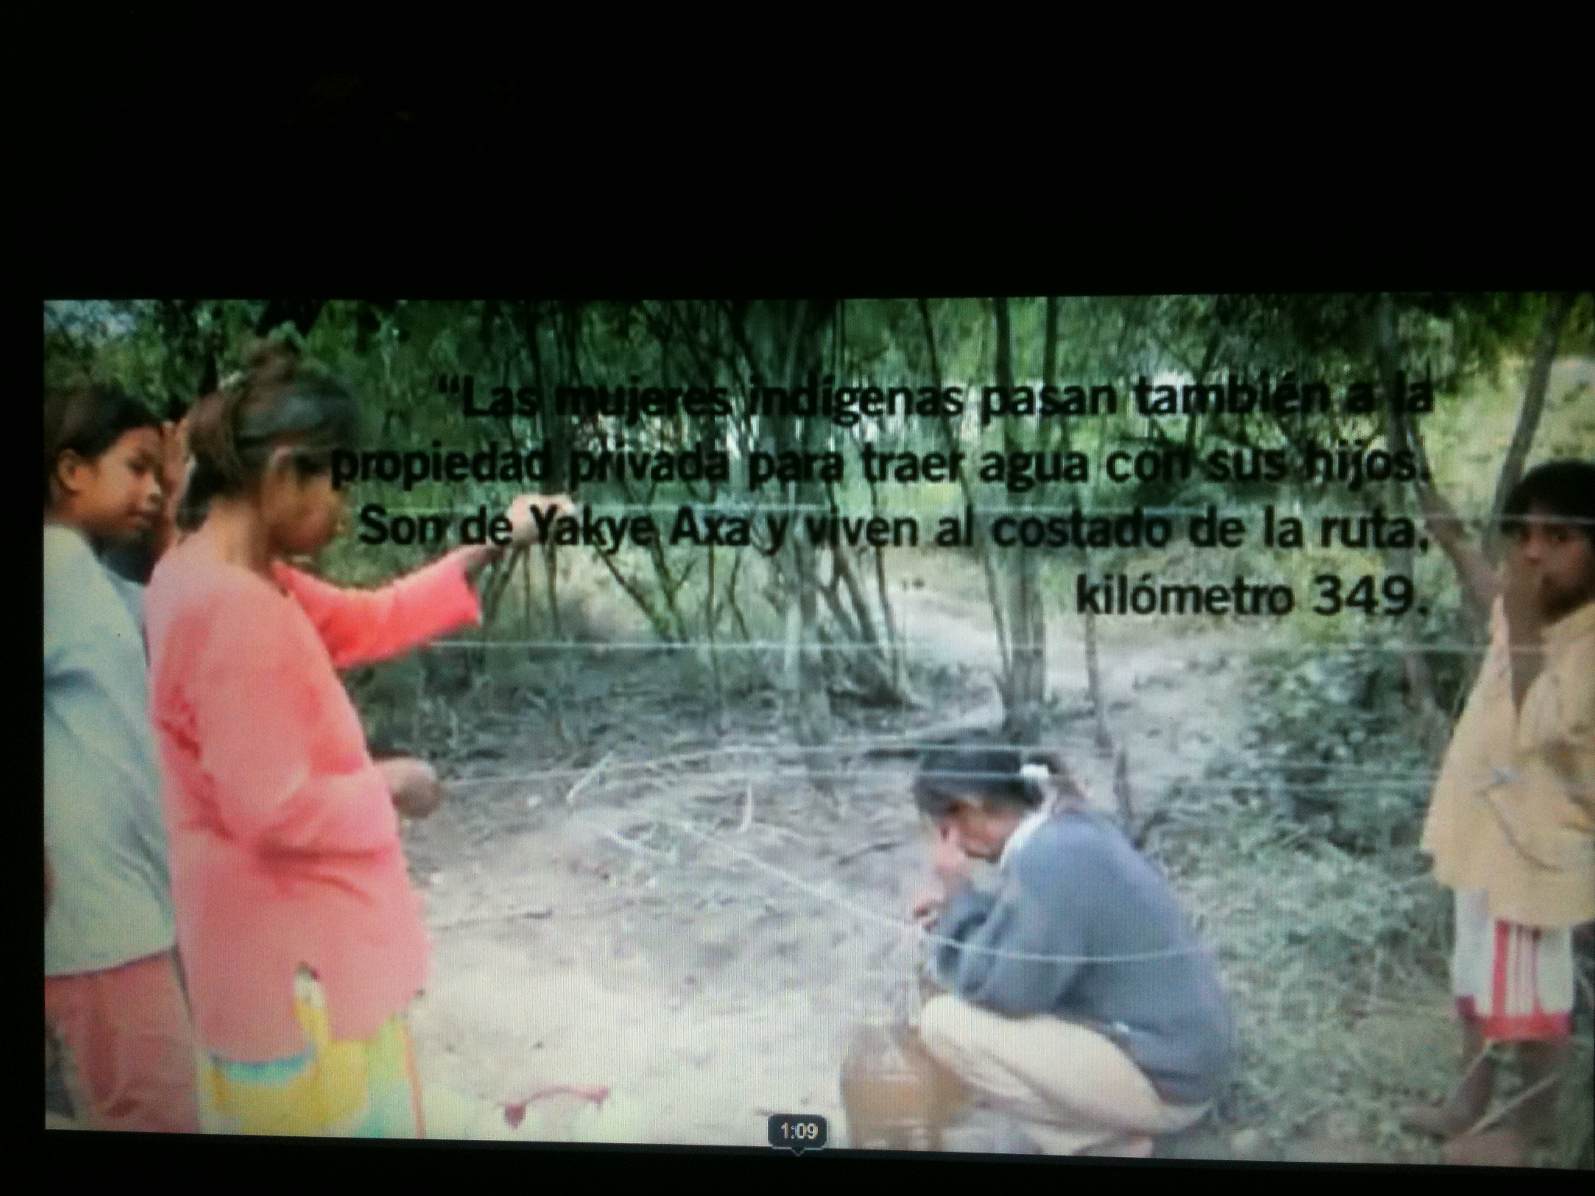

Slide 14
Thank You.

