Slide 1
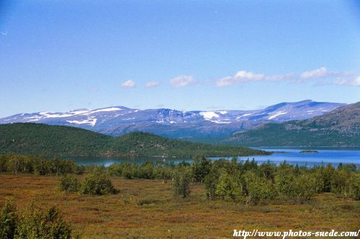
THE PAST, THE TRANSITION AND THE FUTURE – ROLE OF THE FRONTIERS RIVERS AGREEMENT BETWEEN FINLAND AND SWEDEN
Josefin Gooch, Faculty of Law, Lund University
Notes:
In November 2009, Sweden and Finland signed a new bilateral water agreement, replacing the 1971 Frontier Rivers Agreement between the countries. The new agreement entered into force on the 1st of October 2010. However, the work on appointing the new Commission is not ready so the agreement is not fully operational yet.
My presentation will revolve around the old and the new agreement and the reasons for changing the old one.
Someone asked me the other night what the most important problems were in this cooperation. The truth is that it is a highly unproblematic cooperation. So why do I want to present it to you? Firstly, the 1971 Agreement has often been presented as a highly successful agreement and cooperation. Still it has been significantly changed, and I want to present the reasons for this. Secondly I want to point to some implications of the change for water governance in the region.

Slide 2
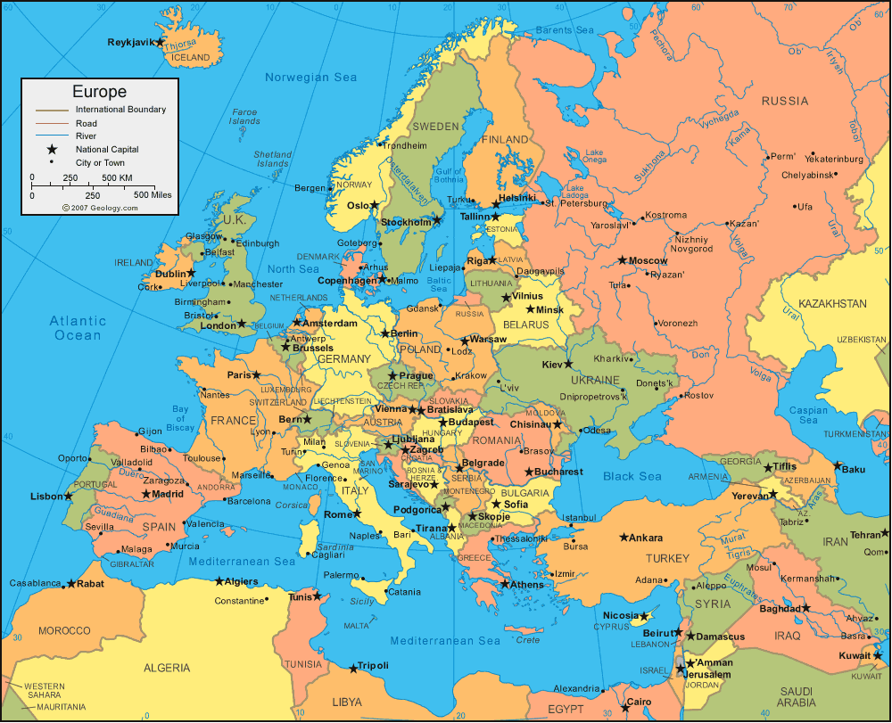
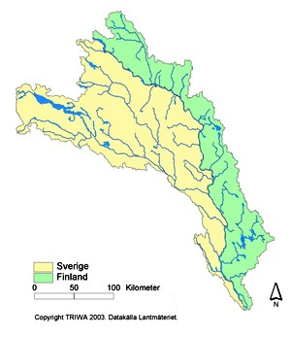
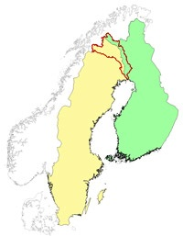
THE TORNE RIVER DRAINAGE BASIN
The agreement governs the river chain Könkämä-Muonio-Torne
Swedish-Finnish Border
EU WFD international river basin district
Europe
Notes:
The Agreement governs the river chain Könkämä-Muonio-Torne, or the Torne River drainage basin, which constitutes the border between Finland and Sweden.

Slide 3
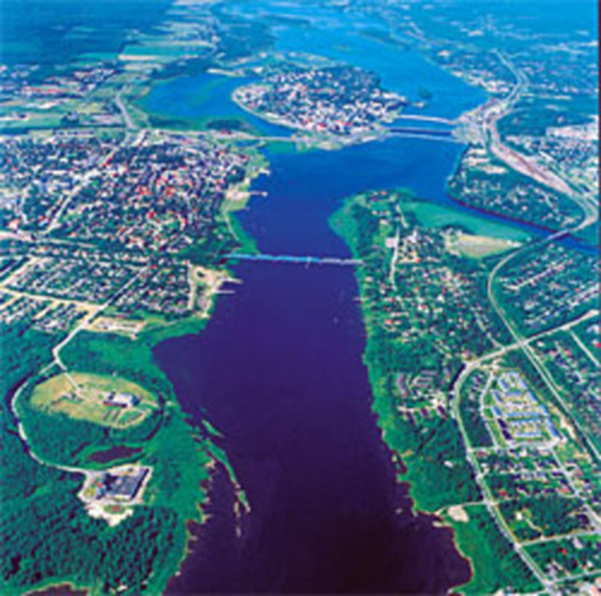
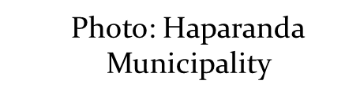
TORNE RIVER BASIN - GENERAL
40 157 km2
App. 60 % in Sweden and the rest in Finland, except for minor areas in Norway (0.7 %)
One of the last large free running rivers in Europe
Protected Natura 2000 site
Forestry, Fishing, mining, recreation
Generally good water quality with low pollution loads.
Physical changes
  rivers cleared for log driving and
  dams built for power plants (tributaries).
Notes:
The Drainage basin extends over 40 000 km2 with app. 60 % in Sweden and the rest in Finland, except for minor areas in Norway (0.7 %). It is one of the last large free running rivers in Europe and a Protected Natura 2000 site in both countries. Forestry, Fishing, recreation, mining are important industries in the basin which is sparsely populated with 1 person/km2 on the Swedish side and two on the Finnish. The water quality is generally good with low pollution loads. However, the physical changes have been significant, with rivers cleared for log driving and dams (on the tributaries) built for powerplants.The cooperation in the basin, and the agreement covers, apart from the main channels, Tributaries, the River Mouth of Torne River and some of the waters outside of the River Mouth. These areas make up an international drainage area in accordance with the EU Water Framework Directive (WFD).

Slide 4
UNPROBLEMATIC COOPERATION
Not much water quality problems
No water quantity problems
Sparcely populated
No upstream-downstream issues
Share history
Similar national laws
Share common EU goals
Notes:
So, the region does not have much water quality problems. Neither does it have water quantity problems as water is abundant in the region.

Slide 5
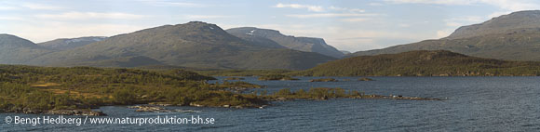
THE 1971 AGREEMENT AND ITS COMMISSION
1971 Agreement covered hydraulic construction works, water regulation, fishing and pollution
Replaced the national legislation in its scope both in Sweden and Finland
The Commission acted, in place of national authorities, as permit authority for:
  applications concerning joint water bodies and
  compensation claims
Notes:
The 1971 Agreement was quite a unique transboundary water agreement. It covered hydraulic construction works, water regulation, fishing and Pollution. But what made it such a special agreements was the great powers which it vested upon the Border River Commission and the fact that it replaced national legislation in its scope both in Sweden and Finland. National law were applied subsidarily. The Commission acted, in place of national authorities, as permit authority for:
applications concerning joint water bodies and
compensation claims

Slide 6
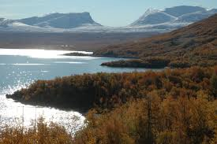
BACKGROUND TO THE 2009 AGREEMENT
New more rigorous national legislation
International agreements,
EU legislation, especially WFD
Outdated the 1971 Agreement
Notes:
The Agreement has generally been regarded as a showpiece of a workable arrangement in international law. However, a lot has happened in the 40 years that has passed since it came into force. New, and more rigorous national laws have been developed in both Finland and Sweden, while the 1971 agreement had remained unchanged. There has also been a lot of development in international law with new agreements. These developments had rendered the 1971 agreemnet outdated. The most significant reason for changing the agreement was however the countries’ membership in the EU and the requirements that stem from the membership. Especially the requirements under the water framework directive have influensed the new agreement.

Slide 7
EU WATER FRAMEWORK DIRECTIVE
Adopted in 2000
To protect and improve the quality of waters within the EU
Good status for all all inland- coast-, and groundwaters by 2015.
States governing the same river basin district are to cooperate.
Notes:
It is a legislative framework to protect and improve the quality of waters within the EU and the objective is to achieve good status for all inland- coast-, and groundwaters by 2015. Waters are to be governed at basin level and states sharing an international river are to co-operate. However, the level of cooperation is not accurately defined

Slide 8
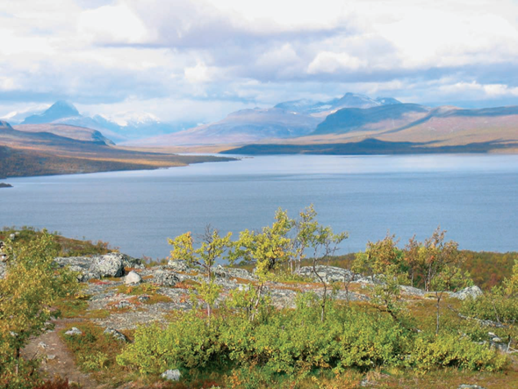

DESIRED FEATURES IN THE NEW FINNISH-SWEDISH AGREEMENT
An agreement with a more holistic approach towards water management and environmental protection.
An agreement with less need of revisions in order to be kept up-to-date.
The possibility of appeal.
An agreement that could cater for the demands of plans under WFD.
Notes:
So, Under the 1971 agreement the commission was the sole authority responsible for the water aspects of an activity while other aspects where handled by national authorities. This was not in line with the developments under e.g national law and the states wanted an agreement with a more holistic approach towards water management and environmental protection. An important issue in the work on changing the agreement was the possibility of appeal. Under the 1971 agreement, the commission’s decisions could not be appealed except in cases of compensation. This was neither in line with national laws nor international agreements and needed to be changed. The new agreement should also cater for the demands on plan projection under the WFD.

Slide 9
The 2009 AGREEMENT
Result: An Agreement in which the Commission has lost it’s role as a permit authority.
These powers have been shifted to national authorities.
New Commission’s main role is to develop cooperation in the TRBD and harmonise and coordinate plans and actions regarding the river basin.
Confirm or reject plans
The Commission also has the right to appeal, recieve information and give statements in issues within it’s scope.
Aim of 2009 Agreement
To secure an equitable use of the TDB to benefit the border region
To coordinate plans and actions to reach agreed goals regarding
  water quality, monitoring and sustainable use of waters (surface and groundwaters and fish stocks
  Flood- and environmental damage protection
  Nature Conservation
Notes:
So, the result of the work on revising the agreement was an agreement in which the commission had lost its role as a permit authority when these powers were shifted to national authorities. The main role of the new commission is to develop cooperation in the river basin and to harmonise and coordinate plans and actions regarding the river basin. The commission shall also confirm or reject plans. It has a right to appeal, recieve information and give statements in issues within its scope.
The aim of the agreement….

Slide 10
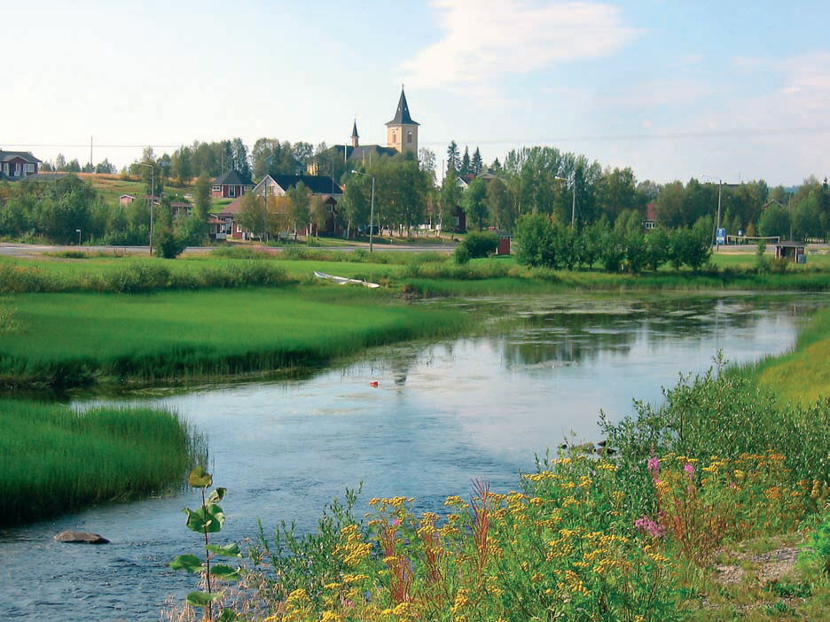
UTILISATION UNDER THE 2009 AGREEMENT
Builds on the principle of non-discrimination
The countries have equal right to the Border Rivers and their tributaries even if more water flows through one of the countries’ territories than through the others (Art. 3.1).
When planning a new activity or regulating an old one, effects on the other country shall be regarded equal to effects within the country of the activity (Art. 16).
Photo: Eira Luokkanen

Slide 11
PARTICIPATION ETC.
Stakeholders have extensive rights to participate in consultation also regarding water permit cases on the other side of the border. Stakeholders have a right view documents at the Commission. Under the 1971 Agreement there was no such right.
The Commission is responsible for info to the public
Citizens in the other country have the same legal rights of compensation and to appeal as concerned citizens in the activity's country of origin (Art. 16).
No transboundary activity can begin before the decision in the other country has become final(Art. 21).

Slide 12
PLANS
To project joint management plans is the aim of both the 2009 Agreement (Art. 4) and of the WFD (Art 13.2).
Up until now, Finland and Sweden have not succeded in this. Each country has reported seperatly to the EU.
Different timespans for consultation (different implementation of the directive) under the WFD leads to Finland being 6 months ahead of Sweden in their work on plans.
Need to coordinate timespans to reach effective governance.
Plans to include Norway (not member of the EU) in the co-operation on managementplans under WFD

Slide 13
FISHERY
The Fishery by-law constitutes an integrated part of the ny agreement. It contains provisions of e.g. no-take zones, no-take periods, minimum size and fishing equipment and the usage of it.
Fishery in Torne Rivers Fishery (somewhat smaller than the drainage basin) is handled by Närings-trafik- och miljöcentralen in Lapland in Finland and by the administrative county court and Havsmyndigheten in Sweden.

Slide 14
CONCLUSION
Advantages under the new agreement
Disadvantages
Possibility of appeal
Enhanced openness
Holistic approach
Longer handling times for applications when shifted to national authorities
Further away (physically)
Notes:
The 1971 Agreement has worked well in the past, however, it could not, in it’s old form, adopt to changes in national, international and regional law. Advantages in the new agreement include the possibility of appeal, a greater openness and a more holistic approach towards water management and environmental protection. Drawbacks are that handling times for applications will become longer in national authorities and that the decision-making process will move further away from stakeholders.
Swedish and Finnish national laws differ somewhat in their procedural approach. Substantially they are however much alike. In practice, the prerequisites for permits does not change in any considerable way. Both countries are members of the EU, and much of the environmental laws derive from EU. The WFD plays an important role towards harmonizing legislations within river basins in the EU. However, directives can be interpreted differently, which shows in the Torne River Basin case regarding time limits for consultations. Efforts should be made to limit the effects of such differences. On a whole I believe the changes in the Agreement have been for the better.

Slide 15
Thank you for listening!
Referenses
The 2009 Frontier Rivers Agreement between Finland and Sweden SÖ 2010:21 http://www.sweden.gov.se/sb/d/12316/a/169441 last accessed 2011-06-25
The Frontier Rivers Agreement 1971 between Finland and Sweden
Prop. 2009/10:212 (Swedish Government Proposition)
Prop. 1971:137 (Swedish Government Proposition)
SOU 1998:39 (Swedish Government Official Report)
RP 264/2009 rd (Finnish Government Proposition)
Finland Ministry of Environment http://www.environment.fi/default.asp?node=19874&lan=en last accessed 2011-06-27
Economic Commission for Europe Assessment of transboundary rivers, lakes and groundwaters discharging into the Baltic Sea ECE/MP.WAT/WG.2/2011/8–ECE/MP.WAT/WG1/2011/8 www.unece.org/.../ECE_MP_WAT_WG2_2011_16_discharging_into_Baltic _Sea.doc last accessed 2011-06-28
TRIWA II Management of an International River Basin District – Torne River, FINNISH ENVIRONMENT 10 | 2008 Lapland Regional Environment Centre, County Administrative Board of Norrbotten http://www.lansstyrelsen.se/norrbotten/SiteCollectionDocuments/Sv/publikationer/miljo%20och%20klimat/TRIWA/TRIWA%20II%20Final%20Report.pdf last accessed 2011-06-30
The Nordic museum http://nationellaminoriteter.nordiskamuseet.se/tornedalingar.htm last accessed 2011-06-28
Haparanda Town http://www.haparanda.se/nya-sidor-haparanda/portal-haparanda/portalsidor/bo-i-haparanda/historik.html last accessed 2011-06-16

