Slide 1
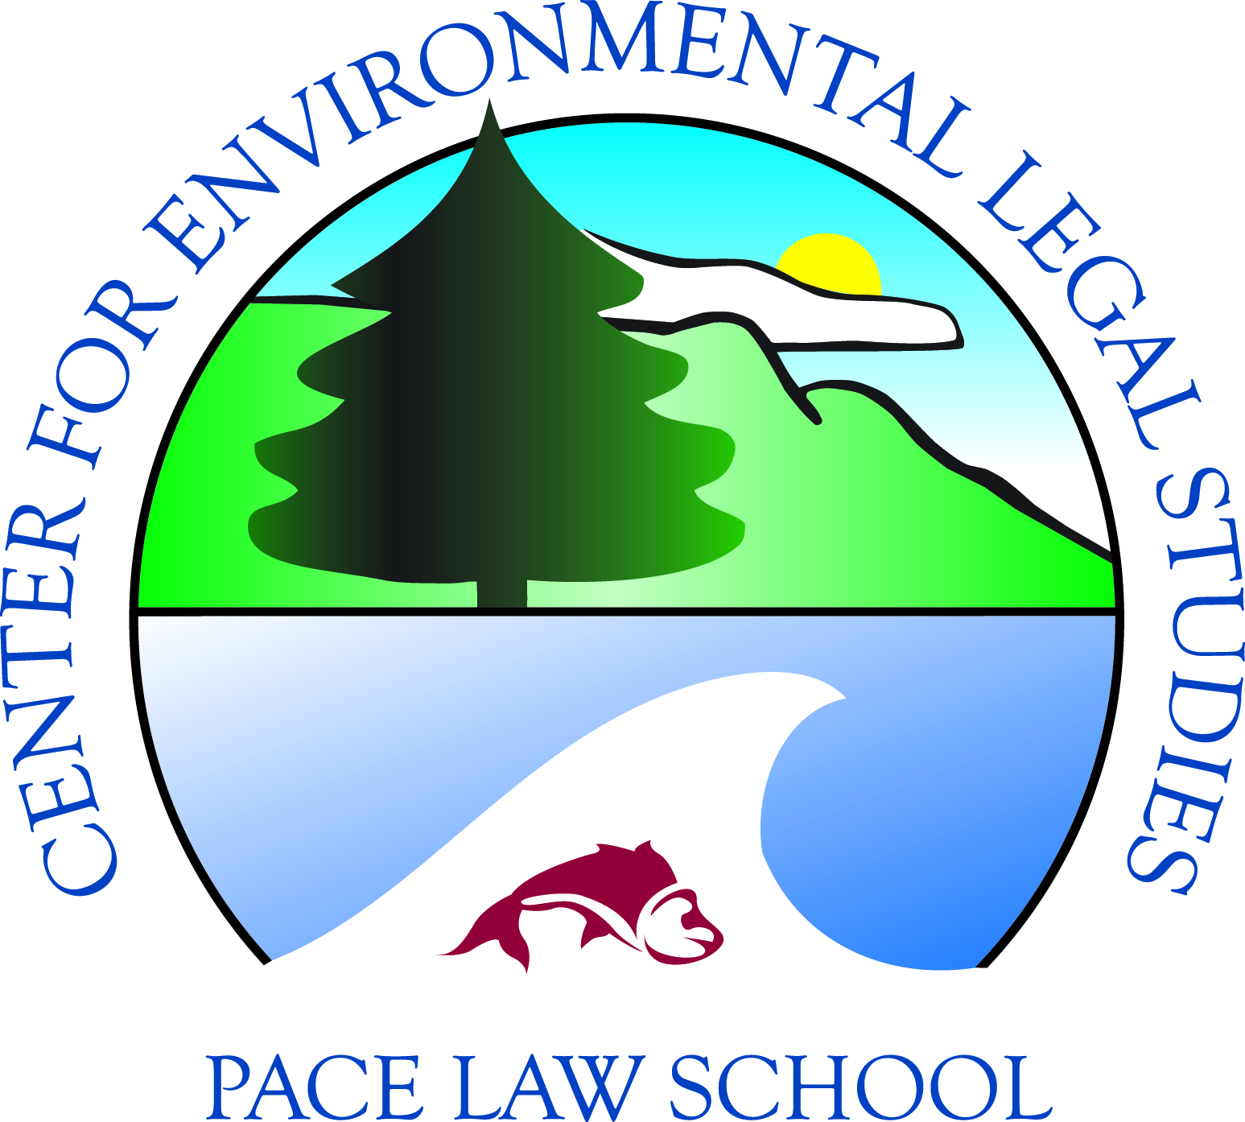
Coastal and Ocean Resources: Protecting the Most Vulnerable States
IUCN Academy of Environmental Law
Colloquium – South Africa 2011
Professor Ann Powers
Center for Environmental
Legal Studies
Pace Law School

Slide 2
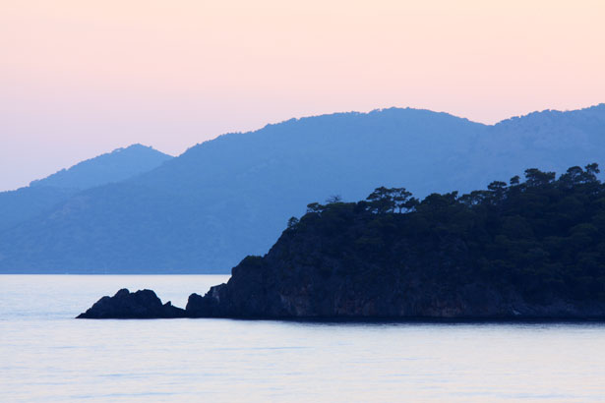
Threatened States
Recent studies suggest that sea levels will rise by more than 1m within the next century
Small island states are among the most susceptible to threats from sea level rise
Petr Kratochvil
Notes:
Pic is public domain photo

Slide 3
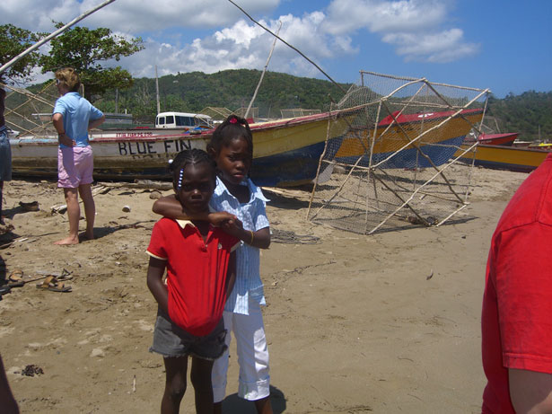
Critical Resources
Many of the world’s most vulnerable coastal states have extensive territorial seas and EEZ’s; containing significant maritime resources
These maritime resources provide many with a way of life
Developing coastal states often lack the capacity to adequately manage their maritime assets
Lee Wang
Notes:
The current UNCLOS baseline regime puts these vunerable nations in a catch 22: unless they adapt and protect their coasts from sea level rise, they will lose critical resources, and without these critical resources they may not be able to adequately adapt to sea level rise.
-photo is public domain

Slide 5
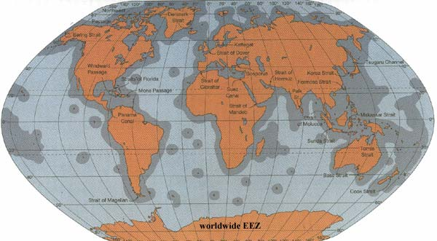

Slide 6
Art. 56(l)
Living resources
  Exclusive right to manage
  Duty to conserve, share surplus
Non-living resources – Cont. shelf regime
Consent to research
Establishment and use of artificial islands, installations & structures

Slide 7
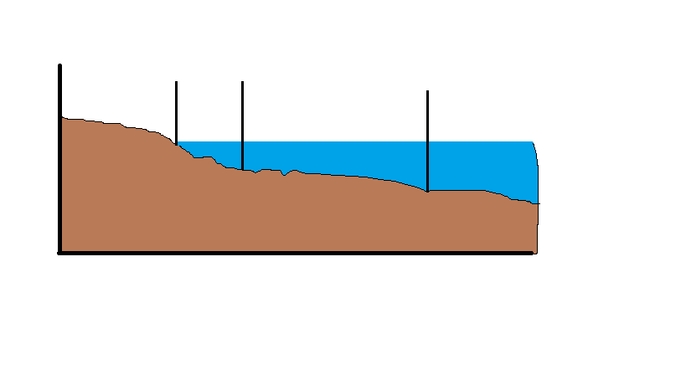

Slide 8
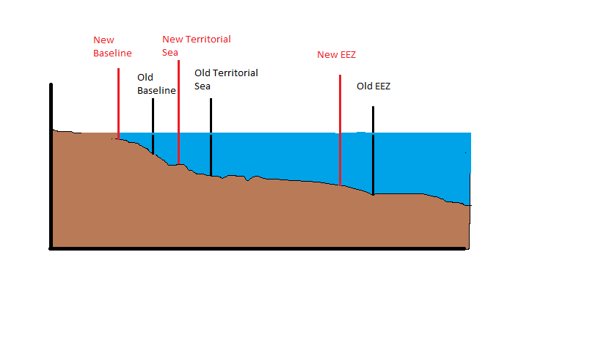

Slide 9
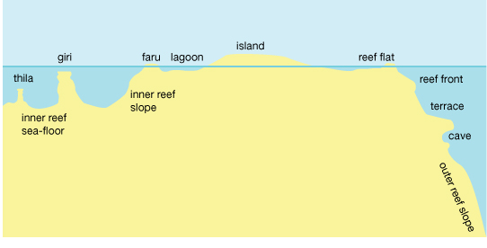

Slide 10
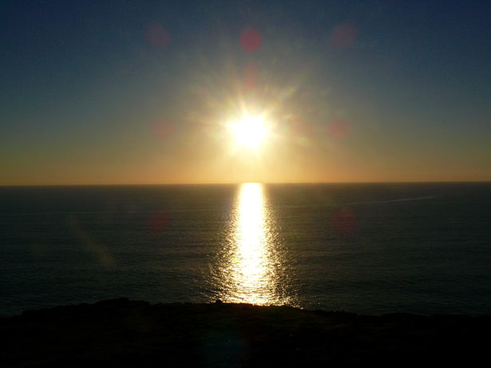
Case Studies
Tuvalu
Seychelles
Maldives
Bangladesh
Notes:
Photo public domain

Slide 11
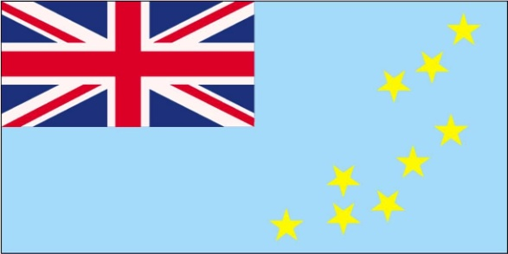
Tuvalu
Pacific archipelago of 9 coral islands with an average elevation of approximately 1m
One of the least developed countries with a per-capita GDP $2,615 in 2009
EEZ is estimated to be between 900,000 and 1.3 million km²
Fishing is a critical component of Tuvalu’s economy and society
Notes:
-pic is public domain
Tuvalu Council of Women implemented a NZAID-funded tree planting project and the NGO’s plant-a-tree project on Niutao

Slide 12
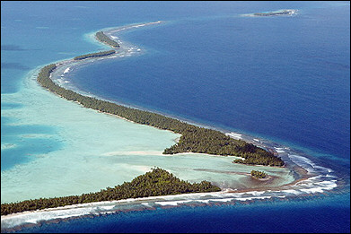
From: http://agradi.org/administrador/tuvalu&page=7
Notes:
This pic was in the original powerpoint; I added the source

Slide 13
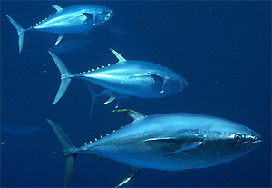
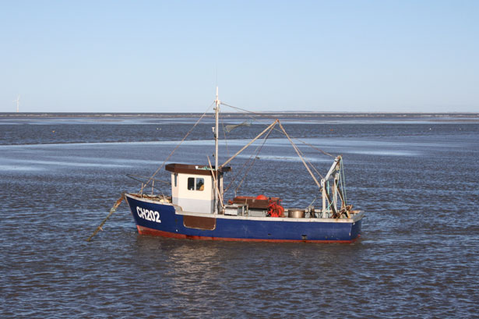
The Importance of Fishing
Fishing contributed approximately 8% of Tuvalu’s GDP in 2002
Fishing makes up about 20% of all Tuvalu’s subsistence activities
Tuvalu has only one fishing patrol boat and a monthly air patrol
Notes:
-in fact, the average Tuvaluan consumes approximately 100 kg per year.
-In 2008, Tuvalu received approximately $8.86 million from the sale of foreign offshore fishing licenses, primarily for tuna.[1] The foreign catch in 2007 was about 35,551 tons of fish, valued at $40,924,370.
-In 1999 Tuvalu, a vast majority of the ships licensed to fish in Tuvaluan waters were from the U.S. and Japan.

Slide 14
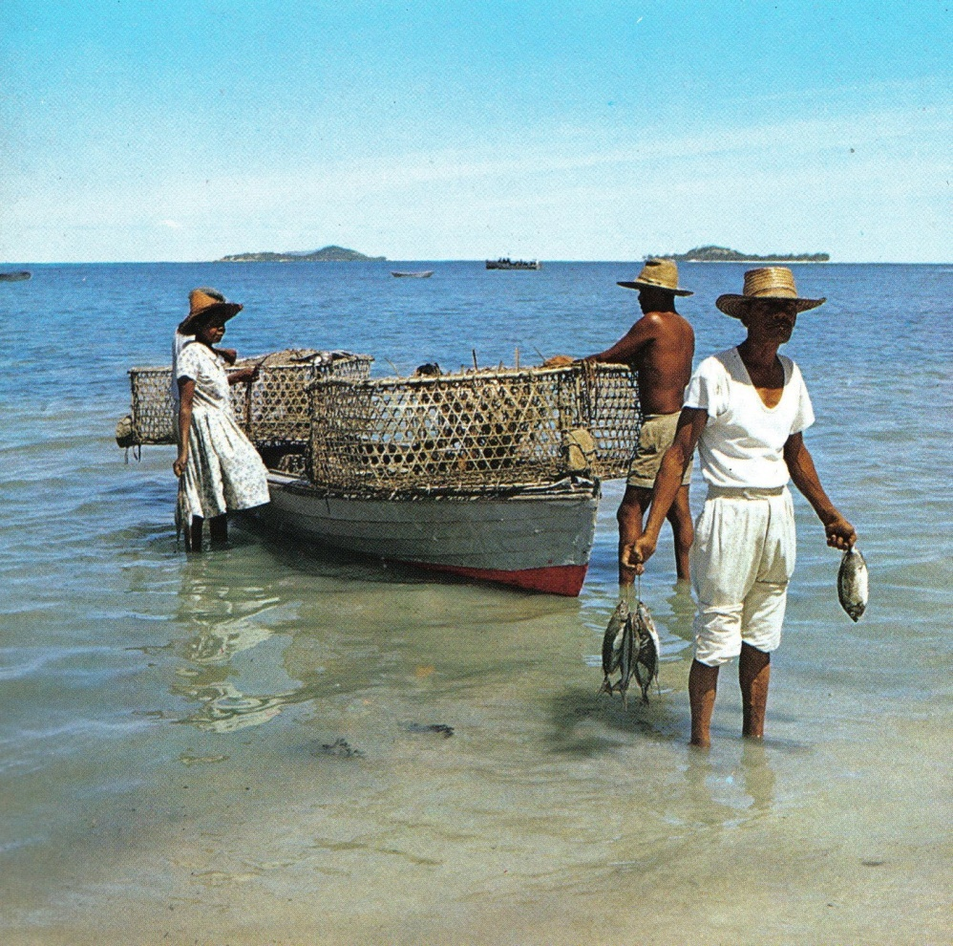
The Seychelles
Indian Ocean Archipelago of 115 islands
Has 1,690 km of coral reefs and 29 square km of mangroves
EEZ of approximately 1.4 million km²
Population of about 84,000
Dino Sassi - Marcel Fayon
Notes:
-Pic public domain
-The Seychelles economy is primarily driven by tourism and fishing, contributing over 40 percent of GNP
-In fact in 2008, the Seychelles supplied about 2.8% of the world’s tuna production
-1m sea level rise result in a loss of 70% of land mass
-possibility for mass coral bleaching

Slide 15
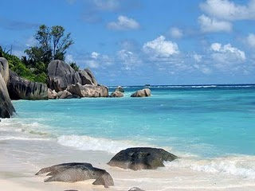
Notes:
Pic public domain

Slide 16
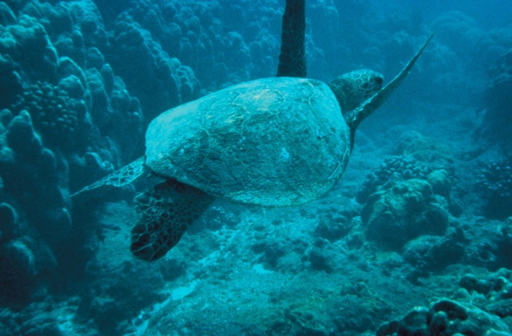
Conservation Efforts
protected 46% of its land, and 226 km² of its ocean, as national parks and reserves
Implemented a comprehensive sea turtle protection act
Developed a “greenline” to address limited monitoring capacity
Notes:
-pic public domain (not authored)
-to protect their the over one thousand flora and fauna endemic to the islands will face increasing pressure

Slide 17
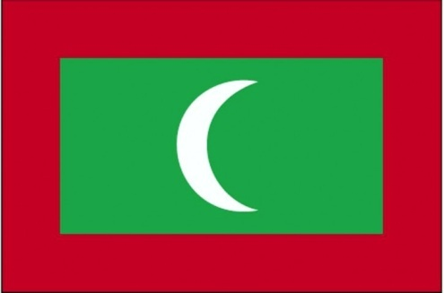
The Maldives
Indian Ocean archipelago of coral atolls of 1,192 islands with a land mass of about 300 square kilometers
EEZ of more than 859,000 km²
Maldives have 21,436 km² of coral reef
Sustained through continuous coral growth
Notes:
-The Maldives fishing sector employs about 11 percent of the workforce and accounts for about 98 percent of its physical exports
-Fishing makes up about 6% of the Maldivian economy
-Tourism makes up 33% of the Maldivian economy
-building a new vessel monitoring system using with GPS signals and help keep track of fish catch reports.
--In 2007 the Maldives emitted .898 million tons of CO2 which is .003% of the global total

Slide 18
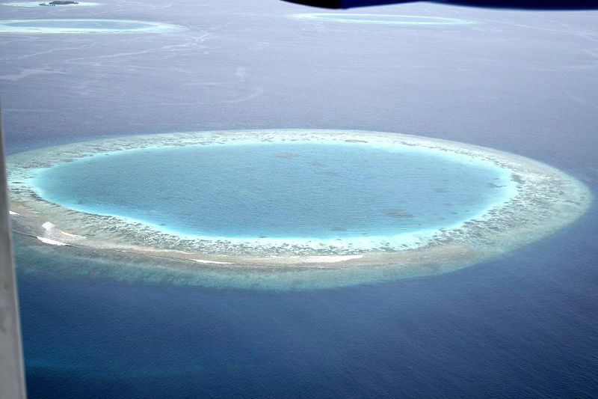
Notes:
-pic public domain
-the Maldives were first country to sign the Kyoto Protocol calling for greenhouse gas reductions
-eighty percent of its land area less then one meter above sea level

Slide 19
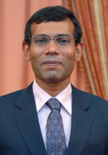
Adaptation?
climate change protection initiatives would amount to 34 percent of the Maldives' GDP
"We can do nothing to stop climate change on our own and so we have to buy land elsewhere. It's an insurance policy for the worst possible outcome.”
President of the Maldives
www.presidencymaldives.gov.mv
Notes:
-the cost of protecting 50 of the 200 inhabited islands of the Maldives with artificial structures was estimated to be over US$ 1.5 billion in 1998; to protect all 200 inhabited islands would require roughly US$ 6 billion, or more than thirty time the countries GDP.
-Japan has engaged in research to grow corals in laboratories and then plant colonies off shore to potentially protect its EEZ

Slide 20
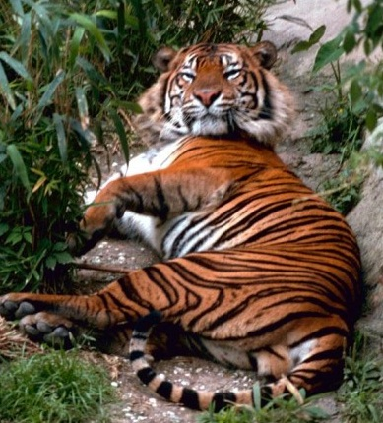
Bangladesh
Home to more than 130 million people; more than 35 million live in the coastal plains
GDP per capita is about $351 annually
The World bank estimates 1m sea level rise would result in 17.5% of the country being inundated
60% of the Sundarbans are in Bangladesh, and the largest remaining habitat for the Bengal Tiger
Notes:
-The Sundarbans are a large track of mangroves forest with immense biodiversity

Slide 21
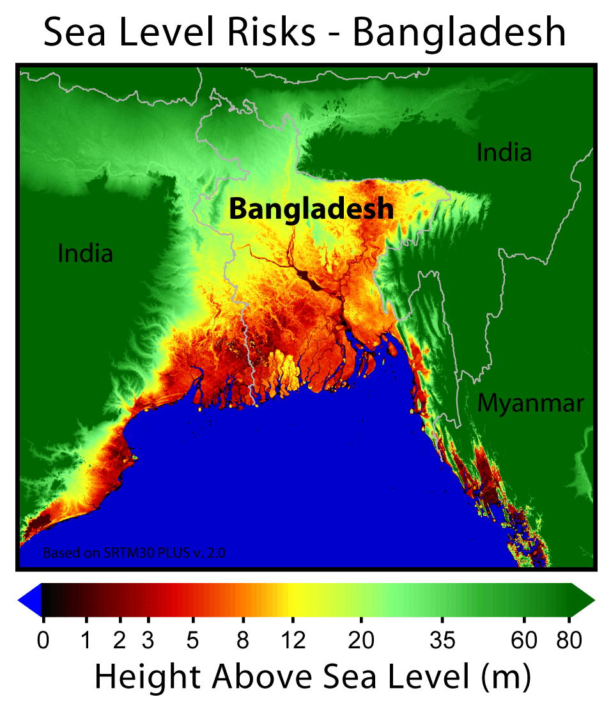
By Robert A. Rohde from the public domain data set SRTM30 PLUS v.2.0 http://www.globalwarmingart.com/wiki/File:Bangladesh_Sea_Level_Risks_png

Slide 22
The Potential for Conflict
Average estimate of offshore undiscovered natural gas, controlled by Bangladesh, is 18.1 trillion feet [worth almost $70 billion]
Bangladesh and Myanmar warships have engaged in disputes over the ownerships of offshore natural gas fields
Notes:
-Bangladesh has submitted their proposal for the delineation of their continental shelf; 86,392km2EEZ

Slide 23
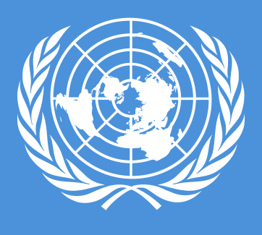
Building Enforcement Capacity
There is a need for greater international efforts to help build enforcement capacity in developing coastal states
Increases in enforcement capacity would likely increase licensing revenues and promote conservation

Slide 24
Freezing Baselines
Historic baselines
Amending UNCLOS to freeze baselines
Bilateral agreements
Customary international law
May help prevent a potential for tragedy of the Commons scenario
Notes:
Example of tragety of the Commons: the “donut hole” in the Bering Sea where Pollock fisheries were depleted and the fishery had to be closed in 1993.

Slide 25
Coastal and Ocean Resources: Protecting the Most Vulnerable States
IUCN Environmental Law Academy
Colloquium – South Africa 2011
Professor Ann Powers
Center for Environmental
Legal Studies
Pace Law School

