Slide 1

Water Permit Judgments in Finland
How to compare material and immaterial interests?
Niko Soininen
Junior researcher, doctoral student of environmental law
IUCN Academy of Environmental Law 2011 Colloquim: South Africa
5.7.2011

Slide 2
Purpose of the Presentation
Short demonstration of the water permit system in Finland.
  Concentration on the problems of legal inference or use of legal discretion: How can we assess the quality of a water permit judgment?
Evoking comparative views on how to solve the problems concerning the water permit judgments in Finland.

Slide 3
Old and New Water Act
The present Finnish Water Act has been in force since 1962.
New Water Act will come to force 1.1.2012.
  Regulations concerning water permit judgment will remain mostly as they were in the old Water Act.

Slide 4
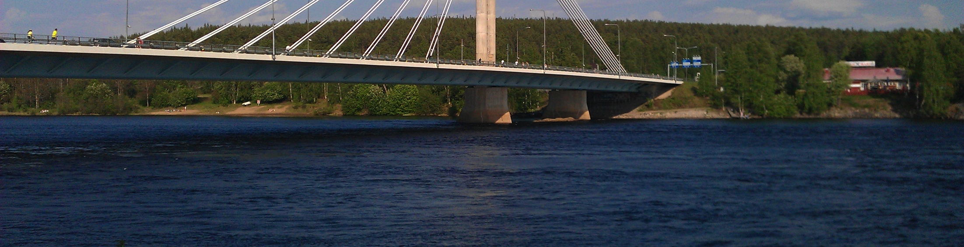
Scope of the Water Act in Finland
Since the enactment of the Environmental Protection Act in 2000, The Water Act has regulated only structural altering of the water bodies:
  Contains all forms of water related undertakings excluding alteration of a water body through pollution.

Slide 5
Requirement to Apply for a Water Permit
The requirement to apply for a water permit is based mostly on sections 12 and 15 of Chapter 1 of the Water Act.
Chapter 1, section 12: Ban on closing a water way:
  The ban on closing states that the deepest section of a river or other water way used in transport, timber floating or the passage of fish shall remain free.
Chapter 1, section 15: Ban on altering water bodies:
  The ban on altering water bodies states that no water may be led from a water body or on land, if such measures may lead to a change in the position, depth or water flow and thereby cause damage to public or private interests.
Above bans are not absolute but state the requirement to apply for a water permit.

Slide 6
Interest Comparison as the Normative Basis for a Water Permit Judgment
The permit judgment is based on weighing and balancing of different water related interests (Chapter 2, section 6 (2) of the Water Act).
If the positive effects clearly outweigh the harms caused by the undertaking, the permit shall be allowed.
Interests included in water permit judgments can be divided into:
  Material: agriculture, silviculture, water traffic, hydroelectric power, damage or benefit to properties, fishing, floating of wood, water supply and sewerage.
  Immaterial: human health, living conditions, effects on the environment, townscape, land use planning, cultural heritage or landscape.
Consolidation of all above interests is a primary principle of the water act (Chapter 2, section 3).
Exception to the main rule: One absolute ban on allowing the permit as a final constraint for the interest comparison even if the comparison would be positive (Chapter 2, section 5).

Slide 7
The problems of the Water Permit Judgments
The legal problem concerning interest comparison in water permit judgments is that the interest comparison is very difficult to perform because multiple material and immaterial interests are involved.
Valid law does not offer direct answers to the problem because the water act advances all above mentioned interests at the same time
This in turn has resulted into poor argumentation in the judicial bodies.

Slide 8
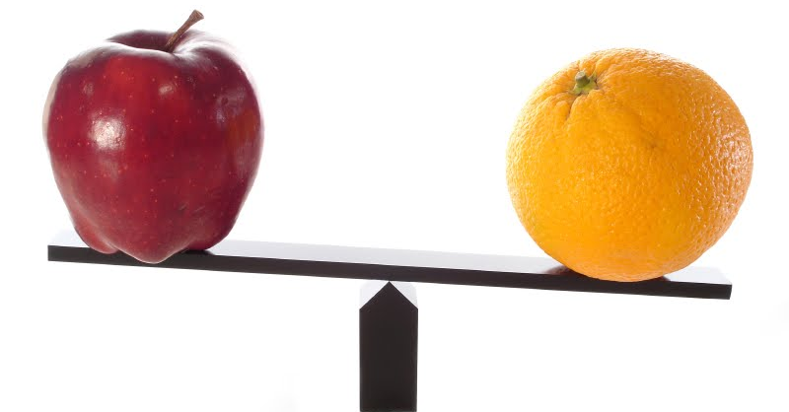
How can Apples and Oranges be Compared?

Slide 9
Attempts to Solve the Problem
How can material and immaterial interests be compared?
  Making interests commensurable, e.g. ecosystem services:
    Comparison would be easy to perform and to control.
    Increased legal certainty.
    Possibilities to define economical value on all relevant immaterial interests?
  Using only doctrine of sources of law in defining individual weight of an interest:
    Dividing interest into primary, secondary… interests.
    Decreased legal certainty.
    Lack of control and uniform criteria for comparison
    Emphasis would have to be placed on evaluative arguments.
    Only possibility in some cases?
Combining the normative and economic criteria of evaluation in order to develop the criteria for the weight of an individual interest?

Slide 10
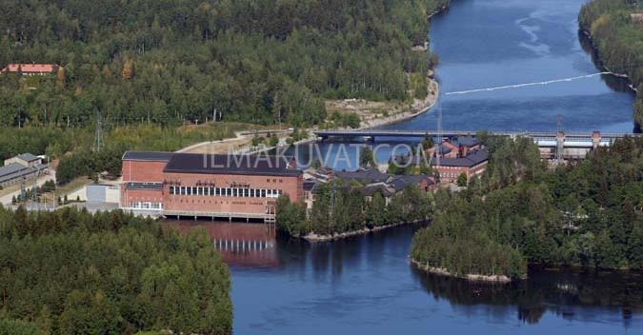
Thank you!

