Slide 1
The Complexities of developing a Transboundary Water Resources Management Agreement: The Experiences from the Nile Basin
By
Dr. Emmanuel Kasimbazi
Associate Professor, School of Law,
Makerere University, Kampala, Uganda

Slide 2
Structure of the Presentation
1. Introduction
2. Background to the Hydro-politics of the Nile
3. Development of Nile Agreements 1891-1959 Limited
cooperation among Nile Bain countries 1967-1993
4. Development of the Cooperative Framework ( CFA)
and the Nile Basin Initiative NBI) 1995-2011
5. Significant Challenges of developing the CFA
6. Lessons from other river basis: Mekong and Zambezi
7. Conclusion and Recommendations

Slide 3
Introduction
The Nature of a Transboundary Water Agreement
A transboundary Water agreement defines rights and obligations of the riparian states and creates institutional framework to govern the transboundary nature of water resources.
The importance of developing a Transboundary River Agreement
Provides a basis for universal participation of all riparian states
Establishes Institutional responsibilities
Promotes cooperative governance
Ensures equitable distribution of benefits of water resources
Clear and flexible criteria for water allocations and quality
Provides mechanisms for dispute resolution

Slide 4
The Nile Basin
Nile River Basin
The word Nile is derived from the Semitic root Nahal meaning river valley, which later took the two forms of ‘Neilos’ in Greek and ‘Nilus’ in Latin. Estimated length of over 6800 km is one of the longest and greatest rivers in the world. Covers about 10.3 per cent of the African continent and has a total population of about 250 million people.
The river is shared by the 11 countries as follows: Tanzania, Uganda and Kenya share Lake Victoria where the White Nile originates as the Victoria Nile. The highlands of Burundi and Rwanda are the origins of the Kagera River, which is the major river flowing into Lake Victoria. The Democratic Republic of Congo shares the Semliki River, which flows into Lake Albert (one of the sources of the White Nile), as well as Lake Albert itself, with Uganda.

Slide 5
The Nile Cont’d
The White Nile consolidates itself in the new state of South Sudan. Eritrea shares portions of the Setit River, which is a tributary of the Atbara River, with Ethiopia, where the Blue Nile and almost all of its tributaries originate.
Sudan and Egypt are the lowest downstream riparian states.
The 11 states that share the Nile River have varying contribution, uses and stakes.
The stakes and interests of Egypt, Sudan and Ethiopia are classified as very high; those of Uganda as high;
Tanzania, Kenya, Burundi and Rwanda as moderate
Eritrea and the Democratic Republic of Congo as low.

Slide 6
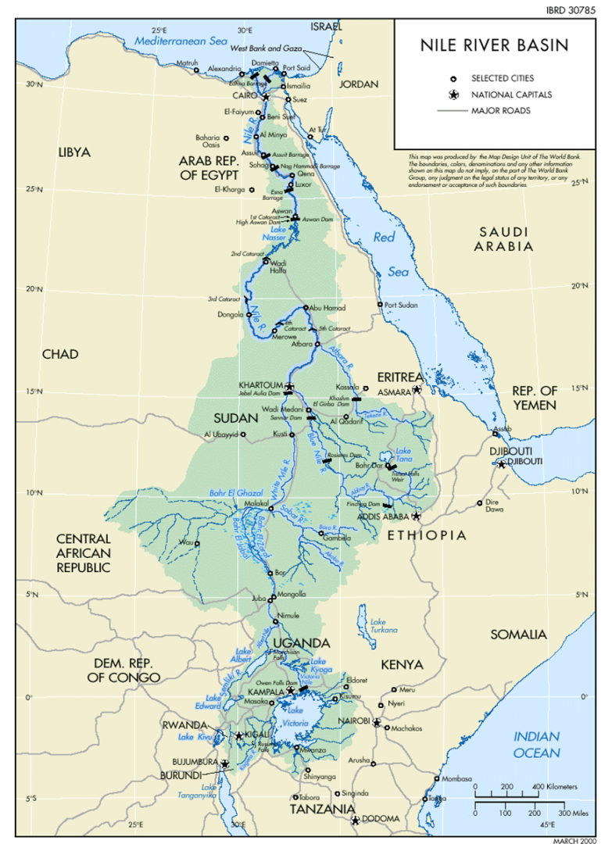
Map showing the Nile

Slide 7
The Hydro Politics of the Nile
The hydro-politics of the Nile is to a greater extent based on the colonial history of the Nile basin.
After the British gained effective control over Egypt in 1882, they were quick to realize the importance of the Nile River for their continued existence in Egypt.
The treaties were concluded mainly by the British colonial government on behalf of Egypt;
The treaties gave Egypt more rights over the waters of the Nile than other riparian countries;
This situation has been subsequently replicated by the lower riparian states: Egypt and Sudan.

Slide 8
The Development of the Nile Agreements 1891-1959
This period was characterized by “ colonial agreements”
Six Agreements were developed:
1. The Protocol between Italy and the United Kingdom of 15th April 1891.
It sought to protect the Egyptian interests in the Nile waters contributed by the Atbara River (known as the Tekkeze in Ethiopia)
The Italian government undertook not to construct any works on the Atbara River that might “sensibly modify” its flow into the Nile.
Agreement between the United Kingdom (acting for Egypt and the Sudan) and Emperor Menelik of Ethiopia,
signed in Addis Ababa on 15th May 1902 .
It bound Emperor Menelik not to construct, or allow to be constructed, any work across the Blue Nile, Lake Tana or the Sobat which would arrest the flow of their waters into the Nile except with agreement of Britain and Sudan.

Slide 9
Nile Agreements Cont’d
3. The tripartite Agreement between the United
Kingdom, France and Italy of 13th April 1906
Required the United Kingdom, France and Italy to act jointly to preserve the interest of Great Britain and Egypt in the waters of the Nile and its tributaries.
4. The 1925 Anglo-Italian Exchange of Notes
Enabled Britain to continue to pursue her interests in controlling the headwaters of the Blue Nile.
It among other things recognized the “prior hydraulic rights of Egypt and Sudan”.
It obliged Italy not to construct in the headwaters of the Blue Nile, the Sobat and their tributaries any work, which might sensibly modify their flow into the main rivers.

Slide 10
Nile Agreements Cont’d
5. The Nile Waters Agreement of 1929 between Egypt and the United
Kingdom.
This is a very important agreement because it covered most of the riparian countries of the Nile Basin.
It was signed by the Egyptian government and the British government, the latter on behalf of the Sudan and the East African riparians to Lake Victoria (Kenya, Tanganyika [now Tanzania] and Uganda);
The primary motive of the agreement was to facilitate an increase in the volume of water reaching Egypt.
The Agreement included specific volumetric water allocations-48 billion m3 ( Bm3/ year (yr) to Egypt and 4 Bm3/yr to Sudan-and this institutionalized the belief that Egypt and Sudan have “ natural and historical rights” to the Nile.
Gave Egypt the right to inspect the entire length of the Nile.

Slide 11
Nile Agreements cont’d
6.The Supplementary agreement between the United Kingdom and Egypt of 1932
Provided for the building of the Jebel Awliya Dam near Khartoum on the White Nile for the benefit of Egypt and with Egyptian funds.
Provided, inter alia, for the construction and maintenance by Egypt of the storage at Jebel Awliya, about forty kilometers upstream from Khartoum on the White Nile.
7. The Anglo-Belgian Agreement of 1934
The only agreement, which was not directed at the interests of Egypt but intended to apportion waters of Kagera between Tanganyika and Rwanda- Burundi.
Required that whenever water was abstracted from the watercourse on one territory, it should be returned without substantial reduction to its natural bed before entering another territory.

Slide 12
Nile Agreement s cont’d
The Owen Falls Dam Agreement
This was entered into between Egypt and the British administration on behalf of the Uganda protectorate with regard to the construction of the Owen Falls Dam.
Contained three exchanges of notes, namely: (1) Agreement on the control of the flow of the Nile waters for production of electricity for Uganda (30 May 1949); (2) Agreement on construction plans of the Owen Falls Dam (December 5, 1949); and (3) Agreement on the financial arrangement for the construction of two Owen Falls Dams (January 5 1953).
The first and second agreements constituted the core of the legal regime for the construction of the Owen Falls dam.
Their purpose was twofold: (i) the control of the flow of the Nile waters; and (ii) the production of hydro-electric power for Uganda.
The British Note of 30th May 1949 provided that this flow was to be supervised by an Egyptian resident engineer at the dam.
The Agreement for Cooperation between the United Kingdom and Egypt of February 1950.
It made arrangements for co-operation with a view to collecting and recording meteorological and hydrological information about the Equatorial Lakes.
Provided the right of the resident Egyptian engineer at the Owen Falls Dam and his assistants access to all the posts in Uganda for periodical inspections t ensure that the posts are being satisfactorily maintained and the observations regularly collected.

Slide 13
Nile Agreements Cont’d
The Agreement for the Full Utilisation of the Nile between Egypt and Sudan of 1959.
It aimed at aimed at full utilizations of the Nile.
After the independence of Sudan in 1956, Egypt’s had plans to build the High Aswan Dam and thus the need to renegotiate existing water allocations under 1929 Agreement;
Sanctioned the construction of the Aswan High Dam in Egypt, and the Roseiris Dam on the Blue Nile in Sudan.
The two countries established that the total annual flow of the Nile measured at Aswan as 84 BCM, and it allocated 55.5 BCM to Egypt and 18.5 BCM to the Sudan.
Established a PJTC to do research related to the management of the Nile waters and increase of the Nile supply and of hydrological survey work in the Nile’s upper reaches.

Slide 14
Limited cooperation among Nile Basin countries 1967-1993
This period was characterized by limited cooperation among Nile Countries and seven arrangements of cooperation were developed.
1. The Hydromet Agreement 1967
Was signed by Egypt, Kenya, Sudan, Tanzania, Uganda, UNDP and World Meteorological organization later expanded to include Rwanda, Burundi and Democratic Republic of Congo (DRC) as parties to the Agreement. Ethiopia participated as an observer
The purpose was to collect collection and analyse the hydro-meteorogical data of the catchments of Lakes Victoria, Kyoga and Albert;
Came to end in 1982 but member countries continued with their own funding 1982-1992;
Unfortunately, the project failed as a result of political disinterest. The project expired in December 1992

Slide 15
Limited Cooperation
2. The Kagera Agreement of 1977
Was signed by the Heads of States of Burundi, Rwanda and Tanzania and Uganda joined in 1980
The treaty was open to membership of four Basin States only.
It aimed at promoting the development of the Basin generally and its specific objectives was to cover all aspects of development including water and hydropower development, mining, industry, agriculture, health, tourism, trade, wildlife conservation and development, fisheries and environment protection.
3. In 1977 when there was an attempt by informal technical committee to establish a Nile Basin commission.
This idea was floated at Cairo Egypt, in 1977 and it was agreed that a Basin-wide treaty be concluded.
A draft treaty was submitted to the technical committee, which recommended such a commission.
Due Political misunderstandings between Egypt and the Sudan on one hand, and the upper riparian States on the other regarding the status of the 1959 Agreement, the treaty could not be concluded.

Slide 16
Limited Cooperation Cont’d
UNDUGU set up in Egypt in 1983 with all the Nile riparians as members except for Kenya and Ethiopia who were just participating observers.
Its policy objective was to collectively compel Egypt to abandon its rather unfair theory that all the waters of the Nile belong to it
It rejected Egypt’s theory that all the waters of the Nile belong to it.
However due to political differences between some States, not much was achieved by the group.
The Agreement between Ethiopia and Sudan (1991) that related to the utilization of the waters of the Blue Nile and Atabara Rivers
The two States established a technical joint committee to extend data and explore cooperation;
Sudan moved away from the united front which binds it with Egypt under the 1959 Agreement.

Slide 17
Limited Cooperation cont’d
Technical Co-operation for the Promotion of the Development and Environmental Protection of the Nile Basin" (TECCONILE)
Was signed by Ministers from 6 countries: Egypt, Rwanda, Sudan, Tanzania, Uganda, and Zaire (now D. R. Congo) and while the other 4 : Burundi, Kenya, Eritrea and Ethiopia participated as observers;
Aimed at continued cooperation in the Nile Basin replacing the HYDROMET Agreement which expired on 31st December 1992;
Short term objective was: to assist participating countries in developing National Water Master Plans and to develop infrastructure, capacity and techniques required in managing the Nile Basin Waters;
Long term objective: to steer the member States towards the development, conservation and use of Nile Basin waters in an integrated and sustainable manner through basin wide cooperation for the benefit of all.
Sought to provide assistance to member States to determine the equitable entitlement of each member State to the Nile waters.
one of its major weaknesses was its concentration on the technical side and as a result it failed to develop a legal regional framework and it was thus terminated in 1998.

Slide 18
Limited Cooperation cont’d
The Framework for General Cooperation between Egypt and Ethiopia 1993.
It recognized the traditional ties existing between Egypt and Ethiopia that have been consolidated during their long history of close relations and linked by the Nile River with its Basin as a center of mutual interest.
The two countries agreed that neither of them would do anything with the Nile that causes appreciable harm to the other.
Further and agreed to consult and cooperate in projects of mutual advantages such as projects that would enhance the volume of flow and decrease the loss of water through a comprehensive and integrated development schemes.
It also requires parties to create appropriate mechanisms for periodic consultations on matters of mutual concern including the Nile waters.

Slide 19
Development of the Cooperative Framework ( CFA) and the Nile Basin Initiative NBI) 1995-2011
Involved established of the NBI and the negotiation CFA). This phase was implemented at three levels
1. The establishment of the UNDP D3 project which started the negotiations for a River Nile Cooperative Framework Agreement in 1997;
The D3 project had three main activities two of which was major for the development of the Cooperative framework agreement.
The Legal and Institutional Component which was tasked with the following activities:
review of existing international water law relative to shared water courses; research and review of institutional arrangements (includes site visits and study tours to relevant river basin organizations);
identification and definition of principles of international water law relevant to the Nile River Basin and review and summary of the above activities and making proposals and draft implementation plan.

Slide 20
Development of CFA
The other activity was the POE Framework Deliberations and analysis Components which were tasked to:
prepare a background paper on the alternative approaches, strategies, and methodologies;
conduct a workshop on the formulation of cooperative framework and finalize the POE report to the Council of Ministers.
The D3 project essentially facilitated a dialogue/negotiation process between the Nile riparian in accordance with an agreed timetable.

Slide 21
Development of CFA
The D3 project has two major outputs:
recommendations for appropriate multi-disciplinary framework for legal and institutional arrangements for water resources development of the Nile Basin
recommendations for process, methodology and activities, which could lead to the determination of equitable and legitimate rights of water use in each riparian country.

Slide 22
Development of CFA
In 1996, each minister nominated a three-person dialogue team to form the Panel of Experts (POE) to form the core of the dialogue process.
The (POE) had assigned two consultants to work with two (POE) groups; namely: legal and institutional team and data and information (Technical resources) team, to submit a report to the (COM).
The (POE) visited Mekong River (Thailand and Cambodia) the study tour to Senegal River (Senegal)to get their practical experience.
The draft CFA was presented to the Council of Ministers at the Khartoum Nile-COM meeting in August 2000.
The 2000 Nile-COM no discussion of the draft CFA because of unresolved substantive issues remained unresolved the text. Decided to form a Transitional Committee to prepare a Cooperative Framework text for consideration by the next Negotiations Committee, with the aim of reaching convergence on outstanding points and putting the text in proper form, including such matters as the preamble, definitions

Slide 23
Establishment of NBI
The second activity involved the establishment of the Nile Basin Initiative (NBI) in 1999.
It was proposed to the COM to form a new transitional institutional mechanism with all riparian states as equal members to succeed TECCONILE until the final institutional and legal framework of co-operation is formed,
NBI has the following major objectives:
to develop the water resources of the Nile Basin in a sustainable and equitable way to ensure prosperity, security and peace for all its peoples;
to ensure efficient water management and the optimal use of the resources; to ensure cooperation and joint action between the riparian countries, seeking win-win gains;
to target poverty eradication and promote economic integration and to ensure that the program results in a move from planning to action.

Slide 24
Development of CFA
The second level covered the period 2001-2002 and the following activities were carried:
a legal consultant was selected;
the Nile-Technical Advisory Committee (TAC) reviewed and finalized the draft Ministerial Accord with reservation from Ethiopia, and therefore, it was not approved by Nile-COM.
There was also introduction of formal additions to the Framework text and TAC recommendation of additional consultations and establishment of the Negotiation Committee (NC).

Slide 25
Development of CFA cont’d
The third level was the period 2005-2009 which involved following activities of the NC.
the NC adopted the articles which had been agreed upon by the TAC with minor corrections and made progress on the reservation and reported finally December 2005.
This report was to be considered and adopted by Nile-Com but Egypt and Sudan objected to its adoption and a recommendation that countries not having NOTES to proceed with signature and also that the Executive Director convene meeting to examine the use of terms “Nile River System;” and Nile River Basin”.
Burundi, DRC, Kenya, Tanzania and Rwanda objected to the recommendation that the Nile-COM accord further time while Ethiopia refused to accept or endorse the recommendations as framed in the report.

Slide 26
Development of CFA cont’d
Egypt and Sudan argued that submission of the report was in violation of consensus and any course of action should be left completely to the respective governments.
There was an extensive discussions on “ existing agreements” now “water security” and after four meetings Nile-COM concluded consideration of NC’s report on 25 June 2007, and decided to refer to one clause Article 14 b Water Security) to Heads of States and Government of the Nile Basin for conclusion.
During COM fifth meeting in Kinshasha on 22 May 2009. The Nile-COM with the exception of Egypt and Sudan absent, agreed and resolved that the CFA is a clean text ready for presentation to the riparian states for signature and the Commission will within six months of its formation resolve the annexed article 14 b.

Slide 27
Development of CFA cont’d
There are divergent bargaining positions, regarding the ambiguous concept of “water security” as a legal principle introduced under Article 14 of Draft Agreement Framework.
The most controversial provision was Article 14 (b) on water security as a result the Extraordinary Meeting of the Nile Council of Ministers held in Kinshasa, DRC on 22 May 2009 resolved that the issue of 14 (b) be annexed and resolved by the Nile Basin Commission within six months of its establishment.
The Article provides that “The States also recognize that the cooperation management and development of waters of the Nile River system will facilitate achievement of water security and other benefits”. Nile Basin states therefore agree in spirit not to significantly affect the water security of any basin state.

Slide 28
Development of CFA cont’d
All other Nile Basin countries agreed with this provision except Egypt and Sudan. Instead Egypt proposed that the article be replaced by “not adversely affect the water security and current uses and rights of any other Nile Basin State”.
Egypt proposed the formation of a committee of Ministers from the Eastern Nile, Equatorial lakes region which include Ethiopia, Egypt and Sudan and one or two experts from international organization to formulate an acceptable text within six months and present it to the Nile-Com members and Sudan explained its position that the matter is before Heads of state and Government.
During the NC’s Eighth Nairobi meeting of 3 July 2009 linguistic changes were introduced, the phrase “ Nile river basin from Articles 4 (1) and 5 ( 1) was deleted, and Article 35 was completed by including specific dates and ordered renumbering the Articles consistently.
Egypt and Sudan refused to sign the Minutes on the basis that Nile-Com Kinshasha meeting considered the CFA as a clean text.

Slide 29
Development of CFA cont’d
The Nile-COM Sixth Meeting in Alexandria during 27-29 July 2009 noted that the decision of the Nile-COM Extraordinary Meeting held in Kinshasha, DRC, on 22 May 2009, and the follow up meeting of the Negotiation Committee on 3rd July 2009, in Nairobi, Kenya, the positions taken at these meetings and communications concerning them;
decided to provide a period of Six Months to allow for more time to enable member states move forward together and also further decided to mandate TAC/NC to recommend to Nile-COM the basis for moving forward in an inclusive manner, consider and advise on the transitional arrangements and advise on procedures for the signing.

Slide 30
Development of CFA cont’d
During the 1st TAC/NC meeting 28-29 September 2009 held in Kampala, Burundi, DRC, Ethiopia, Kenya, Rwanda, Tanzania and Uganda were of the opinion that Alexandria Nile-Com meeting did not reverse the Kinshasha Nile-COM decision
Egypt and Sudan were of the opinion that Alexandria meeting and not Kinshasha meeting provided the best way of moving forward together in an inclusive manner.
7 countries recommended recruitment of a consultant to recommend detailed transitional arrangements
But Egypt and Sudan were of the view that the intrusion of the transitional arrangements in the decisions of the TAC/NC is unacceptable.
In the 2nd joint TAC/NC meeting in Dar es salaam during 10-11 December, 2009 when considering Egypt’s proposal concerning Articles 8, 14 and 35
the seven countries were of the opinion that no new ideas had been forthcoming from Egypt,
the guidance given by Nile-com in Kishansha remains the only option
Sudan was of the view that the benefits accrued from giving more time to further explore possibilities for moving forward in inclusive manner would, by far, outweigh the benefits accruing from the signature of the CFA by some;

Slide 31
Development of CFA cont’d
In the 3rd joint TAC/NC meeting of April 11-12 2010, some countries gave the consultant preliminary comments despite the fact that the report was given few hours before the meeting and the French version was not ready.
The Extra- Ordinary Nile-COM meeting was held in Sharm El Sheikh, Egypt on April 13, 2010 was significant
the upper riparian countries- Ethiopia, Kenya, Tanzania, Uganda, Rwanda, Burundi and DRC- made it clear that the 1959 unilateral agreement between Egypt and Sudan is null and void and
lower riparian countries- Egypt and Sudan vehemently insisted on the historical rights of the Nile water.
After a grueling mid night debate past midnight on April 14, 2010, the riparian countries admitted that they could not reach any agreement on the allocation of the Nile waters.
As a result, the seven countries reiterated their position that Kishansha remains the basis for moving forward together in an inclusive manner and decided to move on to the next stage of signing the CFA beginning May 14, 2010 and the CFA was to remain open for signature for not more than one year.

Slide 32
Signing of CFA:
Ethiopia, Rwanda, Tanzania and Uganda signed the CFA on the very day it was opened for signature on the May 14, 2010.
Kenya signed on May 19, 2010
Burundi signed on the February, 2011.
Six Riparian States that have so far signed the CFA to six and if they ratify it will be enforceable.
DRC, Egypt and Sudan have not signed

Slide 33
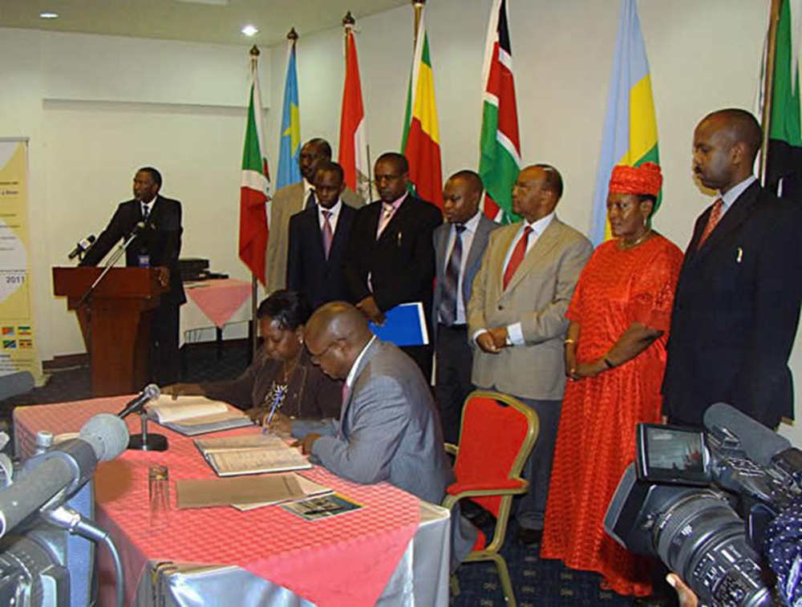
4 countries signs the CFA

Slide 34

Kenya signs

Slide 35
Significant Challenges of developing the CFA
Political situation: the creation of the new state of South Sudan and transitional government in Egypt;
No country has ratified the CFA;
Egypt and Sudan have refused to sign while the position of DRC is not clear;
Trust Fund for NBI ends 2013, it not clear what happens thereafter.

Slide 36
Lessons from other river basis:
Mekong and Zambezi
Lessons from the Mekong:
The Mekong Agreement was signed after a relatively short period of negotiating because of benefiting from a shared data, longtime relationship and familiarity of the key players with provisions of relevant international jurisprudence.
Even if not all riparian countries have signed the agreement, it may be useful to go ahead and implement the Agreement. China and Myanmar are not parties to the Mekong River but the Mekong agreement is:
useful tool it is a single basin that is far likely to be more respected than general principles of international law alone.
meaningful cooperation has been developed with the two countries under the framework of the Agreement. Since 1996, this cooperation of the lower Mekong states has led to greater involvement of China and Myanmar as Dialogue Partners
From the institutional point of view, the Mekong Agreement has provided an opportunity for the management of water utilization programs like dam construction and irrigation; joint development, ecological protection and a dynamic process of water allocation.

Slide 37
Lessons from Mekong and Zambezi
From the institutional point of view, the Mekong Agreement has provided an opportunity for the management of water utilization programs like dam construction and irrigation; joint development, ecological protection and a dynamic process of water allocation.
Lessons from the Zambezi River
Use of regional organisation: Southern African Development Community provided a political climate for developing the agreement.
The Zambezi Watercourse Commission (ZAMCOM) Interim Secretariat has been established though Zambia has not signed the treaty.

Slide 38
Conclusions and Recommendations
Conclusions:
The Nile River basin presents a practical example of some of the challenges of developing a comprehensive transboundary water management;
Achieving a basin-wide agreement governing the Nile River is complicated by the competing needs of upstream and downstream users and colonial treaties;

Slide 39
Recommendations
The six countries that have signed should go ahead and ratify the CFA and so that it is effective and start engaging the others that have not signed;
Raise awareness about the benefits of CFA using data and technical experts;
NBI countries need to sign and ratify the UN Water convention so that it acts as a basis for negotiating.
Continuous use of third parties in the negotiations. For example use of independent and neutral parties;

