Slide 1





Transboundary groundwater management:
Comparison between international law guidelines and EU water policy
IUCN-AEL Water Colloquium,
South Africa, July 2011
By ADRIEN BODART, PhD student, member of the
Western Institute: Law and Europe (IODE), France

Slide 2
“For that which is common to the greatest number, has the least care bestowed upon it.
Everyone thinks chiefly of his own, hardly at all of the common interest”,
Aristotle, Politics, Book II, chapter 3

Slide 3
Introduction
Growing human pressure on environment and its components – especially on water
Difficult association between concepts of water (esp. groundwater) and boundary
Fear of conflicts for fresh water – 4 types of conflicts in transboundary basins:
  conflicts on absolute distribution of the resource
  conflicts on relative distribution of the resource
  conflicts related to water pollution
  conflicts related to transboundary groundwater
New interest in groundwater, too long neglected by law (⇨impacts difficult to detect), whereas exists an old legal tradition related to shared surface waters (cf. agreement on Tiger waters, 26th c. BC)
Two significant multilateral conventions on transboundary waters issues, today:
  Convention on the protection and use of transboundary watercourses and international lakes
  (UNECE, Helsinki, 17 March 1992 – in force)
  Convention on the law of the non-navigational uses of international watercourses
  (United Nations, New-York, 21 May 1997 – not yet in force)

Slide 4
Aquifers have been the first subject of the ILC’s work about shared natural resources
⇨ILC Draft Articles, adopted by a resolution no A/RES/63/124 of the General Assembly of United Nations, on the law of transboundary aquifers, 11 December 2008
Main relevant EU texts (resulting from a construction started in the 1970s):
  Water framework-directive (2000)
  Directive on the protection of groundwater against pollution and deterioration (2006)
Interests of comparison between these draft articles and the EU water policy:
  To put in perspective the principles of this emergent international law on groundwater and their implementation, through ideas from a EU system already settled
  To show what’s possible when States don’t focus exclusively on their sovereign rights
  Structure of presentation
PART I: The transboundary dialectics – sovereignty and complexity of sharing
PART II: The common inspiration of the management principles applicable to transboundary aquifers in international law and EU law
PART III: Is the EU pattern of transboundary groundwater resources integrated management adaptable to other geographical areas?

Slide 5
Part I – The transboundary dialectics: sovereignty and complexity of sharing
A/ Transboundary groundwater: a complex resource
Our subject of study is doubly complex, being subterranean and transboundary ...
... whereas groundwater remains partly unknown
(⇨functioning, volume, expanse of aquifers)
Both draft articles and EU directives define groundwater according to 3 criteria:
  Unity of the groundwater body;
  Significant flow of groundwater
  Possible abstraction of significant quantities of groundwater
The aquifer, to put it simply, is the (hydro)geological formation that contains groundwater

Slide 6
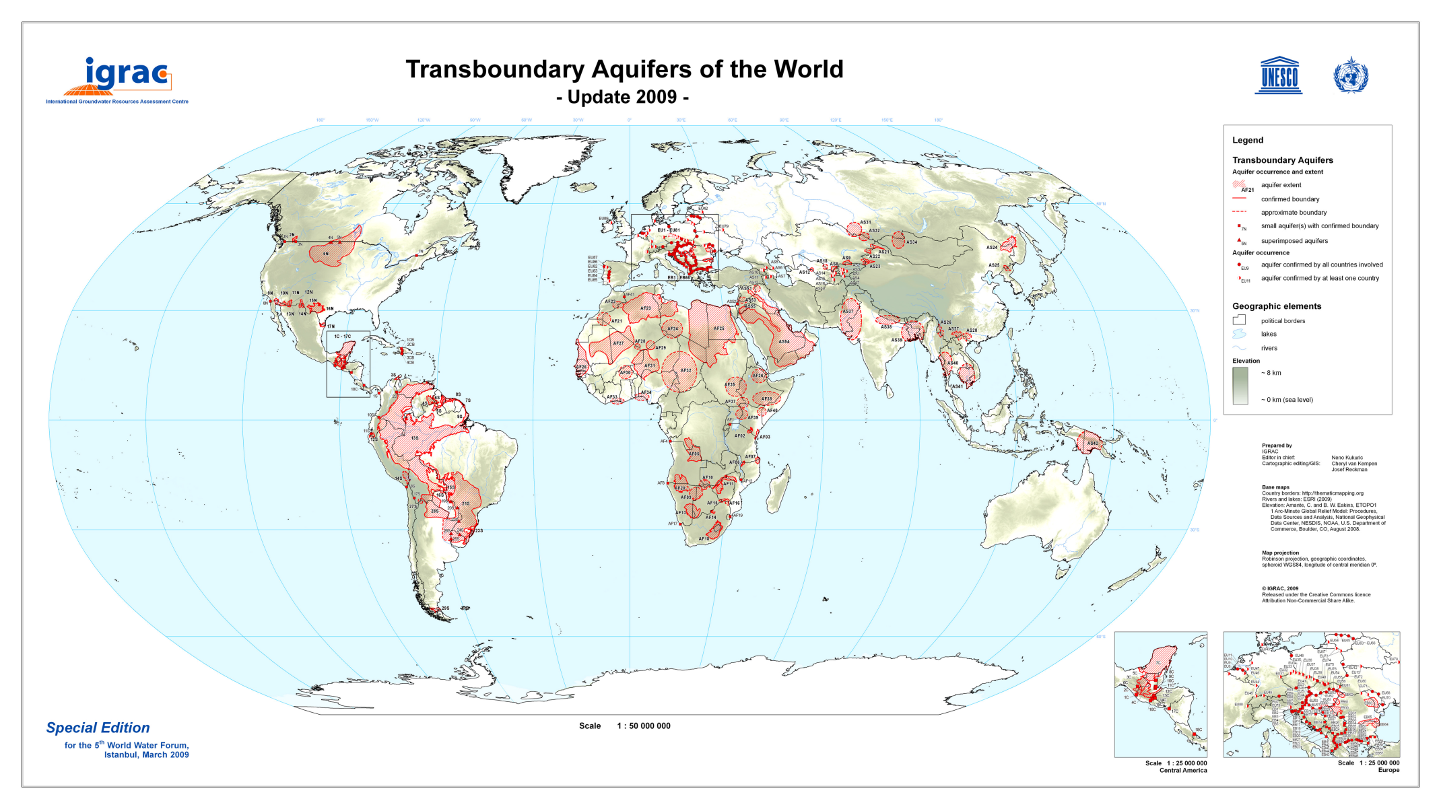

Slide 7
Main kinds of aquifers (depending of geological strata characteristics):
  Decoupled or confined
  Shallow or deeper
  Fossil (non-renewable) or renewable
Existence of aquifer systems (several aquifers hydrologically linked)
Kinds of shared aquifers:
  International aquifers
  Transboundary aquifers (is “transboundary” wider than “cross-border”? – the extent of pollution impacts, notably, would justify this choice of words)

Slide 8
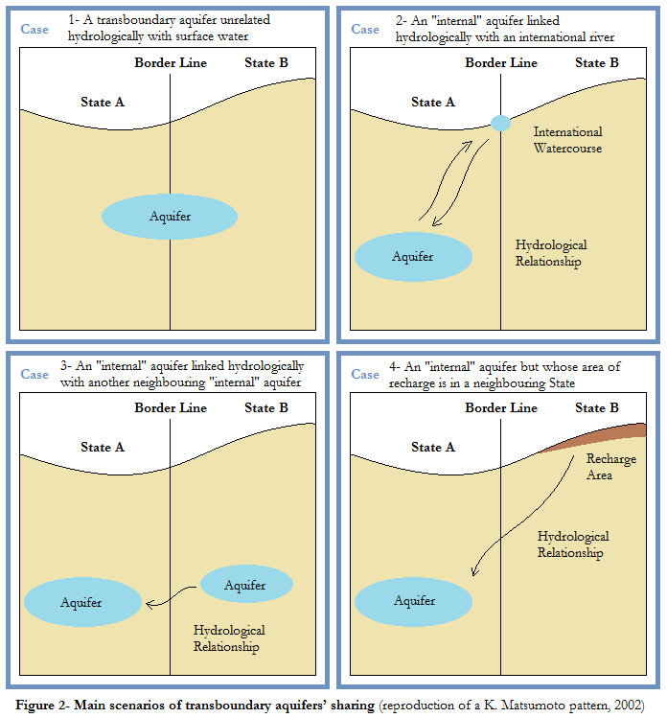
Main scenarios of transboundary aquifers’ sharing
⇨A transboundary aquifer unrelated hydrologically with surface water;
⇨ An aquifer that is entirely in the territory of a State linked hydrologically with an international river
⇨ An aquifer that is entirely in the territory of a State linked hydrologically with an another aquifer in a neighbouring State;
⇨ An aquifer that is entirely in the territory of one State but whose area of recharge is in a neighbouring State – the recharge could be any body of surface water or a rainy flow.

Slide 9
B/ The share of transboundary resource confronted with national strategic requirements
The role played by a State boundary shall depend on two conceptions:
  Conception of what is a boundary (obstacle or interface)
  Conception of the sovereignty, more or less absolute
Both EU law and international law are upgrading logics of opening:
  The EU law works towards a still more advanced integration, beyond Internal Market’s logic
  Many multilateral conventions and regional organizations, in a globalized context, work for a progressive erasure of frontiers
But anyways, fresh water is a more and more sensitive, strategic resource
  Indispensable for populations’ supply
  Basic need for economic activities (irrigation, industrial uses)
  Sometimes used for establishing or strengthening a geopolitical prominence
And it’s known that about 98% of worldwide fluid fresh water is groundwater...

Slide 10
  The sovereignty over water resources remains important, for two main reasons:
  The principle of “permanent sovereignty over natural resources” (cf. draft article 3)
  Sovereignty legally assures to the less powerful States a control of this vital resource, in order to avoid too unfavourable sharing
  Main difficulties due to national “compartmentalization” (according to the AFD)
  Insufficient awareness of the transboundary nature of numerous aquifers by involved public authorities, managers and populations, linked to a recurrent lack of knowledge and non-existent/insufficient communication between riparian States
  Frequent absence of legal system applicable to groundwater – both for their status (ownership?) and protection – and so, uncertainty about competences, which doesn’t facilitate possible cooperation (who’s the interlocutor?)
  Lack of administrative and financial means and huge needs, especially in poorest States, for trainings and financings necessary to implement the appropriate legal and institutional framework
  Political reluctances, sometimes, in front of implementation of long-term joint management

Slide 11
Part II – The common inspiration of the management principles applicable to transboundary aquifers in international & EU laws
A/ The call of international and EU laws for a better scientific knowledge
Three phenomena, concomitant or not, may happen in transboundary situations:
  Depletion of groundwater flow because of withdrawals in upstream States
  A transfer of influence with decrease of water level in the receiving territory
  Transport of dissolved materials (especially pollutants)
To prevent them and therefore to avoid conflicts, a common knowledge is necessary.
Comparison draft articles/EU policy – similar principles despite differences of deepening:
  Knowledge of aquifers and their characteristics – both laws interest in all characteristics of aquifers and in their relationships with aquatic and terrestrial associated ecosystems.
  Knowledge of impacts/harms – even if the draft articles targets only significant harms and doesn’t list materials, substances that may degrade groundwaters (whereas EU law does), the kinds of harms are general enough to cover a whole of harms as wide as EU ones.
  Knowledge about utilizations – the field of study is similar, but EU law is sharper, and regulates water price, to influence utilizations and taking into account their impact.
  Data for monitoring – EU law goes further, programming monitoring, and fixing common rules for controls and reports that Member States have to apply.

Slide 12
 | ILC Draft Articles | EU Directives
Knowledge of aquifers and their characteristics | Art. 5 suggests to take into account: The natural characteristics of the aquifer or aquifer system (a); The contribution to the formation and recharge of the aquifer (d); The role of the aquifer in the related ecosystems (i). The article 8 (1-2) talks about information on the condition, nature and extent of aquifers, mobilizing several relevant sciences. | The WFD, in its Annex II 2, requires a characterisation of groundwater bodies, in order to identify them and to know where the WFD objectives won’t be reached by 2015 – main criteria: Location and limits of bodies of groundwater, Geological and Hydrogeological characteristics of bodies of groundwater Groundwater bodies for which there are directly dependent surface water ecosystems or terrestrial ecosystems.
Knowledge of impacts/harms | Article 5: the management of aquifers must take into account “the actual and potential effects” of their utilization on other aquifer States. The obligation of not to cause significant harm (article 6) implies to prevent impacts caused or probably caused by other activities; the article 11 provides a prevention and minimization of detrimental impacts. The article 12 deals with pollution, underlining the particular vulnerability of aquifers. Such a general terminology requires a vast and transversal knowledge. | Each river basin management plan contains, both for surface and groundwaters (WFD, Annex VII, 2): estimation of point source pollution; estimation of diffuse source pollution; estimation of pressures on the quantitative status of water including abstractions, analysis of other impacts of human activity on the status of water The WFD, 2006/118/EC directive and other relevant texts list forbidden (cessation of discharges, emissions and losses) or to be limited (reduction) pollutants, hazardous or priority substances. Setting of emission limit values (16 WFD). Identification of those BGW for which WFD objectives won’t be reached. Definition of a good groundwater status and a good ecological status/potential. For ground-water, a special attention is devoted to a good chemical status (17 WFD). All parameters and data to be known for these statuses are listed (WFD, Annex V).

Slide 13
 | ILC Draft Articles | EU Directives
Knowledge about utilizations | According to the 1st article, the draft articles apply to utilizations of aquifers and to “other activities that have or are likely to have an impact” upon them. Utilizations are defined in article 2 e, as including extraction of water, heat and minerals, storage/disposal of any substance. The agreements encouraged by the article 9 may concern a particular utilization. Art. 5: are among factors relevant to equitable and reasonable utilization: existing and potential utilization (e) and availability of alternatives to a particular existing and planned utilization (g). To foresee the future utilization, social, economic and other needs (b) must be also known by decision-makers. A “special regard” shall be given to human needs in weighting different kinds of utilizations (art. 5 2). | The WFD sees water utilizations through a marked economic conception: among water uses (art. 2 39), are distinguished water services (art. 2 38), water intended for human consumption (art. 7), and other activities (art. 4, Annex II). Review of the environmental impact of human activity on groundwater and economic analysis of water use (art. 5; Annex II 2.3): for transboundary groundwater, this obligation is strengthened. By 2010, water-pricing policies had to provide adequate incentives for users (industry, households, agriculture) to use water resources efficiently (art. 9), and to recover the costs of supply (for use) and treatment (after use). Emission limit values are meant to protect “legitimate” utilizations/functions of groundwater (2006/118/EC, Annex II), but the latter are not defined.
Data for monitoring | (Article 13) For monitoring, aquifer States should: Identify key parameters [The parameters should deal with the condition of the aquifer (cf. art. 8 1) and its utilizations]. Base their work on an “agreed conceptual model” of aquifers. | Article 8 WFD: elaboration by Member States of monitoring programmes. Annex V, 2.2 – monitoring of: groundwater quantitative status groundwater chemical status Elaboration by Member States of groundwater monitoring networks; obligations of density (sufficiently dense and representative monitoring sites) and frequency (reports), harmonized presentation (⇨ selected parameters, mapping, code of colors…)

Slide 14
B/ The learning of sharing: from “informed” cooperation to joint management
“Water can divide but also can unite” (2nd UN world water development report, 2006); water arouses fortunately more initiatives of cooperation than conflicts.
A good and appropriate knowledge is just the beginning for a wise management; the ultimate objective of draft articles is no doubt a joint management of shared aquifers.
Comparison draft articles/EU policy – the core principles of both law systems meet, even if this similarity tends to fade as legal implementation tools take shape.
  General principles – principles are basically the same (prevention of damages, equitable and sustainable use); the main difference is that EU law doesn’t leave Member States to choose if they want to act separately or jointly: with some room for manoeuvre, they implement the EU water policy.
  Required protections – both law systems aim to protect groundwater and related ecosystems, especially against pollution (EU groundwater must be in particular protected from significant and sustained upward concentration of any pollutant). EU law doesn’t provide special protections such as non-natural exceptional circumstances, whereas the draft articles do.
  Scientific cooperation – even if a large part of the data communication is brought to the attention of the European Commission in the EU, a parallel may be drawn between the scientific cooperation inside EU r. b. districts and the cooperation between aquifer States in draft articles. In both systems, States are encouraged to work with international organizations.
  Legal cooperation or coordination – the WFD and the draft articles both provide for management plans. However, those plans are common to the whole r. b. district in EU law, whereas they merely apply on the national part of the shared aquifer. A joint mechanism (d. art. 14) is just a possibility.

Slide 15
 | ILC Draft Articles | EU Directives
General principles | Principles from existing international law: Equitable and reasonable utilization (articles 4 & 5) Obligation not to cause significant harm (article 6) General obligation to cooperate (article 7) Common or/and separate actions by aquifer States – joint actions should be taken “where appropriate” (articles 12, 13, 14, 17) Precautionary approach in view of uncertainty about: the nature or extent of the aquifer, or about its vulnerability (article 12) | EU water policy obeys the principles and objectives of art. 191 TFEU (environment policy), among them: Prudent and rational utilization of natural resources; promoting measures at international level to deal with regional or worldwide environmental problems; Principles: precaution; preventive action; rectification as a priority at source, polluters payers + general principles of the EU law, such as subsidiarity (art. 5 TEU), sincere cooperation (4 TEU). The WFD is meant to implement obligations from the Helsinki convention (§35 of WFD Preamble). Further integration of water protection in other EU policies (§16 Preamble).
Required protections | Prevention, reduction and control of pollution (article 12) Protection and preservation of ecosystems (article 10) Protection “in time of armed conflict” (article 18) | Article 4 b WFD: 3 specific protections: to prevent or limit the input of pollutants into groundwater and to prevent the deterioration of the status of all BGW; to protect, enhance and restore all BGW, ensure a balance between abstraction and recharge, with the aim of achieving good groundwater status by 2015; to reverse any significant and sustained upward trend in the concentration of any pollutant resulting from the impact of human activity. Member States are allowed to implement supplementary (stricter) measures (art. 11, Annex VI of FWD).

Slide 16
 | ILC Draft Articles | EU Directives
Scientific cooperation | Regular exchange of data and information between aquifer States (article 8) Monitoring (article 13): carried out jointly with other aquifer States when it’s possible; in collaboration with competent international organizations; when a joint monitoring isn’t possible, exchange of data. | Member States provide regularly data for their own groundwater management and for the European Commission, which controls the implementation of water policy and synthesizes it in reports. Data exchange between Member States concerns only international river basin districts (art. 3 FWD) and transboundary BGW (Annex II 2 3). In practice, Member States often collaborate via outside EU organizations to carry out common research (ICPR for instance).
Legal cooperation or coordination | Bilateral/regional agreements and arrangements (art. 9) for management: of an entire aquifer/system; of any part of it; of a particular project, program, use. Creation of utilization plans (art. 4) Creation of management plans (art. 14) Notification, and consultation, negotiation on planned activities (if asked by the aquifer State concerned by impact) (art. 15) Notification, cooperation, assistance in case of emergency situations (article 17) About recharge & discharge zones of transboundary aquifers (art. 11): Prevention, minimization of “detrimental impacts”; States where such zones spread but that are not aquifer States, must also cooperate to the aquifers’ protection | Forsooth, EU Member States, in water policy, have straight off to coordinate their own policies, in the framework of international river basin districts. They have to establish coordination when districts spread totally inside the EU; they just have to try to establish coordination when districts spread beyond EU territory (EU + third States) [art. 3 5]. River basin management plans [cf. part III] implement common rules for the management of a district shared by several Member States (article 13 2 FWD). Programs of measures that may accompany this plan (art. 11 FWD) “should be coordinated for the whole of the river basin district” (§35 WFD Preamble, §16 2006/118/EC directive Preamble).

Slide 17
About management’s choices to make together – different forms/degrees exist:
  From separate national management to joint management
  From sectional management to integrated management
  There’s a specific one: the Integrated Water Resources Management (IWRM)
⇨ According to Agenda 21 (C. XVIII), the IWRM aims to a more efficient and equitable management of water thanks to an enhanced cooperation; this process must protect water while avoiding/solving conflicts.
Are also distinguished multifunctional and integrated managements:
  The first delays the solving of conflicts by giving more water to all users, as long as it can last;
  The second tackles such issues head-on, trying to solve conflicts while preserving a sustainable use (which is far better for non-renewable shared aquifers)
It’s difficult to define a common vision of what should be the shared waters’ management
  What is sustainable? Equitable? Reasonable, rational?
  Defining sustainable use and knowing how to carry it out are two different things
But it’s necessary to avoid a lowest common denominator of protection; a common vision is also a way to erase political frontiers

Slide 18
Part III – Is the EU pattern of transboundary groundwater resources integrated management adaptable to other geographical areas?
A/ The question of relevant territory: the EU pattern of structuring by river basin district [WFD]
The main unit of management of river basins is the river basin district (art. 2-15 & 3)
  Either river basins are put together (main river basin + neighbouring smaller ones),
  Or a river basin spreads across State borders (international river basin district), within the EU territory or beyond (Member State + third State). Example: the Rhine district
  If groundwaters don’t fully follow a particular river basin, they shall be identified and assigned to the nearest or most appropriate river basin district(s).
  Its management is defined in a management plan, supplemented by programs of measures if Member States find it necessary
  A competent authority is designed for each one (existing national/international body; 2003)
  Its analysis, on groundwater, is done through study of bodies of groundwater (distinct volume of groundwater within an aquifer or aquifers)
  ⇨For each body of groundwater, is determined its groundwater status and quantitative status

Slide 19
By its nature and because of the creation of international river basin districts, the EU law doesn’t much explicitly touch on transboundary issues.
⇨ J. Sohnle distinguishes between territorial approach (districts entirely located in the territory of a Member State) and transboundary approach (international districts).
In addition, contrary to the draft articles, the EU law doesn’t really take into account the specificity of transboundary aquifers, quite artificially attached to surface waters.
Summary of WFD provisions about transboundary waters and international districts:
  Coordination (between Member States competent authorities within intra-EU districts / between Member States and Third States within partly extra-EU districts).
  Possibility of assistance from the European Commission to facilitate Member States’ management of international districts.
  Possibility of using existing structures stemming from international agreements (that are quite numerous in Europe) ⇨ facilitation for cooperation and coordination.
  The Member State aims to achieve the WFD objectives throughout the river basin district (it supposes endeavouring to persuade Third States to adopt them).

Slide 20
B/ The ad hoc construction of inter-state organs of transboundary aquifers’ management
Weaknesses of EU water policy and specific propitious European context
  EU water policy has difficulties to solve quantitative issues (no solution for droughts)
  The river basin approach leads to favour a management focused on surface waters
  The characterization of transboundary BGW isn’t enough harmonized between Member States
  The FWD is still imperfectly implemented, because of Member States’ room for manoeuvre
  Because natural, legal, economic and cultural realities are different, each area should follow its own path. The political environment lends itself well to joint management in Europe; but such a propitious context doesn’t necessarily exist elsewhere.
  Actually, there’s no ready-made solution about water management.
  However, the EU water policy’s practice confirms two ideas:
  A hydrological framework (not politically fragmented) is the best way to manage water;
  A commission, third entity with regard to part-States, builds a more efficient policy than could do a simple inter-State cooperation – a joint management is the best solution.
  + EU experience shows that participation (art. 14-1 FWD) is fundamental for a peaceful management of water (public authorities, indeed, are not the sole actors).

Slide 21
Assistance mechanisms act to favour the structuring of such managements:
  Exchanges of experiences inside the INBO (International Network of Basin Organizations);
  Assistance provided by the EUWI (European Union Water Initiative – financial and technical support for strengthening cooperation by promoting river-basin approaches in national and transboundary waters & improving coordination of research activities);
  Methodology suggested by the AFD (Methodological Guide, Towards a concerted management of transboundary aquifers, November 2010).
Thanks to this worldwide awareness about groundwater, many projects arise or run faster – examples (we notice the dynamism of Africa):
  Guarani aquifer management plan (MERCOSUR)
  Iullemeden Aquifer System (IAS) project
  Nubian Sandstone Aquifer System (NSAS) project
  North-Western Sahara Aquifer System (NWSAS) project
  SADC groundwater programs & creation of the Groundwater and drought Management Institute of Southern Africa (GMISA)

