Slide 1

Could it be Fracking Sustainable...??
Carin Bosman – CBSS
IUCN Colloquium 2011
Mpekweni Beach Resort, Eastern Cape, South Africa
6 July 2011

Slide 2
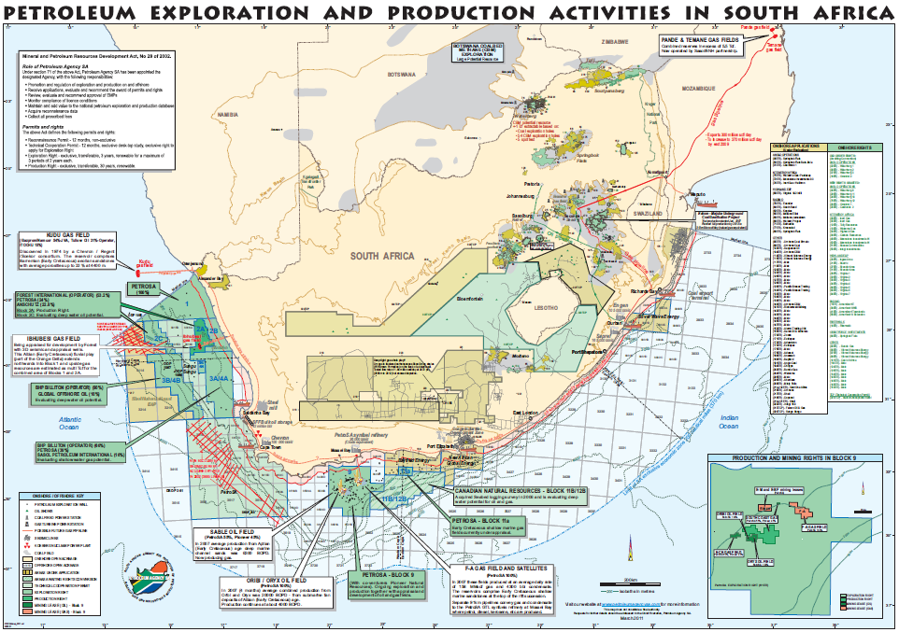

Slide 3
Introduction
During the latter part of 2010 and the beginning of 2011, a myriad of applications for exploration of shalegas by means of hydrological fracturing or ‘fracking’ was submitted to the Department of Minerals and Energy
These applications are for an area that is over 20% of the total land surface of South Africa, more than 150,000 ha
After extensive lobbying and comments by NGO’s, on these applications, especially in relation to the impacts of fracking on groundwater resources, the South African Government placed a moratorium on the further acceptance and processing of these applications
Government is currently ‘investigating’ the matter by means of a task team, and this moratorium may be reversed in future

Slide 4
What are we talking about?
What is ‘groundwater’?
  Importance of Groundwater in a semi-arid country like South Africa
What is ‘fracking”?
  What are the impacts of fracking on the groundwater resource?
What are the sustainability principles that should be considered to manage the impacts of anthropogenic activities such as fracking on the groundwater resource?
Take a position: Could fracking be regarded as a sustainable use of the groundwater resource?

Slide 5
What is groundwater??

Slide 6
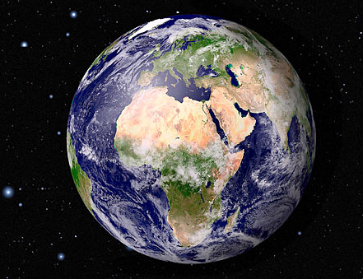

Slide 7
Only planet with water present in all its forms – basis for life on Earth
1,4 billion cubic kilometre in total
96.5% is saline water in oceans
3.5%
69% in polar ice sheets, glaciers and snow
30% is found underground as groundwater
0.25% in lakes
0.006% in rivers
0.04% in the atmosphere

Slide 8
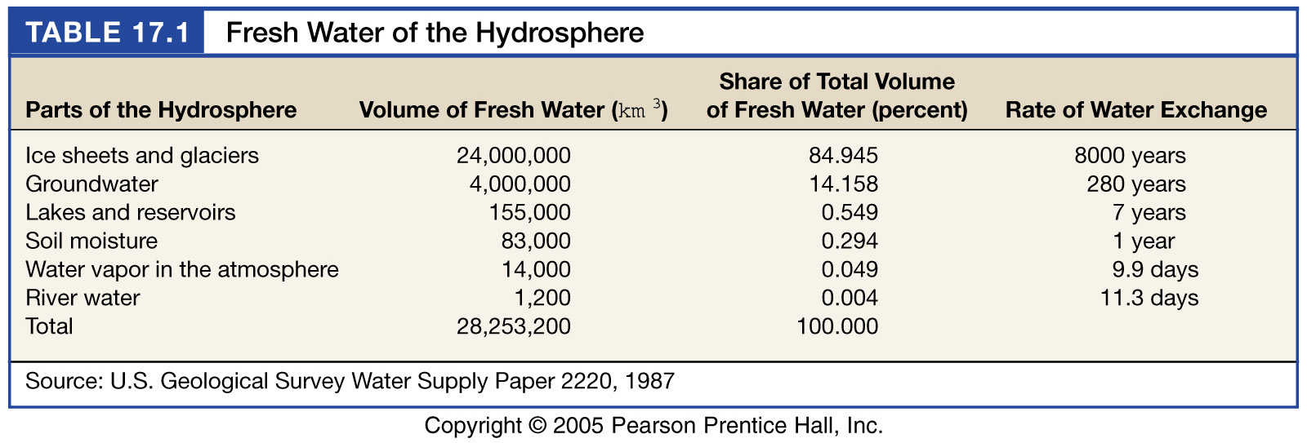
Fresh water of the hydrosphere

Slide 9
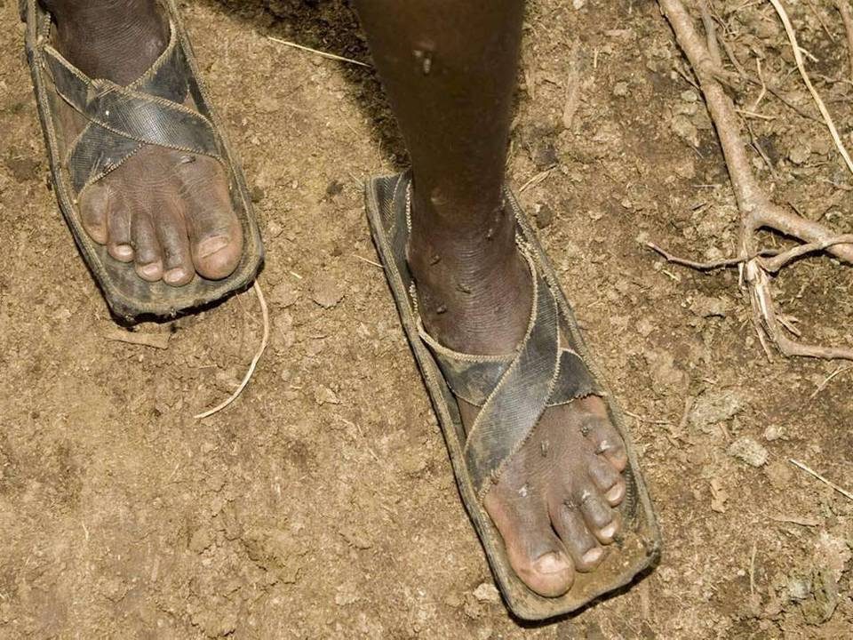
The invisible resource
Under our feet…
Notes:
9

Slide 10
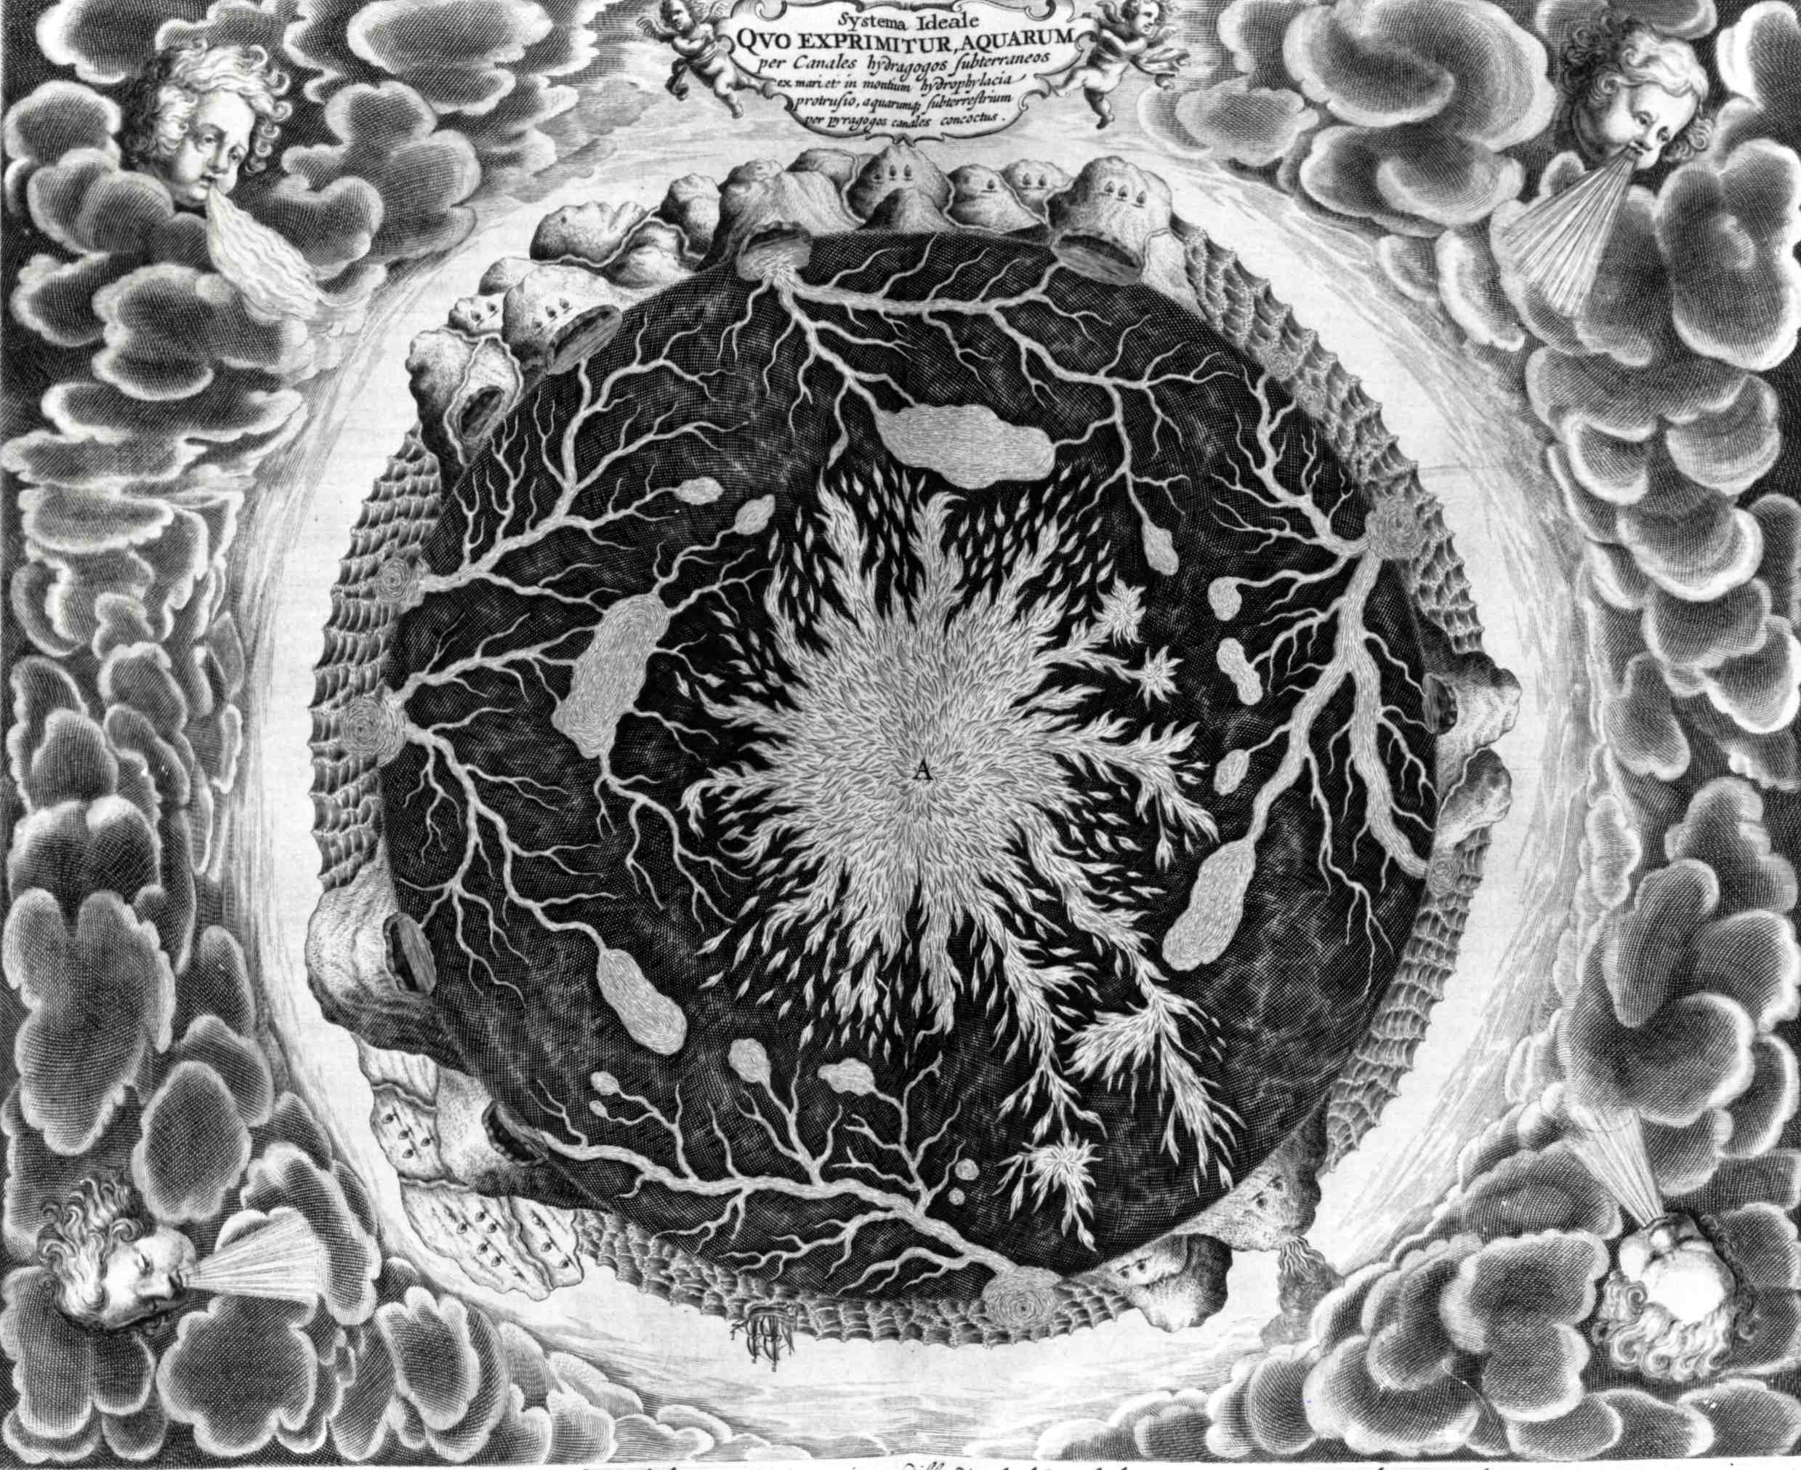
Athanasius Kirchner, 1665

Slide 11
Origin of springs and groundwater:
debated among scientists for more than two millennia
Aristotle
Seneca
René Descartes
Homeros
Thales of Milete
Plinius the Elder
Leonardo da Vinci
Johann Kepler
Oceanus
theory
Condensation
theory
Percolation
theory
Vitruvius
Bernard Palissy
Pierre Perrault
Edmund Halley
Edmé Mariotte
Conceptual basis for our modern understanding

Slide 12
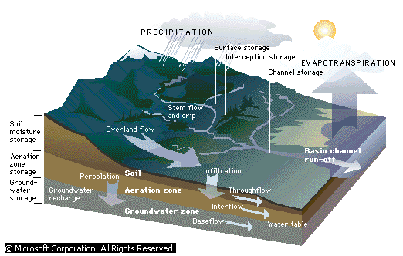
Basic Hydrological Unit

Slide 13
What is groundwater?
Definition of Groundwater/geohydrology
  The rainfall that soaks into the ground and moves downwards into spaces and cracks in the rocks below the ground surface becomes groundwater.
  The study of groundwater is called geohydrology.

Slide 14
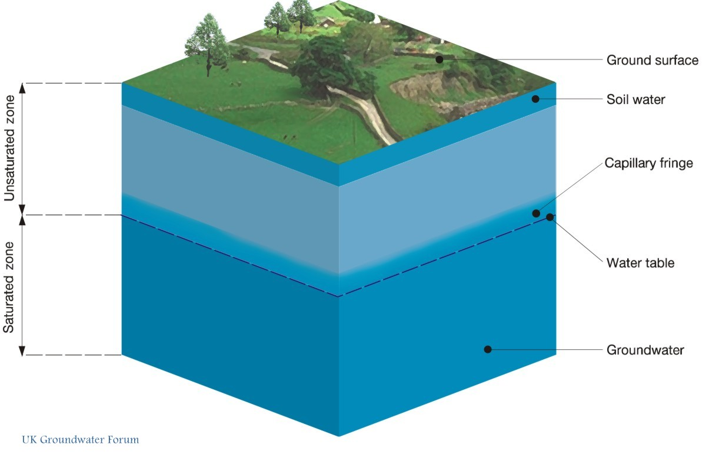
What is Groundwater?

Slide 15
Relationships between surface, ground and atmospheric water

Slide 16
Relationship between groundwater and surface water
Changes to surface water bodies in response to groundwater development can cause significant consequences:
  Long term reductions in stream flow can affect vegetation along streams
  Changes in the flow direction to/from streams may affect temperature, oxygen levels, and nutrient concentrations in the stream (affect aquatic life)
  In gaining and in losing streams, affect hyporheic zones (active sites for aquatic life)
  Impacts can either be quantitative (where excessive withdrawal of groundwater reduces baseflow contribution), or qualitative (e.g. infiltration of polluted surface water can contaminate groundwater resources)

Slide 17
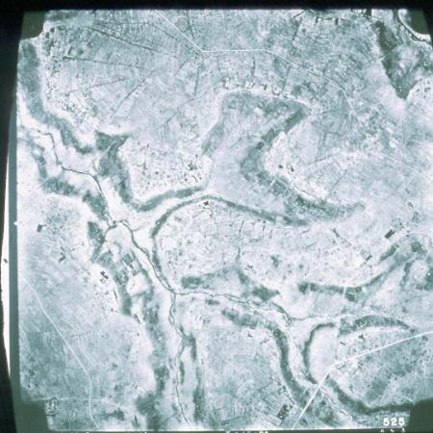
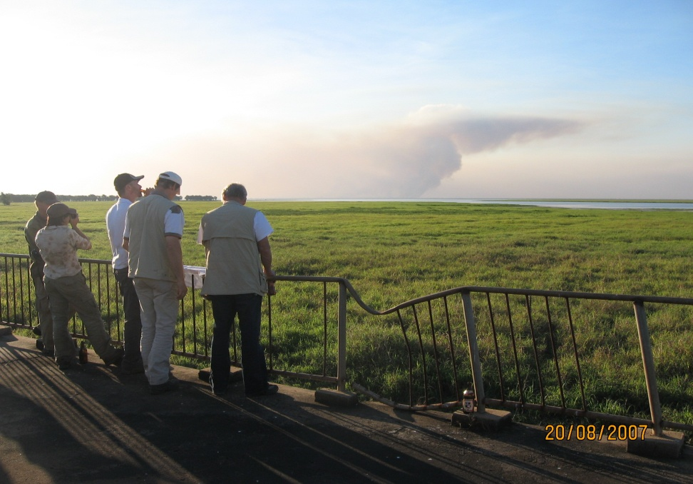
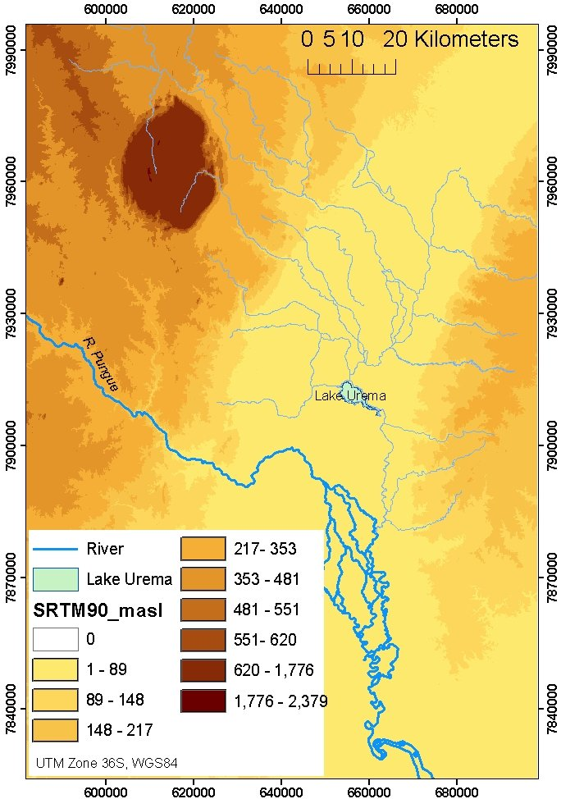
Groundwater
Dependent
Ecosystems
Regional features
eg Rift Valley
Small local
features
eg wetlands
W
E

Slide 18
Relationship between groundwater and surface water
Geological role of groundwater
    Groundwater serves as an equalizer of streamflow
Diagnosing the relationship surface water / underlying aquifer is an important component of groundwater system characterization.
It is important to distinguish between:
  Streams and rivers on which an aquifer is dependent as a significant source of its overall recharge
  Rivers that in turn depend significantly on aquifer discharge to sustain their dry-weather flow.
  It should be noted that in some cases rivers may fluctuate seasonally between two of the conditions depicted.

Slide 19
Importance of Groundwater
A readily available source at point where it is needed
Employs relative low cost technologies compared to surface water
Availability in most areas
Potable without treatment in most areas
Available during droughts and dry seasons when many small intermittent rivers and streams dry out

Slide 20
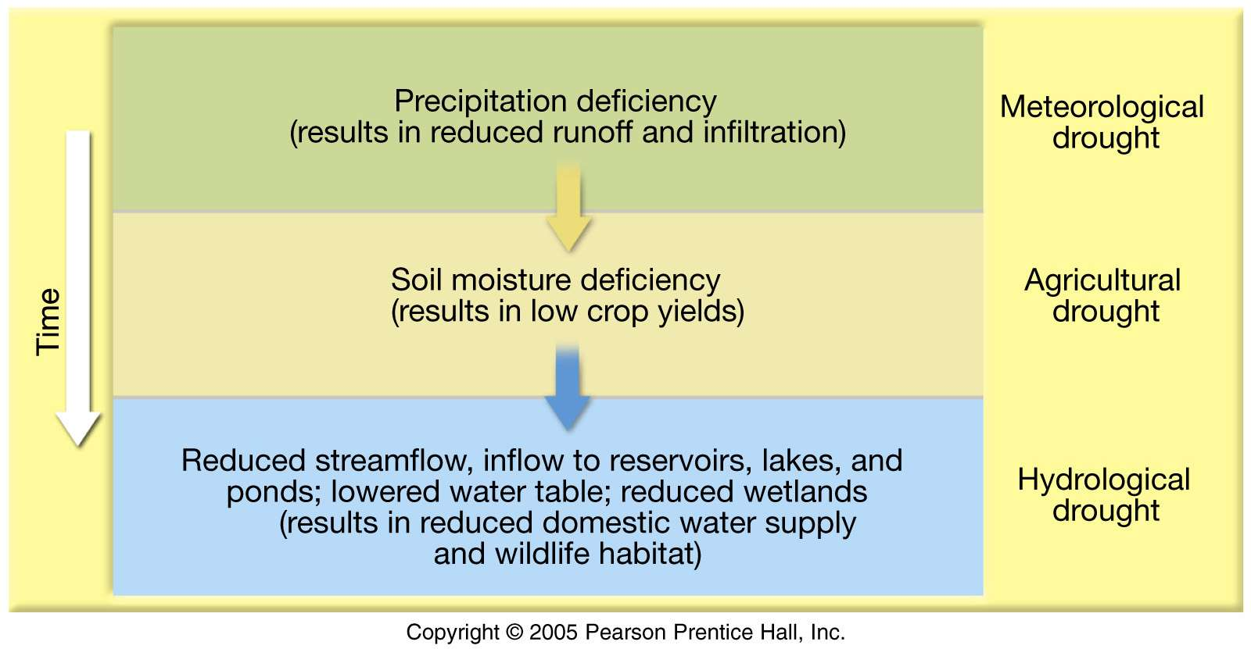
Chart showing sequence of drought impacts. Note chain reaction of symptoms; and time span required for recovery

Slide 21
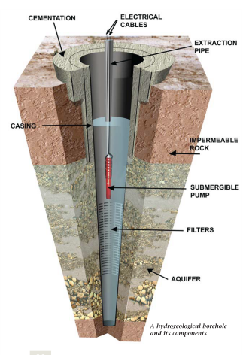

Slide 22
Setting
Borehole
Vertical
fracture
Bedding plane
fracture

Slide 23
Importance of groundwater
Groundwater is water found in the pores and micro-pores of soil and sediment, as well as small fractures in bedrock
Groundwater is the largest reservoir of fresh water that is readily available to humans
Some 2 billion people depend on it for their water supply
provides low-cost, drought-reliable & high-quality water supplies for both urban + rural populations
  ∴will be vital for achieving water MDGs
its replenishment is finite and limited to shallower aquifers, it can be over-exploited, and its quality can be seriously degraded by certain land-use activities that can cause pollution.

Slide 24
Groundwater Quality
Under natural conditions the quality of groundwater is
  determined by composition of the source rocks (where water previously was)
  often modified by composition of the host rocks (rocks within which it occurs)
Anthropogenic land-use activities affect quality and chemistry of groundwater

Slide 25
Geohydrological terminology

Slide 26
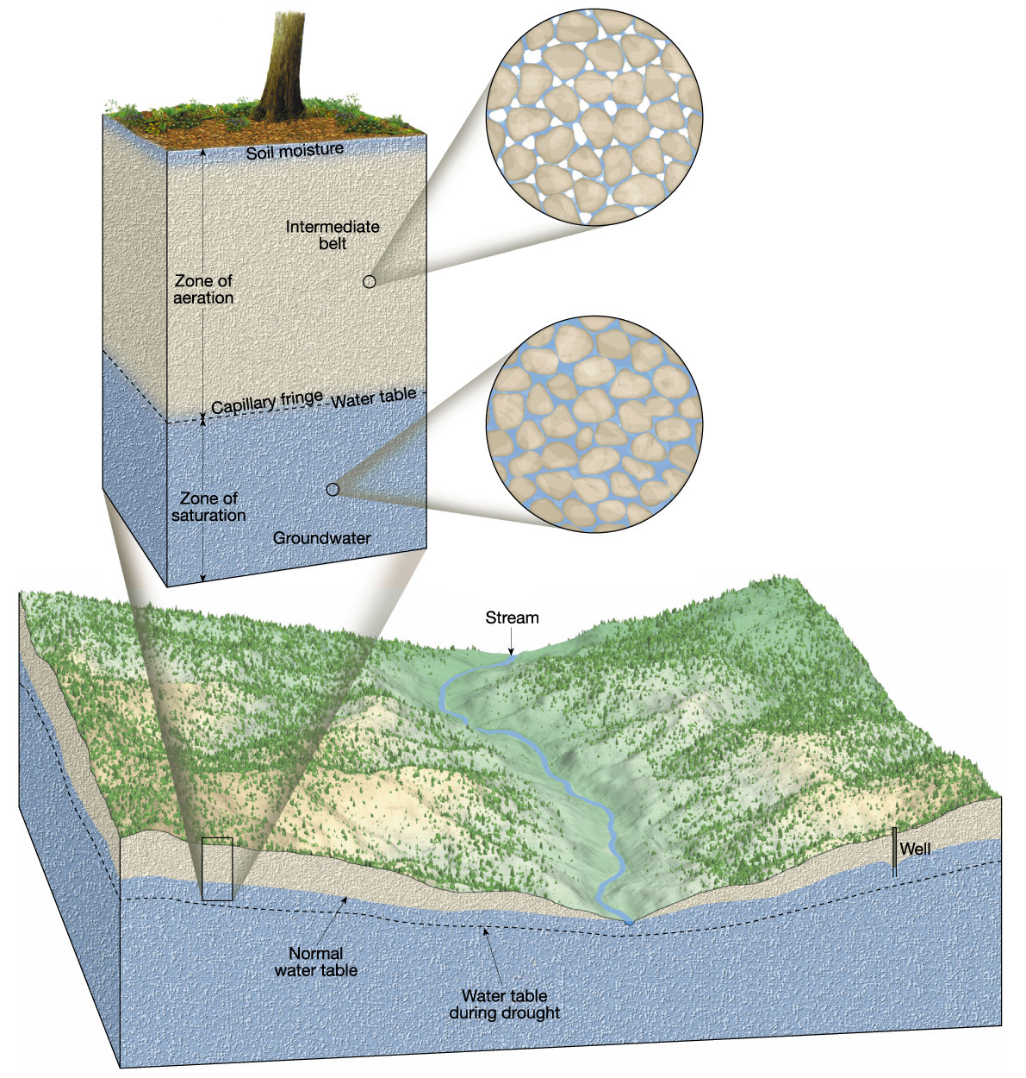
Groundwater Terminology

Slide 27
Sub-surface water entails
Interflow that occurs in the vadose or unsaturated zone.
Soil moisture (and interflow) support vegetation, etc.
Water in the capillary fringe is above the water table
Only that part of subsurface water that occurs within the saturated zone, (i.e. below the water table) is groundwater.

Slide 28
The water table
The water table is the upper limit of the zone of saturation
Variations in the water table
    Depth is highly variable
      Varies seasonably and from year to year
    Shape is usually a subdued replica of the surface topography
Factors that contribute to the irregular surface of the water table
  Water tends to “pile up” beneath high areas
  Variations in rainfall
  Variations in permeability from place to place

Slide 29
What is an Aquifer?

Slide 30
What is an Aquifer?
In the NWA, “aquifer'' is defined to mean “a geological formation which has structures or textures that hold water or permit appreciable water movement through them
All aquifers have two fundamental characteristics:
  A capacity for groundwater storage (hold water); and;
  A capacity for groundwater flow (movement).

Slide 31
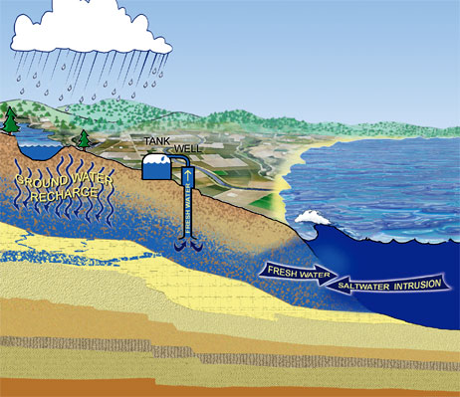
Aquifers main functions
Storage capacity (storage coefficient or specific yield)
Transfer capacity (transmissivity)
Physical and chemical interaction capacity (reservoir-rock vs GW)

Slide 32
Groundwater characteristics
Groundwater occurs in most geological formations because nearly all rocks possess openings (pores or voids, or fractured).
An aquifer is a geological formation capable of yielding useful groundwater supplies to wells and springs.
There are huge differences among aquifers with respect to geological environments
  Resulting in their capacities to store water and to transmit water flow as well.

Slide 33
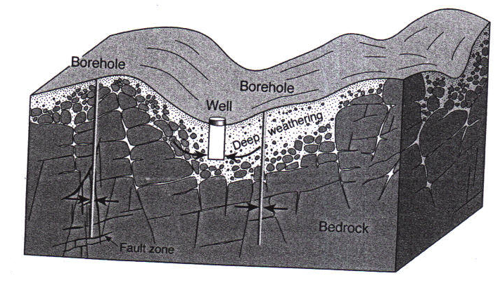
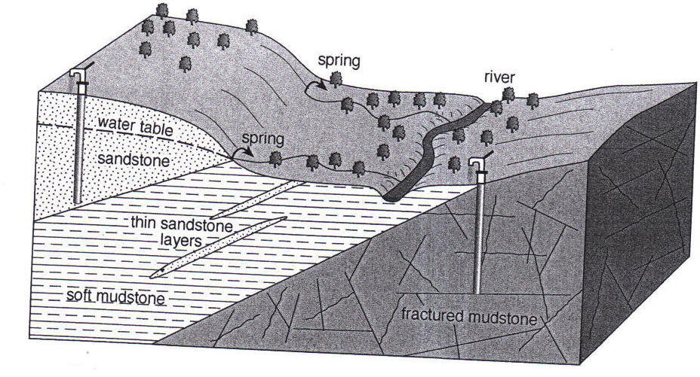
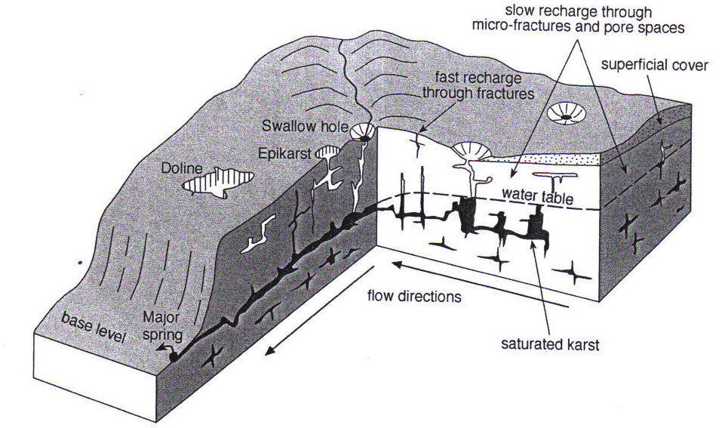
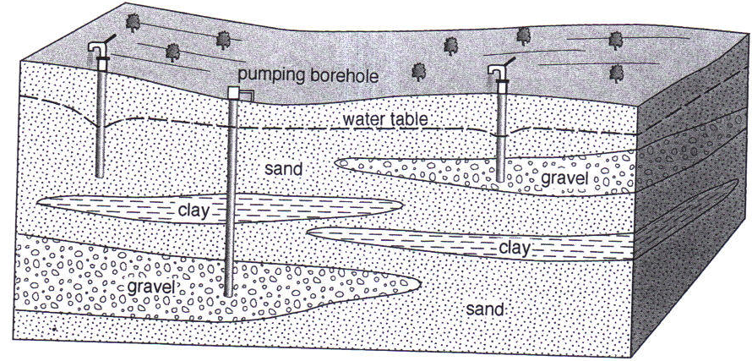
Different hydrogeological environments

Slide 34
Permeability, aquitards, and aquifers
Permeability – the ability of a material to transmit a fluid
Aquitard – an impermeable layer that hinders or prevents water movement (such as clay)
Aquifer – permeable rock strata or sediment that transmits groundwater freely (such as sands and gravels)
  unconfined (free surface), called water-table aquifer or phreatic aquifer;
  confined (under pressure) aquifers are bounded by impervious or semipervious layers.

Slide 35
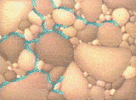

Aquifer Types
Primary Aquifer: groundwater occurs in pores that developed during deposition (Kalahari sands, coastal areas and alluvial)
Secondary or Fracture Aquifer: occurs where solid rock cracked, & later followed by water that fills the fractures (Weathered hard rock, karst dolomite, or fractured sandstone)

Slide 36
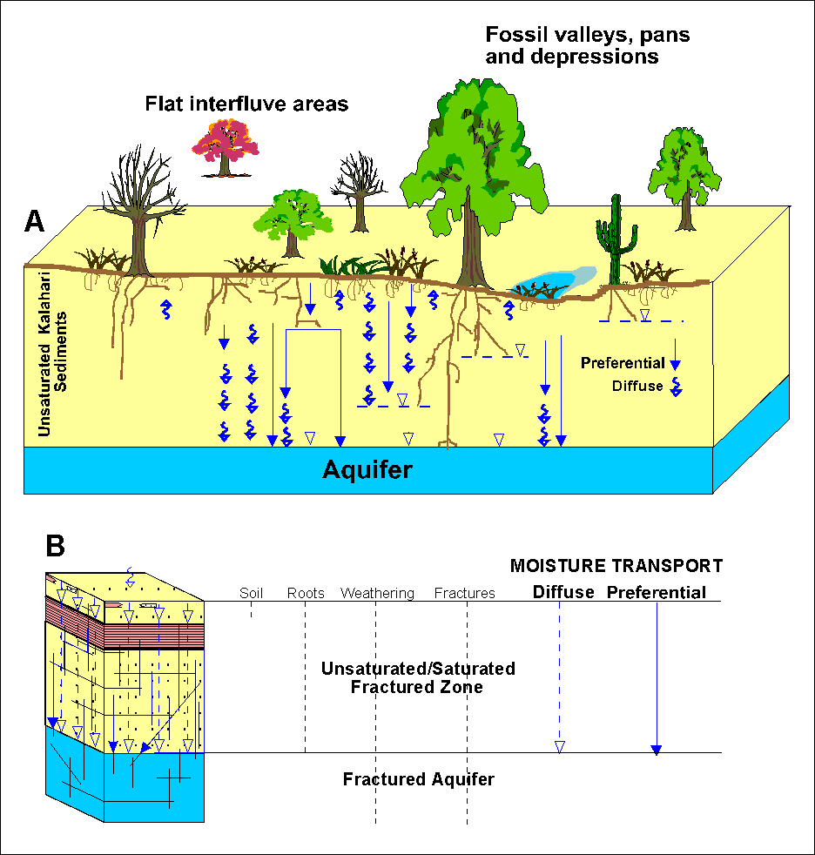
Recharge
Surface Water that infiltrate and replenish groundwater is recharge

Slide 37
Groundwater recharge
Recharge may result from:
  Precipitation that percolates through unsaturated zone to water table
  Losses of surface water bodies (steams, lakes, wetlands)
recharge rates is a fundamental consideration in the sustainable development of groundwater resources.
Understanding aquifer recharge mechanisms and their linkages with land-use is essential for integrated water resources management.
The quantification of natural recharge rates is subject to significant methodological difficulties, data deficiencies and resultant uncertainties because of:
  Wide spatial and temporal variability of rainfall and runoff events, and;
  Widespread lateral variation in soil profiles and hydrogeological conditions.

Slide 38
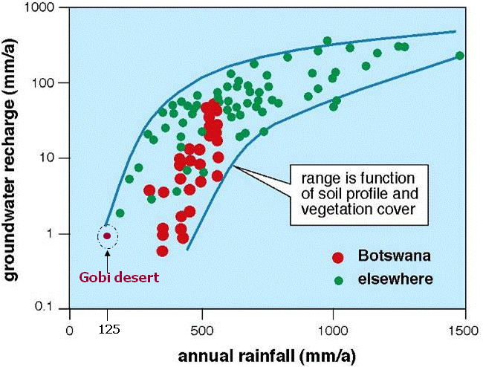
Recharge rates

Slide 39
Groundwater recharge
Recharge rates vary with:
  river flow diversion or control,
  modifications to surface water irrigation,
  changes in natural vegetation or crop type in recharge areas,
  reduction in leakage from urban water-supply networks and in-situ wastewater percolation,
  lowering of water-table, etc.
Areas of increasing aridity will have a much lower rate and frequency of downward flux to the water table,
Indirect recharge from surface runoff and incidental artificial recharge arising from human activity is generally becoming progressively significant than direct rainfall recharge.

Slide 40
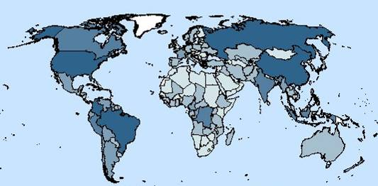
Groundwater recharge
GGIS, 2004
Based on data from several sources, mainly obtained by enquiry.
Country-scale resolution, low degree of consistency, moderate reliability.
However, local hydrogeological knowledge incorporated (“ground truth”).
Döll and Fiedler, 2008
Based on modelling (WaterGap), half-degree resolution. Limited hydrogeological ground truth.
Reliable, except for (semi-)arid regions and intensely pumped zones. Not suitable for predictions under changing abstraction conditions.

Slide 41
Residence times
Groundwater moves through aquifers from areas of recharge to areas of discharge, normally at slow rates ranging from 1‑m/year to 100s‑m/day.
Tens/hundreds/thousands of years may elapse between recharge and discharge to a spring/stream/sea.
These slow flow rates and long residence times are distinctive features of groundwater systems.

Slide 42
Residence Times
Typical groundwater flow regime and residence times of major aquifers under semi-arid climatic regimes (after GW-Mate2, 2006)

Slide 43
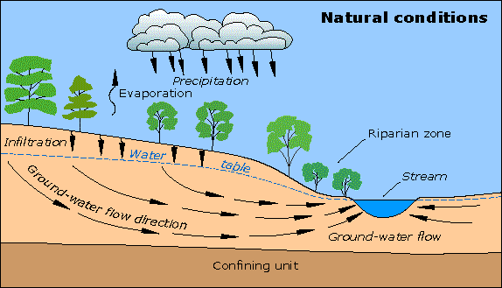
Groundwater
Groundwater is an important natural resource and an integral part of the social and natural environment.

Slide 44
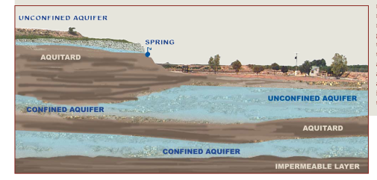
Groundwater…the “hidden” resource
Underlying resource, stored in underground reservoir (rocks) and transmitted through interconnected spaces
Aquifers have huge differences with respect to their hydrogeological setting.
GW management based on a good understanding of aquifer system.

Slide 45
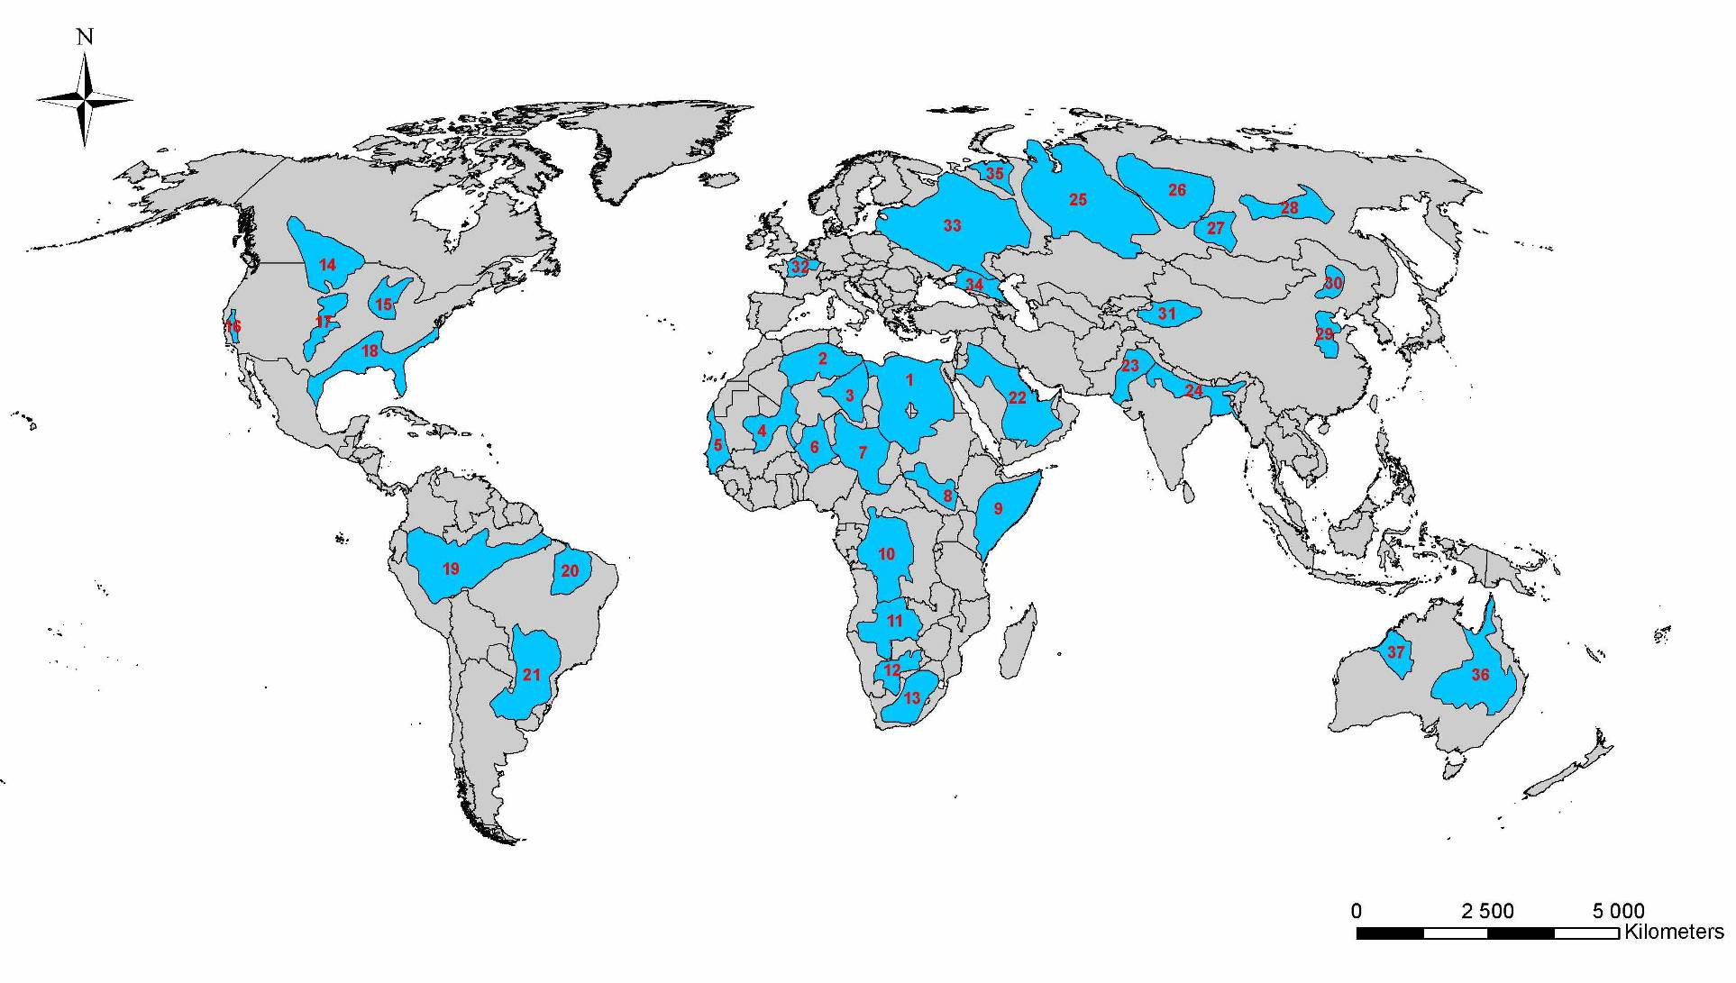
The world’s largest aquifer systems
Source: J. Margat, 2008

Slide 46
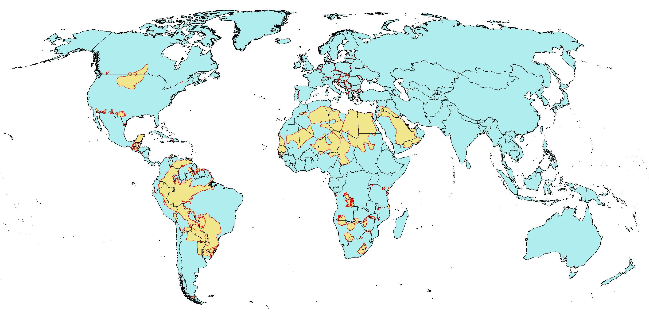
Transboundary aquifers
Source: IGRAC

Slide 47
Importance of Groundwater for South Africa

Slide 48
MEAN ANNUAL RAINFALL
D. R. C.
TANZANIA
ANGOLA
ZAMBIA
MOZABIQUE
MALAWI
= 860 mm isohyet
= World average rainfall
ZIMBABWE
Mean Annual
Rainfall (mm)
NAMIBIA
2500
BOTSWANA
2000
1500
1250
1000
SADC Average Annual Rainfall = 948 mm
900
800
700
SWAZILAND
600
SOUTH
AFRICA
500
400
© Pete Ashton
300
LESOTHO
200
0
250
500 km
100

Slide 49
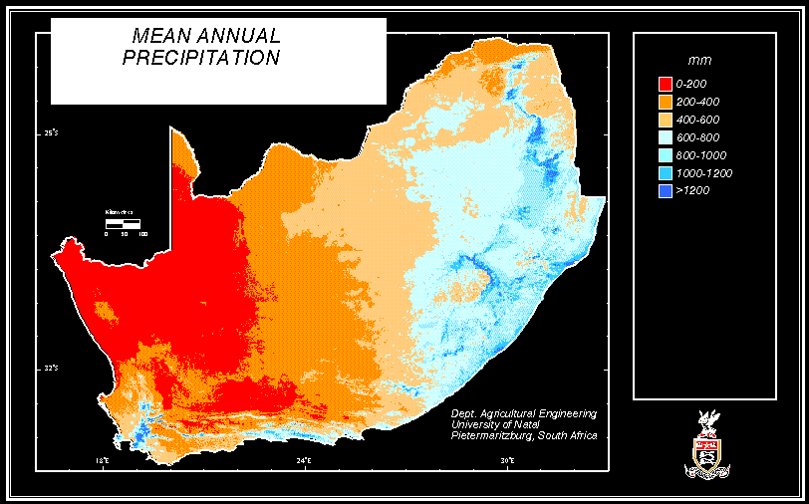

Slide 50
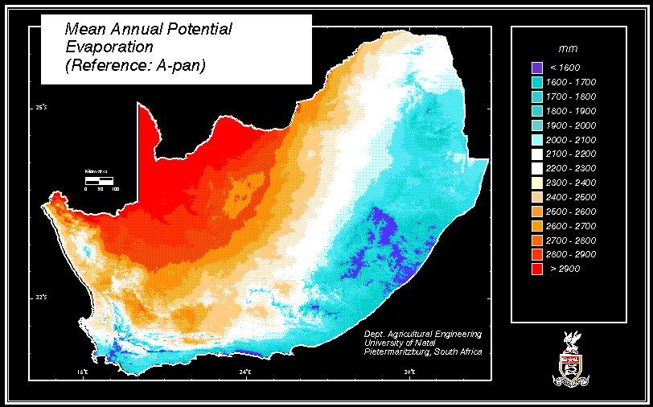

Slide 51
South Africa
semi-arid climate
  water supply from surface water sources alone not adequate to address current and future demand
Integrated nature of the hydrological cycle:
  interrelationships between surface water, ground water and atmospheric water

Slide 52
Ground Water Resources
ground water only 13% of total national water supply, but 65% of the country rely on it
Protection of groundwater high priority
  sedimentation in dams
  limited number of suitable dam sites
  cost of developing surface resources, and cost of removing contaminants for re-use.

Slide 53
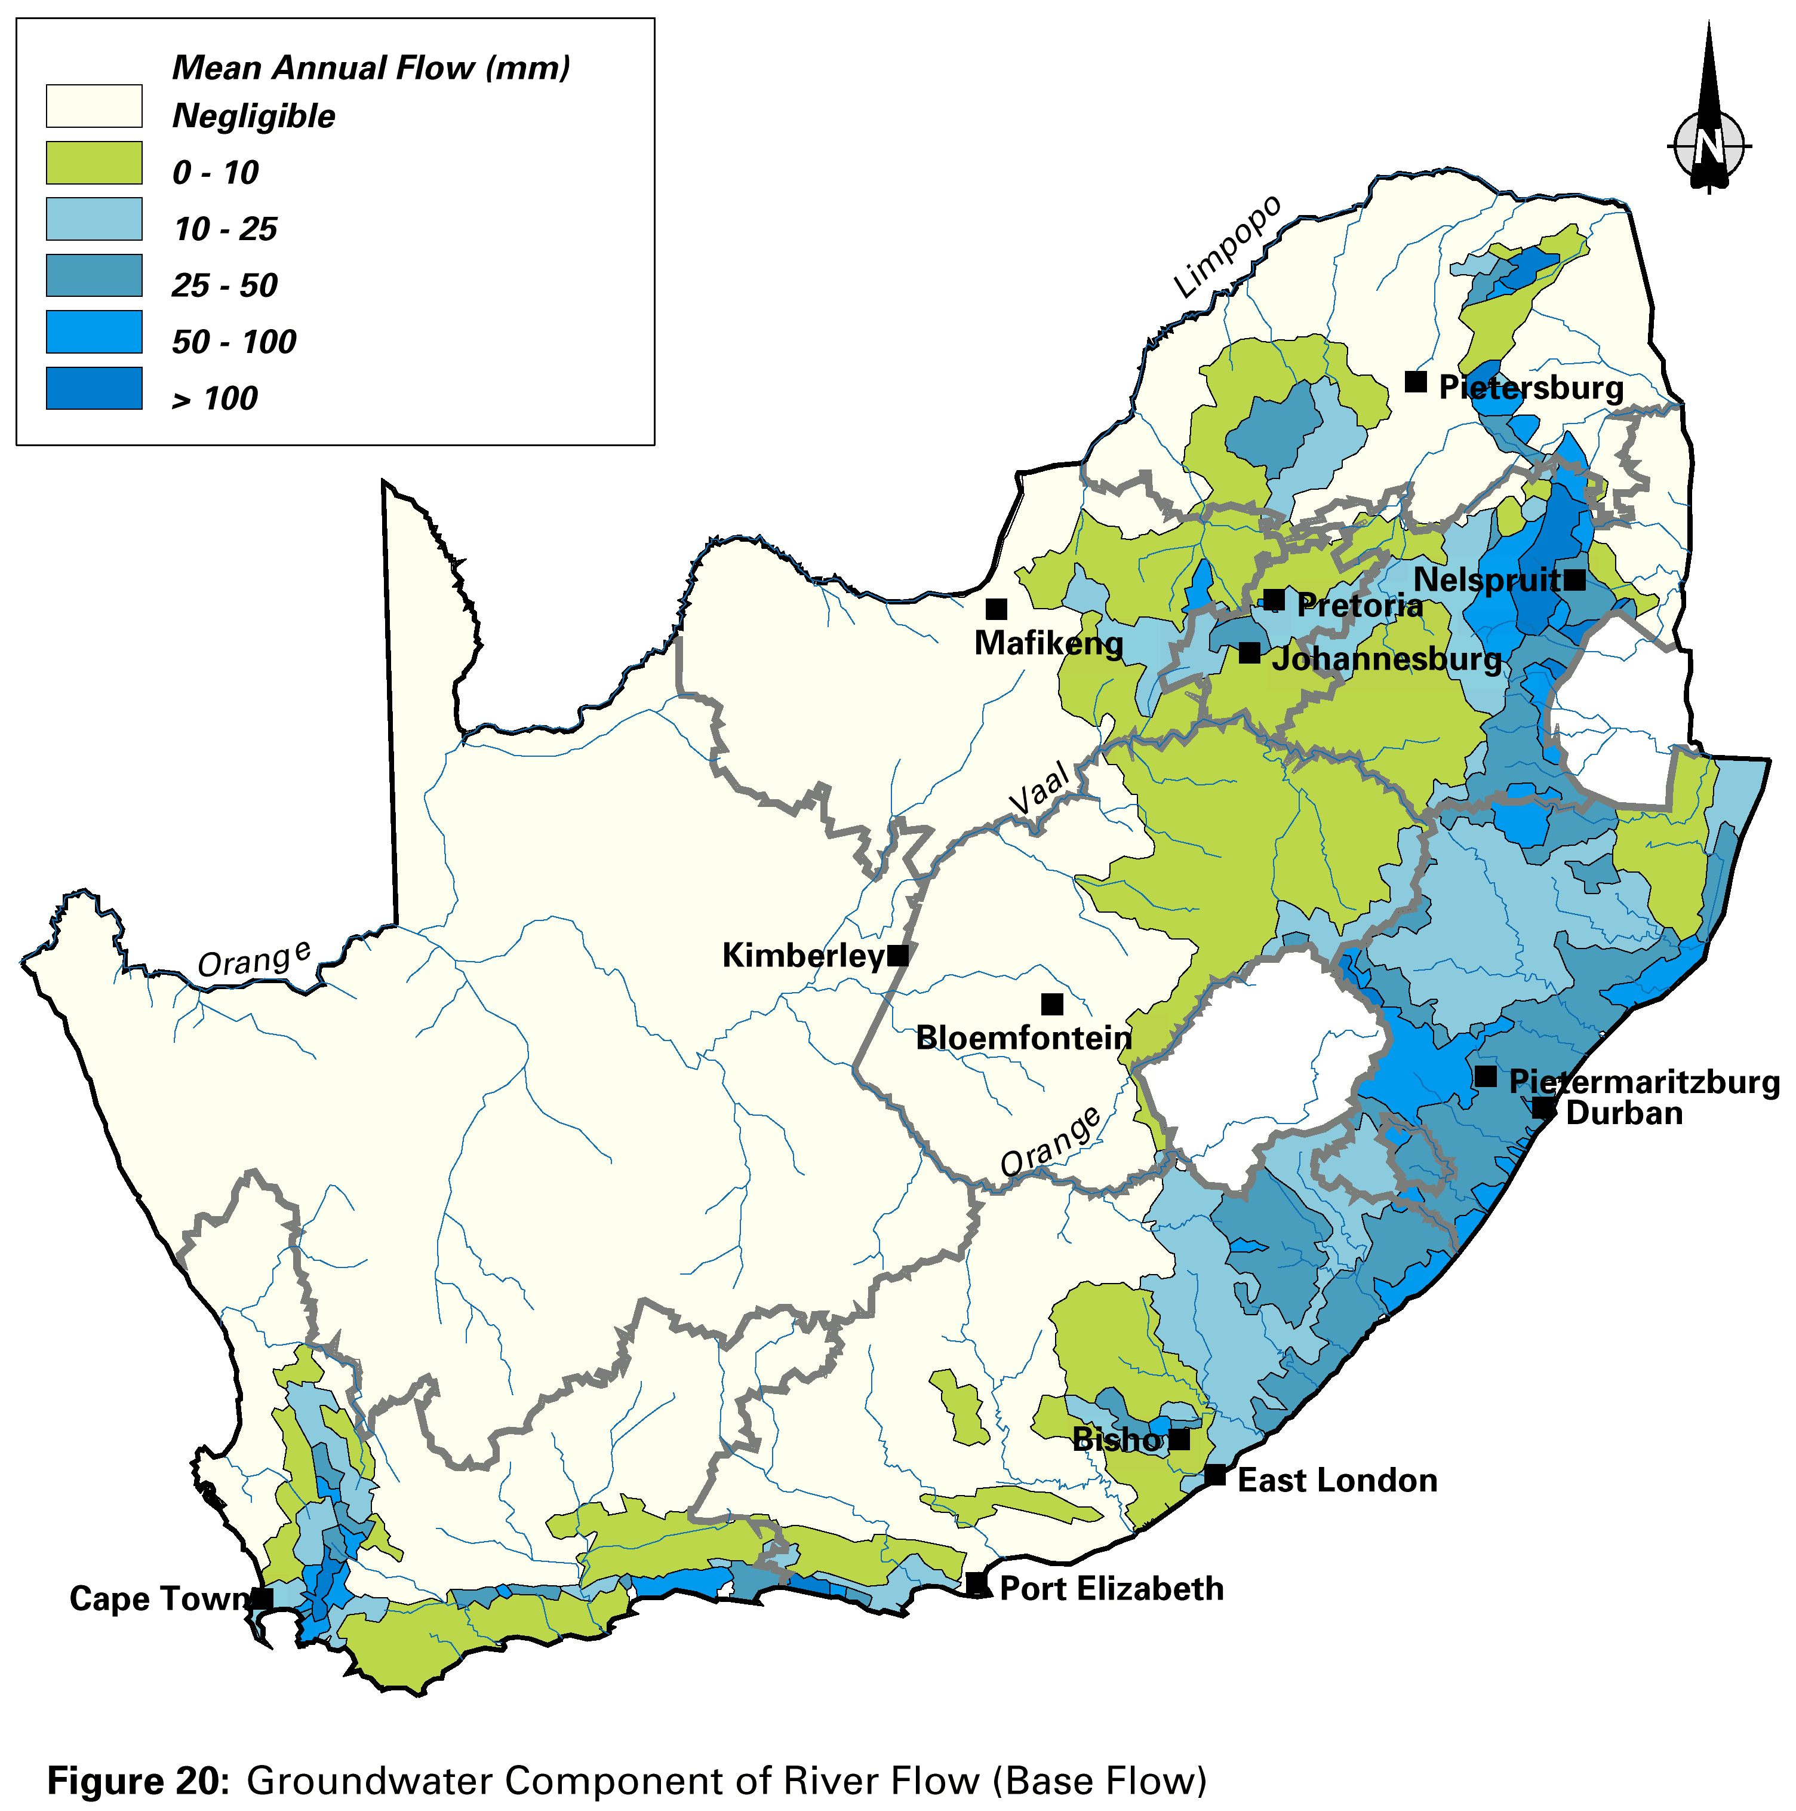
GW Component of Baseflow

Slide 54
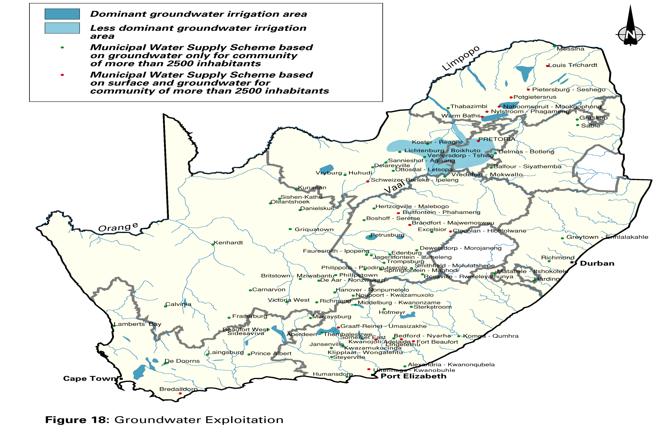
Ground water usage in SA

Slide 55
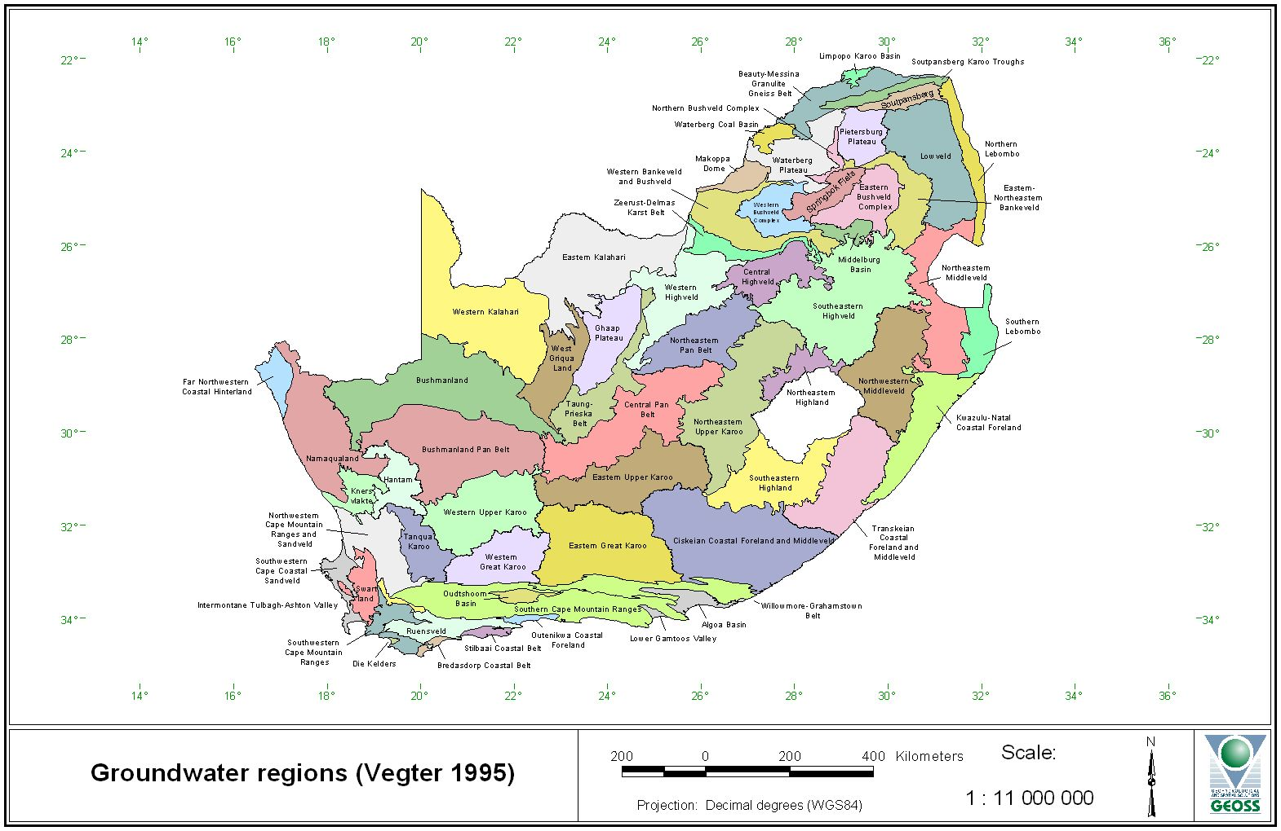
Groundwater Regions

Slide 56
Karoo Supergroup
groundwater highly variable quality
  tends to be brackish or saline in mudstone
    EC>300 mS/m expected in Dwyka
  Very good potable quality in sandstones
pH generally above 7
Chloride high percentage of anions
Generally a Na-Cl to Na-Cl/HCO3 type groundwater
Only source of water for domestic use and livestock watering in many areas

Slide 57
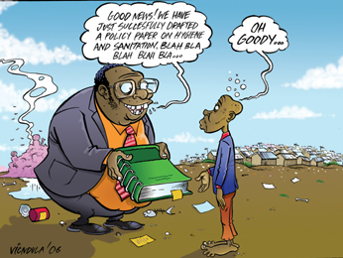
What are the principles to consider in the management of human activities on groundwater resources?
Good News. We have drafted a policy paper on groundwater management.

Slide 58
Constitution of the RSA –
Section 24
Everyone has the right -
  to an environment that is not harmful to their health or well-being; and
  to have the environment protected, for the benefit of present and future generations, through reasonable legislative and other measures that –
    prevent pollution and ecological degradation;
    promote conservation; and
    secure ecologically sustainable development and use of natural resources while promoting justifiable economic and social development

Slide 59
Constitution of the RSA –
Section 22
Freedom of trade, occupation and profession:
  Every citizen has the right to choose their trade, occupation or profession freely.
  The practice of a trade, occupation or profession may be regulated by law.

Slide 60
Hierarchy of South African Environmental Legislation
Constitution of the Republic of South Africa Act (Basic Rights of SA citizens)
National Environmental Management Act
(FRAMEWORK: Defines & entrenches Sustainability Principles)
Occupational Health & Safety
Act
Minerals & Petroleum Resources Development
Act
National Water Act
Water Services
Act
Other National Acts & Regulations
Provincial Legislation
(Functions in terms of the Constitution)
Local Government
Bylaws

Slide 61
Framework Legislation, Policy and Strategy
National
Environmental Management Act
Pollution and
Waste Legislation
Protection &
Management of
Renewable
Resources
Utilisation of
Non-Renewable
Resources
Protection of
Natural &
Cultural
Resources
NEM: Waste Act
National
Water
Act
Minerals and
Petroleum
Development
Act
Biological
Diversity
SAHRA
White Paper on Environmental Management

Slide 62
National Environmental Management Act 107 of 1998 (NEMA)
NEMA Section 1: Definitions
  Environment
  Hazard
  Pollution
  Sustainable Development
  Best Practicable Environmental Option (BPEO)
Section 2
  All should adhere to the Principles of Sustainable Development and take them into account in decision-making.

Slide 63
Some Specific Principles for Sustainable IEM in NEMA s2
The Polluter Pays
  Duty of Care and Cradle to Grave responsibility
  Pollution Prevention
  Accountability and Liability
A Precautionary Approach (Risk Averse and Cautious)
  The Concept of Pollution
  Prior Assessment of Impacts
Within the Carrying Capacity of Resources
Consideration of alternatives to select the Best Practicable Environmental Option (BPEO)
Continual Improvement

Slide 64

"It isn't pollution that's harming the environment. It's the impurities in our air and water that are doing it.“
-- Al Gore, (then) Vice President of the USA

Slide 65
The Polluter Pays
The polluter should bear the full cost of any damage caused to the environment
  DOES NOT mean that those who can pay can pollute
  Associated Liabilities
  NEMA Section 33: Private Prosecution
  NEMA Section 34: Criminal Proceedings
Place the burden of proof on those who argue that a proposed activity will not cause significant harm, and make the responsible parties liable for environmental harm.
        EARTH CHARTER, NEMA

Slide 66
The Principle of Carrying Capacity
Responsible use of natural resources (non-renewable & renewable)
  Ensure that development and operation does not exceed the natural carrying capacity
  Protect and restore the integrity of Earth’s ecological systems, with special concern for biological diversity and the natural processes that sustain life.
      EARTH CHARTER, CARING FOR THE EARTH, CERES
also “environmental capacity” or “assimilative capacity” of environmental systems

Slide 67
Development and use within Carrying Capacity limits
Limits to carrying capacities:
  Different ecological and environmental systems may not have the same capacity to carry or “assimilate” contaminants
  Forms the basis of concepts such as “critical loads”, “thresholds” or standards
  maintaining ecological integrity depends on staying within the limits of carrying capacity by promoting ecologically realistic consumption or use standards
Groundwater, due to its nature, and its long residence time, and the lack of aquatic ecosystems, is not considered to have assimilative capacity

Slide 68
Precautionary Approach Principle
Little understanding of the issues at stake :
  pro-active principle
  Prevention of pollution
  avoiding environmental impact before it occurs
  Research Precautionary Approach
Ensure that:
  a risk-averse and cautious approach is applied to environmental management,
  which takes into account the limits of current knowledge about the consequences of decisions and actions

Slide 69
“Risk-Averse and Cautious”
Prevent harm as the best method of environmental protection and, when knowledge is limited, apply a precautionary approach
Take action to avoid the possibility of serious or irreversible environmental harm even when scientific knowledge is incomplete or inconclusive.
        EARTH CHARTER, ICC and NEMA

Slide 70
Precautionary Principle
The Precautionary principle is always based on three common elements:
  If there is reasonable suspicion of harm
  accompanied by scientific uncertainty, then
  a duty to take action to prevent harm is imposed.
Old style ERA…
  “Old style” Risk Assessments took uncertainty as a green light.
  Risk assessments are often still used merely to argue that a certain amount of harm is justifiable, not to learn how much harm is avoidable
  An assessment of a single option can never be deemed precautionary…

Slide 71
Precautionary Principle and Uncertainty
The precautionary principle means viewing scientific uncertainty as a yellow light or even a red light.
The precautionary principle assumes that scientific uncertainty is itself a reason to be concerned.
When scientific uncertainty is combined with potential of harm, then precautionary action is warranted.

Slide 72
What is the fracking fuss all about...?

Slide 73
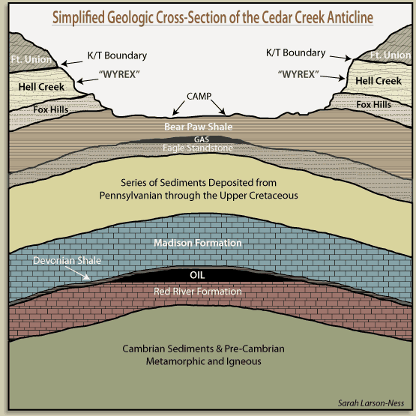
Conventional extraction of oil and gas
When drilling for ‘Conventional’ oil and gas, the target is a reservoir rock capped by an impermeable seal

Slide 74
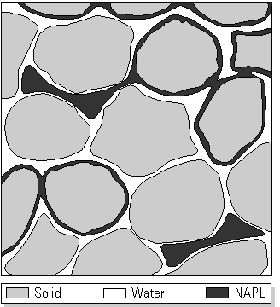
Conventional extraction of oil and gas
Conventional’ oil and gas are extracted from porous reservoir rocks
An efficient operation can extract ~ 40 % of the oil/gas present in the rocks

Slide 75
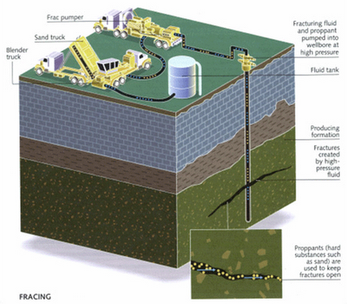
Conventional Fracking

Slide 76
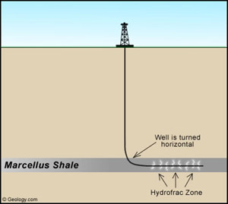
Since early 2000:
Horizontal Drilling

Slide 77
Horisontal fracking
A means of extraction of gas occurring in shale deposits by means of drilling a number of holes into the shale formation, first vertically, then horisontally
Once the well is drilled, millions of litres of water mixed with sand and proprietary chemicals are injected under high pressure into the wells
The water and sand, under this high pressure, fractures the shale and the chemicals keeps the fractures open and dissolves the gas, which is then pumped to surface

Slide 78
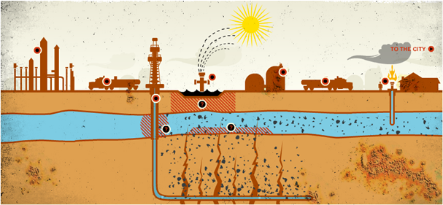

Slide 79
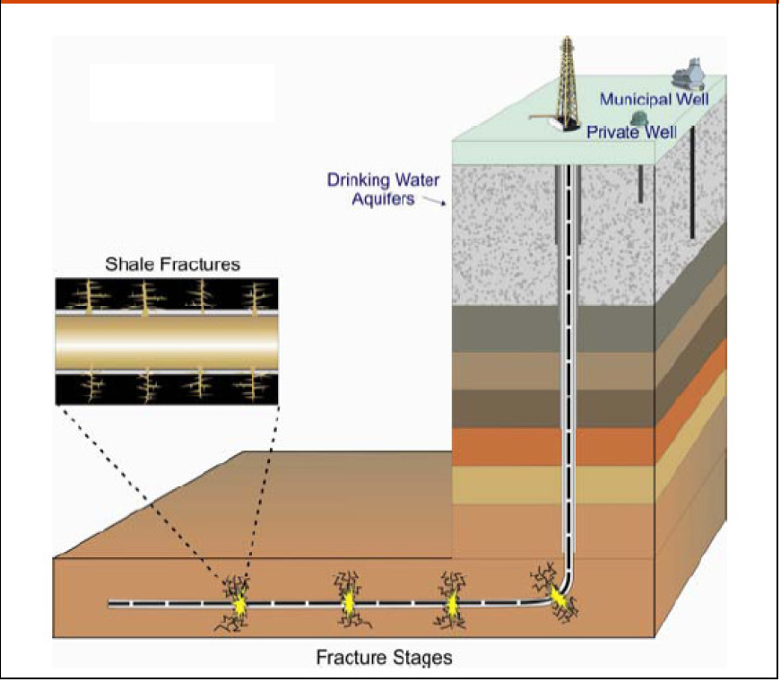

Slide 80
Difference between conventional and horisontal fracking
Conventional
Horisontal
Pressure: 10,000 pounds/inch²
Water volume: 2 – 7 million gallons/hole
No need for chemical cocktails
Pressure: 13,500 pounds/inch²
Water volume: 1 000 gallons/minute, for up to 4 days at a time
Unable to execute without using complex chemical cocktails in the fracking fluid

Slide 81
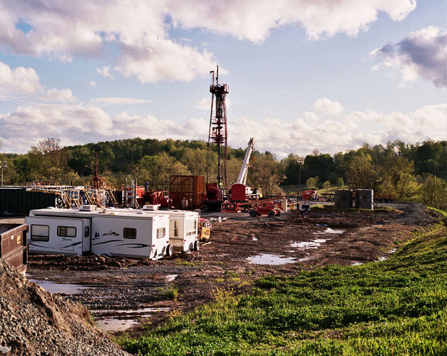
~10 – 30 million litres of water mixed with fracking fluid per well

Slide 82
‘Fracking Fluid’
NEEDS TO:
Initiate and expand fractures
Transport ‘propant’ (sand, bauxite, other granular materials)
Distribute ‘propant’ evenly
Mix of over 600 chemicals:
PROPERTIES
Viscous
Maximise travel distance
Ability to hold ‘propant’ in suspension

Slide 83
Fracking Fluid impacts
10 tons/million liters of water
Chemicals are ‘proprietary’, and not disclosed
More than 600 different chemicals have been identified:
  Includes biocides, BTEX, deodorised kerosene, coffee-grinds, etc.
  Carcinogenic, mutagenic, causes of chemical pneumonia, and highly toxic to aquatic organisms
  Endocrine disruptors

Slide 84
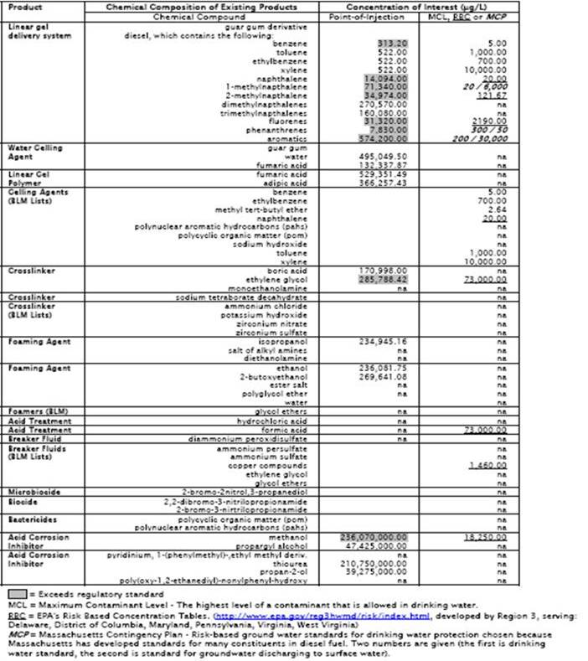
Some fracking chemicals

Slide 85
Chemical Name Chemical Purpose
Hydrochloric Acid Helps dissolve minerals and initiate cracks in the rock
Glutaraldehyde Eliminates bacteria in the water that produces corrosive by-products
Quaternary Ammonium Chloride Eliminates bacteria in the water that produces corrosive by-products
Tetrakis Hydroxymethyl-Phosphonium Sulfate Eliminates bacteria in the water that produces corrosive by-products
Ammonium Persulfate Allows a delayed break down of the gel
Magnesium Peroxide Allows a delayed break down of the gel
Magnesium Oxide Allows a delayed break down of the gel
Choline Chloride Prevents clays from swelling or shifting
Tetramethyl ammonium chloride Prevents clays from swelling or shifting
Sodium Chloride Prevents clays from swelling or shifting
Calcium Chloride Product Stabilizer
Isopropanol Product stabilizer and / or winterizing agent
Ethylene Glycol Product stabilizer and / or winterizing agent.
Methanol Product stabilizer and / or winterizing agent
Isopropyl Alcohol Product stabilizer and / or winterizing agent.
Formic Acid Prevents the corrosion of the pipe
Acetaldehyde Prevents the corrosion of the pipe
Potassium Metaborate Maintains fluid viscosity as temperature increases
Triethanolamine Zirconate Maintains fluid viscosity as temperature increases
Sodium Tetraborate Maintains fluid viscosity as temperature increases
Boric Acid Maintains fluid viscosity as temperature increases
Zirconium Complex Maintains fluid viscosity as temperature increases
Borate Salts Maintains fluid viscosity as temperature increases

Slide 86
Chemical Name Chemical Purpose
Polyacrylamide “Slicks” the water to minimize friction
Guar Gum Thickens the water in order to suspend the sand
Polysaccharide Blend Thickens the water in order to suspend the sand
Naphthalene Carrier fluid for the active surfactant ingredients
Petroleum Distillate Carrier fluid for borate /zirconate /polyacrylamide /guar gum in liquid gels
Hydrotreated Light Petroleum Distillate Carrier fluid for borate /zirconate /polyacrylamide /guar gum in liquid gels
Citric Acid Prevents precipitation of metal oxides
Acetic Acid Prevents precipitation of metal oxides
Thioglycolic Acid Prevents precipitation of metal oxides
Sodium Erythorbate Prevents precipitation of metal oxides
Lauryl Sulfate Used to prevent the formation of emulsions in the fracture fluid
Sodium Hydroxide Adjusts the pH of fluid to maintains the effectiveness of other components
Potassium Hydroxide Adjusts the pH of fluid to maintains the effectiveness of other components
Acetic Acid Adjusts the pH of fluid to maintains the effectiveness of other components
Sodium Carbonate Adjusts the pH of fluid to maintains the effectiveness of other components
Potassium Carbonate Adjusts the pH of fluid to maintains the effectiveness of other components
Copolymer of Acrylamide and Sodium Acrylate Prevents scale deposits in the pipe
Sodium Polycarboxylate Prevents scale deposits in the pipe
Phosphonic Acid Salt Prevents scale deposits in the pipe
Lauryl Sulfate Used to increase the viscosity of the fracture fluid

Slide 87
Shalegas extraction
Once at the surface, the gas has to be separated from the fracking fluid
Typically, only 30 – 50% of the fracking fluid is recovered from a well
Recovered fracking fluid stored in evaporation dams
Fracking fluids can enter groundwater supplies as a result of seepage from surface storage areas as well as though new cracks and fissures formed during the gas-extraction process

Slide 88
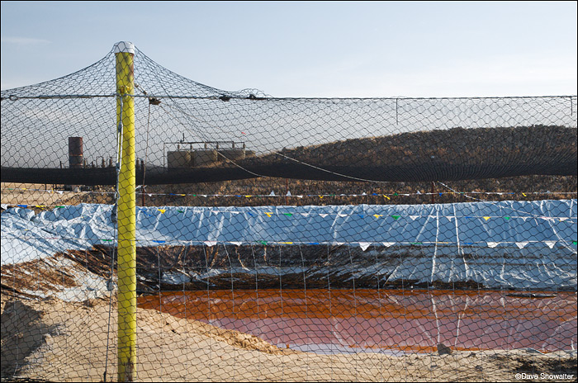
Fracking Fluid Dam

Slide 89
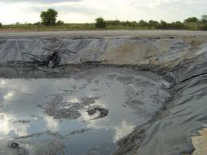
Fracking Fluid Dam Failure

Slide 90
Incidental release of methane
Methane is the largest component of shale-gas
Exposure by ingestion through water supplies is not harmful, but it is harmful through inhalation, and flammable
As the gas concentration increases, it can cause headaches, nausea, brain damage and death
It is odourless
Methane gas can also enter groundwater supplies though new cracks and fissures formed during the gas-extraction process

Slide 91
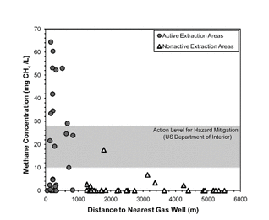
Methane in groundwater

Slide 92
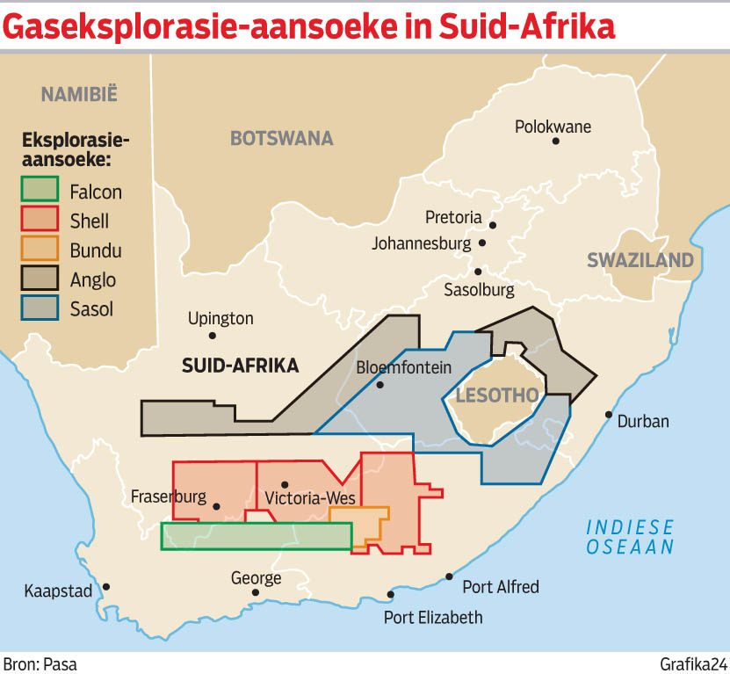
Other

Slide 93
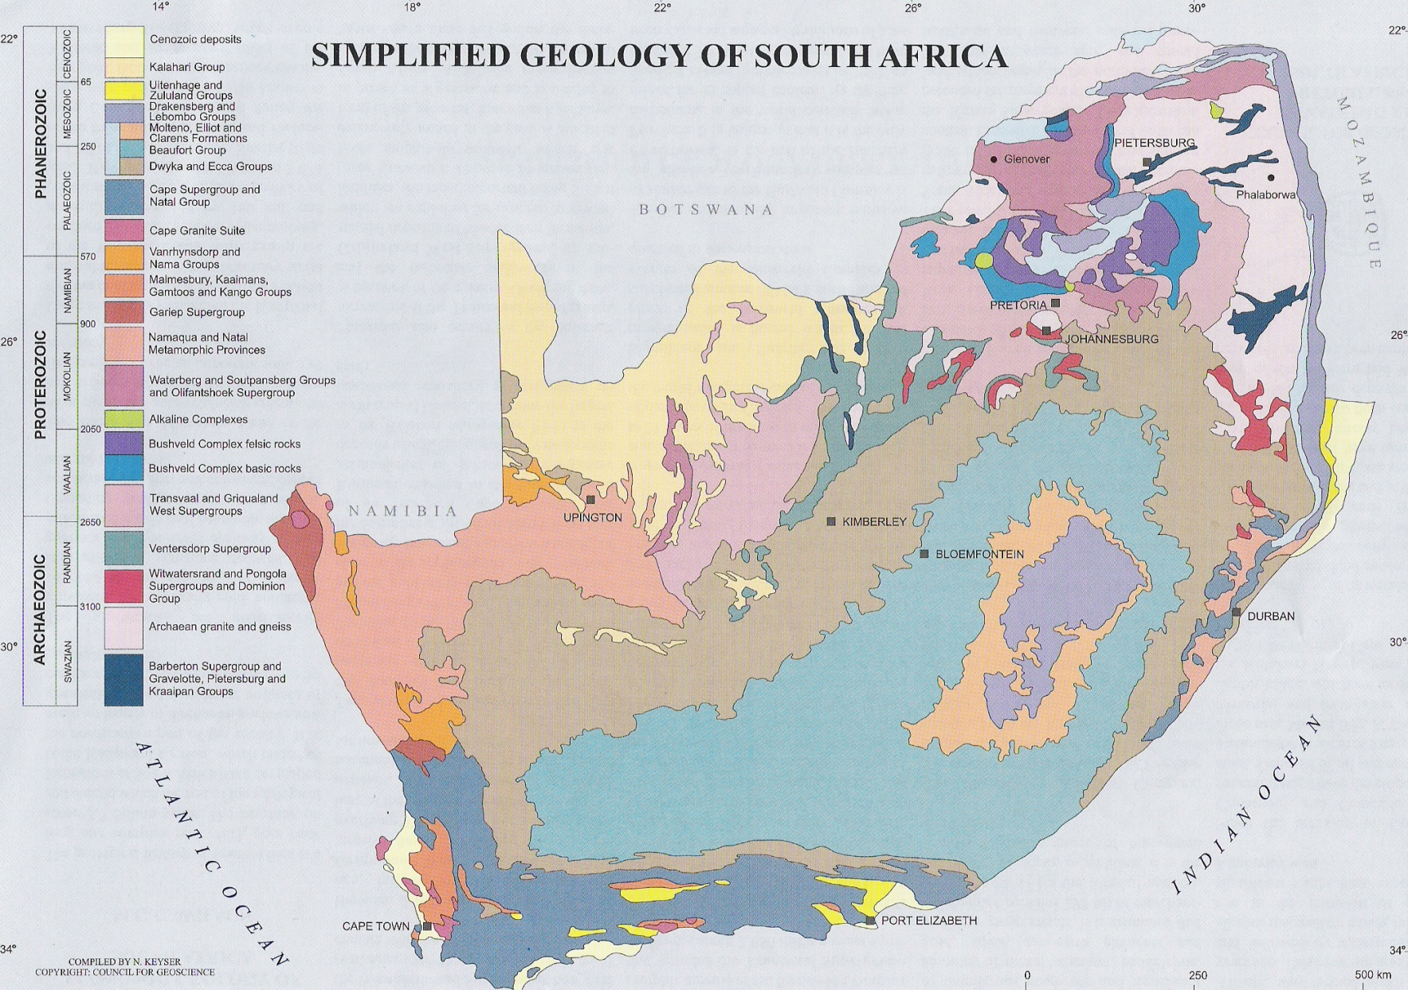
The Geology of South Africa

Slide 94
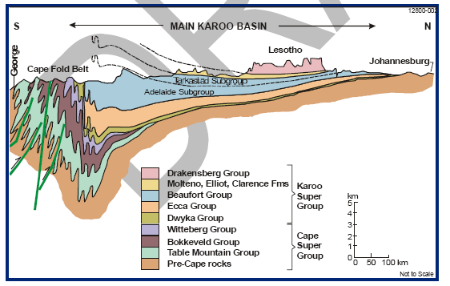
Karoo and Cape Supergroups

Slide 95
Unconsolidated sedimentary environments
loose materials, GW stored and transmitted through pore spaces, not fractures.
Large to very large storage capacity and usually huge regional extension.
Distinguished major hydrogeological units are:
  Major alluvial and coastal basins: sands, gravels and clays :
    High potential (1- 40 l/s), Sands and gravels are targeted layers.
  Small riverside deposits: mixed alluvium (cobbles, gravels, sands, silts clays), and others deposits like coastal dunes (sandy):
    potential moderate (1 – 20 l/s), sandy/gravel deposits targeted .
  Valley deposit in mountain: poorly sorted rock fragments, sands, gravels, volcanic materials:
    Moderate to high potential: 1 – 10 l/s, Stables areas of sands and gravels are interesting targets.

Slide 96
Consolidated sedimentary environments
Large groundwater storage and major regional extension → different aquifers types:
Sandstones: moderate to high potential (1 – 20 l/s);
  Targeting for abstraction:
    coarse porous or fractured sandstones
Mudstone and shale: fractured or interbedded with sandstone layers;
  its potential is low (0 – 0.5 l/s) with minor regional flow;
  Targets:
    hard fractured mudstone or thin sandstone layers
Limestones: slightly soluble in rainwater → fractures can be enlarged to form karsts (developed conduits and fracture systems)
  Its potential is moderate to high (1 – 100 l/s).

Slide 97
What are the issues....?

Slide 98
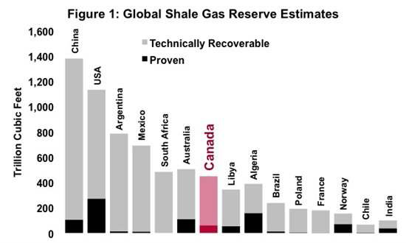
Fracking:
Economic Implications

Slide 99
The hot issues:
Shalegas is ‘natural gas’, and is a ‘cleaner energy alternative than coal’
VS
Referring to shalegas a ‘natural gas’ is regarded as one of the seven sins of greenwashing – radio-active materials also occur ‘naturally’
AND
Measured across the entire lifecycle, shalegas exploration has a higher level of CO2 emissions than other energy sources, including coal-fired power stations – estimated that each well will require about 5000 truck visits, during construction alone

Slide 100
The hot issues:
There will be no pollution of surface and groundwater: “any person who can provide evidence that the fracking activities have polluted their groundwater will be compensated”
VS
The polluter pays principle places the onus of proof on the developer, not on the affected party

Slide 101
The hot issues:
The precautionary approach does not apply ‘as one cannot prove a negative”
VS
The precautionary approach does not require anyone to ‘proof a negative’, but holds that when faced with uncertainty, a risk-averse approach should be followed

Slide 102
The hot issues:
Water requirements is not an issue, and water will be trucked in from the ocean (up to 500km) or piped down from the Witwatersrand ~use for AMD
VS
Water requirements is critical and one cannot turn water into oil, especially not in a water-scarce country....

Slide 103
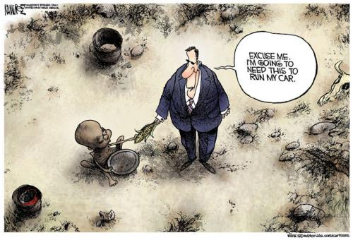
Water for food or for oil...?

Slide 104
Conclusions

Slide 105
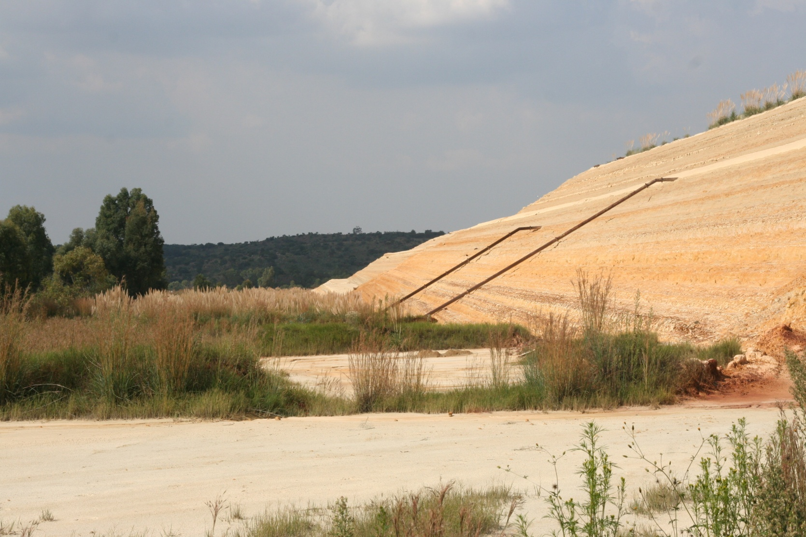
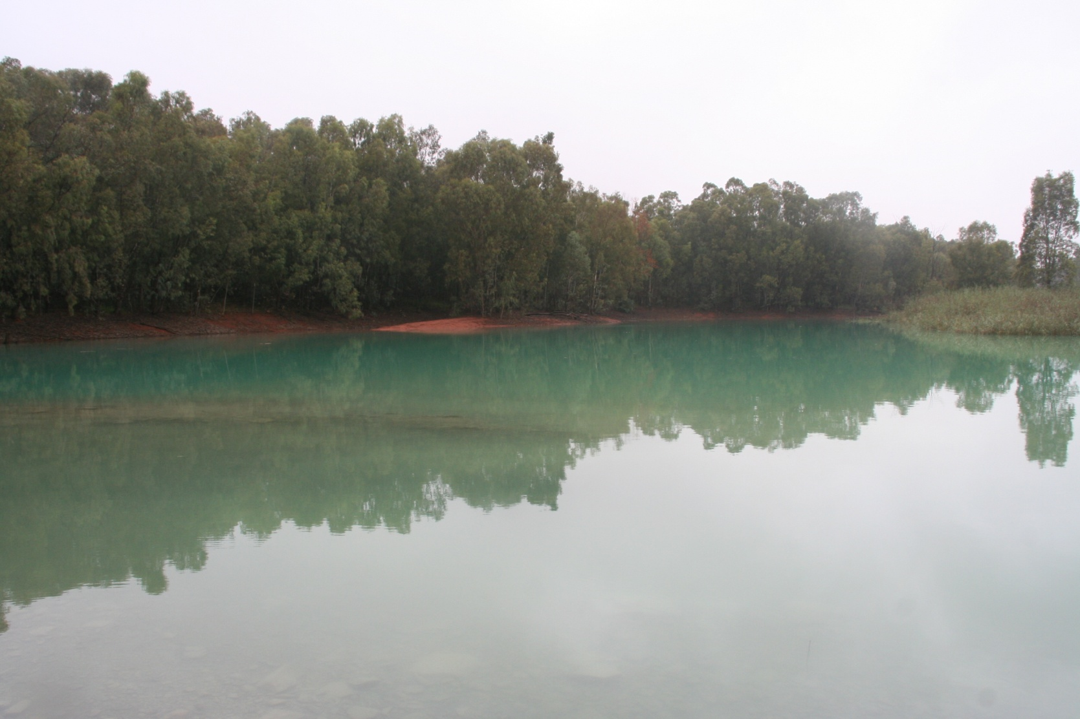
The sins of our fathers.....
Have we not learned our lesson?

Slide 106
Externalization of Costs Model
Off-Balance Sheet Items
Value
Mine Closure
Remediation Cost
Externalized Costs
Revenue
V2
Dev Cost
Profit
V1
Balance Sheet Items
Magnitude at Closure
T1
T2
Time
© Adler et al., 2007

Slide 107

What we were left to deal with by our fathers...

Slide 108

What will we leave our children to deal with...?

Slide 109
The care for human life and happiness, and not their destruction, is the first and only legitimate object of every good government
~Thomas Jefferson

Slide 110

...

