Slide 1

coal seam gas
Australia
Nicola Franklin, Sydney Law School

Slide 2
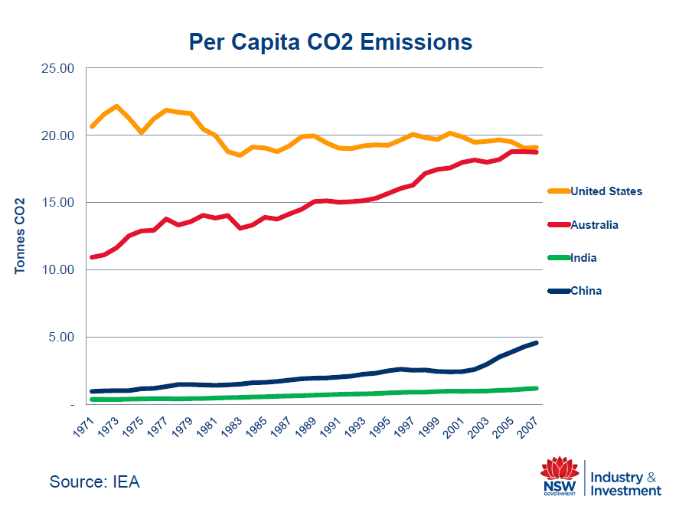
The context: fossil fuelled Australian economy

Slide 3
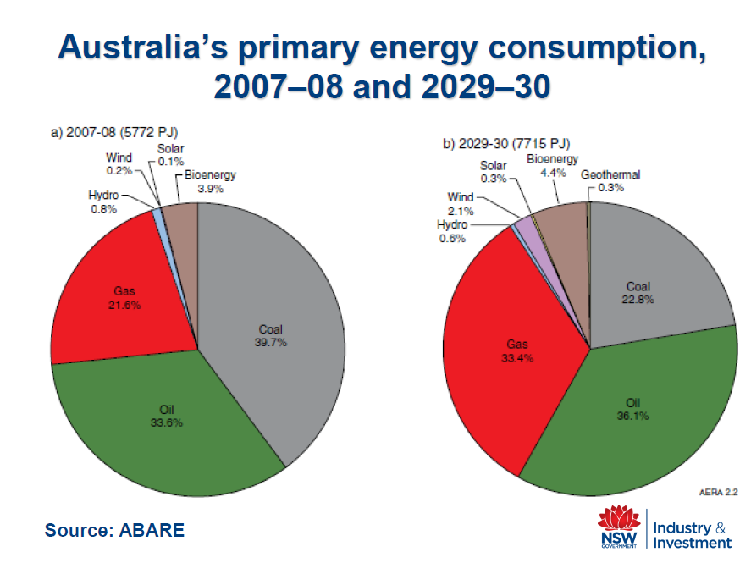

Slide 4
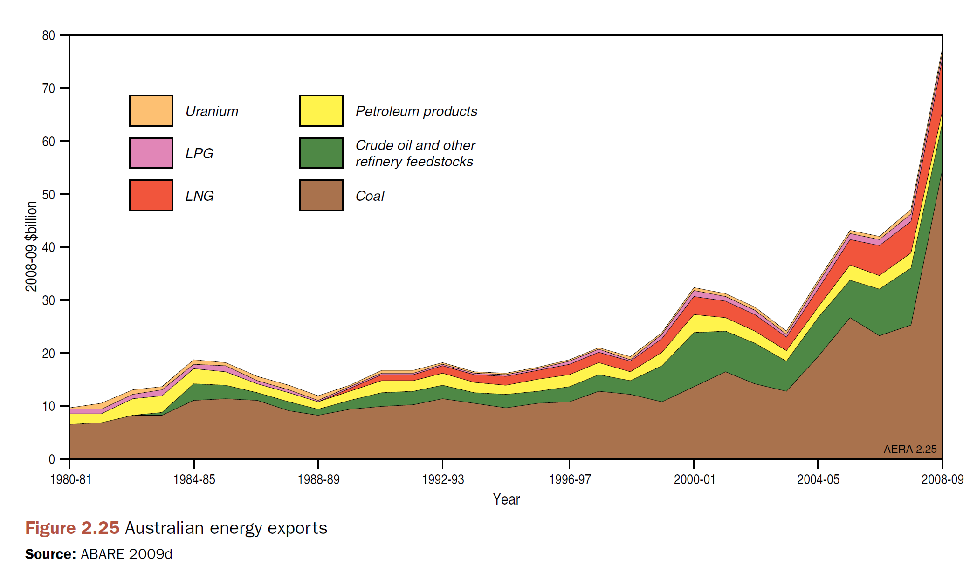
Australian Energy Exports (2008-09 $billions)

Slide 5
Australian Coal Seam Gas Industry
Relatively new industry
  Production commenced in the Bowen Basin in Queensland in 1996
  Marked increase from 2004
    2004-2008: 32% increase per year
  Likely to peak 2020

Slide 6
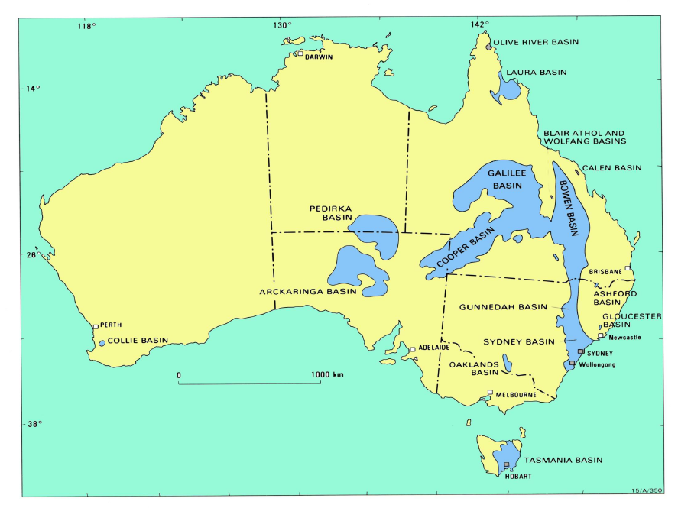

Slide 7
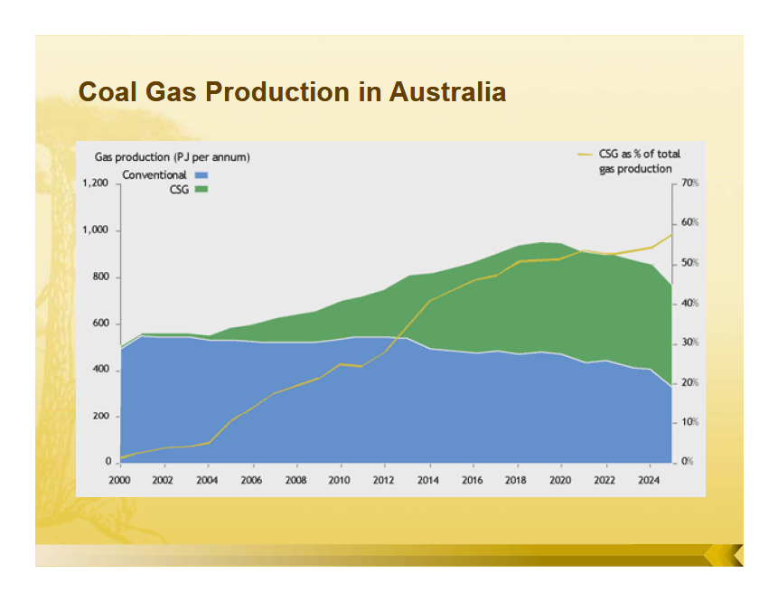
Notes:
In Australia: Gas-fired Power Plants and export market

Slide 8
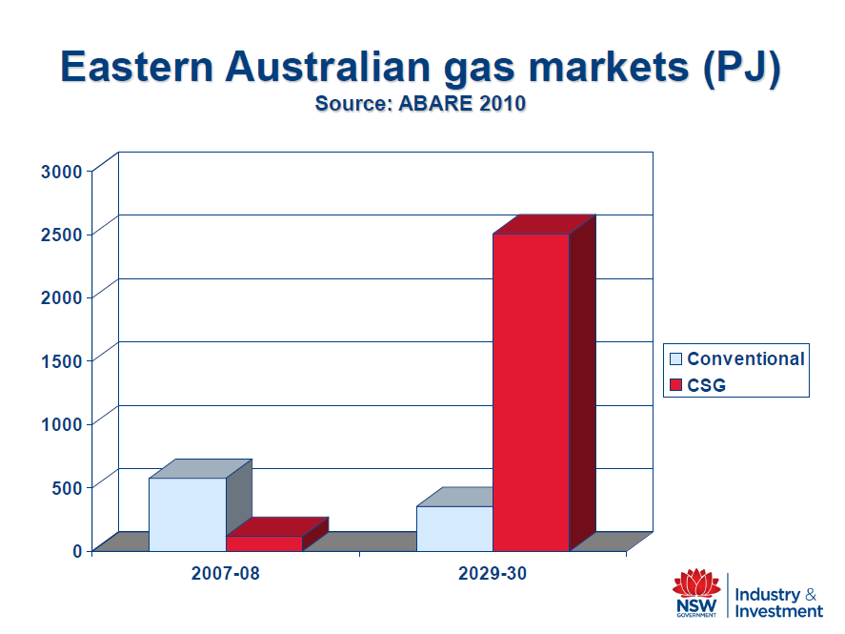

Slide 9
NSW Context
  More than 70% of the State of New South Wales is under mineral and petroleum title and application
  Royalties to the State from existing mineral and gas tenements: AU$1.768 billion in 2010/11 (NSW State Budget)
  5-year royalties holiday on production from petroleum discoveries in NSW

Slide 10
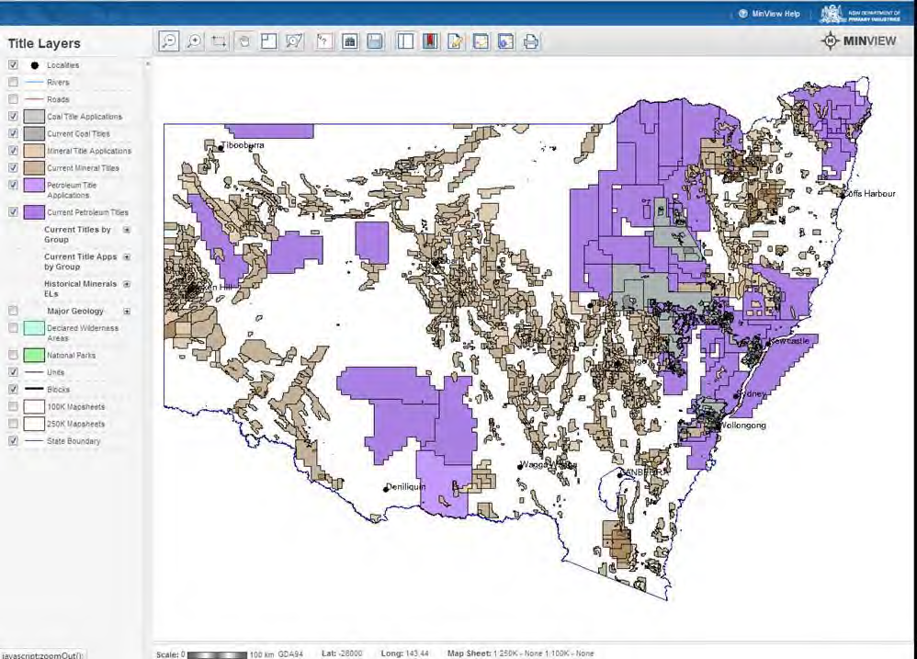
Titles & applications for coal, mineral and petroleum/CSG in NSW

Slide 11
CSG production in NSW
NSW Government
  “Gas has a critical role to play in NSW moving to a low carbon economy. It is the only conventional energy source that can underpin this transition in the timeframes envisaged under State initiatives for the reduction of GhG emissions”
Notes:
60% reduction by 2050

Slide 12
AGL’s Camden Gas Project
  78 producing gas wells, 100km of gas gathering lines and associated infrastructure, and Gas Plant
  Expansion proposals approved or being approved
Metgasco’s Richmond Valley Power Station and Casino Gas Project
  30 MW gas fired power project approved
  Supplied by gas from adjacent CSG field
  Combined capital value in excess of A$50 million

Slide 13
AGL’s Gloucester Gas Project
  Concept plan approval in March 2011
    Potential gas extraction area of approx 210km²
  Project approval for Stage 1 Gas Field Development Area
    110 gas extraction wells and associated infrastructure
    Central processing facility to compress and process gas
    Gas transmission pipeline
  Barrington-Gloucester Stroud Preservation Alliance Inc v PAC and AGL, Land & Environment Court

Slide 14
Eastern Star Gas project
  Plans cover about 85,000 ha
  Establishment of up to 550 gas well sets and a range of associated infrastructure such as gas-gathering lines, gas processing facilities and water storage and treatment infrastructure
  A capital investment value of $2.3 billion

Slide 15
Coal seam gas mining
Coal seam gas – also known as coal seam methane or coal bed methane – is a naturally occurring methane gas in coal seams
  Similar to conventional natural gas and can be used for the same purposes
  The main difference between CSG and other natural gas is how it occurs in nature and thus how it is extracted
    CSG is trapped by the water forming a thin film on the surface of the coal
    In conventional reservoirs such as sandstones, gas is stored within pore spaces between individual sand grains

Slide 16
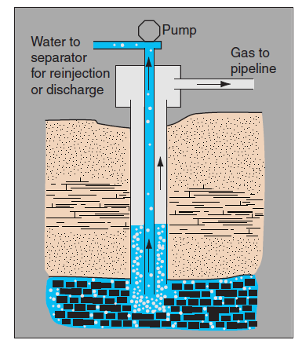
Notes:
Large quantities of methane, carbon dioxide and water are generated during the coal formation process over geological time. Most of the gas and water migrates away, but some methane is retained within the coal seam. Most of this is absorbed onto the coal surface. The remainder exists as free methane in the natural fracture (cleat) system of the seams, or is dissolved within the seam water. Water in the seam traps methane within the coal and has to be drawn off (a process called dewatering) before the methane is extracted:
As the amount of water in the seam decreases, methane production increases:
In order to increase the amount of gas captured through dewatering, mining companies may use a method called hydraulic fracturing (fraccing25). In this process, water is pumped into the coal seam under high pressure to blast (fracture) it open, and keep it open. Sand and a mixture of chemicals are added to the water to assist the fraccing process – sand to keep the new fractures open, and chemicals to alter the properties of the water.

Slide 17
Novel technology
  Unknown impacts of hydraulic fracturing ('fraccing')
  Use of “muds” that may include toxic substances
Scale
  Water demand, wastewater production
  Intrusion on landscape, infrastructure footprint
Uncertainty
  Baseline data of the natural systems being impacted
  Chemicals used in the process
  Nature and extent of the potential and cumulative impacts over a long time period

Slide 18
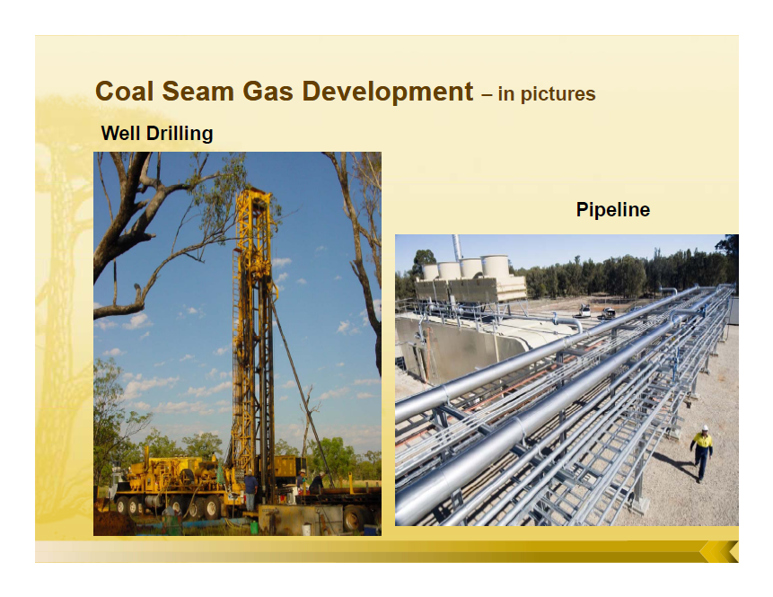

Slide 19
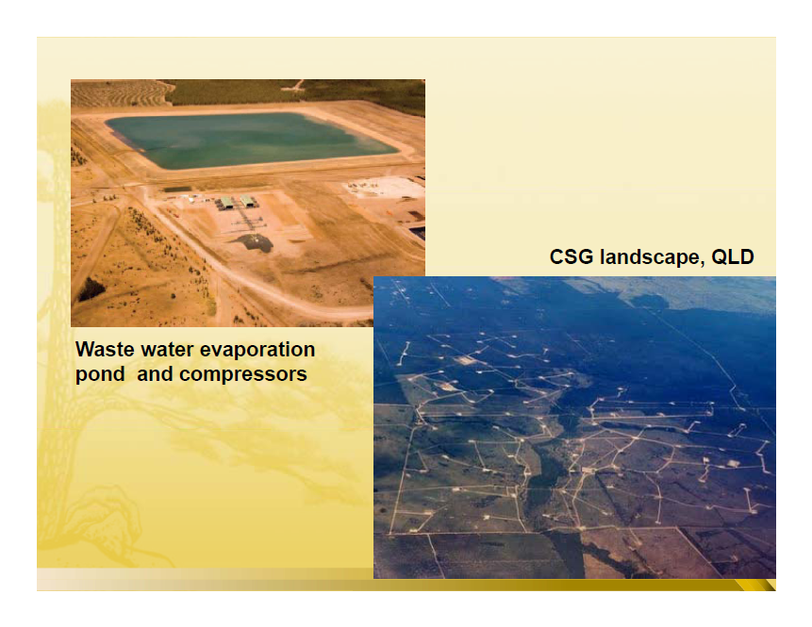

Slide 20
Quintessentially
  A strategic planning issue – land-use, water, infrastructure
    Cannot be negotiating with individual landholders
    Cumulative, and not well understood, impacts of multiple projects at a regional level – ecological and social
  A technology requiring a risk management framework and application of the precautionary principle

Slide 21
Impacts of CSM – water
  Water
    Voracious water user
      CSM is expected to extract 7,500 gigalitres from groundwater systems in the next 25 years
      Current total extraction from the Great Artesian Basin is 540 gigalitres per year
    Wastewater (often saline) – industry is still looking for acceptable disposal options
    Irreparable damage to and destruction of aquifers
Notes:
Evaporation ponds concentrate the toxics
Potential risks to sustainable water management
Extracting large volumes of low-quality water will impact on connected surface and groundwater systems, some of which may already be fully or overallocated, including the Great Artesian Basin and Murray-Darling Basin.
Impacts on other water users and the environment may occur due to the dramatic depressurisation of the coal seam, including:
- changes in pressures of adjacent aquifers with consequential changes in water availability
- reductions in surface water flows in connected systems
- land subsidence over large areas, affecting surface water systems, ecosystems, irrigation and grazing lands.
The production of large volumes of treated waste water, if released to surface water systems, could alter natural flow patterns and have significant impacts on water quality, and river and wetland health. There is an associated risk that, if the water is overly treated, 'clean water' pollution of naturally turbid systems may occur.
The practice of hydraulic fracturing, or fraccing, to increase gas output, has the potential to induce connection and cross-contamination between aquifers, with impacts on groundwater quality.
The reinjection of treated waste water into other aquifers has the potential to change the beneficial use characteristics of those aquifers.

Slide 22
National Water Commission identified five areas of potential risk to sustainable water management
  Extraction of large volumes of water, impacting on connected groundwater and surface water systems
  Impacts on other water users and the environment due to depressurisation of the coal seam
      changes in pressures of adjacent aquifers, and resulting changes in water availability
      reductions in surface water flows in connected systems
      land subsidence over large areas, affecting surface water systems, ecosystems, and agricultural lands

Slide 23
Production of large volumes of treated waste water, if released to surface water systems, could alter natural flow patterns and significantly affect water quality, river and wetland health. There is an associated risk that, if water is overly treated, ‘clean water’ pollution of naturally turbid systems may occur
Hydraulic fracturing has the potential to induce connection and cross-contamination between aquifers, with impacts on groundwater quality
The reinjection of treated waste water into other aquifers has the potential to change the beneficial use characteristics of those aquifers

Slide 24
Looming major public policy failure
  All Australian governments have signed up to the National Water Initiative (NWI)
    A fundamental aim is to restore surface and groundwater systems to environmentally sustainable levels through effective water planning and by providing certainty about the terms of access for consumptive and environmental water users
    Multi billion dollar program to buy back water in over-allocated and overused systems and return to sustainable levels of extraction
    $82m National Groundwater Action Plan in progress
Notes:
A comprehensive $82 million National Groundwater Action Plan initiated by the National Water Commission in 2007 is investing in projects to improve our knowledge and understanding of groundwater. The plan consists of three major components:
The National Groundwater Assessment Initiative
National Centre for Groundwater Research and Training
Knowledge and Capacity Building component.
The National Groundwater Assessment Initiative
This $50 million initiative is the centrepiece of the action plan. It funds hydrogeological investigations to help overcome critical groundwater knowledge gaps. There are eight priority investment themes.

Slide 25
  Clause 34 of NWI is an escape clause for the States in relation to the petroleum and minerals sectors
    The clause envisages special circumstances facing these sectors that may need to be addressed by policies and measures beyond the scope of the NWI Agreement
    Special circumstances are not clearly defined and no progress has been made in fleshing them out
    In the result, CSG development is not integrated with State water planning and management

Slide 26
Further impacts of CSM
  Land and subsurface geo-systems
    Disturbance and fragmentation of land surface
    Contamination from drilling and fracking fluids
    Subsidence
    Methane migration
    Increased seismic activity
  Air
    Methane and CO2 liberation
  Biodiversity

Slide 27
  Society
    Loss of valuable agricultural land and associated water resources – food security
    Stress on rural communities and infrastructure
    Economic impacts on farmers, property values etc
    Transformation of landscapes from rural to industrial
Notes:
Compromising food security for a 30-year fossil fuel based industry

Slide 28
Planning and regulation
Federal system
  Federal government does not have comprehensive environmental authority
    Federal assessment and approval at development stage
      Where development significantly impacts on specified “matters of national environmental significance” eg nationally threatened species
      Not including impacts on water resources, climate change
    Concurrent with state regulation
    Acknowledged need for more strategic intervention at Federal level
Notes:
the World heritage values of a world heritage property
the National heritage values of a national heritage property
the ecological character of a declared Ramsar wetland
nationally listed threatened species and communities
listed migratory species (under Bonn Convention, JAMBA, CAMBA)
the environment, if it is a nuclear action
the Commonwealth marine environment
the environment, if the action is taken within a Commonwealth marine area

Slide 29
State level
  Industry well ahead of the game
Queensland
  Recent legislative amendments targeting CSG regulation
    Adaptive management
    Duty to “make good” impacts on aquifers
    Proposed reforms for “Strategic Cropping Land”
New South Wales
  A lesson in the need for resilient planning and regulatory systems
Notes:
Science , legislation and the community
Current discourses on sustainability emphasize the need to consider the nature of
complex adaptive systems influenced by both social and ecological factors Sustainability in this context is understood as the ability
to be resilient through an ability to constantly adapt
At no time before has effective land-use and transport planning, and urban infrastructure funding, been so critical to building urban resilience. Cities are at the forefront in facing the impacts of climate change, resource depletion and economic shocks. They are also the engines for rebuilding and renewal. Yet decades of neoliberal reforms have dulled our political imaginations and gutted the institutional capacities so essential to meet the challenges. A particular manifestation of this is the past decade of developer-driven planning law reform in New South Wales. This presentation will examine NSW environmental planning law through the resilience lens. The lens magnifies the view that lot-feeder metropolitan planning, nineteenth century zoning and dysfunction governance have seriously contributed to urban vulnerability in New South Wales. Building resilience into urban planning is not new to planners. What is needed is a legal framework that revitalises the skills and commitment of planners and re-focuses on the enabling social fabric.
What is the ability of the institution to effectively
anticipate, respond to, and manage the
emerging issue, trend, or event?

Slide 30
New South Wales
Mining and Petroleum Law
  Coal and CSG are dealt with under different legislative regimes
    Coal: Mining Act 1992
    CSG: Petroleum (Onshore) Act 1991
      CSG not mentioned in these Acts
  State ownership of all petroleum, helium and CO2 existing in a natural state on or below the surface of any land

Slide 31
  From exploration to production
    Exploration and production of petroleum requires a petroleum title
    Access arrangements agreed between the title holder and each landholder, or determined by an arbitrator
      No template or minimum standards
    Exploration licences
      No land-use planning context
      No requirement for development control unless drilling is involved
      No community consultation
      Possibly a Review of Environmental Factors
Notes:
SEPP (Mining, Petroleum Production and Extractive Industries) 2007
Provides that development for the purpose of petroleum exploration is permissible without development consent under Part 4
Part 5 will apply

Slide 32
  Production
    Development assessment and approval usually as State significant development (SSD)
    SSD approval is not subject to local planning instruments or regional planning strategies
    Comprehensive loss of public confidence in SSD process
      Political donations by developers and mining companies
      Unstructured ministerial discretion
      Reduced accountability
      Sidelining of other environmental agencies
Notes:
EPAA Part 3A applied to
Development for the purpose of drilling and operation of petroleum wells (including associated pipelines) that
has a capital investment value of more than $30m or employs 100 or more people, or
is in an environmentally sensitive area of State significance, or
is located in one of 16 LGAs
Part 3A is being repealed
No new Part 3A declarations
Amendment Bill for determination of State significant projects pending

Slide 33
Following defeat of the Labour government in March 2011, Liberal/National coalition government has committed itself to
    Strategic Regional Land Use Planning
      Using triple bottom line assessment
      Identification and protection of strategic agricultural land and associated water
    Comprehensive planning law reform
    Review of the Water Management legislation
Notes:
Australia’s tired, old political parties have blocked a move by the Greens for a standalone Senate inquiry into the coal seam gas industry, Greens Leader Bob Brown said. In a split with the Liberals, the Nationals abstained.
“The prospect of coal seam gas mines across the country, from the Kimberley to Queensland to Tasmania, encroaching on Sydney and broader New South Wales, as well as in South Australia is truly appalling,” Senator Brown said.
“There is a new urgency to assess the health impacts of the toxic materials used in the fracking process. The last-minute inclusion of coal seam gas in the terms of reference for the Inquiry into the management of the Murray Darling Basin is not enough, although we are pleased that our proposed terms of reference – circulated yesterday – have served as their template.”
The inquiry and report by the Environment and Communications References Committee, proposed by the Australian Greens and blocked by Labor and the Coalition, would have examined the social, environmental, health, economic and legal impacts of coal seam gas, with particular reference to:
a) adverse health effects associated with coal seam gas mines;
b) impact of coal seam gas mines on property values;
c) food security and the viability of farms with coal seam gas mines;
d) contamination of underground water sources and soil;
e) the legal rights of property owners versus gas companies; and
f) any other relevant matters.
“It is inadequate for coal seam gas mines, a threat to farmers in New South Wales and Queensland in particular to be an add-on to any other inquiry.”

Slide 34
  Transitional arrangements
    60-day moratorium on issuing exploration licences for coal, CSG and petroleum
    Precautionary approach, including at the exploration stage
    Public consultation before exploration licences issued
    New project applications for coal, CSG and petroleum extraction require a focused Agricultural Impact Assessment
    Proposed aquifer interference regulation

Slide 35
Litigation
USA
  Class action against BHP Billiton by Arkansas landowners alleging earthquakes and contamination of water, soil and air
Queensland
  Dalby gas leak
NSW
  Judicial review of concept plan and stage 1 approval
    Lack of finality/uncertainty of conditions relating to groundwater impacts and wastewater disposal
    Failure to apply the precautionary principle

Slide 36
A resilient legal system
Key components
  A normative framework: ESD
  Strategic assessment and planning
  Independent scientific advice
  Communication and participation
    Beginning at the strategic level
  Structured discretion at the project approval stage
  Monitoring, credible enforcement and regulatory culture
  Accountability
    Open government
    Open standing for civil enforcement
    Third party appeals
Notes:
such as a “maintain or improve” test

Slide 37
CSG regulation
  A precautionary framework
  A moratorium until
    Baseline data has been compiled
    Strategic land-use and infrastructure plans are in place
      Including no-go areas for mining operations
    CSM is integrated with water planning and management
  Improved land access provisions that ensure the informed consent of landowners
  No permitting beyond the capacity to monitor and enforce
Notes:
– assisted by a template outlining landowners’ rights and mining company responsibilities (for example, in relation to access, exploration, approval, and land acquisition).

Slide 38
Adaptive management?
    Not appropriate where harm may be irreversible
    A deception given the finality of approvals in planning law
  “Adaptive management should not be the strategy of first resort – it is what we invoke when we have already lost the initiative, when we are already in trouble and we sense that we are as ill-informed about causes, drivers, and responses of the system under stress as we are about solutions.” – Alan Randall, Risk and Precaution
Notes:
Suck it and see

